Slide 1
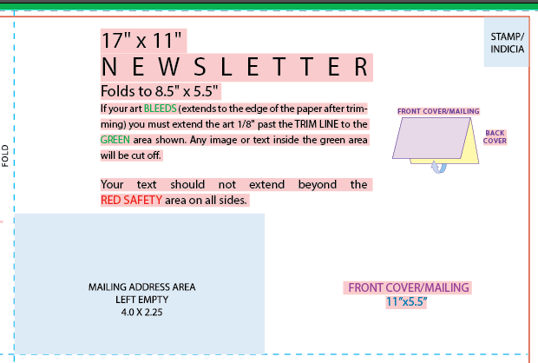
Front Cover - Outside
This is the front cover of our postcard, so we would like the below included within the template you create:
“2017 Category Management & Shopper Insights Conference” (graphic attached)
Conference logo (attached)
“Register Here: http://catman.global/events/annual-conference/registration”

Slide 2
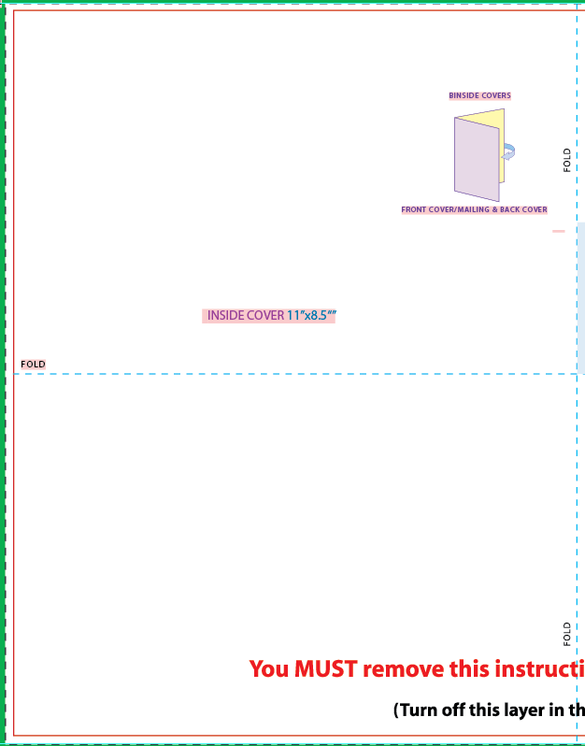
Inside Cover - Outside
This is the inside of the front cover for the outside top and bottom, so we would like the below included within the template you create:
“About the 2017 Category Management & Shopper Insights Conference” as a fun header
Then leave space for a paragraph of about 8 lines and then if you could create an interesting “bullet” design to list off about 8 items.
The bottom half of this cover, there will be 6 sections of content that consist of 6 headers and then 1-2 short sentences for each section.

Slide 3
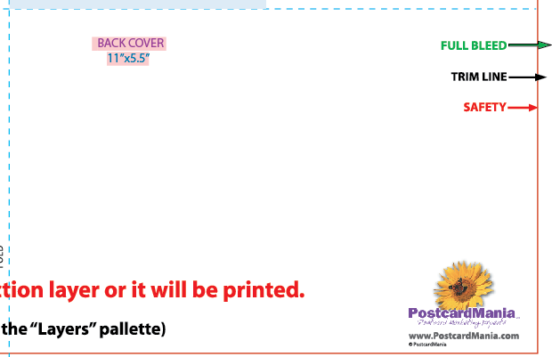
Back Cover - Outside
This is the back cover of the post card, so we would like the below included within the template you create:
Our company logo (attached)
“We look forward to seeing you in May!”
“Questions? Contact us at memberservices@cpgcatnet.org or call 210.587.7203”
“Visit www.catman.global for more information about the CMA!”
Then some design aspects around it

Slide 4
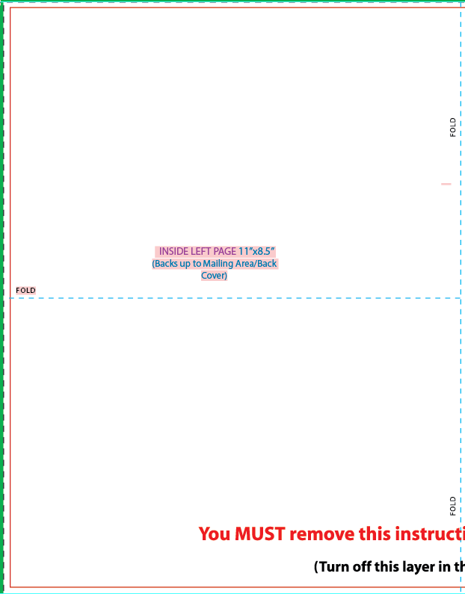
Insight Left Page
This is the inside left page of the postcard, so we would like the below included within the template you create:
Header at the top of this page saying something like “2017 Agenda at a Glance”
Design aspects
A framework to show the attached agenda at a glance with dates and times

Slide 5
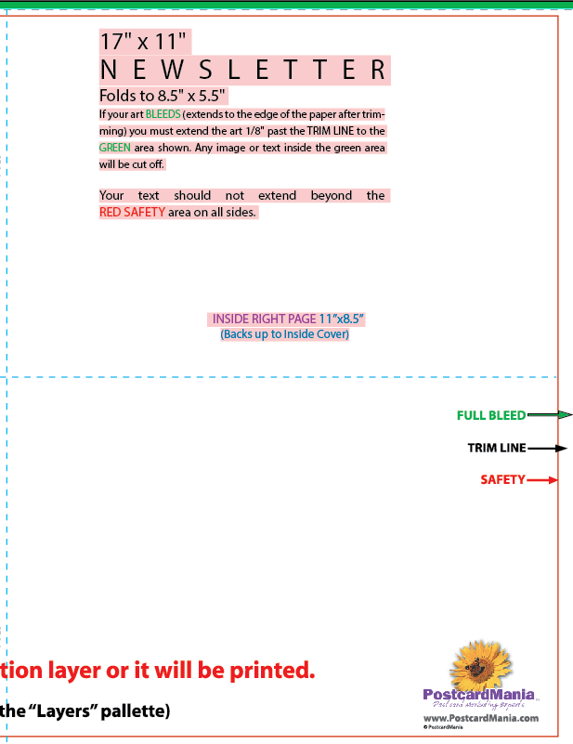
Insight Right Page
This is the inside right page of the postcard, so we would like the below included within the template you create:
Header near the top saying something like “Meet This Year’s Starting Speaker Line up!”
Design aspects
A framework for 4 keynote speaker headshots and leave space for their job title, company name and a session topic.
A framework to show about 10 company logos (target, Walmart, Walgreens, etc.
A phrase at the bottom saying “Register Now and Receive 10% off your conference registration”
Include 2 pop up areas that we can put in a statistic
**Also attached is a conference flyer – we don’t want the design of this BUT just to give you some content to plug in.

