Slide 1



PRIVATE & CONFIDENTIAL
Enterprise Chatbot Platform
Presentation for Thunder Bay Regional Health Leadership
May 8, 2017
Notes:
ccRobot:
Cloud Based; Enterprise Graded; Agile Chatbot Development Platform;
The Build:
DIY; Program by example;
Deploy Quickly; Low Risk;
Result:
Any Language; 24/7; Cost + Service Quality Optimization;

Slide 2

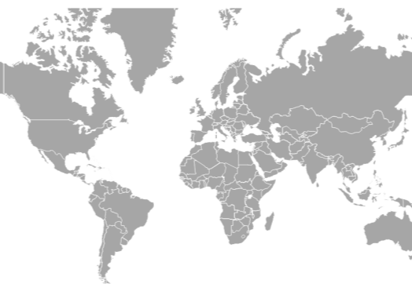


CONTEXT
We’ve spent the last *25 years building end-to-end automation solutions for leading companies
A Track Record Of Long Term Relationships With Top Companies
Experts In Custom Automation + Business Intelligence Systems
Toronto – Based, But With A Growing Global Footprint
25 years including Korah and its predecessor, Netstar Solutions
Notes:
The market needs…
About Korah…

Slide 3
CONTEXT
…And because of maturing technology, the way these companies interact with their customers is about to change!
Notes:
Technology Trend
Spoiled customers

Slide 4

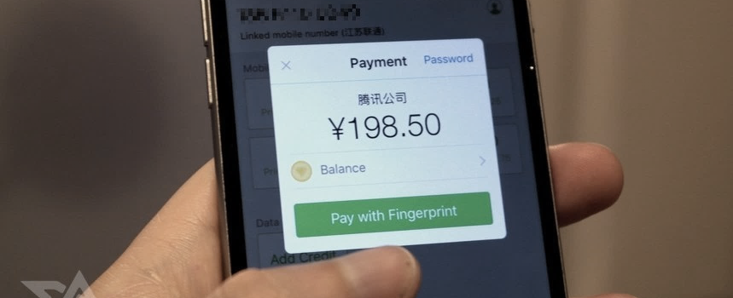
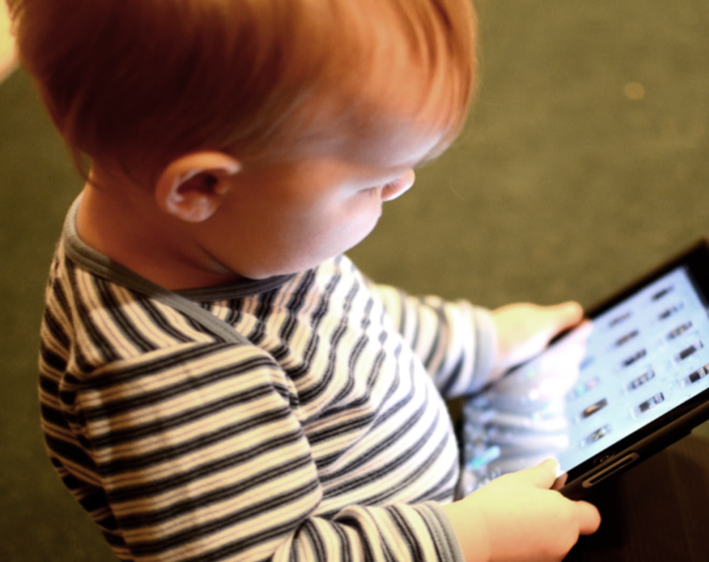
CONTEXT
Digital customer experience is becoming the new battleground (for winning customer hearts and wallets)
On-demand
Low Friction
Intuitive
Notes:
low-friction way of interactions -> Text

Slide 5
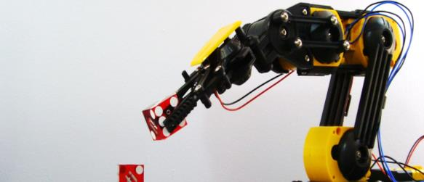




INTRODUCING CCROBOT
And customer service automation, such as chatbots, is going to play a major role in making this happen!
80/20 Automation
24/7
Call Volume Agnostic
Standardize Customer Experience
Reduce Costs
Notes:
Automate repetitive enquiries (80%)
to reduce cost and enable 24/7 service
Standardize call script to improve customer exp.

Slide 6

INTRODUCING CCROBOT
Achieving customer experience success has just become a lot easier for you – Introducing ccRobot!
A Cutting-Edge Enterprise Chatbot Platform:

Slide 7

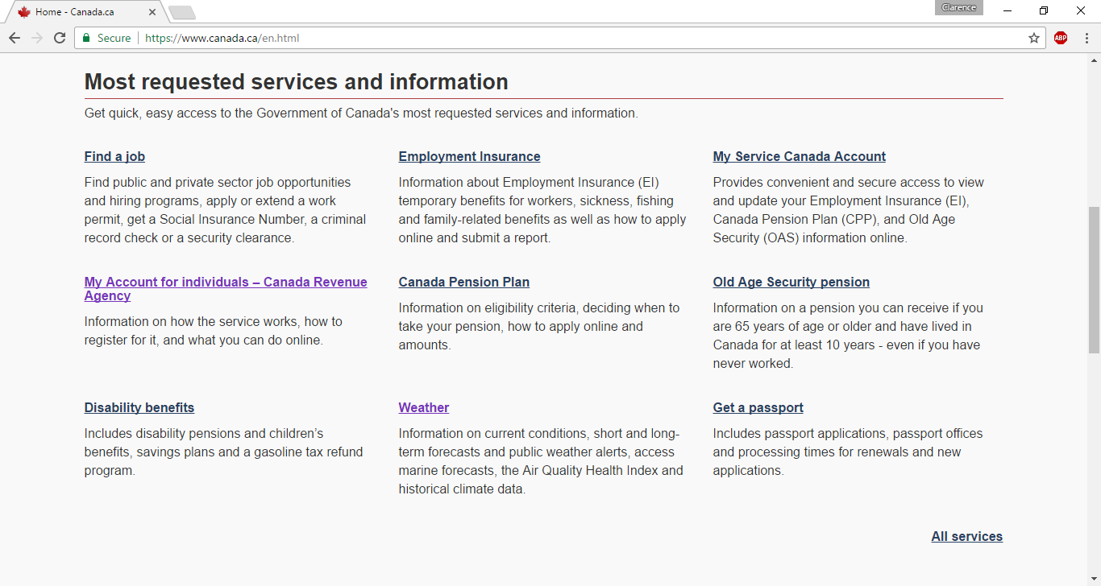
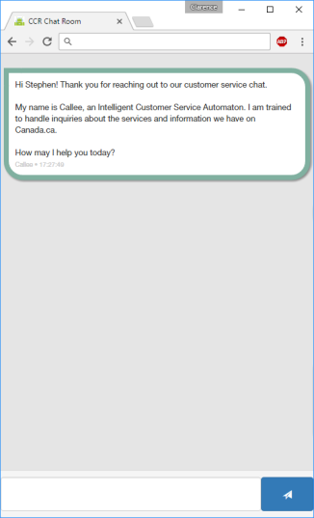
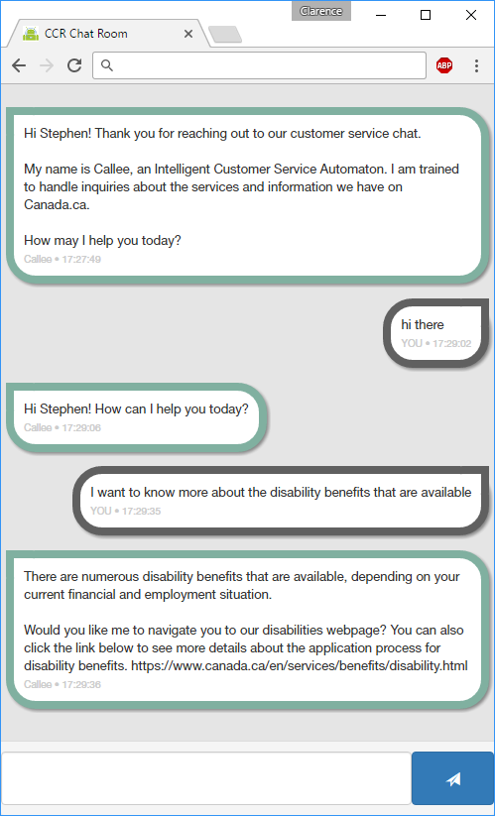


INTRODUCING CCROBOT
ccRobot is really, really easy to use for customers
CHAT NOW
Notes:
“Instant” Service – Start serving as soon as 30 min.
Automate up to 80% of customer service workload
Pareto principle (80/20 rule):
80% of workload is contributed by 20% of inquiry set.
Mobile Ready
Any organization that currently offers, or wishes to offer round-the-clock customer service to their website visitors can benefit from using ccR-Web, including service for internal or external customers.
Any website or web application can be enhanced by automating end user interactions with natural user interfaces.
ccR addresses the needs of organizations who wish to improve the efficiency and service quality of their customer service offerings, and also addresses the needs of smaller organizations by offering a low cost alternative for those who wish to offer 24/7 customer service but cannot afford a team of customer service agents.

Slide 8

INTRODUCING CCROBOT
And it has a unique set of benefits for operators
Omni-Language
Performance
Fast Impact
Real World Natural
Language Interaction
Keeps your
data secure
Mixed-Media Responses
Low Cost Independent
Operations

Slide 9


INTRODUCING CCROBOT
Omni-Language Performance
Traditional AI/NLP
Language dependent: only 1 language at a time
Rule-based
Multiple layers of translation
Language independent
  Supports all known written/spoken languages
  Supports mixed-language dialogs
Statistics-based
  No translation layers
vs.

Slide 10
INTRODUCING CCROBOT
Real World Natural Language Interaction
Traditional AI/NLP
Voice commands
Keyword matching
Programmed in isolation
True NLP
Trained on-the-job from real conversations
vs.

Slide 11



INTRODUCING CCROBOT
1
2
3
Real World Natural Language Interaction
Live agent works
ccRobot learns
ccRobot works
Live agent verifies
ccRobot works
independently
Semi-automatic Mode
Automatic Mode

Slide 12
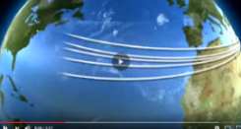
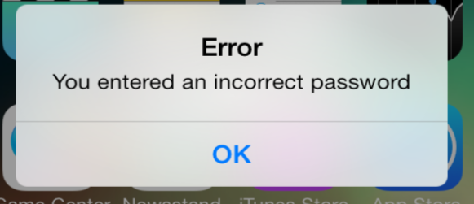


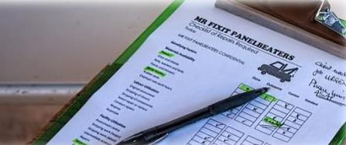

INTRODUCING CCROBOT
Mixed-Media Response Modules
Media Responses (e.g. video and sound)
Password Reset
Account Info Lookup
Email or Ticket Creation
Form Filling
User Feedback Surveys
Notes:
Modules will be available.
Better user experience with mixed media interactions.
HTML/Javascript can trigger actions via web services that forms the robotic arms
Hyperlinks in robot response enables direct integration with back office systems
Customer survey robot can be deployed for both outbound and inbound calls.

Slide 13
INTRODUCING CCROBOT
Accelerated Speed to Impact
Automate inquiries as they meet your confidence threshold
Niche Requests
Most Frequent Requests
FAQ Content
Time
Notes:
Agile approach
Horizontal axis = iterations in development
Vertical axis = scope of the service

Slide 14




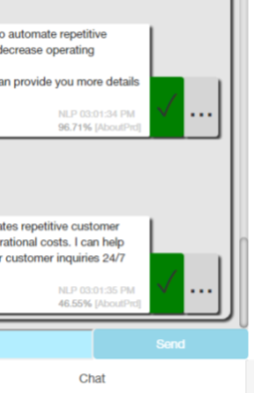
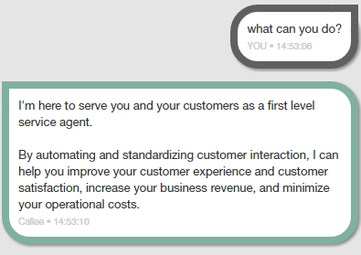

INTRODUCING CCROBOT
Accelerated Speed to Impact
Risk elimination via accuracy threshold
I am 99.18% confident in this response
Self-assessment capability
On-the-job training console
Escalation processes
Notes:
ccRobot can be deployed gradually and risk free
Eliminate catch-22 problem by providing a safety net

Slide 15
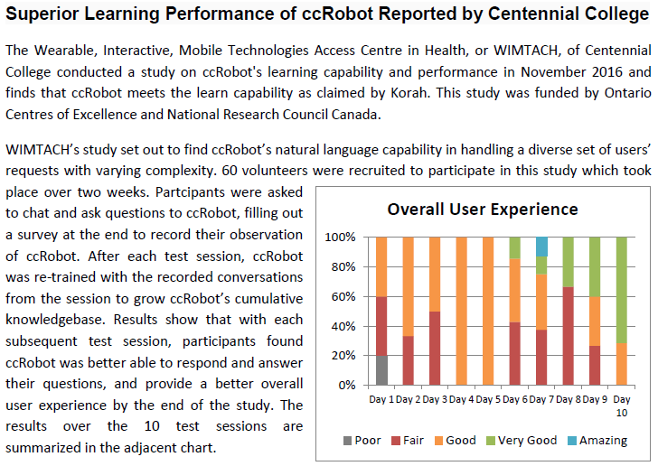
INTRODUCING CCROBOT
Accelerated Speed to Impact
Notes:
ccRobot uses the most cutting edge machine learning in the industry, which means it learns very fast. Your organization can start using it right away, and see the impact almost immediately – both in terms of reducing cost and improving customer experience.

Slide 16
INTRODUCING CCROBOT
Data/IP Ownership and Privacy
100% IP Ownership of Collected Data
100%
Full Data Privacy (no need to share your data with outside parties)
Private DIY Hosting (or Optional Korah Cloud-Based Solution)

Slide 17
INTRODUCING CCROBOT
Low Cost Independent Operations
Traditional AI/NLP
Requires expensive outside developers and linguistics consultants
Improvements (CR) dictated by developers’ and linguistics consultants’ availability
Robot learns from live operations – no programming or consulting required
Improvement at your own pace, without external parties
vs.
Notes:
Program by example
Train / Compile at needed
No external consultant

Slide 18

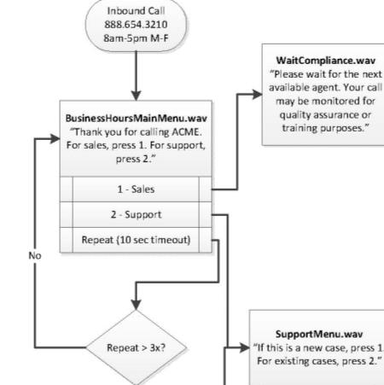
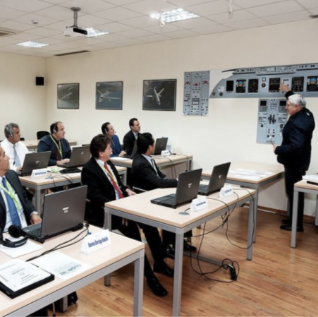
HOW IT WORKS
What is required to get started? – NOT MUCH!
Provide us with your existing training material
We’ll design a draft “call script” for you
We train your customer service reps together

Slide 19
HOW IT WORKS
Implementing ccRobot
  Gather existing training materials
1-3 weeks
  Develop call script together
  (can be phases)
1-8 weeks
  Deploy ccRobot on your platform
  (depends on integration)
1-4 weeks
  Semi-automatic mode:
  Trained on-the-job and continually improves
Ongoing
  Automatic mode:
  Handles visitors on its own
Ongoing

Slide 20

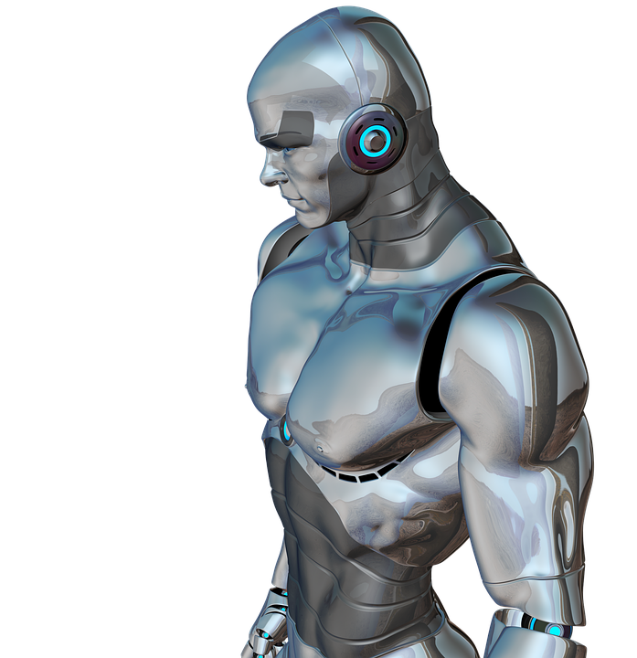
MAKING IT HAPPEN
Operating ccRobot
Demonstration
Notes:
User Experience [korahlimited.spoon.x10host.com/ccrSales]
Easy to implement or add to mobile, web or chat app
Easy for user to find [ Another level of self-serve! ]
Can ask user for information, get ticket or not (your choice)
Robot self-introduction guides users
Hybrid response (sample) mixed languages
Confident levels + escalation
Agent Experience [http://korahlimited.spoon.x10host.com/oprCns/Opr.html?oprId=spoon&orgId=14C20537-F311-B294-662C-C144D90A9444]
Operator Console tells you when user needs help.
Show auto mode operation
Show Agent has joined call for semi-auto operation
Canned responses and selection
Admin Experience [http://korahlimited.spoon.x10host.com/admCns]
Call Script / Decision Tree / FAQ; Question and Answer Design
Adding Inquiries
Adding Multimedia response
Show Training Data
Show Training Data (in different languages; i.e. omni-language)
Show Training Data (Real World Language Skill) added by OprCns
Confident threshold (for self-assessment)

Slide 21
HOW IT WORKS
Cost Breakdown
Initial
Ongoing
~$300-600/human agent equivalent (monthly)
ccRobot License:
Hosting + Hardware
Consulting/Integration
Optional Packages Only (you can DIY if you prefer)
Optional (as needed)

Slide 22

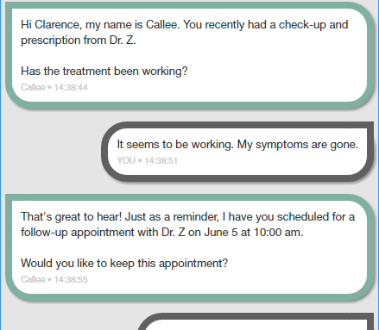
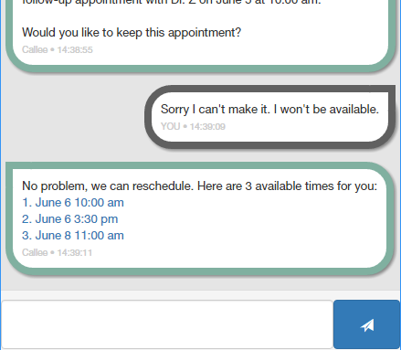
SOME EARLY IDEAS FOR YOU
Using ccRobot for coordinating with patients
Interact with and take care of patients in an engaging way
Notes:
Patient outreach
Hospitals can use ccRobot as an automated, natural communication channel to more easily interact and take care of patients in an engaging and interactive way. ccRobot can follow-up with the patient after a hospital visit to learn about their progress in healing.
For example, ccRobot connects with the patient at home and asks,
“Hi Clarence, my name is Callee. You recently had a check-up with Dr. Z at Thunder Bay Regional Health Sciences Centre who prescribed you some medicine to take. Has the medicine been working?”
The patient responds using his/her natural language,
“The medicine seems to work. My symptoms have been gone for now.”
ccRobot captures the response and can deliver it to the appropriate channel, i.e. electronic medical record, and can then trigger an appropriate action, i.e. confirm the next appointment for the patient,
“That is great to hear. Just so you know, I have you scheduled for a follow-up appointment with Dr. Z on June 5 at 10:00 am. Would you like to keep this appointment or book it for a different date/time?”

Slide 23
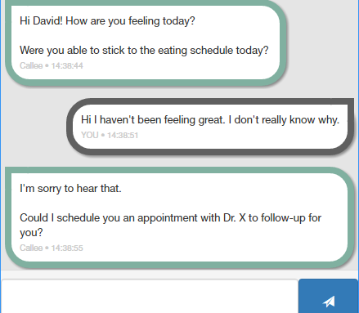
SOME EARLY IDEAS FOR YOU
Using ccRobot to monitor chronic conditions
Perform non-intrusive weekly check-ins
Provide engaging interaction while getting at-home feedback from the patient
Notes:
Early detection to help prevent youth suicide and youth obesity
ccRobot can perform non-intrusive weekly check-ins for patients, to provide an engaging interaction while getting valuable at-home feedback from the patient.
For example, ccRobot connects with the patient at home and asks,
“Hi Stephen! How are you feeling today? Were you able to stick to the eating schedule today?”
The patient responds using his/her natural language,
“Hi I haven’t been feeling great. I don’t really know why.”
ccRobot captures the response and can trigger an appropriate action, i.e. suggest an appointment for the patient,
“I’m sorry to hear that. Could I schedule you an appointment with Dr. X to follow-up for you?”

Slide 24
SOME EARLY IDEAS FOR YOU
Using ccRobot to assist in enrollment & remote assistance
Communicating through diverse channels (SMS, web chat, etc.) Collecting Patient Information
Streamlining paperwork and the need for diverse human intervention
Working in native patient languages
Notes:
Local language form-filling for uninsured First Nations individuals
ccRobot can help automate repetitive steps in the process required for uninsured individuals to get healthcare, interacting in the individuals’ native language.
ccRobot connects with the individual at home, allowing him/her to begin the process with minimal paperwork
Users provide answers to ccRobot in their native language
Responses are captured by ccRobot and then securely sent to and stored in the appropriate hospital/government database
Thus starting the process needed to get these uninsured individuals into the healthcare system; all of this is accomplished faster and more convenient than ever before.
Understanding that many First Nations individual do not have access to the internet, ccRobot can connect over SMS/voice to communicate to the individual.

Slide 25


MAKING IT HAPPEN
Q&A and Next Steps

