Slide 1

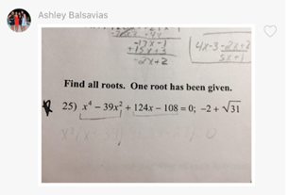
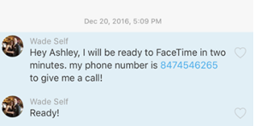
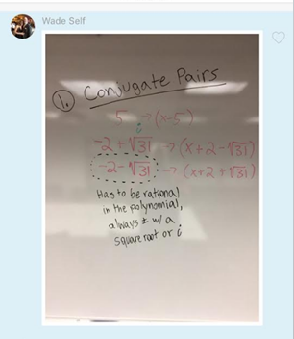

Personalized tutoring from STEM experts via your mobile device
Subjects: All Math, Science, Standardized Test Prep, and Writing 6th-12th grade.
Our tutors are local St. Louis PhD candidates or PhD degree holders in STEM fields.
No scheduling required! As soon as you send a message for help, a tutor will respond to set up a study session as soon as possible.
Payment Plans:
  Pay-as-you-go: $0.83/minute. $0 up-front before session begins!
  Unlimited Subscription: $150 per month
Step 1: Send Tutors Your Problem
Step 2: Tutor Sends Response to set up session
Step 3: Perform Tutoring Session and Receive Copy of your notes!
Contact us today to set up for your first, FREE tutoring session
Website: pocketphds.com
Phone: 866-743-4325
Email: tutor@pocketphds.com

