Slide 1
Mighty Lighthouse Logo

Slide 2
Logo Thoughts
Looking for something simple
Like line illustration, but open to other looks
Something you could build a brand around
Open to versions with and without ‘Mighty Lighthouse’ included in the design
Translates across desktop, mobile, t-shirts, social / apps
Could also work as embroidered logo (like on a golf shirt)
Looking for something unique / ownable… not just something you would pull off of clip art
Ideally patterned after Fire Island Lighthouse or Montauk Point Lighthouse (see images for reference on next slide)

Slide 3
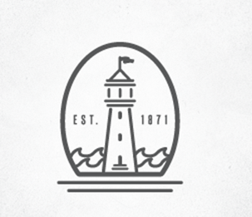
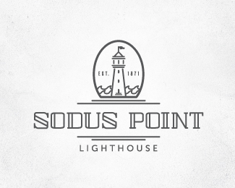
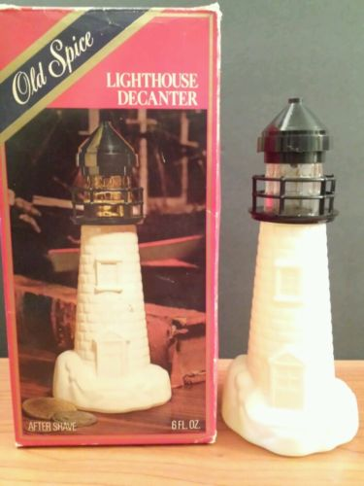
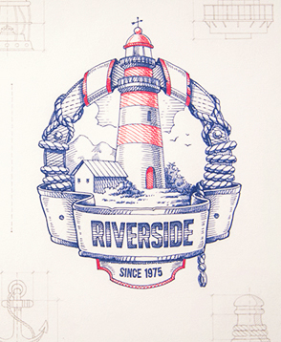
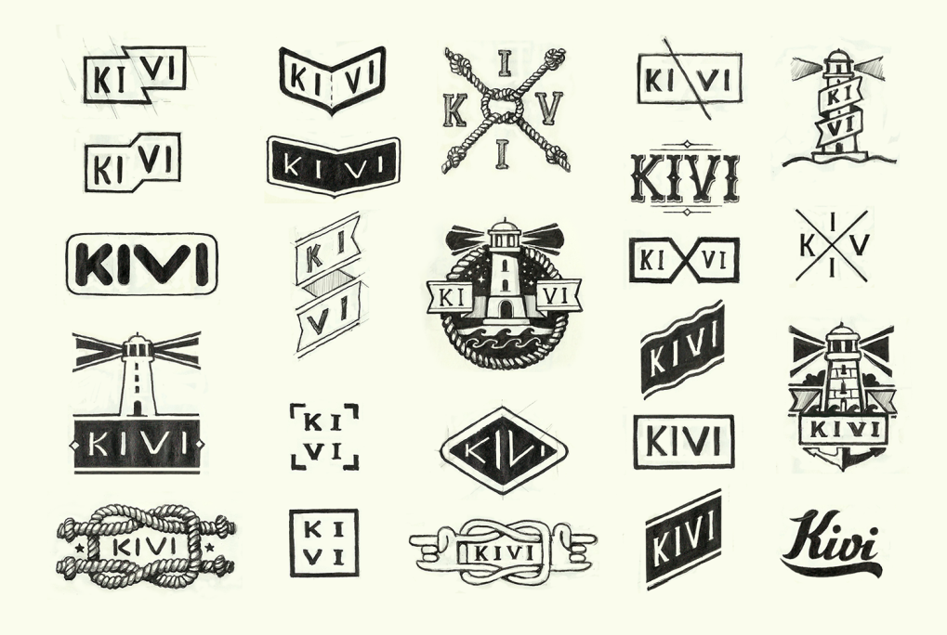
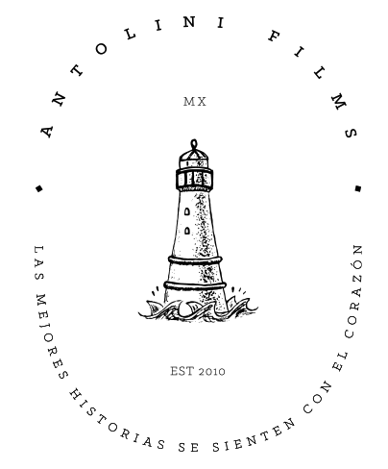
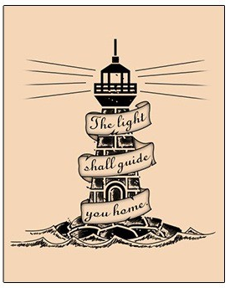
Inspiration

Slide 4
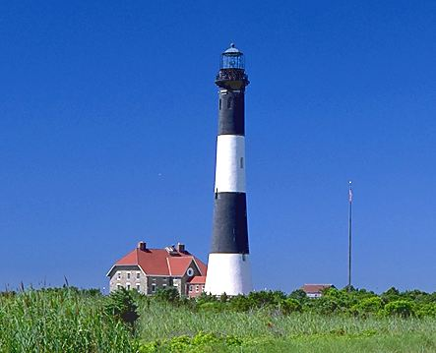
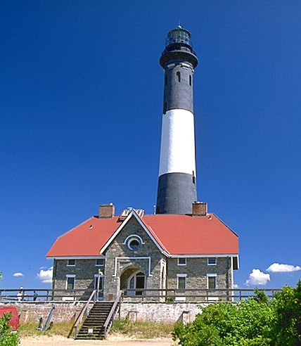
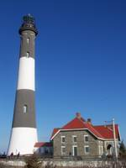
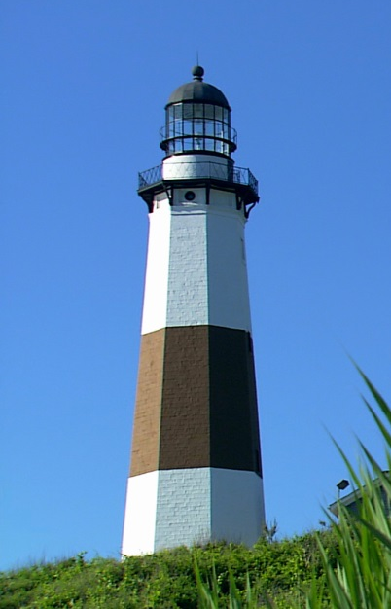
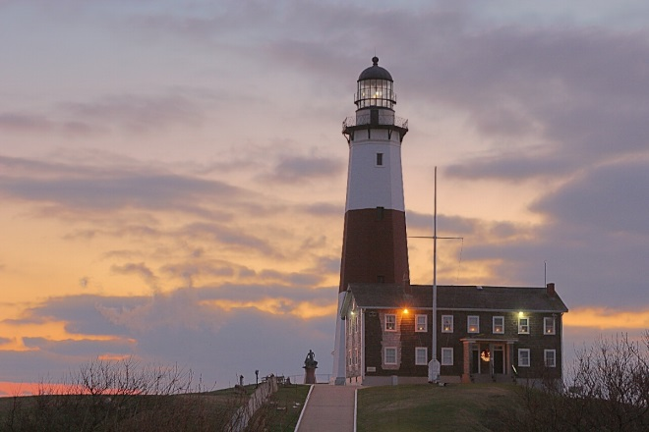
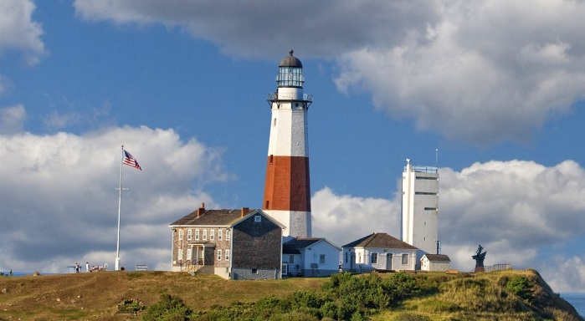
Lighthouse Image References

