Slide 1
THE BRIEF

Slide 2
TASK
DELIVERABLES
Logo (4 versions):
Name only
Name & Tagline
Icon
Lock up logo (icon, name, tagline)
Pattern:
To use on website home page
To use as a brand element in comms / promotional material
Brand Guidelines & Style Guide
Font (headlines, body copy)
Website Home page
Business Cards
PowerPoint Presentation Template
Email Signature
Develop a brand identity for a boutique fashion label (womenswear).
Once logo & pattern elements have been approved.

Slide 3
BRAND NAME
TAGLINE
WEBSITE
MICHELETTI
Eclectic Chic
www.micheletticollections.com

Slide 4
NOTES:
Logo needs to be strong enough to work well as either a lock up (word mark + icon + tagline) or with the brand name only.
Social media applications are very important: all logo options need to work for home pages of each main social media outlet… in a circle (Instagram) or square application (Facebook).

Slide 5
ABOUT

Slide 6
MICHELETTI
An eclectic chic fashion label with a penchant for colourful summer dresses and vibrant cover-ups.
We love:
Unique, luxurious, sumptuous textiles
Bold and bright patterns and prints
Colourful, brave, fun and effortless fashion and styles
Life, love, family, food, travel, all cultures, peace, and freedom
We value femininity, imperfect bodies and individuality.
We are not into fashion per se, but unapologetically into making a statement in comfort.
We don’t follow trends or seasons. We are eclectic, nomadic and cosmopolitan.
We are MICHELETTI. And we believe in freedom fashion.

Slide 7
About Us
MICHELETTI creates limited edition, hand-crafted summer dresses and cover-ups.
The MICHELETTI collections are not swayed by trends or seasons; all pieces are essential and timeless.
Our designs are honest; they are for today’s sophisticated, cosmopolitan, independent woman who values elegance, comfort and individuality. We celebrate a real woman’s perfect imperfections with loose cuts and oversized styles; our designs harmonise women of all shapes, sizes and ages.
Our motto is simple, but strong: BE BRAVE & CARPE DIEM.
MICHELETTI garments are hand-crafted in luxurious, sumptuous textiles with the utmost care and love in the UAE.
The MICHELETTI team are staunch advocates for fair trade and treatment for all parties involved in our boutique fashion business; we only work with small suppliers and well-cared for artisans.
Freedom fashion is important; it starts with each supplier and partners and trickles down to the end user.

Slide 8
Our Products
Resort & Beach Wear + Outerwear = Summer Dresses
Day Dresses
Kaftan Dresses
Tuniques
Beach cover-ups
Light jackets, kimono jackets, summer blazers
Scarves

Slide 9
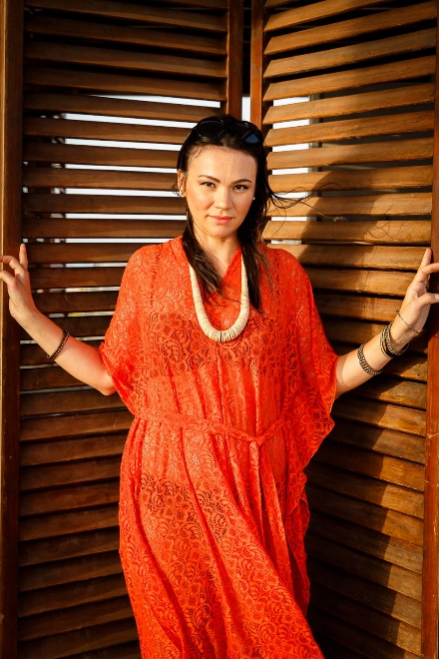
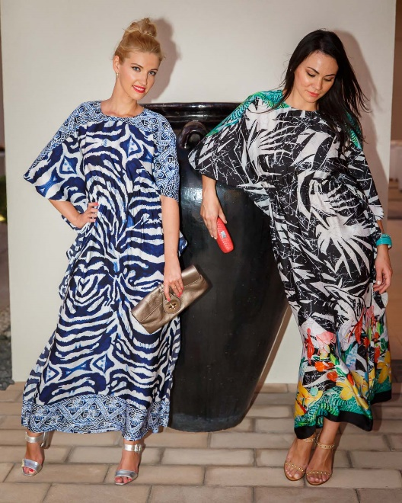
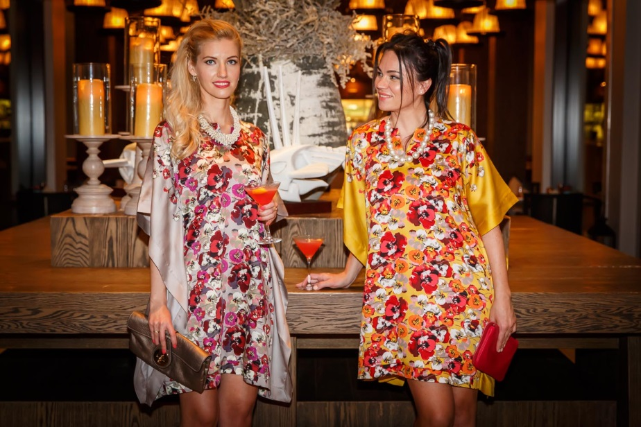
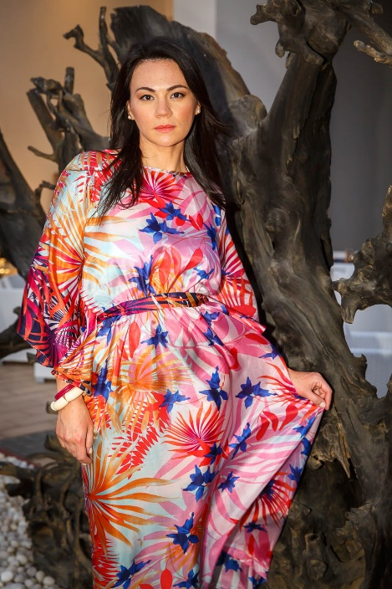
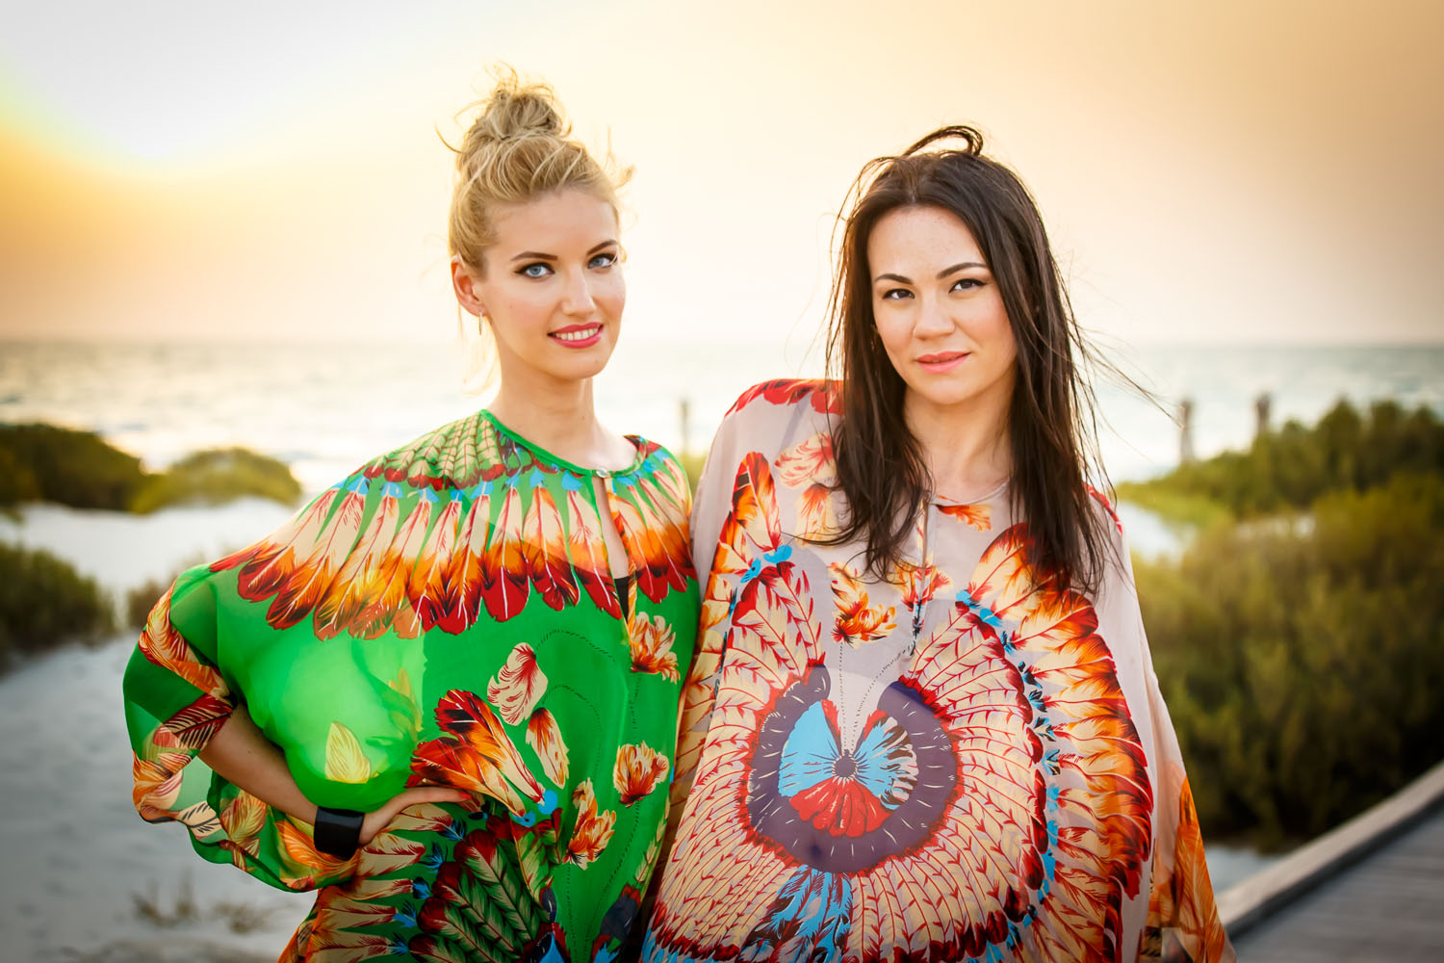
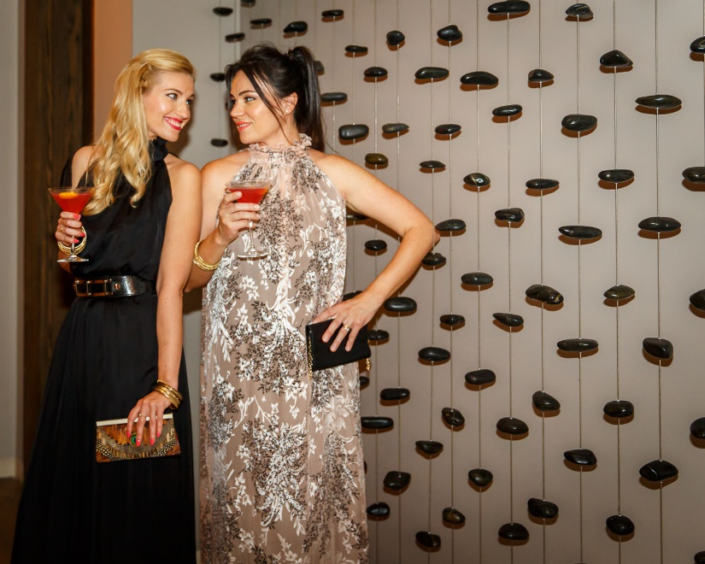
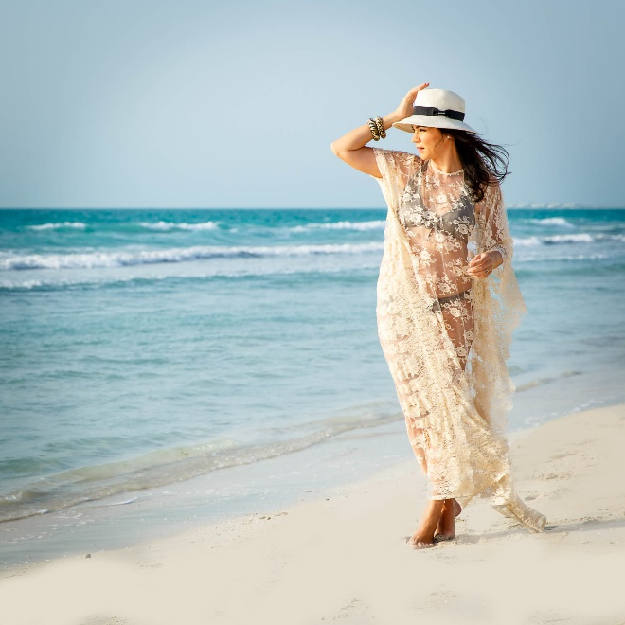
SAMPLE DESIGNS

Slide 10
BRAND tweak / evolution

Slide 11
CURRENT/PAST BRAND IDENTITY
There have been 2 attempts to design a corporate brand identity for MICHELETTI. Both have failed to capture the following key influences and distinct uniqueness and character of the brand:
→ Essentially, “East meets West” in the Middle East. Two halves (Mediterranean and AustraliAsian) become one in Arabia…
Corsican, Mediterranean, French, European background (strong Corsican roots)
Asian and Arabian influences on style, lifestyle and fashion design
IDENTITY NEEDS TO MARRY ALL THESE :
Mediterranean/European identity
Arabian Mosaic, Arabesque influence
Fashion brand/product

Slide 12
KEY ELEMENTS for INSPIRATION & IDEAS

Slide 13
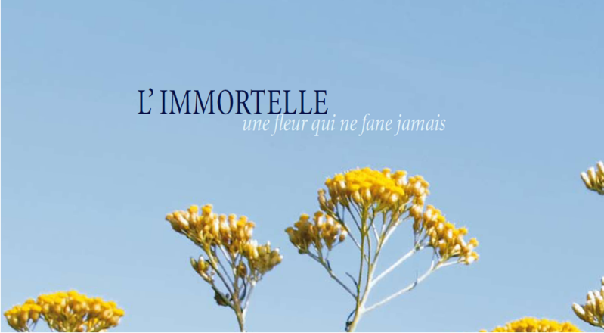
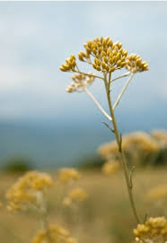
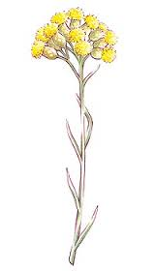
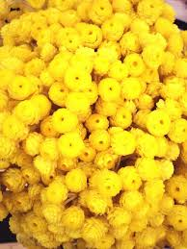
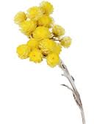
CORSICA
CORSICAN TYPICAL FLOWER: “IMMORTELLE”…
“Immortelle” means “undying”. It’s a flower that never dies.

Slide 14
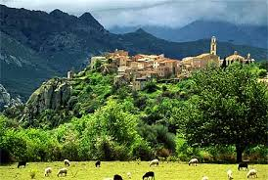
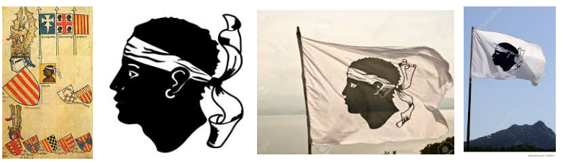
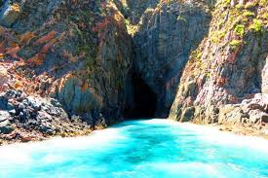
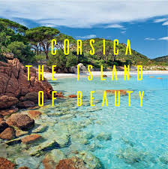
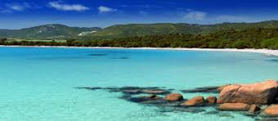
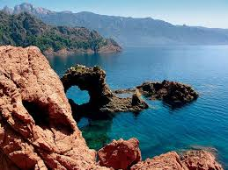
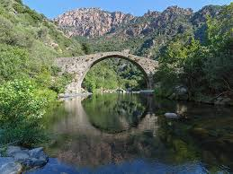
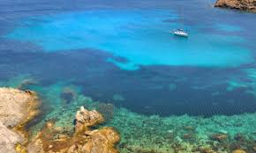
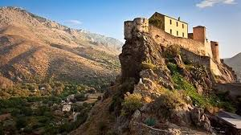
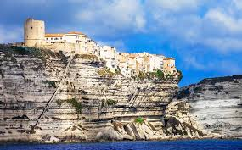
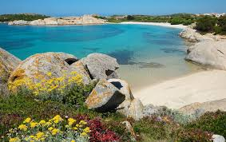
CORSICA
Corsican Flag
Corsica is called “the island of beauty”. Or “KALLISTE” – in ancient greek “the most beautiful”

Slide 15
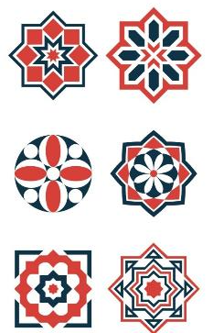
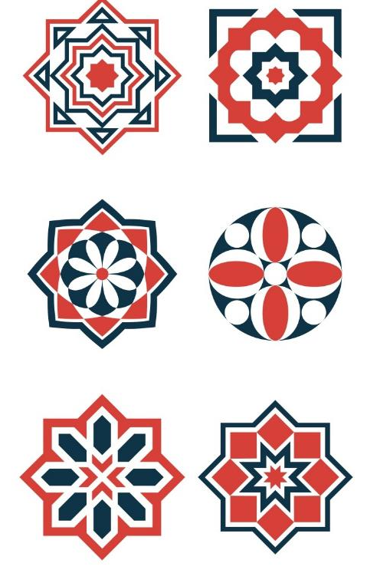
ARABESQUE / MOSAIC MOTIFS

Slide 16
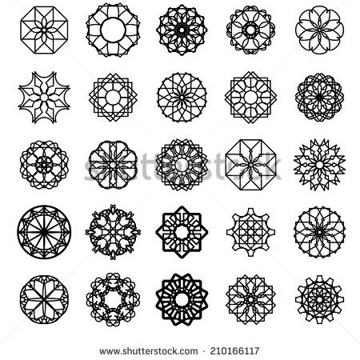
ARABESQUE / MOSAIC MOTIFS
http://www.shutterstock.com/pic-210166117/stock-vector-black-round-east-ornament-set-vector-symbols.html?src=dXWZdDPTez6QkWRMROe63g-3-19

Slide 17
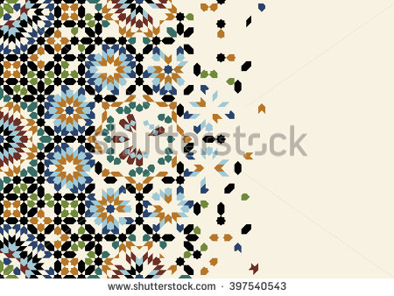
ARABESQUE / MOSAIC MOTIFS
http://www.shutterstock.com/pic-360806762/stock-vector-geometric-logo-template-set-vector-circular-arabic-ornamental-symbols.html?src=dXWZdDPTez6QkWRMROe63g-1-25

Slide 18
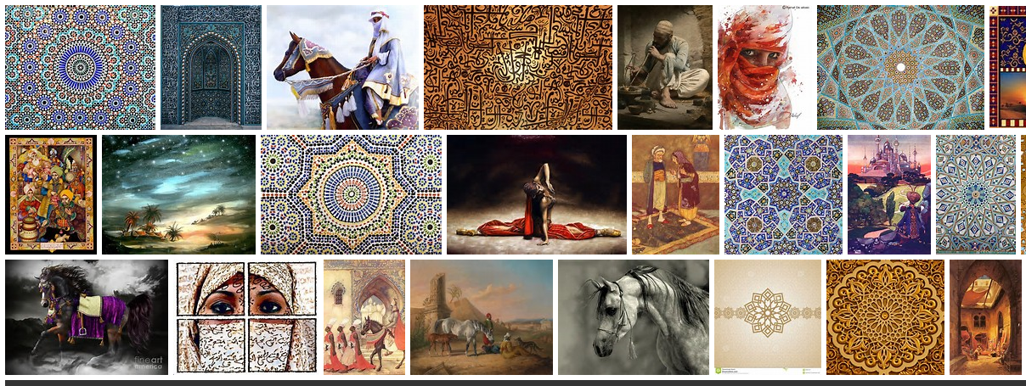
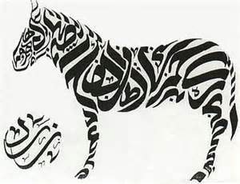
ARABIA

Slide 19
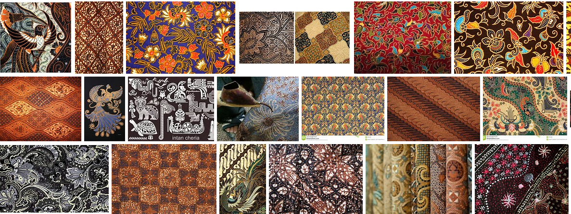
SOUTH ASIA

Slide 20
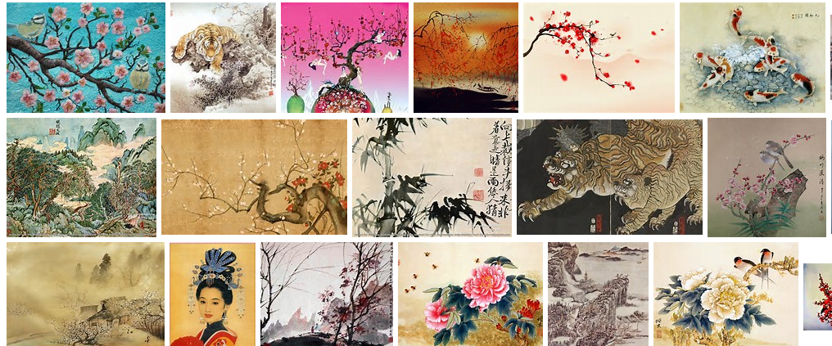
NORTH ASIA

Slide 21
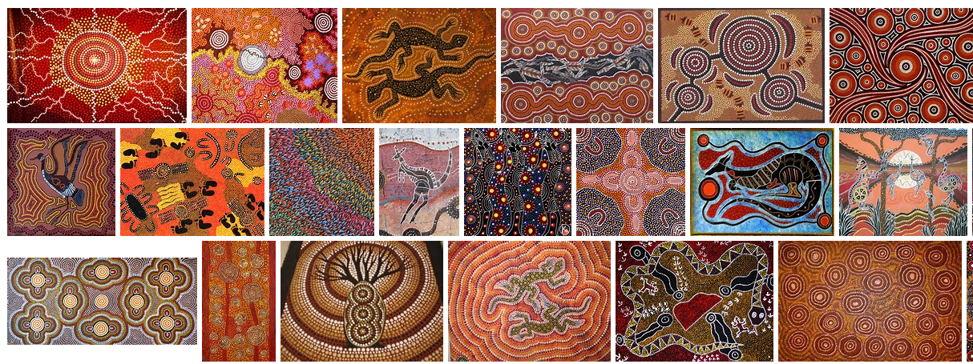
AUSTRALIA

Slide 22
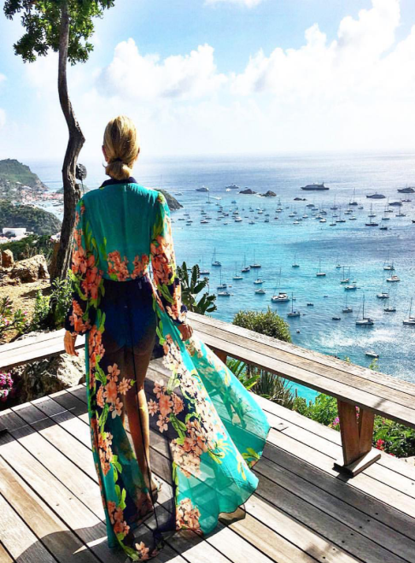
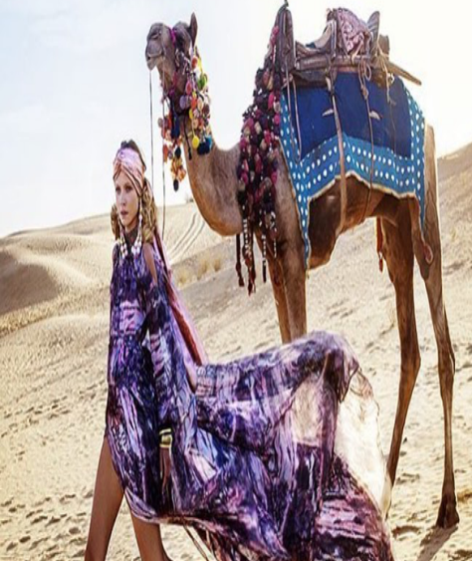
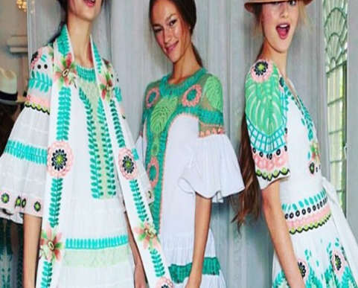
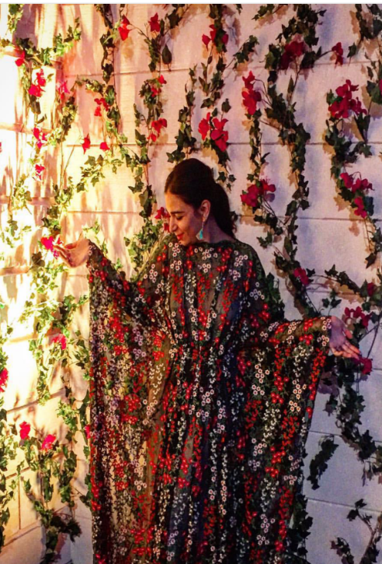
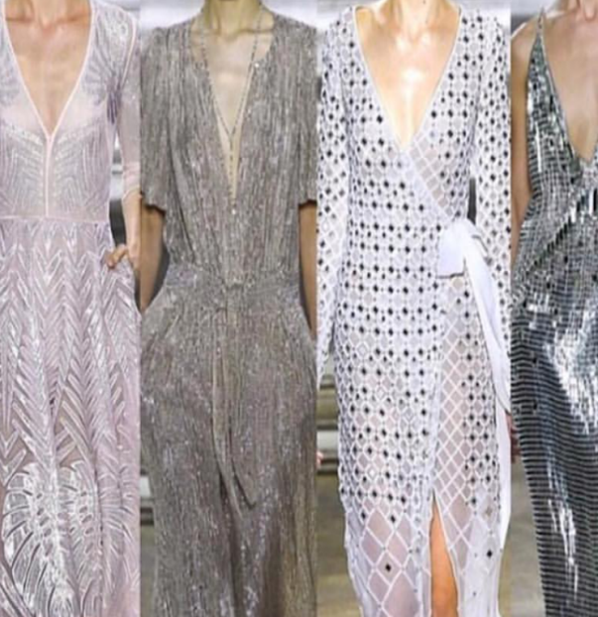
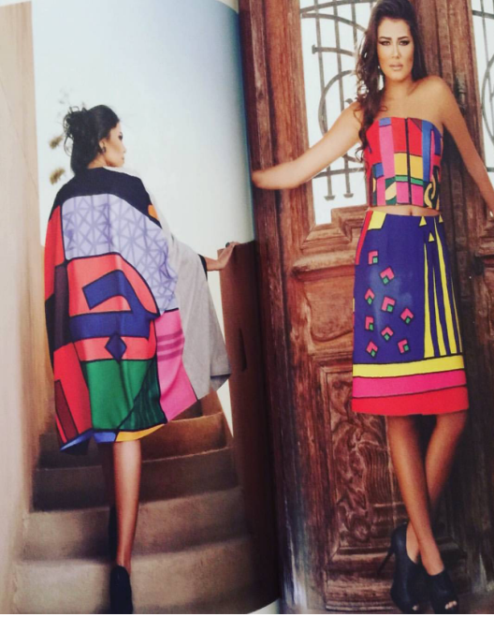
MOOD BOARD
Resort Tuniques
Cover-ups
Lounge Wear
Outerwear
PRODUCT ASPIRATION

Slide 23
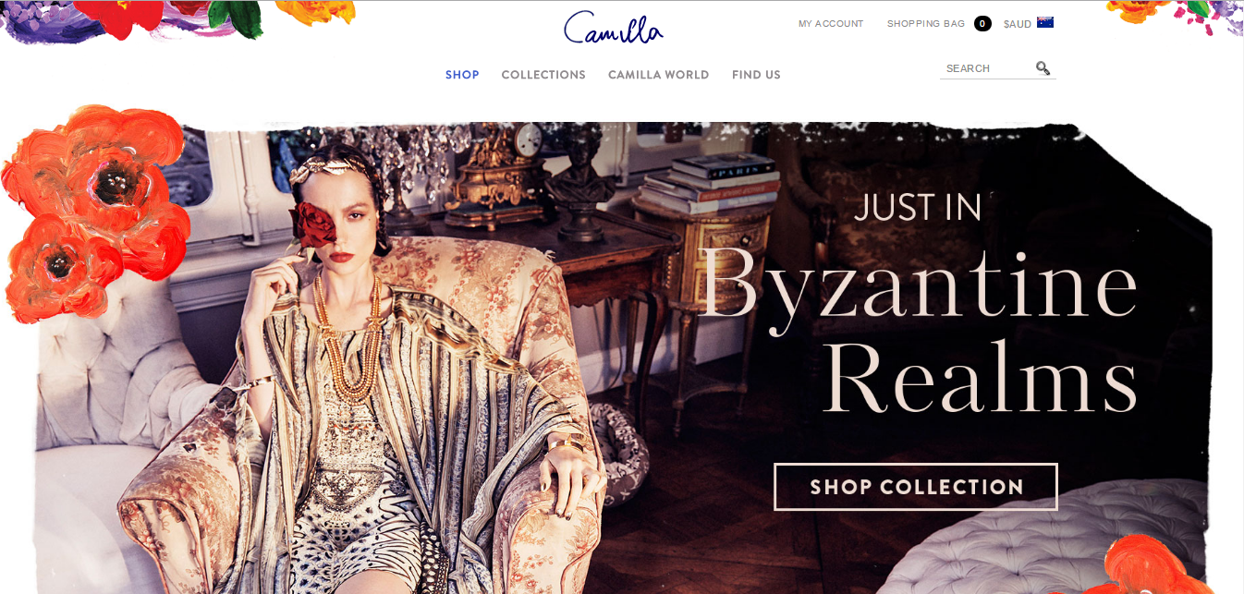
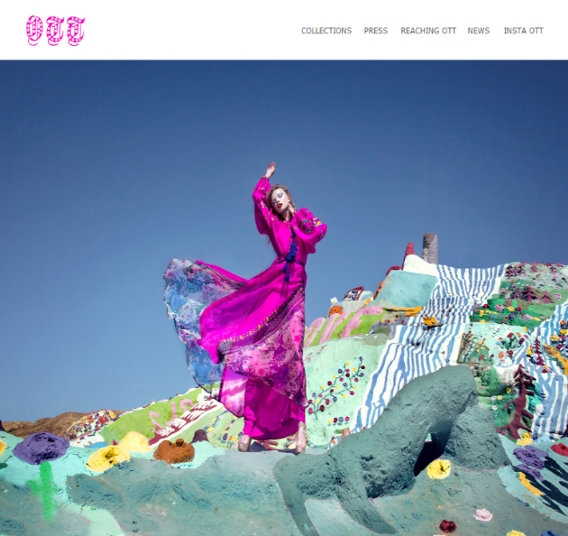
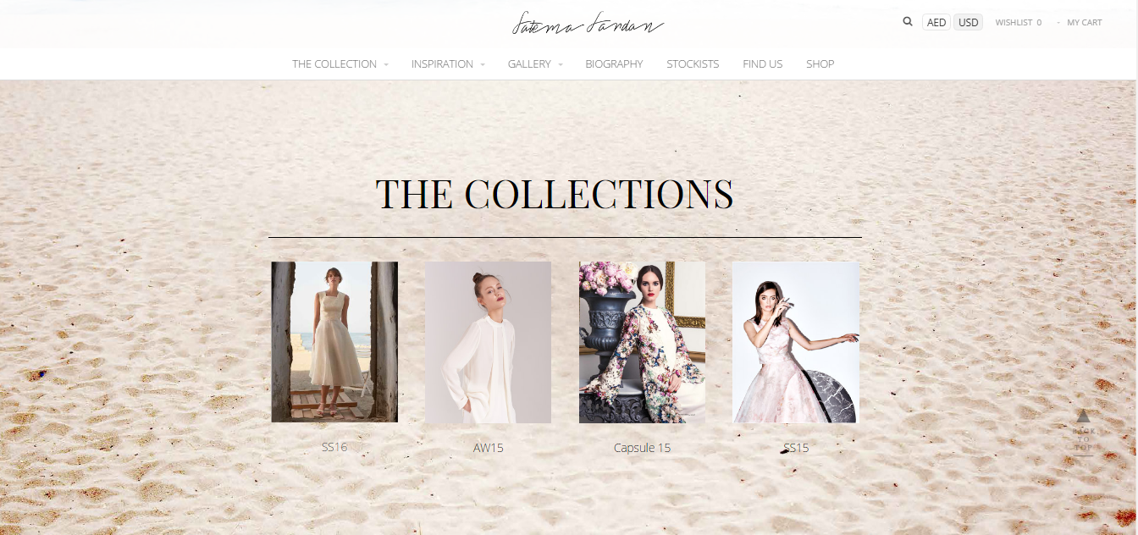
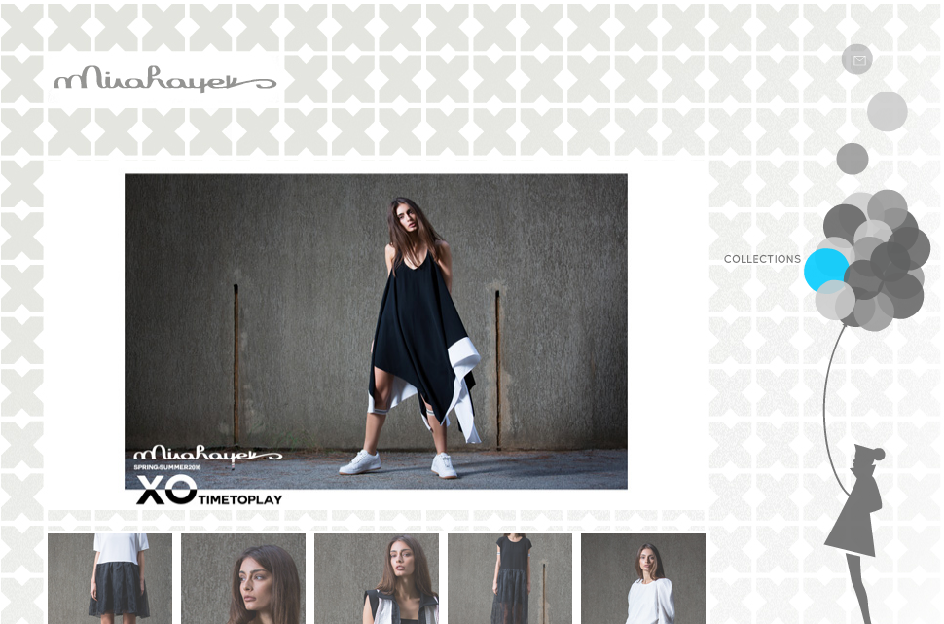
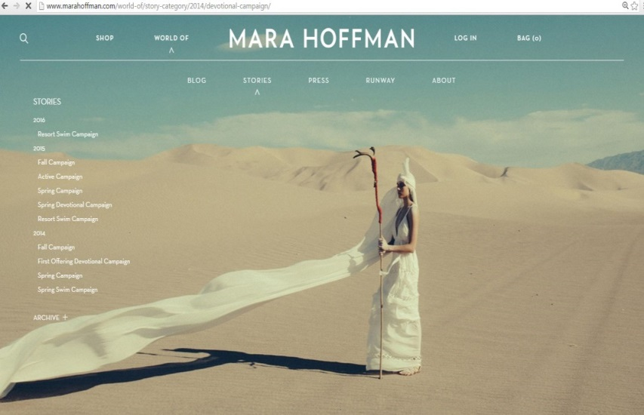
BRAND INSPIRATION
----------
Camilla
Alice Temperley
Mara Hoffman
OTT Dubai
----
BRANDING DREAMS
www.camilla.com.au
www.byott.com
www.temperleylondon.com
www.marahoffman.com
http://mirahayek.com

