Slide 1
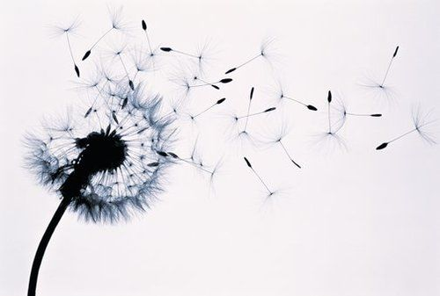
Namaste Yogis

Slide 2


Namaste Yogis

