Slide 1




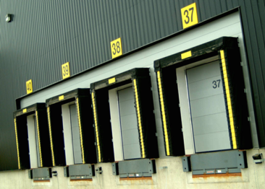

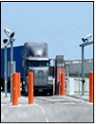
SV3 Suite
Visitor Management
1- SECURE VISITOR
2 -SECURE VEHICLE
3 -SECURE VENDOR
Facility & Enterprise
Vehicle Management
Loading Dock Security
Vendor Management
Vendor Marketplace
A Full Suite of Application Services for the Secure & Efficient Management of Visitors, Vehicles, & Vendor Access
Save time, increase efficiency, lower risk and secure your environment
Modular cloud services
Hosted service with unlimited capacity for big data
Enterprise license available
Fast deployment done on site or virtually
Relational database connects vehicles to drivers, vendors, & host
Deploy one, two, or all three modules for a holistic approach to managing the unknown
Actionable Intelligence

Slide 2

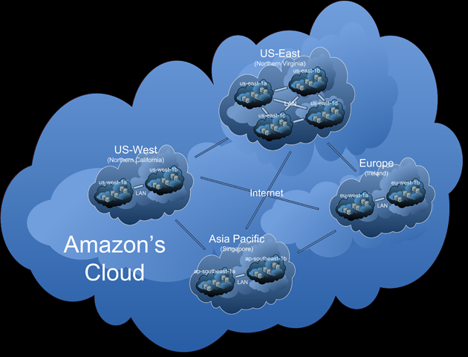









SV3-Suite
No maintenance fees
Updates are
automated
Unlimited capacity
Accessible from virtually anywhere
Quick & easy to deploy
Global reach
Build a secure environment by adding one or all three modules.
Address the risk of the unknown with a cost effective security operations program that includes knowledge of visitors, vehicles, and vendor companies who access your facility.
Lower risk by identifying people and vehicles arriving at the back of the house as well as the front lobby.
Secure Vendor
SV3 - Vehicle
SV3 - Visitor
Key Integration Partners
Access Control: AMAG, Lenel, Software House
Credentials: AssureTec, CSSN, Access IS
License Plate Recognition: Elsag, Inex Zamire, Mango, Perceptics
For more information within the United Kingdom please contact
17 Ensign House, Admirals Way
Canary Wharf, London E14 9XQ
+44 (0) 207 363 7523
For more information within the United States please contact Building Intelligence at 877-353-3377
© 2014 Building Intelligence, Incorporated. All rights reserved. Building Intelligence and Building Intelligence logo are registered trademarks of Building Intelligence Incorporated in the United States and/or other countries. All other trademarks are the property of their respective owners. www.buildingintelligence.com

