Slide 1
What is Workhorse EAM
Workhorse enterprise asset management is a boutique firm specializing in maintenance and reliability, supply chain, business intelligence and program management for asset intensive industries.
We represent the finest people, process and technology tools to achieve greater results.

Slide 2
Why – business drivers
Improved planned & scheduled maintenance
Uptime improvements
Longevity and safety of equipment
Optimized asset performance
Administrative savings
Improved inventory levels
Skills portability, increased employee morale

Slide 3
Why – employee drivers
Executive & Operations Managers
  More reliable operations.
  Increased efficiency and profitability.
  Reduced and reliable maintenance costs.
  Reduced liability/risk.
  Manage by knowledge (reduce surprises).
  Better Budgeting.
Maintenance Managers
  Better information.
    Better organization, decisions and justifications.
  Identify where to spend money most effectively.
Maintenance Workers
  Easier to prevent messes before they happen.
  Get information, not the runaround
  Spend time working on the right things.
Notes:
Executive
More reliable operations Well-maintained equipment keeps running. Poorly-maintained equipment can break down. Breakdowns cause production delays and lost revenue
Increased efficiency and profitability Better-running equipment also means people are more productive. Workers don't sit around waiting for machinery to get repaired.
Reduced and reliable maintenance costs Preventive maintenance is cheaper to do than trying to fix something after it's broken. Moreover, preventive maintenance costs are predictable; they stay on budget. Repair costs are always wild cards: maybe you'll be lucky, maybe you won't.
Reduced liability risk
Better maintenance means greater safety for everyone
Manage by knowledge: reduce surprises The bottom line is that MainBoss offers greater knowledge to you and your people. Greater knowledge means better information for making decisions. Those directly involved with maintenance can do their jobs better. Everybody else can do their jobs better too, because everything works the way it's supposed to. You can allocate personnel and resources with confidence, because you'll have fewer nasty surprises.
General Managers
Increased equipment uptime Well-maintained equipment keeps running. Poorly-maintained equipment can break down. In a manufacturing context, breakdowns cause production delays and lost revenue; in a facility, they interfere with smooth operations and annoy everybody who's affected. MainBoss makes it easier to maintain equipment proactively, finding potential problems before they turn into real headaches.Wouldn't it be nice if you never had to worry about missing a production deadline or irritating a client because of equipment breakdown?
Reduced and reliable maintenance costsPreventive maintenance is cheaper to do than trying to fix something after it's broken. Moreover, preventive maintenance costs are predictable; they stay on budget. Repair costs are always wild cards; it's better not to trust to luck. Wouldn't it be nice if you knew what maintenance would cost...and it was less than you're paying now?
Better budgeting for capital expensesMainBoss lets you know where maintenance money is going. That can help you make decisions about capital costs. What equipment should be replaced? Which brands have proved the most reliable? Which cost the most to maintain? Are there any trends you should know about (e.g. a pattern of problems that seem to be getting worse)?Wouldn't it be nice if you had the facts you needed to optimize your budget...and to justify your decisions to your superiors?

Slide 4

How – project approach
Three Pillars
  Maintenance & Reliability
  Inventory & Stores
  Procurement & Payables
Three Phases
  Pre-Feasibility
  Feasibility
  Execution
Three Dimensions
  People & Process
  Physical
  Technical
Pre-feasibility
Feasibility
Execution
People & Process
Technical
Physical

Slide 5

PROJECT APPROACH – MAINTENANCE AND RELIABILITY FRAMING
Capabilities
Value Proposition
Role of M&R
Operational Excellence
Continual Improvement
< 10%
Reliability Centered Organization
Reliability Centered Organization
Precision Work and Fully Integrated Plan
< 20%
Enterprise Asset Management Program
Increasing value (and required capabilities)
Reliability Program Development
< 30%
Integrated Org Dev | Skills/Training | Shutdown Mgmt. | Operator Care
Elimination of Defects & Process Improvement
< 40%
Work Management (Planning Scheduling Processes) | Work ID | Backlog | WO Discipline
P&S Execution, Auditing
< 50%
Road Mapping | MMS Mapped| GAP Identification | Action Teams (Lube/Oil) | Procurement and MRO Catalogs
Improvement Plan Developed
< 70% Unscheduled Work
*Source: 2015 SMRP

Slide 6
PROJECT APPROACH – INVENTORY AND STORES FRAMING
Capabilities
Value Proposition
Role of Inventory Management
Operational Excellence
Joint planning and optimization of inventory levels throughout supply chain
Continual Improvement
40%
Quantification
Inventory algorithms
Larger and segmentation and structuring process
60%
Structuring
Inventory methodology is applied
Increasing value (and required capabilities)
Planning is based on part(s) segment
80%
Differentiation
Inventory has been segmented
Inventory is based on experience
90%
Flat Sizing
Ensure everything is in Inventory
95%
Part may be in Inventory
One-Size Fits All
Inventory 100%
*Source: 2013 Supply Chain Management Association

Slide 7
PROJECT APPROACH – PROCUREMENT AND PAYABLES FRAMING
Capabilities
Value Proposition
Role of Procurement
Just in time, wholly vendor owned, value management
Continual Improvement
%60+
Stimulating good demand and increasing business value derived from spend (supply markets) rather than just reducing spend magnitude
Safely harnessing the power of supply markets for competitive advantage
40%
Reducing unneeded demand activity, complexity, immediacy and
Customer relationship management; money management; demand/specification influence
25%
Increasing value (and required capabilities)
By reducing total supply costs (not just supplier profits)
Cost modeling; supplier/market analysis; supplier management; supply planning; risk management
15%
Negotiations
And at the right price
10%
Site-level tactical sourcing, ordering and expediting
Right goods and services at the right time and place
Cost Reduction %5
*Source: 2013 Supply Chain Management Association

Slide 8
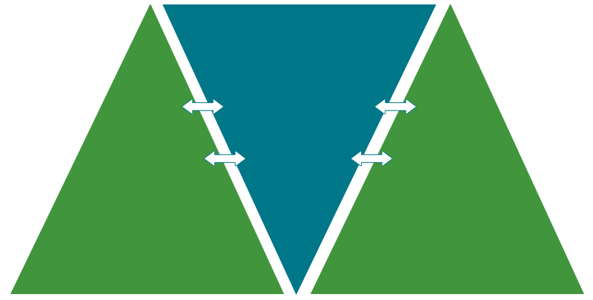
How – Project Approach
Complex Integration
INVENTORY & STORES
Operational Excellence
Quantification
Operational Excellence
Operational Excellence
Structuring
MAINTENENCE & RELIABILITY
Reliability Centered Org
Differentiation
Stimulating good
demand
Reliability Program Development
PROCURMENT & PAYABLES
Reducing unneeded demand activity
Flat Sizing
Integrated Org Dev | Skills/Training Shutdown Mgmt.
Reducing total supply costs
One Size Fits All
Work Management (Planning Scheduling Processes) | Work ID | Backlog |WO Disc
Right Prices
Road Mapping | MMS Mapped | GAP Identification | Action Teams | Procurement/MRO Catalogs
Right goods and services at the right time and place

Slide 9
Contatct:
  Email: info@workhorseglobal.com
  Twitter: @Workhorseglobal
  Instagram: @Workhorse
  Phone: 604.999.9999
  Address:

