Slide 1
Business Plan
Career Pathway Foundational Skills Curricula

Slide 2


A More Demanding Labor Market
1973
2016
The Passport to the American Dream:
In 1973, the Passport was High School Diploma.
*72% of the workforce had no more than a high school degree
In 2016, the Passport is Education beyond High School
*Nearly 80% of today’s workforce has at least some college.
Source: Center on Education and the Workforce, Georgetown University

Slide 3
The Problem
In order to grow our economy and livable wage attainment we have to improve or increase the skill level of America's workforce
One of the holes in our education system, is the approach to College Only for our learners without creating viable career choices.
As a result only 40% achieve a post secondary degree and as a result America’s on time completion rates are alarming high.
Youth have lost the connection to careers as the opportunities to experience and explore careers are at a minimum in our educational system.

Slide 4
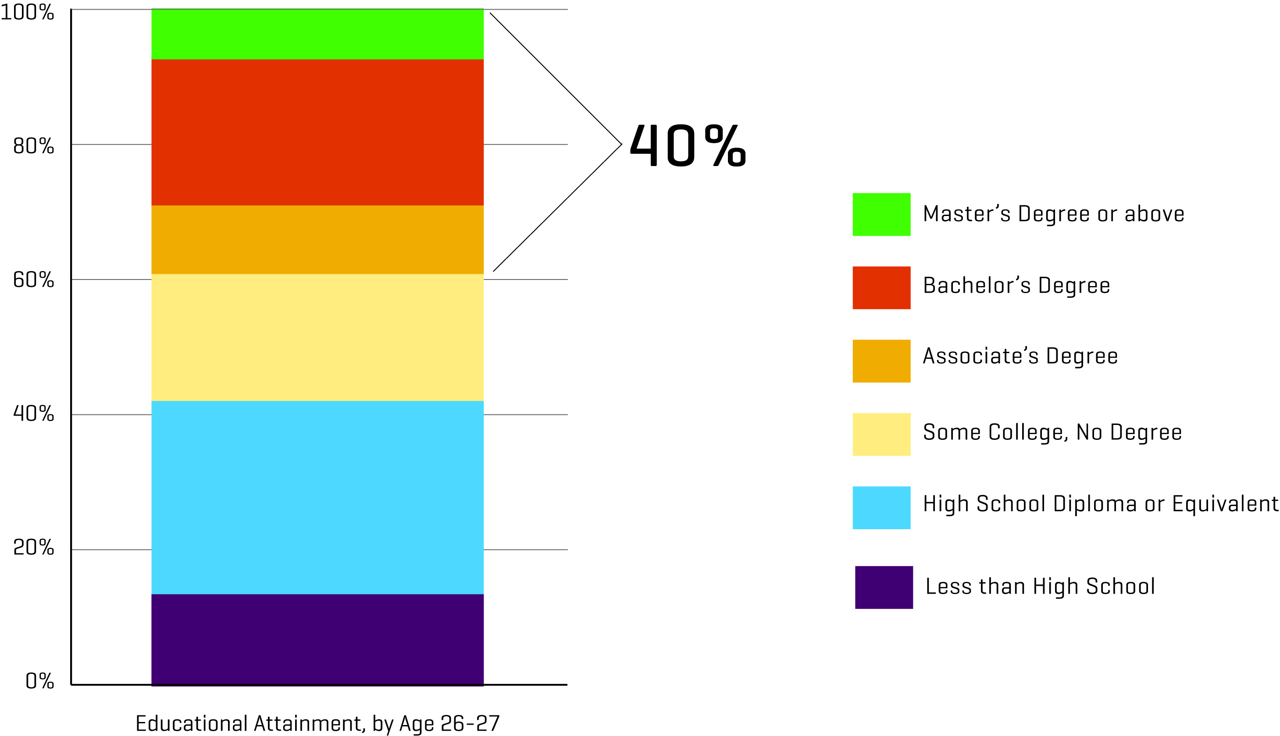
The current U.S. reality: only 40% of 27-year olds have earned an A.A. degree or higher
Note: Represents data collected in surveys between 2006-2008; GED is approximation based on data from GED Testing Program. Source: Current Population Survey Annual Social and Economic Supplement.

Slide 5
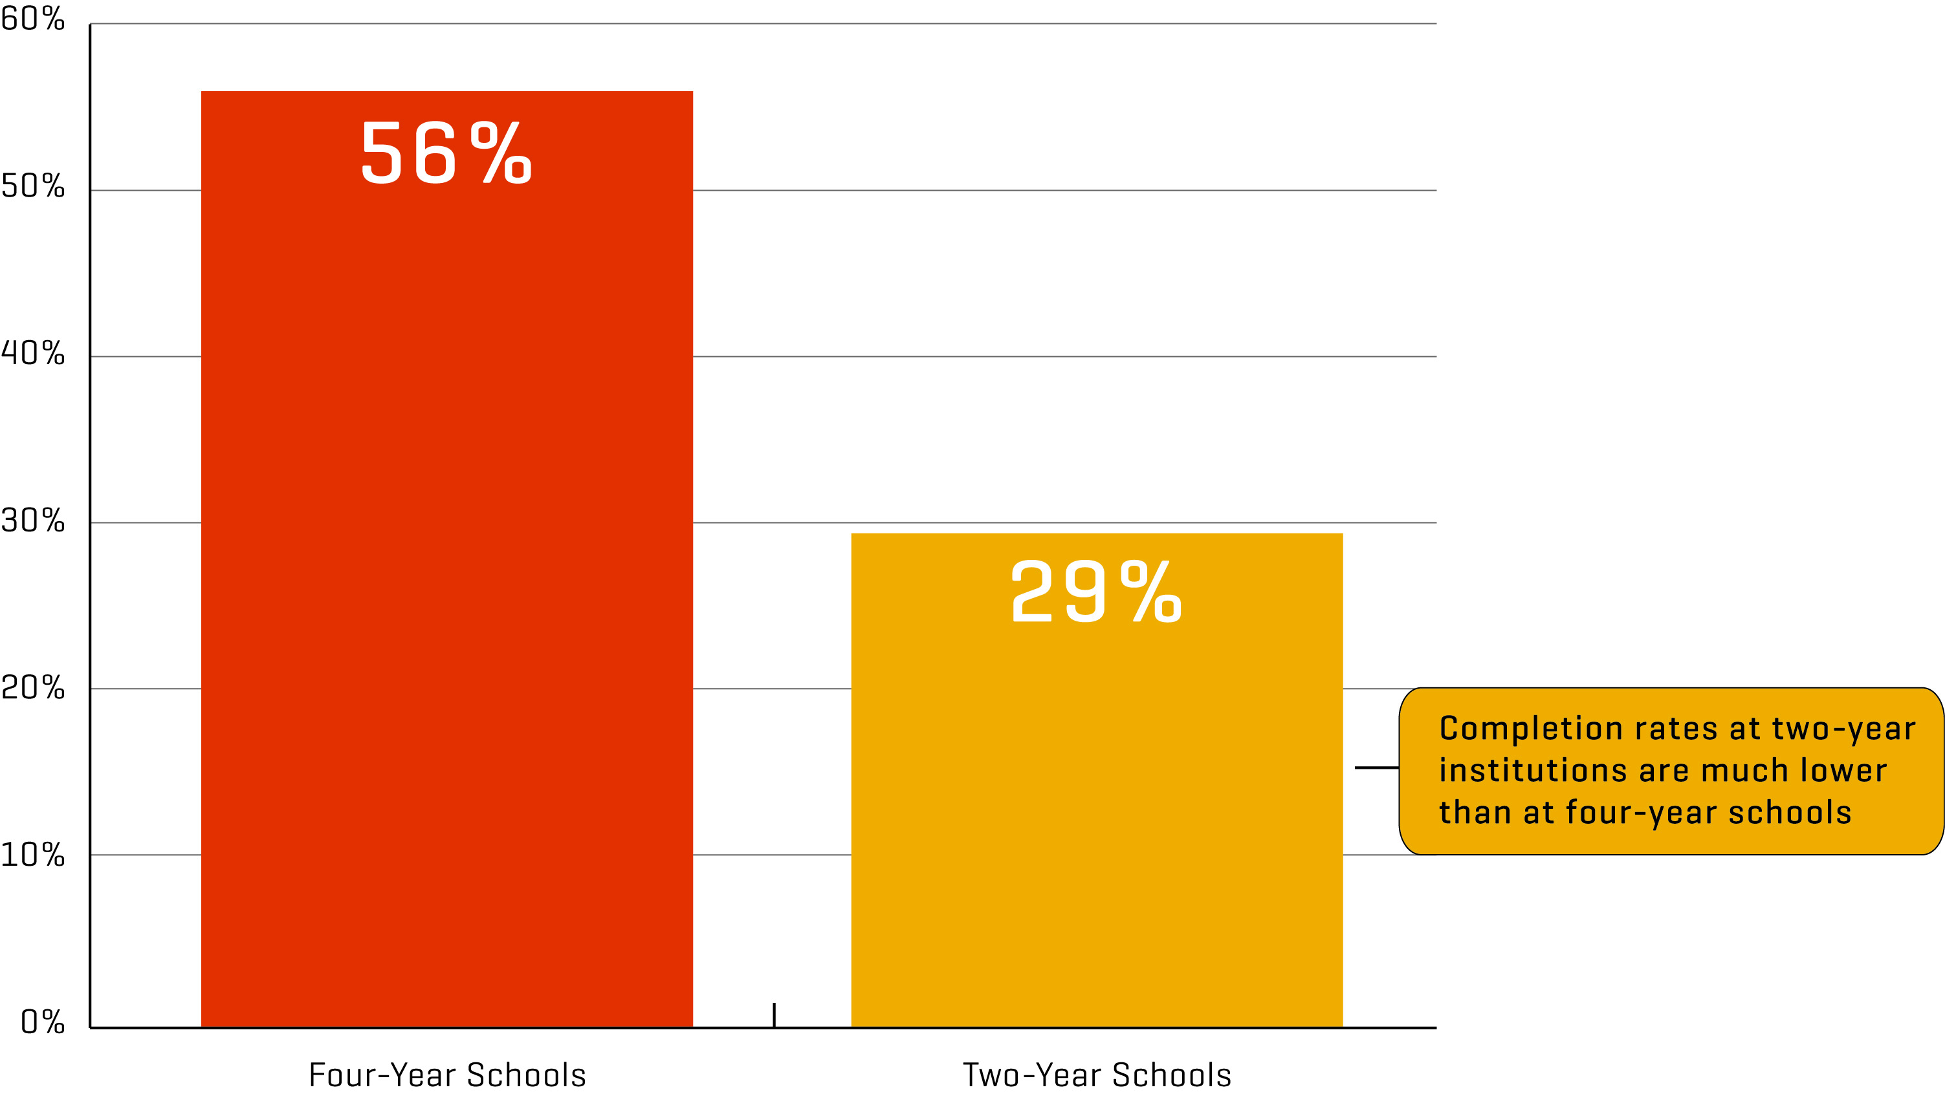
U.S. “on time” college completion rates are alarmingly low
Note: Two-year schools have a three year graduation window. Four-year schools have a six-year window Source: Higher Ed info-NCES/IPEDS Graduation Survey.

Slide 6
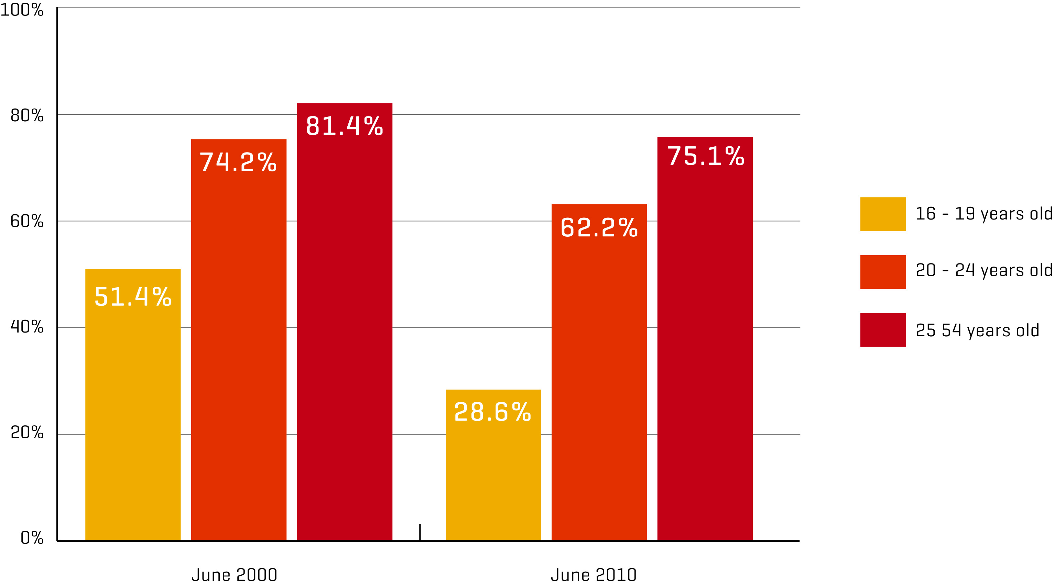
Shrinking employment opportunities: Teens and Young Adults have been hit the hardest by the Great Recession
Source: Center for Labor Market Studies; U.S. Bureau of Labor Statistics, “CPS Labor Force Statistics”.

Slide 7
Performance has not substantially changed
Scores from the most recent National Assessment of Educational Progress (NAEP), better known as the Nation’s Report Card:
8th Grade Proficiency Math – 33% of 8th grade students
Reading – 34% of 8th grade students
ACHIEVEMENT GAP:
8th Grade Math Proficiency Among Subgroups
White: 45%
Black: 14%
Hispanic: 21%
8th Grade Reading Proficiency Among Subgroups
White: 46%
Black: 17%
Hispanic: 22%
HOW U.S. STUDENTS COMPARE INTERNATIONALLY:
According to the Program for International Student Assessment (PISA), out of 34 countries, the U.S. ranks:
27th in math
17th in reading
Across the total U.S. working age population, ages 16-65, the new data confirm that there is a significant portion of employed adults with low measured skills. Fourteen percent of the employed population have low literacy skills; 23 percent have low numeracy skills, and 62 percent have low digital problem solving skills.

Slide 8
Market Size
TOTAL K-12 ENROLLMENT: 54,876,000
Elementary: 38,716,000
Secondary: 16,160,000
Career Technical Education (CTE): 12,500,000
Adult Workers with Low Measured Skills: 24,000,000
Adult Corrections, Ages 18-29: 8,500,000
Juvenile Correction: Approximately 1,700,000 cases with an average daily attendance of 70,000

Slide 9
Funding Streams
TOTAL FUNDING OF PUBLIC EDUCATION: $597,485,869,000
Federal: $75.99 billion (12.7% of total)
State: $259.8 billion (43.5% of total)
Local: $261.7 billion (43.8% of total
Office of Career, Technical and Adult Education: $2,000,000,000
The programs and grants managed by the Office of Career, Technical, and Adult Education support a wide range of activities that help prepare young people and adults for further education and successful careers.
$1.2 billion for CTE
$600 million for Adult Education Programs
WIOA Core programs - formula grants to states:
$777M for adult activities
$1.012B for dislocated workers
$832M for youth activities

Slide 10

Funding Model
K12 Public Education
WIOA
CTE
600 Billion
2 Billion
2 Billion
36 Billion Instruction

Slide 11
How a Core Foundation Career Program Solves the Problem
-Academic (Core Skills needed for 21st)
-Aligned to Career Interest
-Contextualized throughout
-Aligned to Labor Market Needs
-Customized to Local Interest
-Personalized Career Learning=College and Career pathways

Slide 12
Competition
WIN Learning
Wkeys (Keytrain)
Skillbott (Softskills)
Training Associates
Houghflin Mifflin (Print Curriculum)

Slide 13
Alignment Needs
ONET
WKEYS
TABE
ASVAB
GED
MS/ HS Standards associated Math/Reading (Common Core Standards)

Slide 14

Federal and State Funding

Slide 15

WIOA, Perkins, and ESSA(K12): Intersections and Opportunities
Career Readiness

Slide 16

Workforce Innovation and Opportunity Act (WIOA)
Signed into law July 2014, replaced the Workforce Investment Act (WIA)
Implementation began July 1,
2015
Focus on alignment across federal workforce, education programs
Photo credit: Flickr user Katie Harbath.
Used by permission under a Creative Commons license.
www.nationalskillscoalition.org

Slide 17

WIOA – Four Titles, Six “Core”
Programs
Title I – Workforce Development Activities (Adult, Dislocated Worker, Youth)
Title II – Adult Education and Family Literacy Act (AEFLA)
Title III – Wagner-Peyser Act
(Employment Services)
Title IV – Rehabilitation Act of 1973 (vocational rehabilitation)
www.nationalskillscoalition.org

Slide 18

WIOA – State and Local Planning
WIOA requires new four-year Unified Plan: sets vision and strategy across all six core programs
States may elect, instead, to create a Combined Plan: Unified Plan plus alignment with at least 1 optional program (Perkins CTE, TANF, etc.)
Local/regional plans must align with state plan, require 30 day public comment period
First round of state plans submitted April 2016 - seven included Perkins CTE as part of combined plan
www.nationalskillscoalition.org

Slide 19
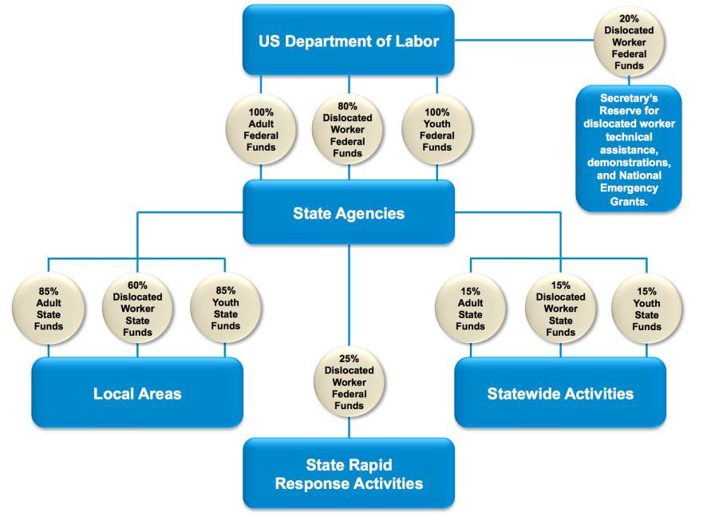
WIOA Title I Workforce Programs
Core programs - formula grants to states (FY 2015):
$777M for adult activities
$1.012B for dislocated workers
$832M for youth activities
National programs include:
YouthBuild
Job Corps
Native American grants
Migrant and Seasonal
Farmworker grants
Reintegration of Ex-Offenders
www.nationalskillscoalition.org

Slide 20

WIOA and Career Pathways
State board must develop strategies to support the use of career pathways
Local board must lead efforts to develop and implement career pathways with secondary and postsecondary providers, and include descriptions in local plans
Youth service strategies must include career pathways
www.nationalskillscoalition.org

Slide 21
Carl D. Perkins Career and Technical Education Act (Perkins)

Slide 22





•
•
•
•
•
•
•

Slide 23
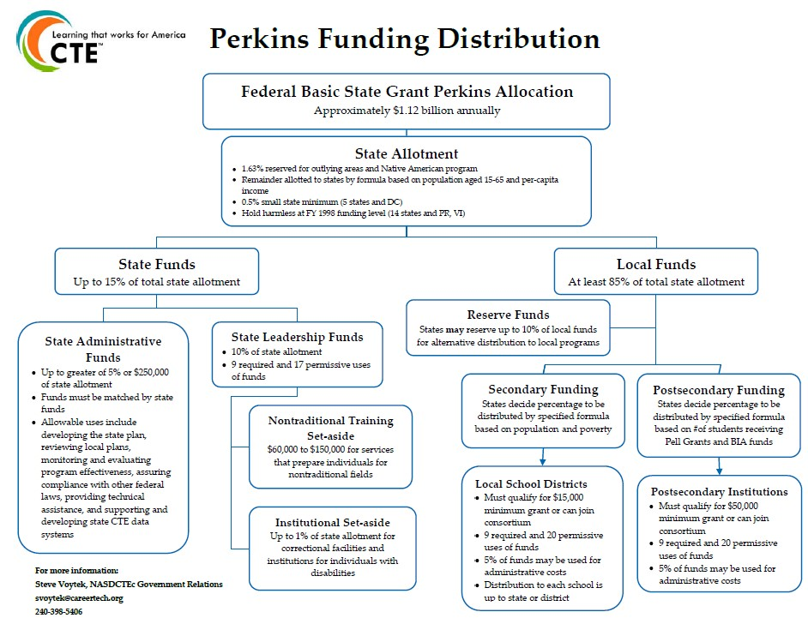




•
•
•

Slide 24




•
•
•
•
•

Slide 25








•
•
•
•
•
•

Slide 26













•
•
•
•
•
•
•

Slide 27
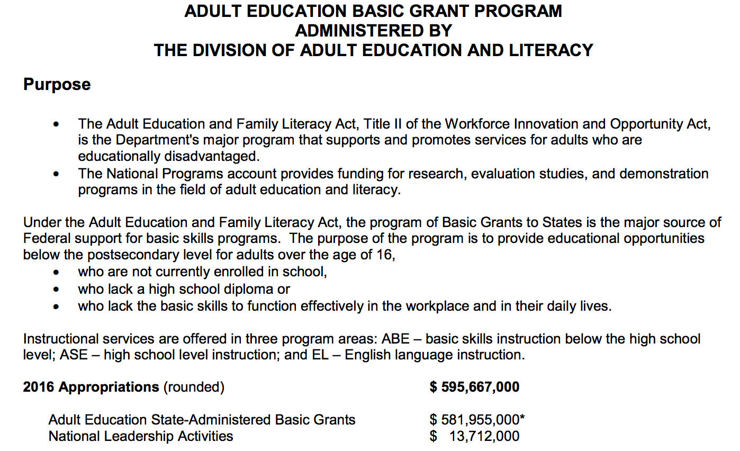
Notes:
Add to Perkins

Slide 28
Business Potential

Slide 29
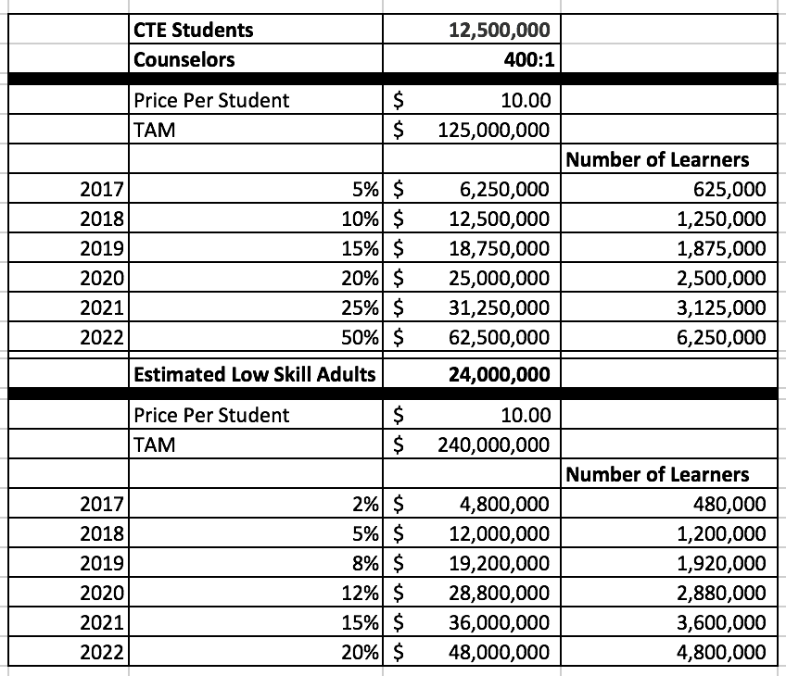
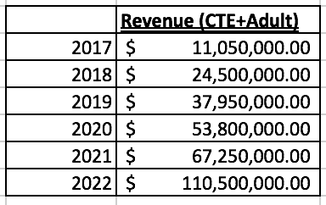
Revenue Potential

Slide 30
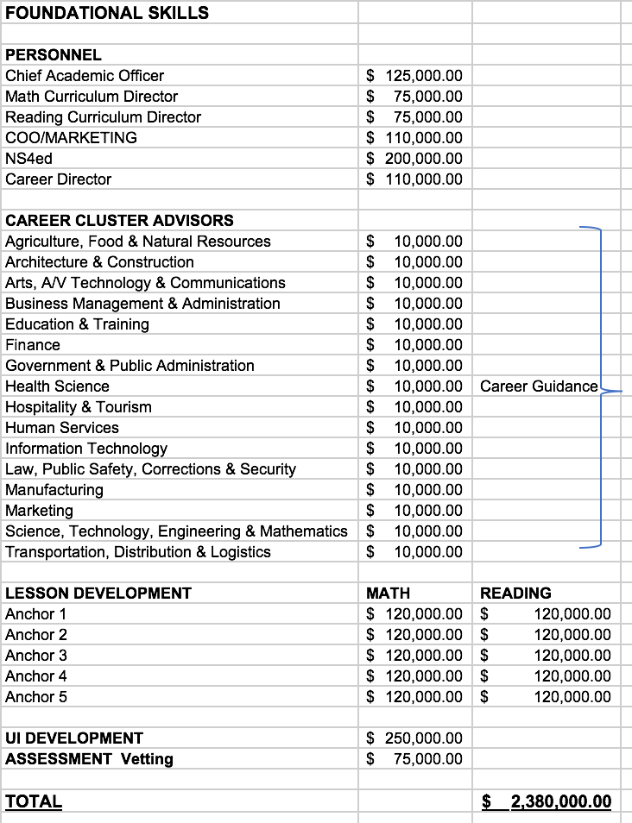
Initial Budget Summary 17

Slide 31
Marketing Strategy
CTE Summit
Workforce Presence
Corrections
NDP

Slide 32
Management Team

Slide 33
FOUNDATION SKILLS
PRESENTED BY

Slide 34

WELCOME

Slide 35
Foundation Skills
Aligned to ONET Skills
Foundation Skills
Math & Reading
Placement= Assessment
Anchor Skills (1 – 5)
Career Pathways (16)
Digital Badging
Aligned to ONET Skills

Slide 36


Aligned to ONET Skills
Aligned to ONET Skills

Slide 37
Career Pathways (16)
16 Copies of
Each Skill Level
Random Assignment
Career
Pathways (16)
Contextual Version
For Each Pathway
Career Profiles for each learning
objective
Occupation
Profile
Salary & Wages
Profile

Slide 38

Digital Badging
Micro Badge for each Skill Level
Digital Badging
Summative Assessment on each Skill Level

Slide 39




Web Based and Mobile Ready
Web Based
&
Mobile Ready

Slide 40
Develop Anchors around Onet Skills 1-5
Develop Anchors around Onet Skills 1-5
Production Cycle
Develop Anchors
around Onet Skills 1-5

Slide 41
Develop 16 Career Pathways
Agriculture, Food & Natural Resources
Architecture & Construction
Arts, A/V technology & Communications
Business Management & Administration
Education & Training
Finance
Government & Public Administration
Health Science
Hospitality & Tourism
Human Services
Information Technology
Law, Public Safety, Corrections & Security
Manufacturing
Marketing
Science, Technology, Engineering & Mathematics
Transportation, Distribution & Logistics
Develop 16 Career Pathways

