Slide 1
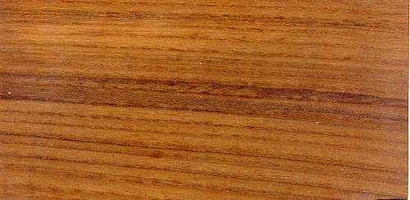
Teak Advisors
Real Estate Investment Management
Greg Ryan
Managing Principal
404.307.0620 | gryan@teakadvisors.com |www.teakadvisors.com
Teak Advisors, LLC | 1792 White Oak Hollow | Atlanta | GA | 30324

