Slide 1
Chicken Breasts
The Chicken Breast is derived from young broiler chickens and consists of the breast meat cut, sometimes with rib meat added. It is offered primarily in fillet and butterfly cuts, and can be sold boneless and skinless, or with bone-in and skin-on.
Presentation
The following packings are available in even net-weight cartons with a master polyliner:
Packed bulk in 40 lb (18.14 kg)
The following packings are available inside even net-weight master cartons:
Packed in 4 x 10 lb even net-weight polybags, 40 lb (18.14 kg)
Halal
We are pleased to offer Halal Boneless Skinless Chicken Breasts for export and can source other Halal products for our customers as requested.
Labeling
Chicken Breast cartons are labeled according to current USDA export requirements. Additional shipping marks can be added per customer request.
Private Labels
Intervision can work together with customers to create a new Private Label Brand in order to meet individual customer and market needs.

Slide 2
Chicken Drumsticks
The Chicken Drumstick is produced from young broiler chickens and is typically packed for export in cardboard cartons with a master polyliner. The drumstick is the lower portion of the leg. It is separated from the thigh at the point where the femur, fibula, and tibiotarus bones are joined.
Presentation
The following packings are available in even net-weight cartons with a master polyliner:
Packed bulk in 10 kg
Packed bulk in 15 kg
Packed bulk in 20 kg
Packed bulk in 40 lb (18.14 kg)
The following packings are available inside even net-weight master cartons:
Packed in 6 x 4 lb even net weight polybags, 24 lb
Packed in 4 x 10 lb even net-weight polybags, 40 lb
Halal
We are pleased to offer Halal Drumsticks for export and can source other Halal products for our customers as requested.
Labeling
Chicken Drumstick cartons are labeled according to current USDA export requirements. Additional shipping marks can be added per customer request.
Private Labels
Intervision can work together with customers to create a new Private Label Brand in order to meet individual customer and market needs.

Slide 3
Chicken Grillers
Frozen Chicken Grillers are a whole frozen chicken, usually sold without giblets.
Presentation
Chicken Grillers are usually sold IWP (Individually Wrapped in Polybags) and packaged with 10 Grillers in one catch weight master carton. The below sizes are estimates- actual product weight and packing varies.
10 x 1.9 kg
10 x 1.2 kg
10 x 1.0 kg
10 x 0.9 kg
Halal
We are pleased to offer Halal Chicken Grillers for export and can source other Halal products for our customers as requested.
Labeling
Chicken Griller cartons are labeled according to current USDA export requirements. Additional shipping marks can be added per customer request.

Slide 4
Chicken Leg Quarters
The Chicken Leg Quarter is derived from young broiler chickens and consists of the drumstick, thigh, and back portion attached in one piece. The part may also include a portion of the tail, abdominal fat, and up to two ribs. Once frozen, it has a shelf life of one year or more.
Estimated Size Range (grams):
Small: Approximately 250-350
Medium: Approximately 350-450
Large: Approximately 450-600
Jumbo: Approximately 600+
Presentation
The following packings are available in even net-weight cartons with a master polyliner:
Packed bulk in 10 kg
Packed bulk in 15 kg
Packed bulk in 40 lb (18.14 kg)
The following packings are available in polybags inside even net-weight master cartons:
Packed in 4 x 2.5 kg even net-weight polybags, 10 kg carton
Packed in 4 x 4.54 kg even net-weight polybags, 40 lb carton
The following packings are available in even net-weight polylined cartons:
Packed 40 lb. layerpack- a layer of leg quarters put in the case and then covered with a polyliner, followed by another layer of leg quarters
Halal
We are pleased to offer Halal Chicken Leg Quarters for export and can source other Halal products for our customers as requested.
Labeling
Chicken Leg Quarter cartons are labeled according to current USDA export requirements

Slide 5
Chicken Thighs
The chicken thigh is the upper portion of the leg, without the drumstick.
Presentation
The following packings are available in even net-weight cartons with a master polyliner:
Packed bulk in 10 kg
Packed bulk in 15 kg
The following packings are available inside even net-weight master cartons:
Packed in 4 x 10 lb even net-weight polybags, 40 lb

Slide 6
Three Joint Wings
Three Joint Wings are the Whole Chicken Wing and include the humurus, the ulna/radius together, and the wingtip.
Presentation
The following packings are available in even net-weight cartons with a master polyliner:
Packed bulk in 10 kg
Packed 15 KG layerpack- a layer of Wings put in the case and then covered with a polyliner, followed by another layer of Wings

Slide 7



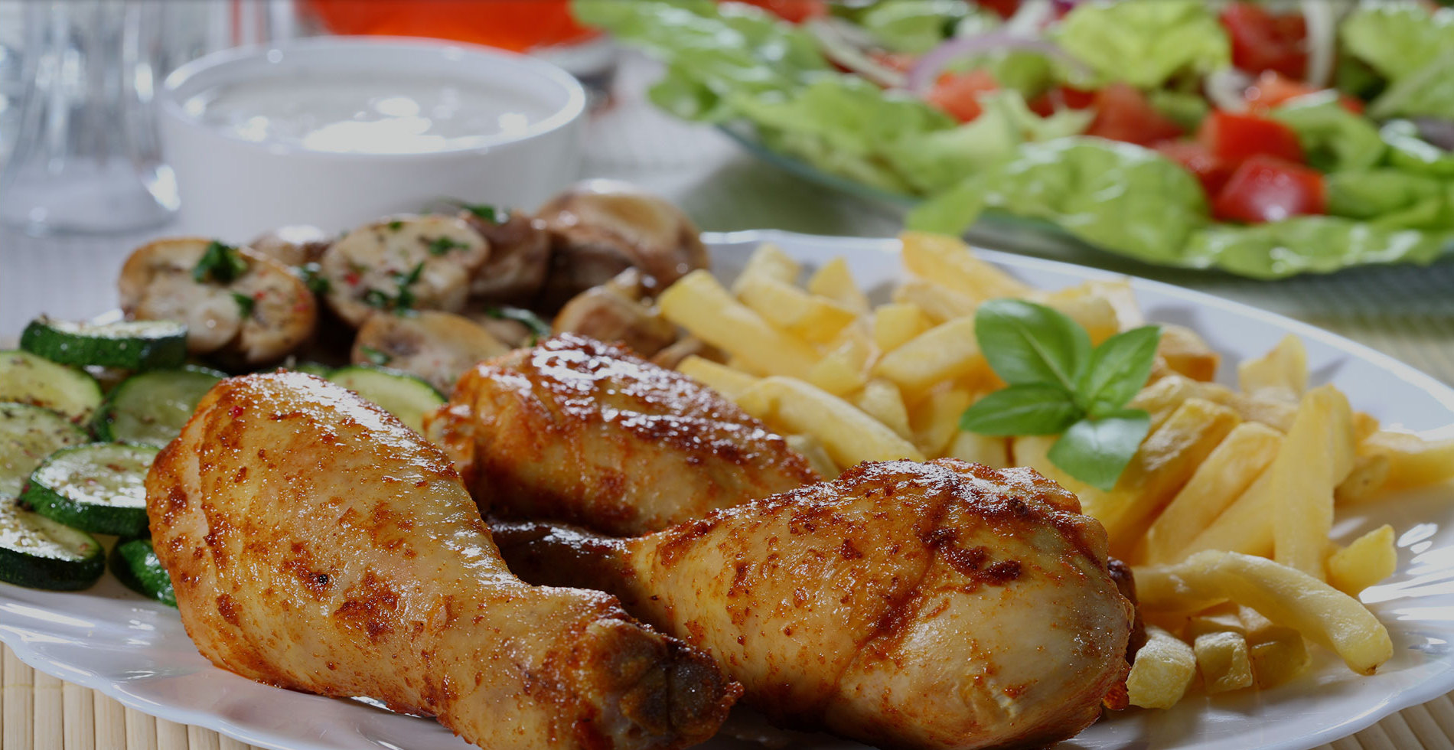
Logos/Other pictures to use on Cover/back pages

