Slide 1

Intervision Foods – Bringing Years of Global Meat and Poultry Merchandising Experience to the International Marketplace
Intervision Foods’ beginnings stretch back to 1983 when our founders launched their international trading careers. Today, with over 100 years of senior management experience, Intervision maintains an active customer base in over 60 countries with offices and direct representation in Atlanta (USA), China, the Middle East and South America.
As one of the largest U.S. exporters of frozen animal proteins, Intervision Foods ships a wide variety of multi-origin food products to all corners of the globe. Our multinational team of highly trained professionals assures attentive efficiency to the demands of diverse markets. Intervision’s cumulative experience and prowess in cultivating multilevel relationships offer our clients a significant advantage that is unmatched in the industry.
Please contact us to discuss business opportunities:
E-mail: Inquiries@ivfoods.com
Tel: +1 404 814 1282

Slide 2
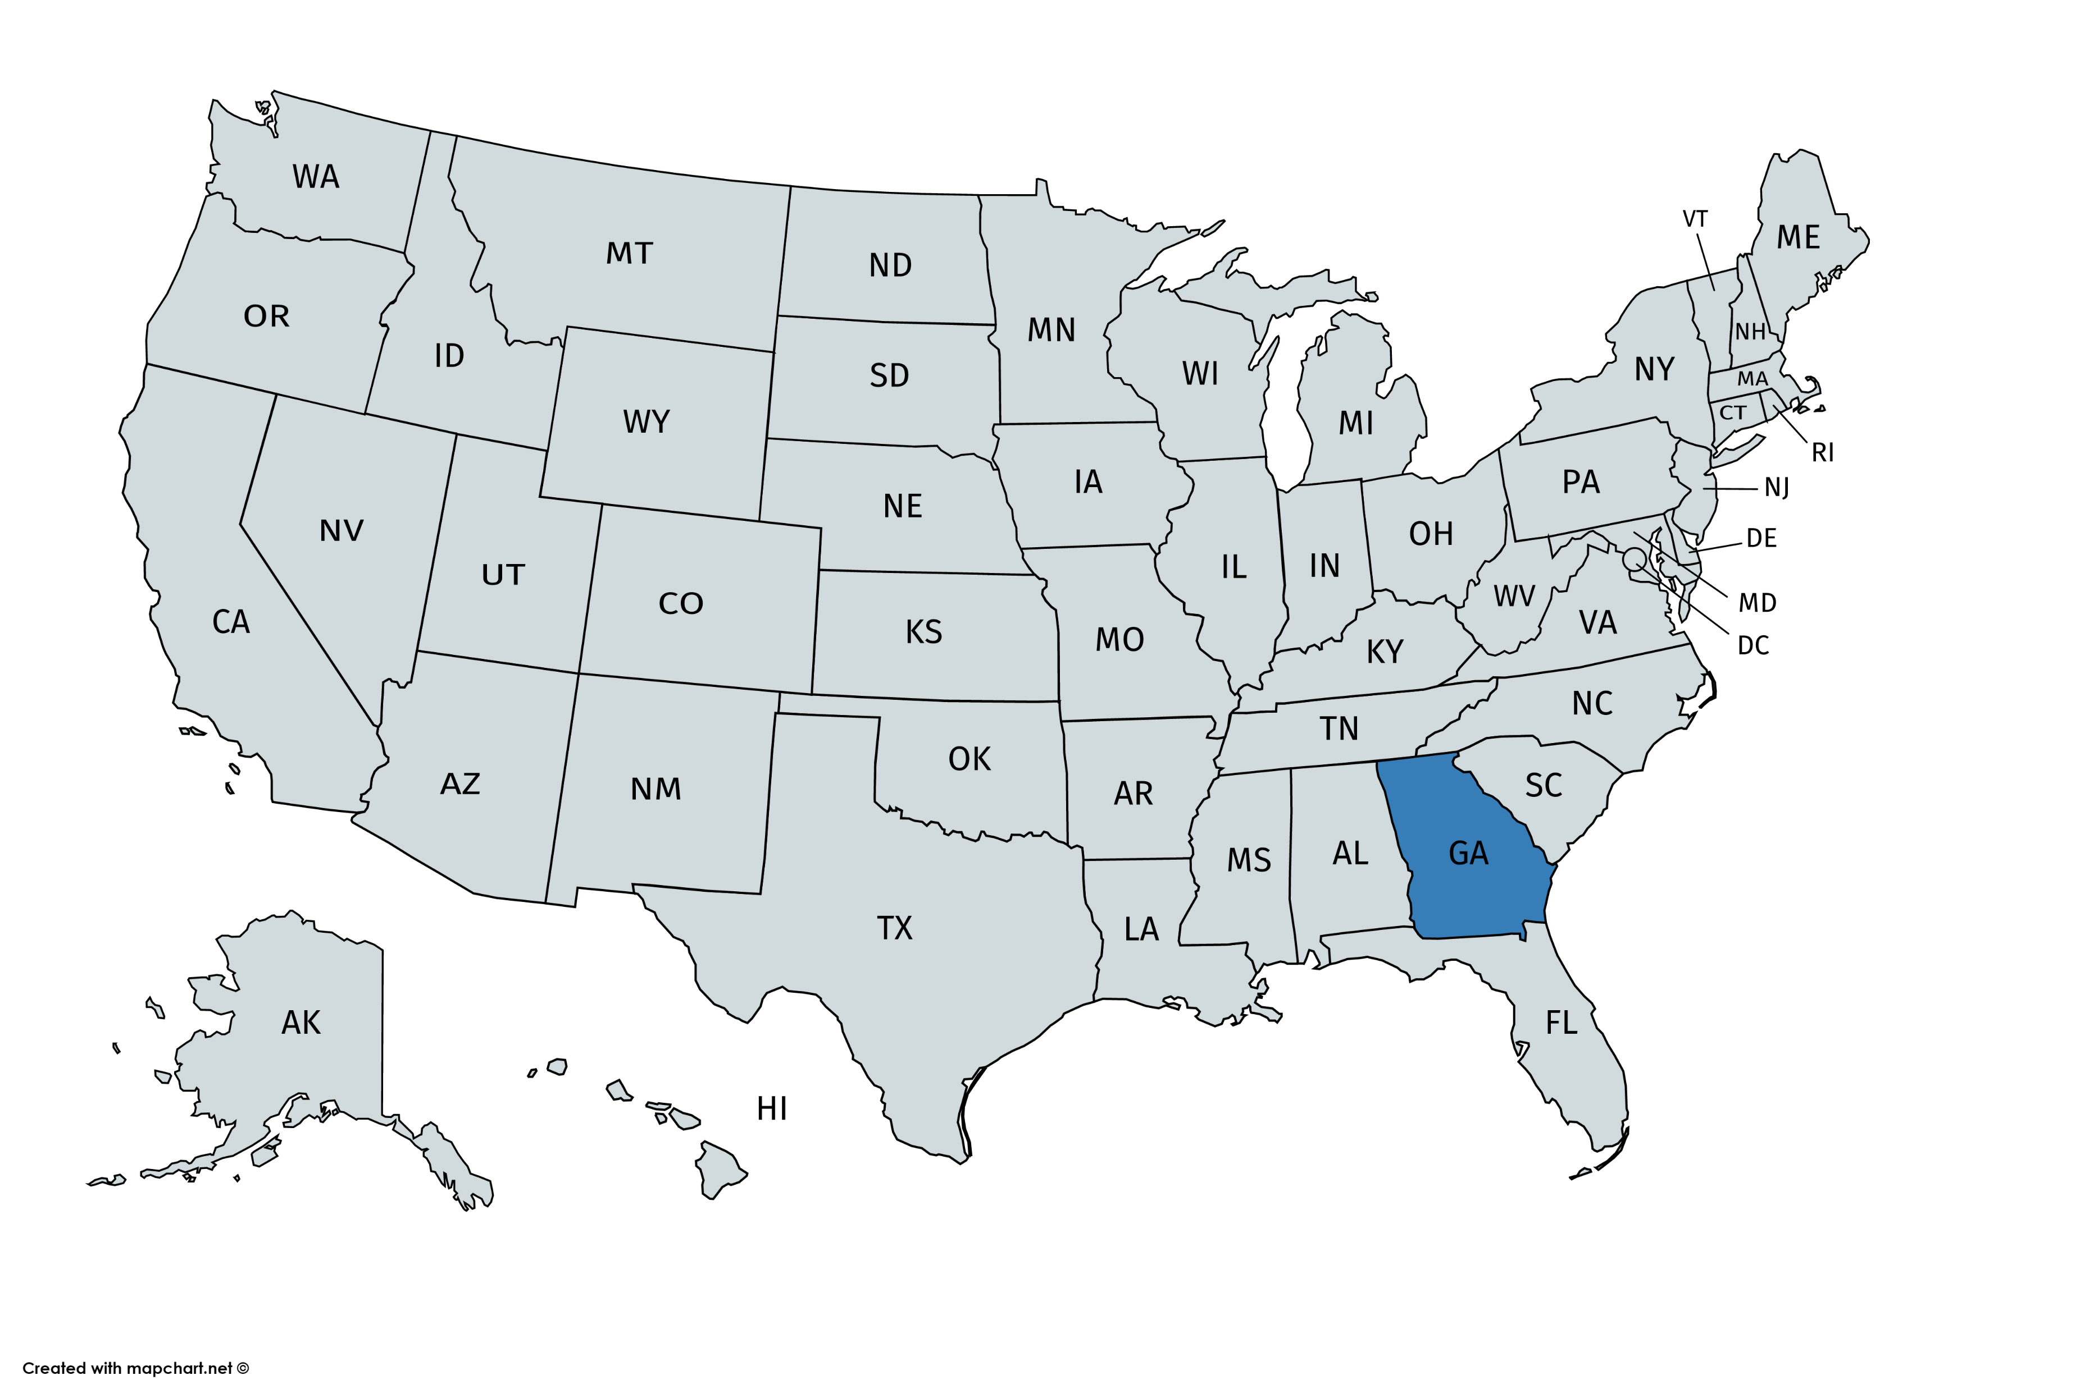
Values, Vision, Mission
As an international trading company, Intervision Foods specializes in bringing high quality frozen animal proteins to markets all over the world. A dedicated, multilingual team with a reputation for excellent customer service is here to assist you and meet your needs.
Core Values:
Teamwork, Responsibility, Integrity and Perseverance = Excellence
Vision:
To be a sustainable enterprise that delivers value and excellence to its customers, vendors and employees.
Mission:
Incorporate our core values of Teamwork, Responsibility, Integrity and Perseverance to cultivate and deliver value and Excellence to our customers, vendors and employees.

Slide 3
Chart
Origin | Packing | Size
USA/Brazil | 4 x 2.5 kg even net-weight polybags | 10 KG Carton
USA/Brazil | 6 x 2.0 kg even net-weight polybags | 10 KG Carton

Slide 4
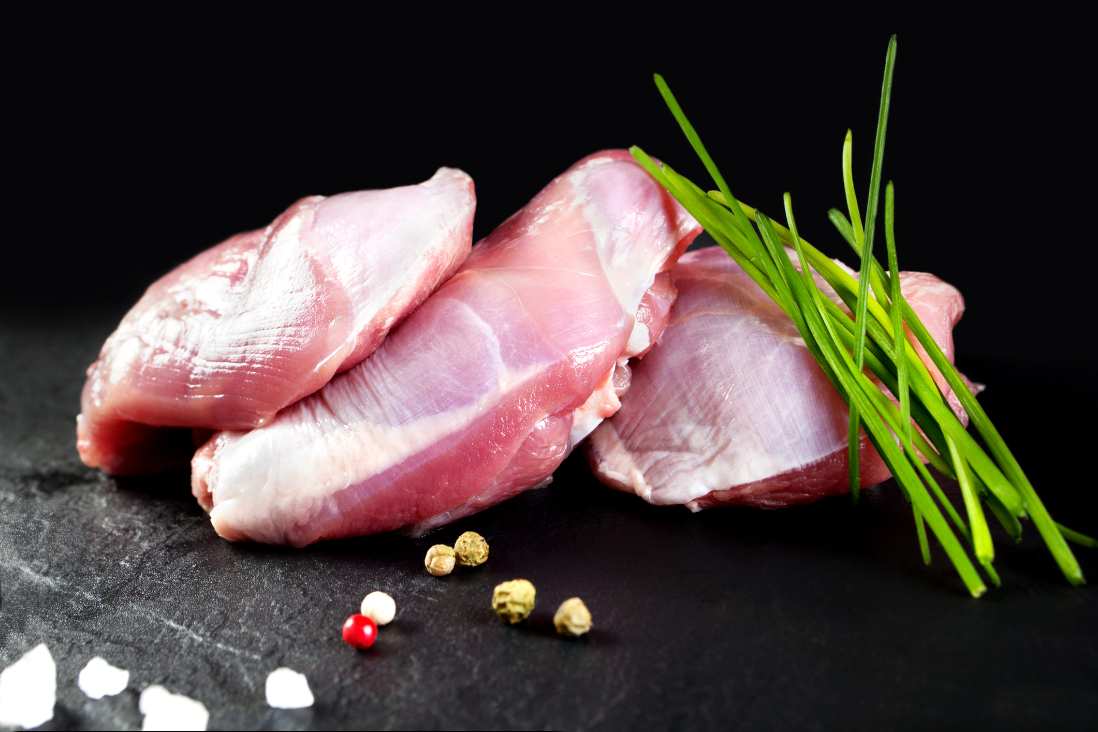
Boneless Skinless Thighs
The upper portion of the leg with the bone removed

Slide 5
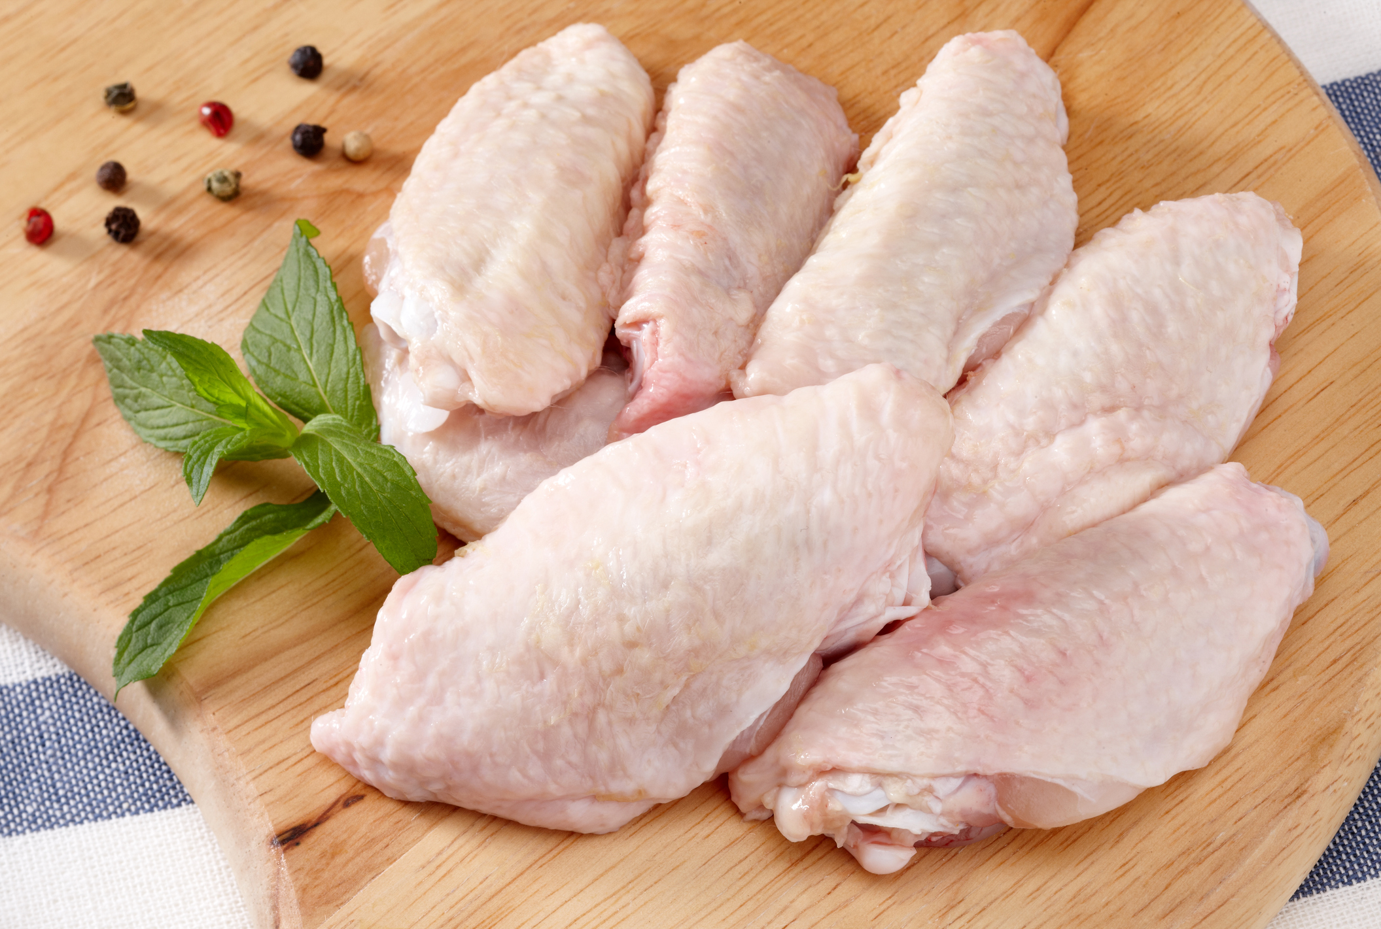
Mid Joint Wing
The middle or second joint of the chicken wing

Slide 6
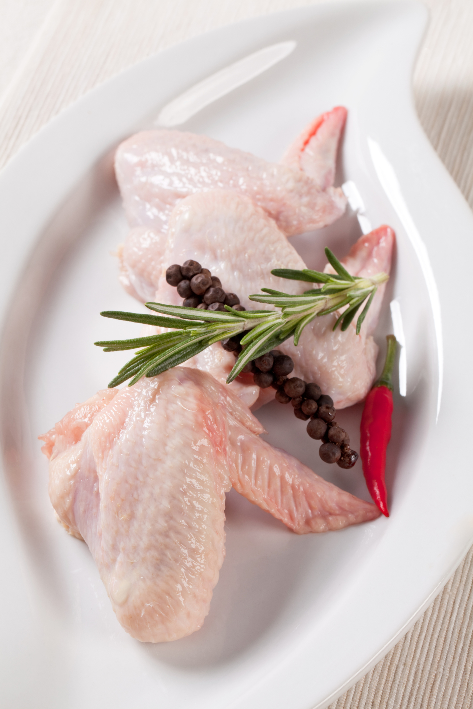
Two Joint Wing
The two joint wing consists of the mid joint wing plus the wingtip.

Slide 7
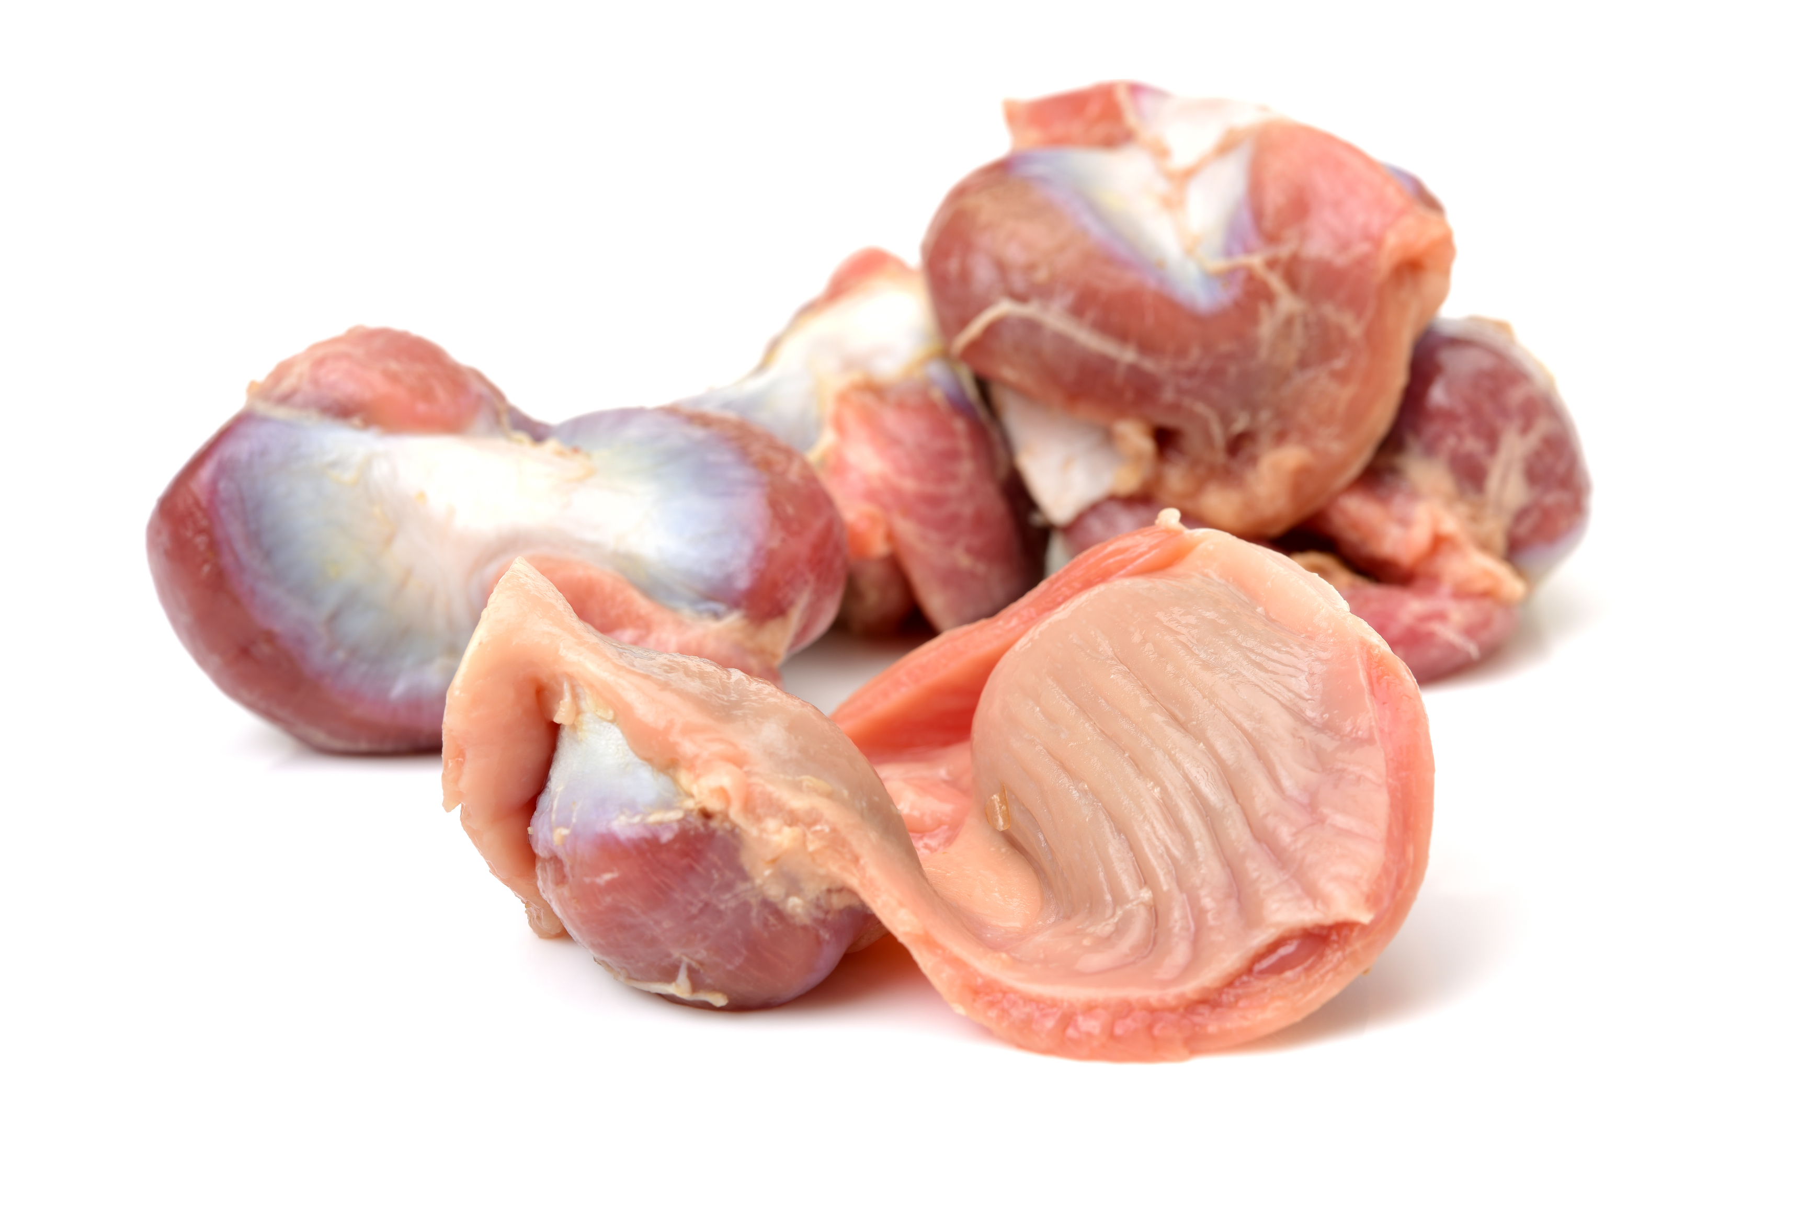
Gizzards
The Chicken Gizzard

Slide 8
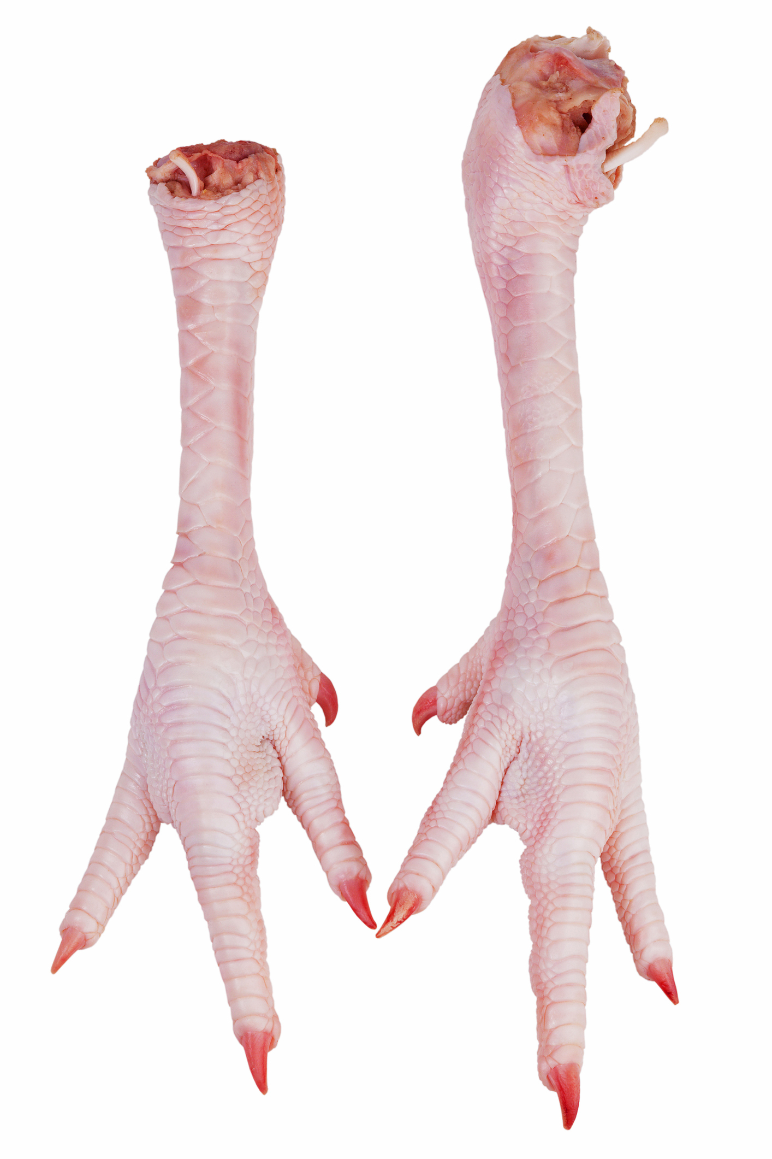
Paws
Chicken Paws are the cut which includes the feet, plus a short portion of the bone above the foot.

Slide 9
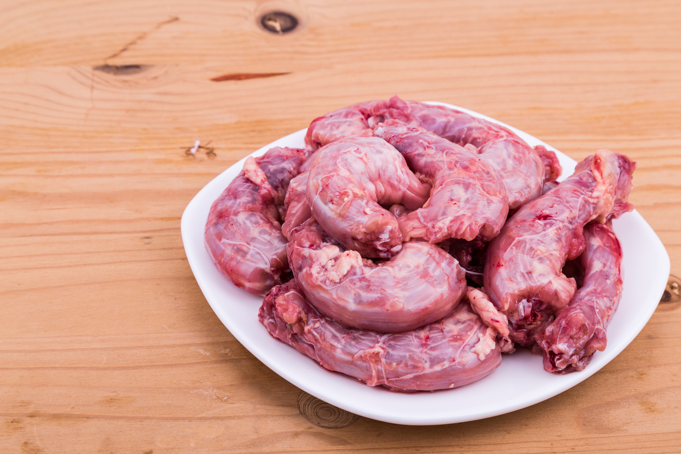
Necks
The chicken neck from below the head to the shoulder, with or without skin

Slide 10
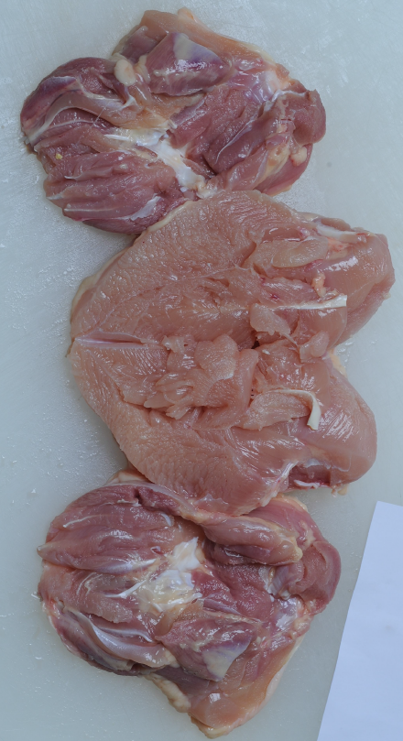
Shawarma
Chicken Shawarma is a frozen boneless whole chicken without wings.

Slide 11
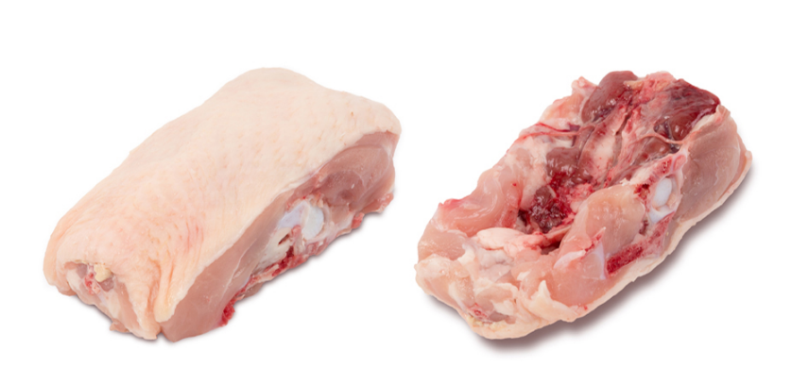
Lower Back
The lower portion of the chicken back

Slide 12
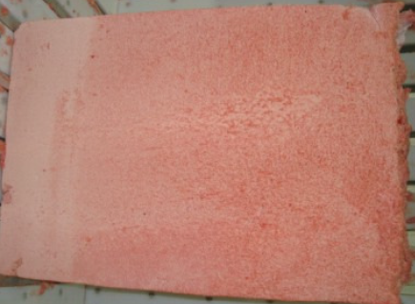
MDM
Mechanically Deboned Meat

Slide 13
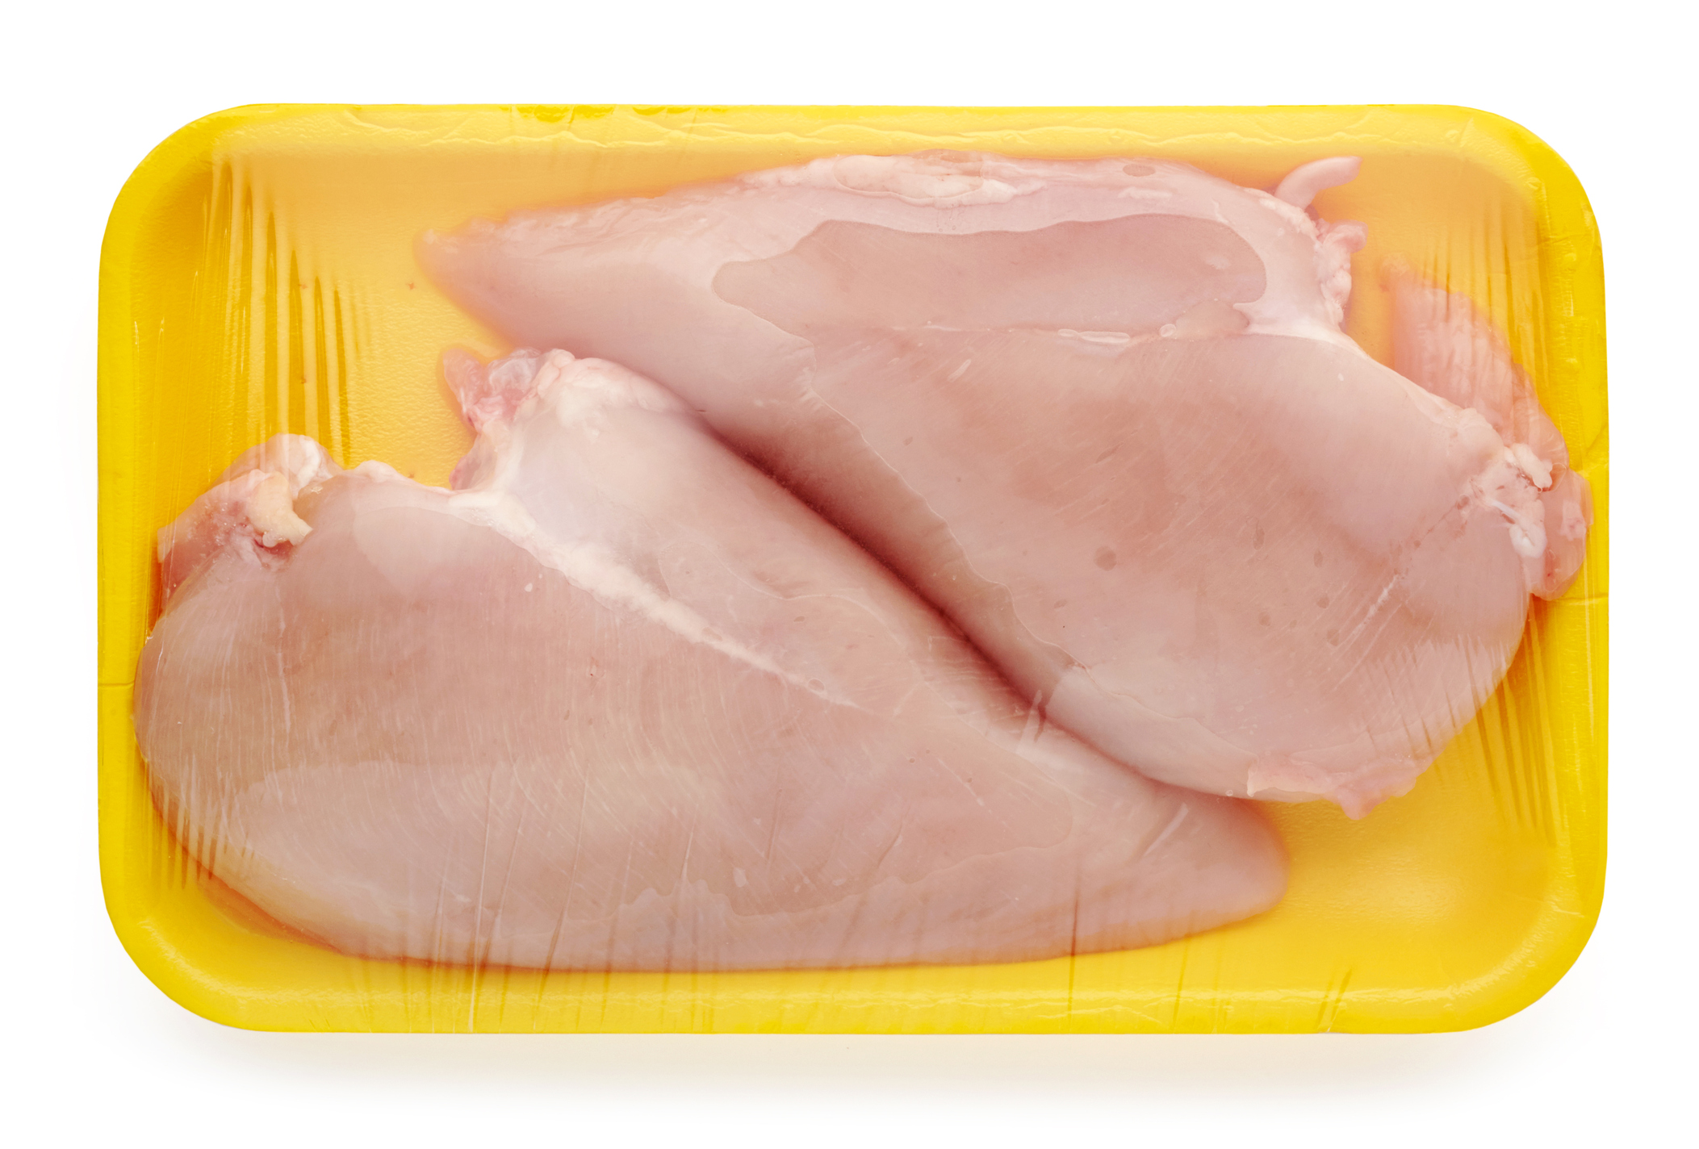
Traypack Boneless/Skinless Breasts Boneless, skinless chicken breasts in a tray package

Slide 14
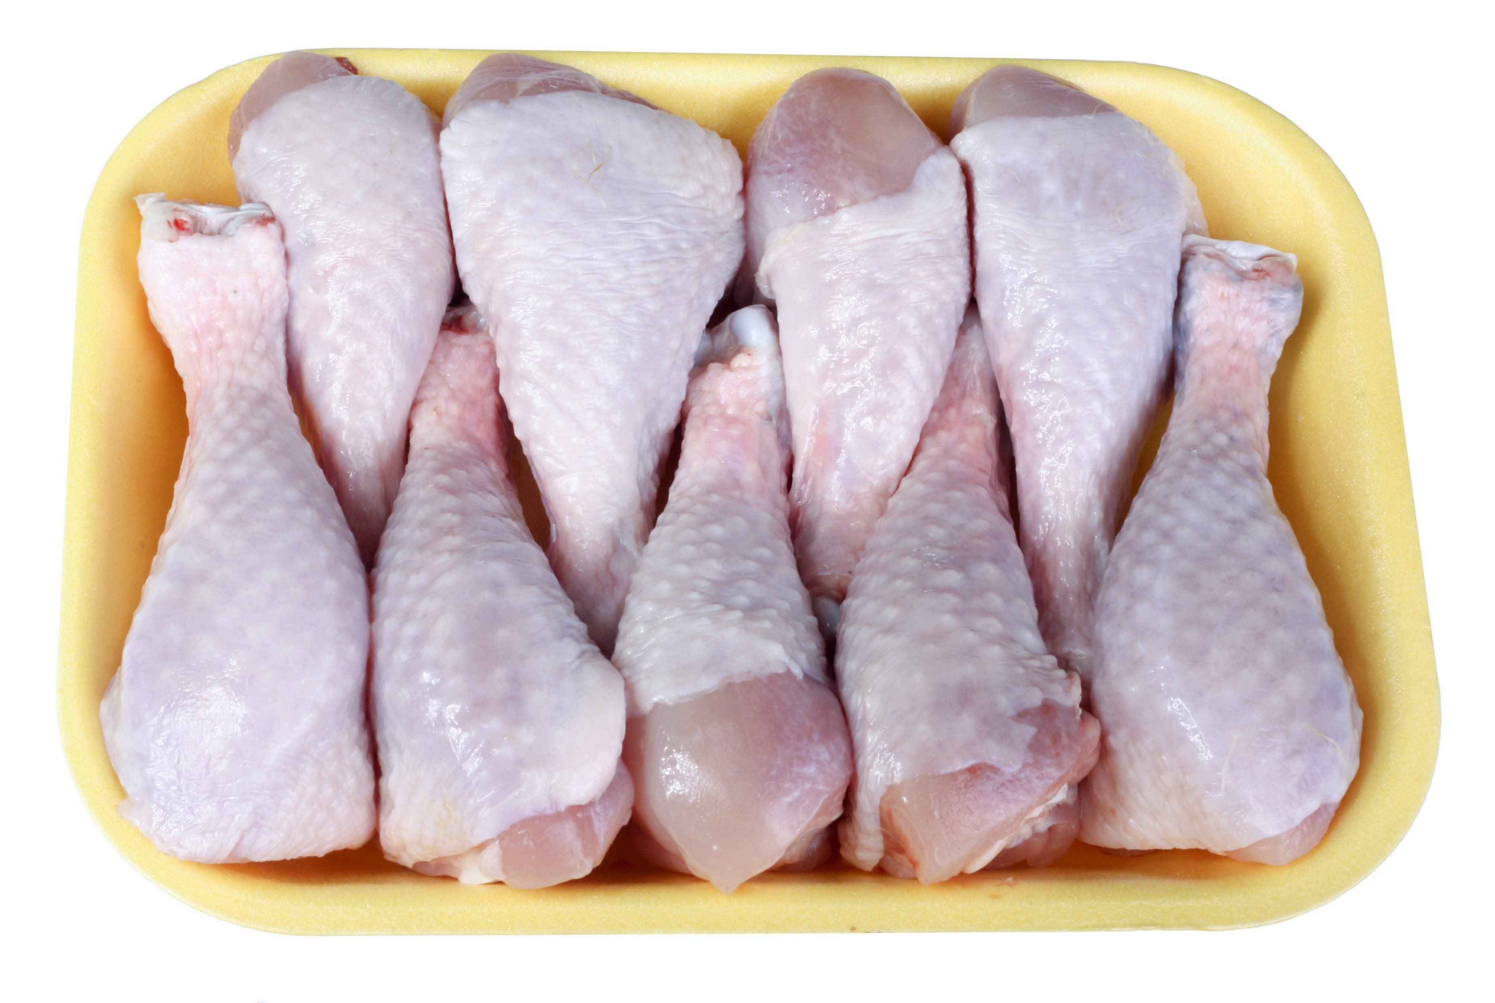
Traypack Drums Chicken Drumsticks in a tray package

Slide 15
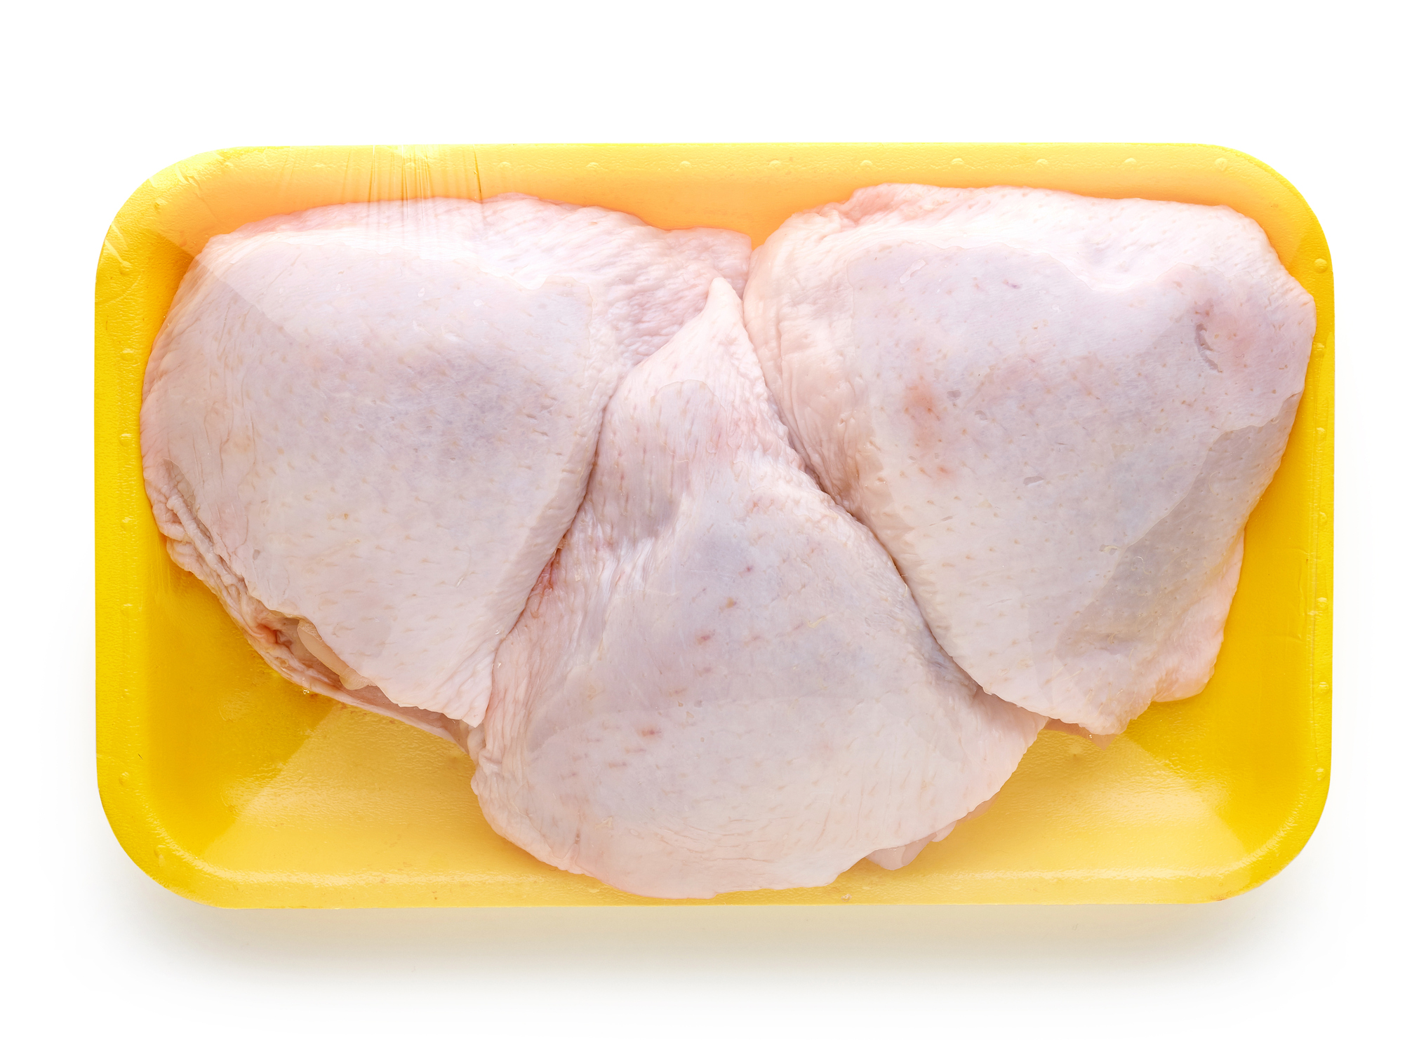
Traypack Thighs Chicken Thighs in a Tray Package

