Slide 1
Twilio
Hypertrack.io
Stripe
Drift
Layer
Buddy
Firebase
Zendesk

Slide 2
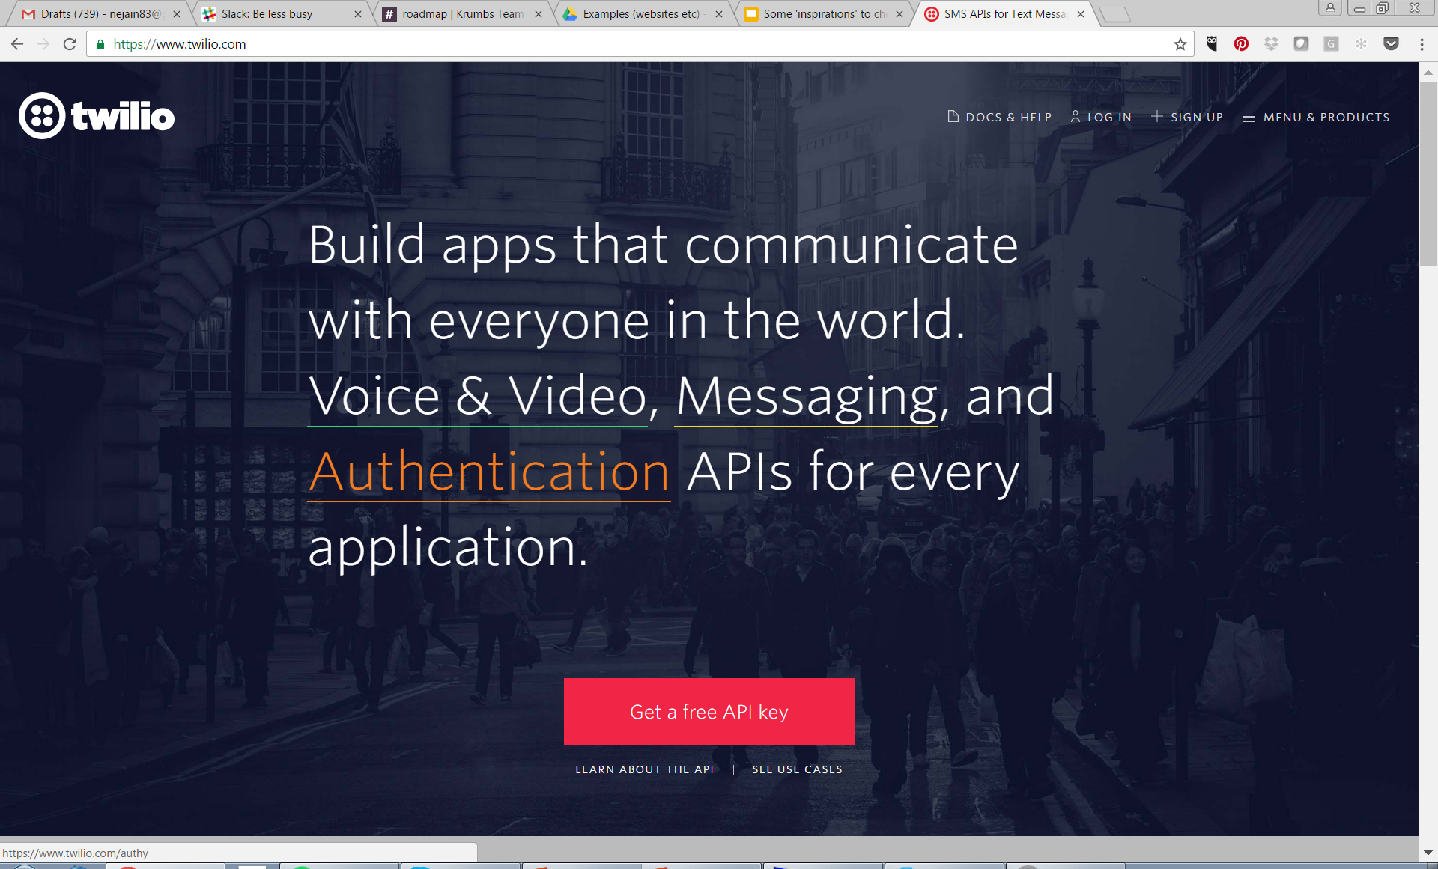
Twilio

Slide 3
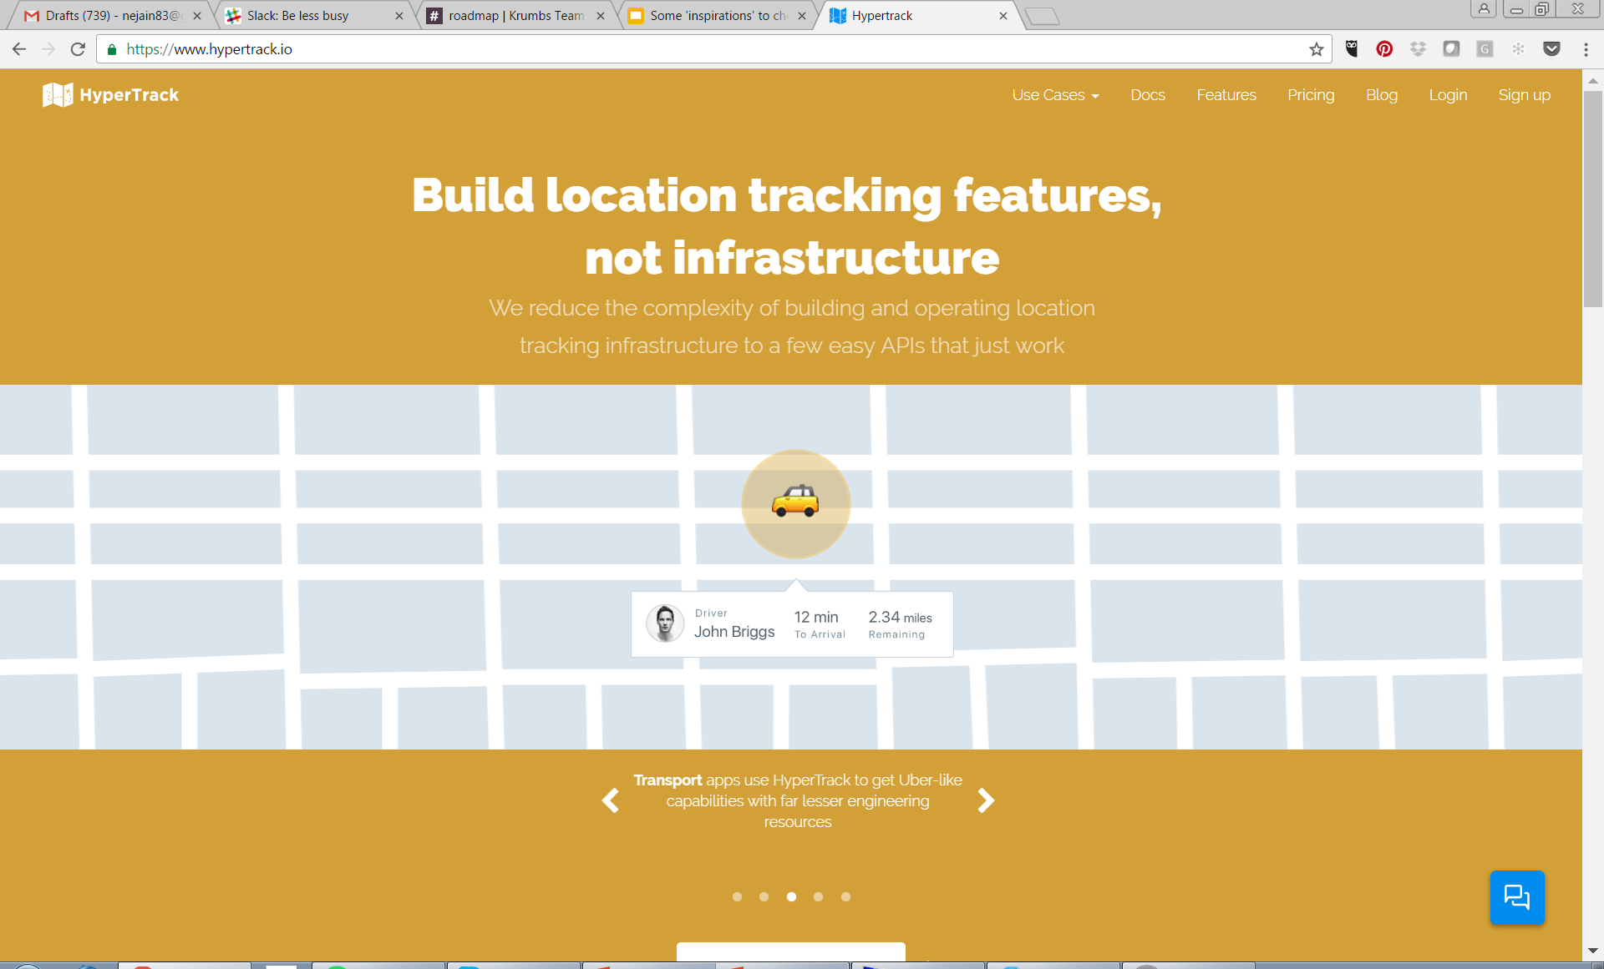
HyperTrack.io

Slide 4
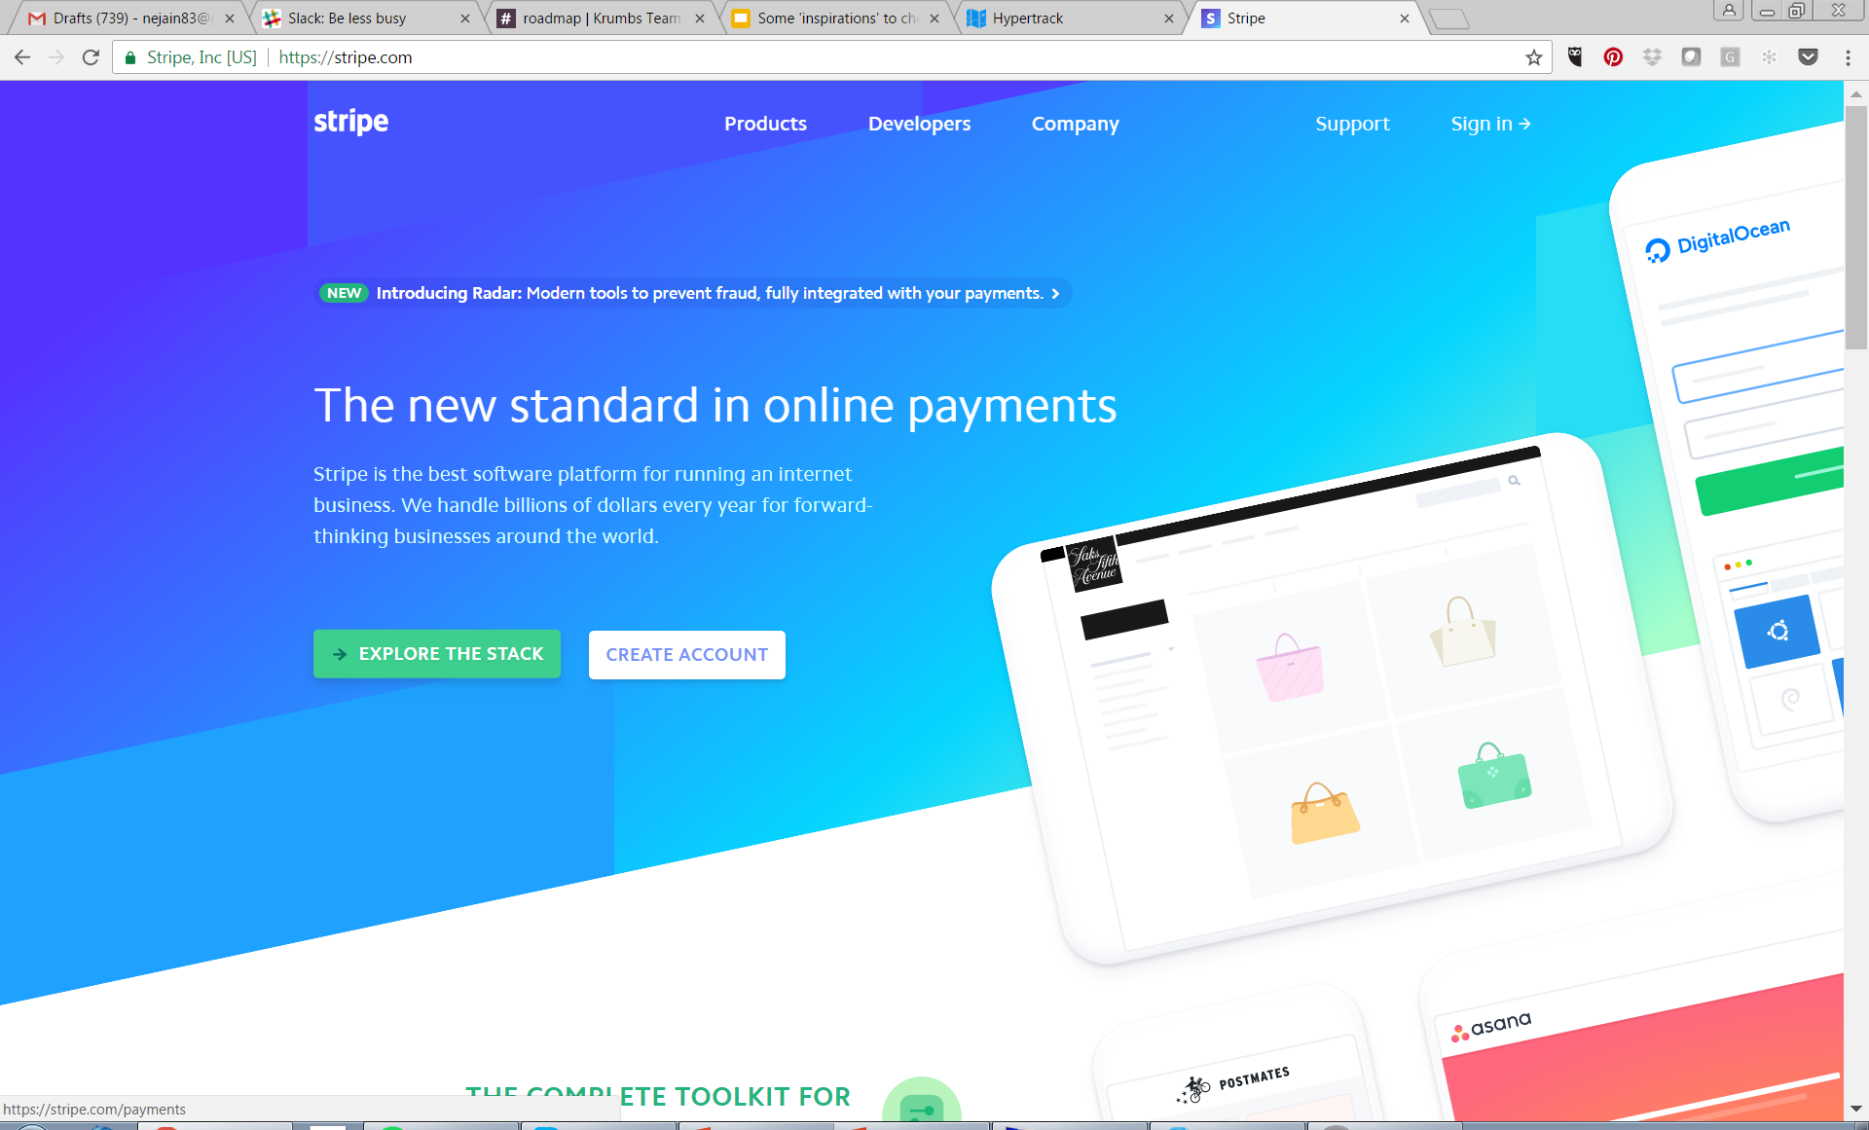
Stripe

Slide 5
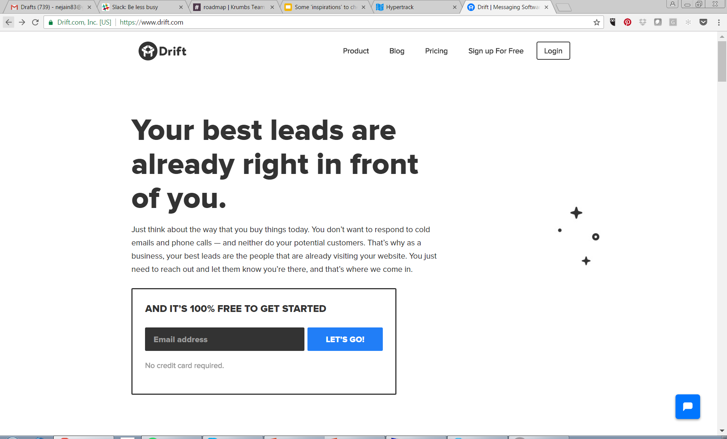
Drift

Slide 6
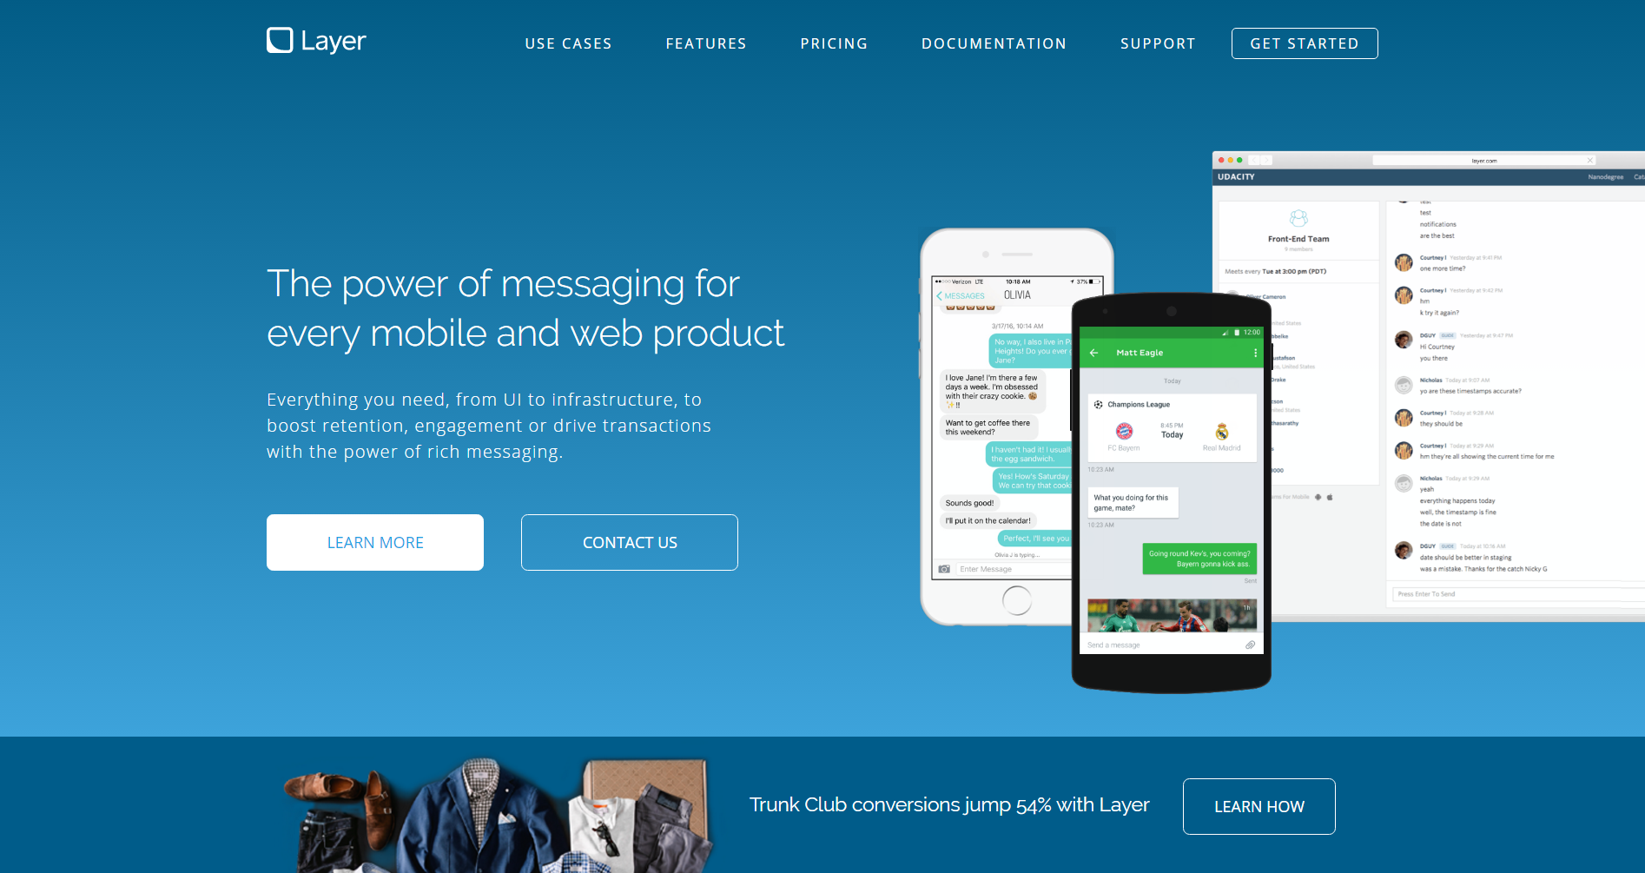
Layer

Slide 7

Buddy

Slide 8
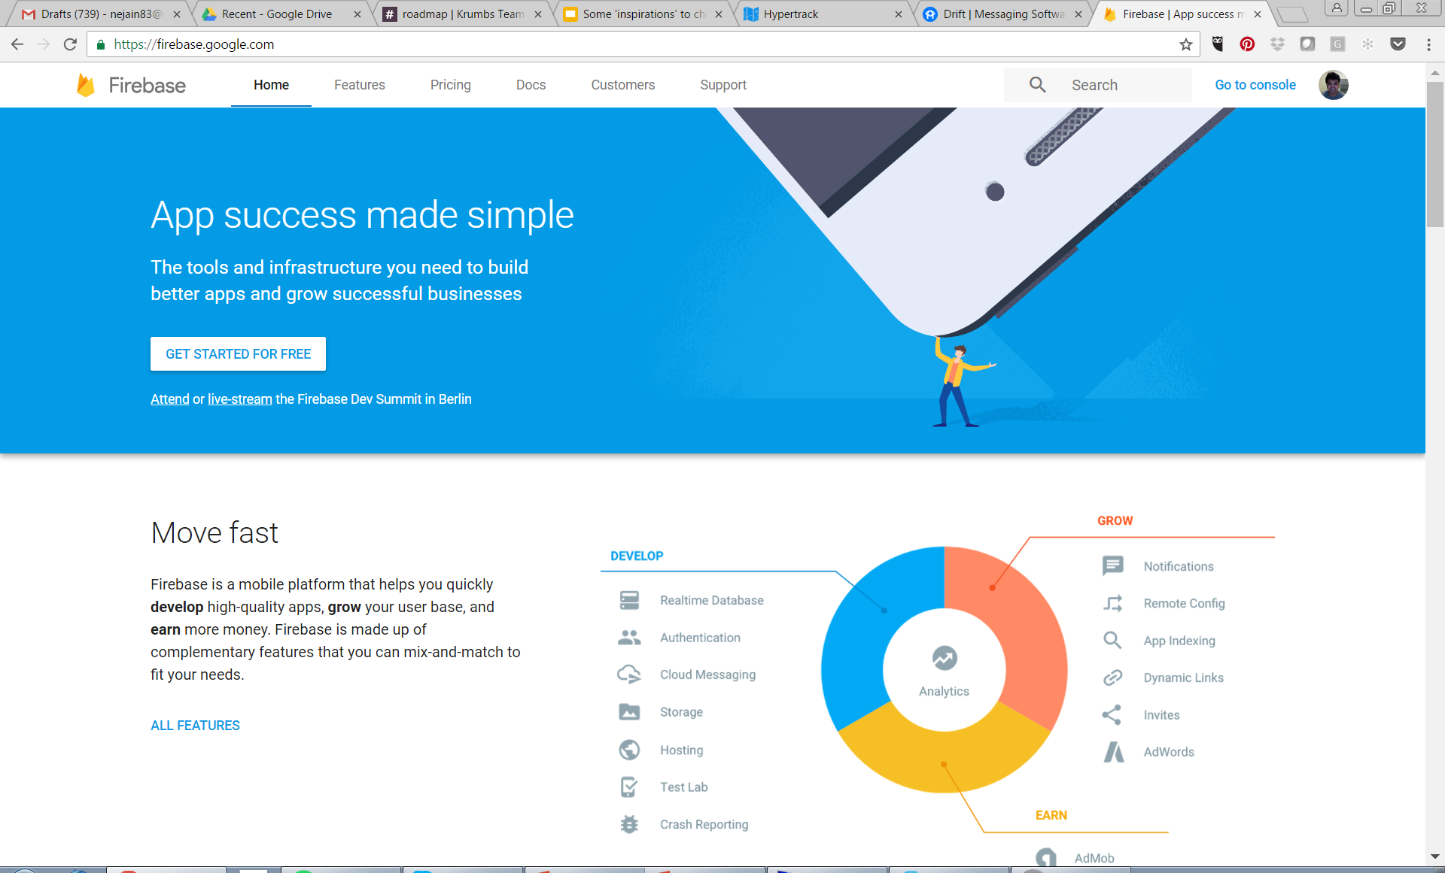
Firebase

Slide 9

Zendesk

