Slide 1
PlayBow Design Brief Elements

Slide 2
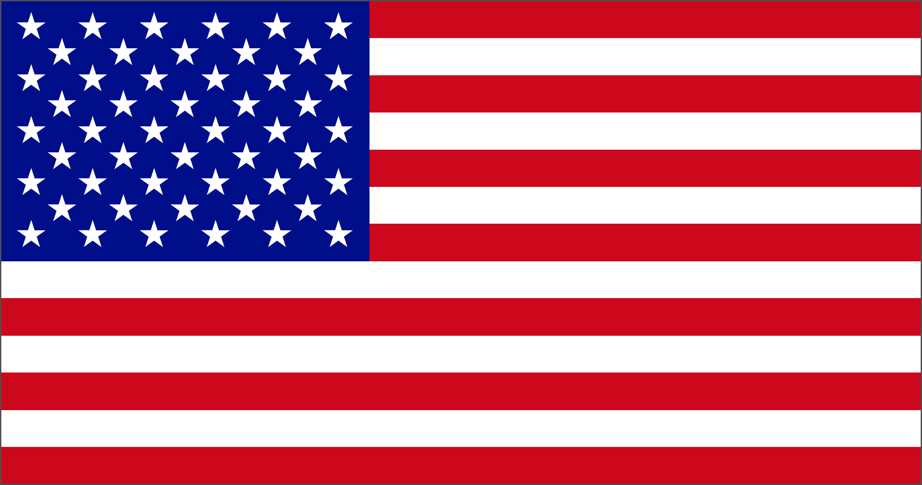
Functional Map of Oil Bottles (front panel height/width ratio of 9:5)
PlayBow logo
PlayBow logo
Pure
Salmon Oil
Omega-3
Fish Oil
Supports Healthy Coat & Skin
Supports Healthy Coat & Skin
All Natural Supplement
For Dogs + Cats
All Natural Supplement
For Dogs + Cats
Made with
100% Wild
Alaskan Salmon
Made with
Atlantic Sardines
& Anchovies
Made
In USA
Made
In USA
Net 32 FL OZ / 946 ML
Net 32 FL OZ / 946 ML

Slide 3
Functional Map of Chewable Supplements (height/width ratio 9:10)
PlayBow logo
PlayBow logo
HIP & JOINT
SKIN & COAT
Supports Healthy Joints with Glucosamine Chondroitin, & Willow Bark
Supports a Healthy Skin & Coat with B Vitamins Omega-3, & Biotin
Soft & Chewable Supplements
For Dogs
Soft & Chewable Supplements
For Dogs
Made
In USA
90
chews
-No Gluten
-No Grain
-No Soy
Made
In USA
90
chews
-No Gluten
-No Grain
-No Soy
Net Wt 16 OZ / 453 g
Net Wt 16 OZ / 453 g

Slide 4
Functional Map of Chewable Supplements (height/width ratio 9:10)
PlayBow logo
PlayBow logo
DIGESTION
IMMUNITY
Supports Healthy Digestion with Enzymes Pre-Biotics, & Pro-Biotics
Supports a Healthy Immune System with Vitamin B12 Vitamin C, & Zinc
Soft & Chewable Supplements
For Dogs
Soft & Chewable Supplements
For Dogs
Made
In USA
90
chews
-No Gluten
-No Grain
-No Soy
Made
In USA
90
chews
-No Gluten
-No Grain
-No Soy
Net Wt 16 OZ / 453 g
Net Wt 16 OZ / 453 g

Slide 5
Functional Map of Chewable Supplements (height/width ratio 9:10)
PlayBow logo
CANINE MULTI
A Blend of Vitamins, Minerals
& Antioxidants for Daily Health Support
Soft & Chewable Supplements
For Dogs
Made
In USA
90
chews
-No Gluten
-No Grain
-No Soy
Net Wt 16 OZ / 453 g

Slide 6





Logo and Other Existing Elements

