Slide 1
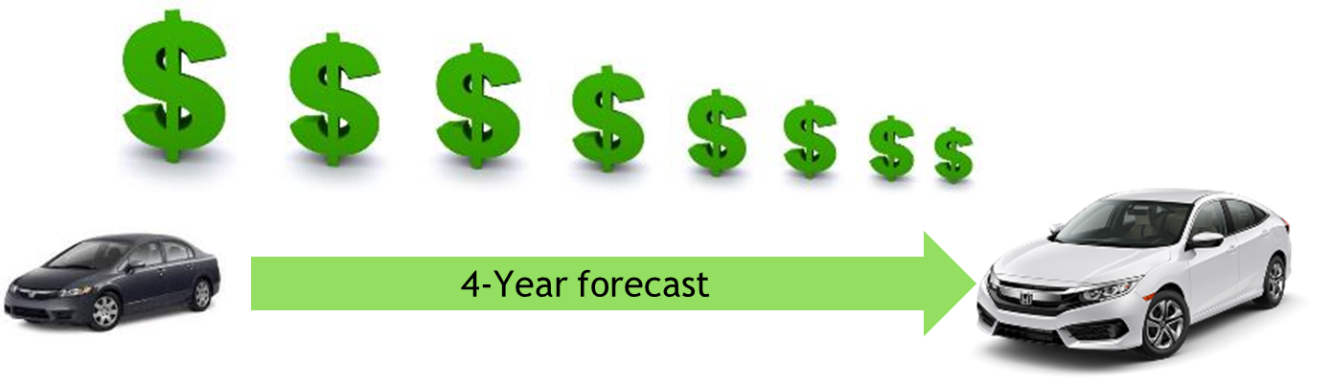
Re-building Automaker/Supplier Relations
An Innovative plan for cost reduction
By Jason Gallion, Cost Reduction Specialist
E: Jason.Gallion@EPICpwr.com
P: +1 (614) 286-5142
Columbus, Ohio
Notes:
Slide #1, Example #1
Re-building supplier relationship for Honda
Building the OEM & Supplier relationship
Notes:
the dollar $ signs should descend big to small from left to right
Ok, to keep your design work
Larger auto graphics are ok, keep arrow with “forecast”, remove “4-year”
Title implies…What we'll do for you and change text to “Re-building OEM/Supplier Relations “An innovative plan for cost reduction”
At least a 30 point font for all titles

Slide 2
Building the strength of the supplier group & Re-building supplier/OEM relationships
Creating opportunities for
immediate innovation
By Jason Gallion, Cost Reduction Specialist
E: Jason.Gallion@EPICpwr.com
P: +1 (614) 286-5142
Columbus, Ohio
Notes:
Slide #1, idea #1
Title “Creating opportunities for immediate innovation” “By, Developing cost reduction solutions across suppliers with related processes and forecast.”
“Building supplier / OEM relationship”
“Supply chain added value”
“Building the strength of the supplier group and rebuilding supplier / OEM relationships”
30 point font!

Slide 3
Increasing pressure to reduce costs has created a strain on supplier relations.
Often, suppliers are forced to operate with shrinking margins.
Notes:
Slide #2, Example #1
Problem opportunity
Notes:
Your design is very nice keep
Remove the JG logo
Change text to “Often, suppliers are forced to operate with shrinking margins.”

Slide 4
Re-build Automaker/Supplier relations
Build on supplier group strengths
Create collaborative efforts
Notes:
Slide #3, Example #1
Value process – explain the value of the pain you alleviate…
Solution… this often sounds like the company mission “…creating immediate innovation by…”
“Re-Building supplier relationships, supply chain added value, supplier group strength” Leveraging the strength of the supplier group”
Focused supplier group effort…
The goal is to utilize the strength of the supplier group, integrate innovation
Notes:
Replace map, see new map on next slide, ok to change color of map to match graphic
Change text and font

Slide 5
Notes:
Use this map with graphic on slide #4, ok to change color to match theme

Slide 6
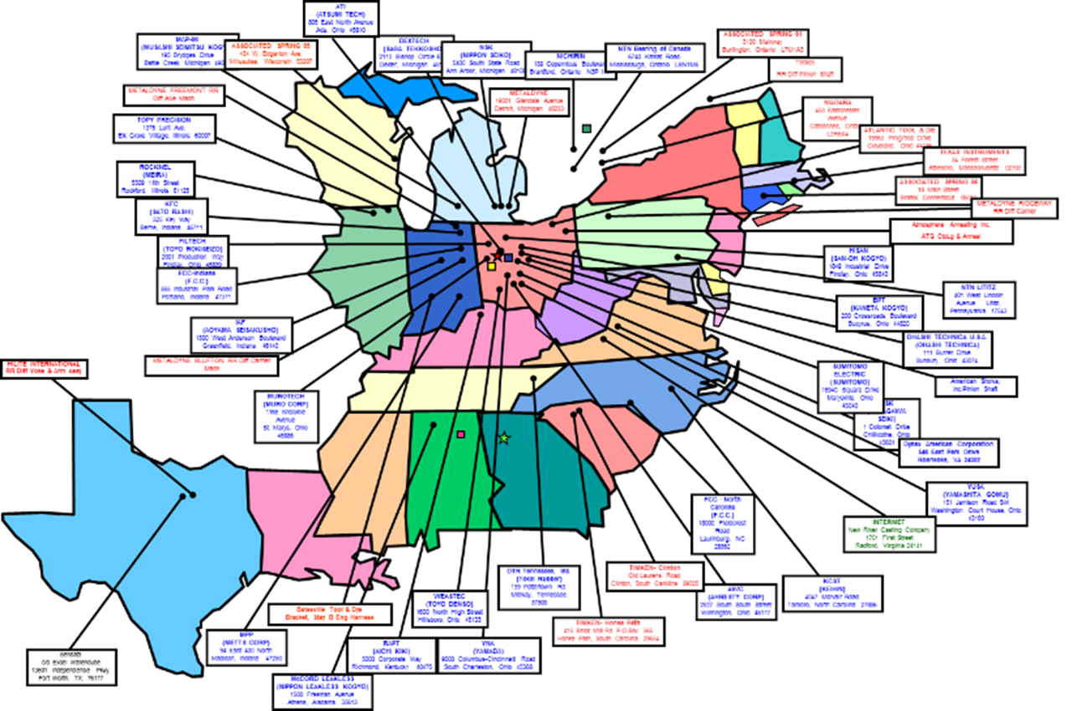
Creating opportunities for immediate innovation, by developing cost reduction solutions across suppliers with related processes.
$95M Target
Annual cost reduction
$22M Effort
Collaborative effort
$3B Supplier base
Total annual sales
47 Suppliers
Focused supplier group
Notes:
Slide #3, idea #1
Value process
The goal is to utilize the strength of the supplier group
“Creating opportunities for immediate innovation, by developing cost reduction solutions across suppliers with related processes”
Maybe purchase map “case study” graphic circle with map inside

Slide 7
Creating opportunities for immediate innovation, by developing cost reduction solutions across suppliers with related processes.
$95M Target
$95M Target
$22M Effort
$22M Effort
$3B Supplier base
$3B Supplier base
47 Suppliers
47 Suppliers
Notes:
Slide #3, idea #2
Value process
The goal is to utilize the strength of the supplier group
“Creating opportunities for immediate innovation, by developing cost reduction solutions across suppliers with related processes”
Maybe purchase map “case study” graphic circle with map inside

Slide 8
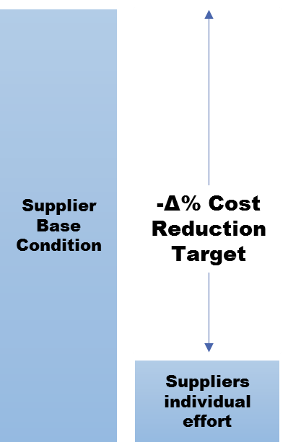
Individual supplier effort is not enough
$5.7M Actual impact on cost reduction
Missed target
$95M Target
Missed cost reduction targets, supplier accepts loss and is forced to operate with lower margins
Notes:
Slide #4, Example #1
The data further reveals a lack of consistency in the areas in which suppliers have achieved the cost improvement. For example, some suppliers have achieved a high degree of cost improvement in Assembly, while others have either achieved a small degree of cost improvement or none at all. There is no available data to understand this inconsistency.

Slide 9
Collaborative effort, or Supplier Survey
Supplier survey
Actual impact, gap
Cost of best practices
Notes:
Slide #4, Example #2

Slide 10
Collaborative Effort
Leveraging the power of a $3B supplier base
Establishing the maximum effort towards $95M target
Applying the maximum $23M group effort
Connect, collaborate, integrate innovation
Impact
Area of impact
Energy
Productivity
Survey data
Best practices
Innovation
Applied innovation
Raw Materials
Machine process
Assembly
Packaging
Tooling
Quality
Components
Innovation
Supplier X,Y,Z
Supplier A,B,G,F
Forecast
Events
$95M Target
Notes:
Slide#4, Example #3
Magic, secret sauce, leverage strength of supplier group, magic behind the product…
Creating opportunities for immediate innovation, by developing cost reduction solutions across suppliers with related processes.
Leveraging supplier strengths…
Or this is the Value proposition, supplier survey + best practices
Also!, the unique advisor group!!!
**Keep 7 or 8 or combine value & magic = production forecast + ROI +Survey + Events = Innovative impact!

Slide 11
Collaborative Effort
Leveraging the power of a $3B supplier base
Establishing the maximum effort towards $95M target
Applying the maximum $23M group effort
Connect, collaborate, integrate innovation
Impact
Area of impact
Energy
Productivity
Survey data
Best practices
Innovation
Applied innovation
Raw Materials
Machine process
Assembly
Packaging
Tooling
Quality
Components
Innovation
Supplier X,Y,Z
Supplier A,B,G,F
Forecast
Events
$95M Target
Notes:
Slide#4, Example #4
Magic, secret sauce, leverage strength of supplier group, magic behind the product…
Creating opportunities for immediate innovation, by developing cost reduction solutions across suppliers with related processes.
Leveraging supplier strengths…
Or this is the Value proposition, supplier survey + best practices
Also!, the unique advisor group!!!
**Keep 7 or 8 or combine value & magic = production forecast + ROI +Survey + Events = Innovative impact!
V graphic

Slide 12
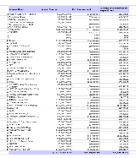








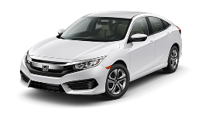

Creating opportunities for immediate innovation, by developing cost reduction solutions across suppliers with related processes.
Survey
Effort
Forecast data
Events & timing
ROI
Solutions
Survey
Best Practices
Forecast
ROI
Innovation
Events
Piece Price Reduction
4-Year forecast
Notes:
Slide #4, Idea #1
Magic, secret sauce, leverage strength of supplier group, magic behind the product…
Creating opportunities for immediate innovation, by developing cost reduction solutions across suppliers with related processes.
Leveraging supplier strengths…
Or this is the Value proposition, supplier survey + best practices
Also!, the unique advisor group!!!
**Keep 7 or 8 or combine value & magic = production forecast + ROI +Survey + Events = Innovative impact!
V graphic

Slide 13
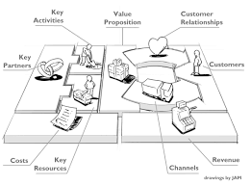
Business model
Supplier survey
Cost reduction
  Using our research methodologies, expert advisors and applied best practices we can provide:
    Identified opportunities
    ROI presentation
    Project planning
Notes:
Slide #5, Example #1
Business model, create graphic
Notes:
1. If you can make a graphic like this one let me know

Slide 14
Conceptual Model
Proposal
  1. Strategic, Supplier Survey
  2. Tactical, Potential or costs of efforts
  3. Execution, Integrating innovation
Forecast data
Automaker, OEM
Supply chain added value
New business development
Project planning
ROI presentation
Innovation
GAP Analysis
Notes:
Slide #6, Example #1
Go to market plan, list first customers, true believers the very first true believers!
**could use feedback from MEP CDME John, or PDM, or Honda R&D
Share conceptual model, how suppliers benefit from assured cost reduction…
Best practices, MEP resources…CDME collaborations… National Network for Manufacturing Innovation, Advanced Manufacturing National Program Office
Next steps… Build advisor group, build conceptual model, proposal for Honda & PDM
Maybe V graphic… I’ll provide a sketch of what I’m thinking…
1. Strategic...Supplier survey, what it is currently, and best practices 1A. Strong or weak effort vs available technology. agile assessments, level of difficulty to implement, some travel
2. Tactical...What it could be. Potential with existing technology, RX gen example Requires travel
3. Execution...Where it should be, applied technology, or technologies to develop over 1-4 years. Identify Difficulties to implement or develop Partnership with tech providers, materials development , create blue paper for write patt Air Force base Manage solutions, engineered proposals, cost reduction data, measure results **what EPIC will facilitate, DOWA did not have the engineering resources to provide cost solution, EPIC partnership with State to fund engineering, CDME built engineered solution EPIC coordinated manages installation or implementation
4. Assured cost reduction, not the solution but the big target goal

Slide 15
Business model
The products and services provided will support cost reduction objectives.
Which includes, a proven mathematical methodology for preparing ROI proposals.
Example:
  Using a variety of research methodologies, expert advisors and applied best practices we can provide support in the following areas:
    Identified opportunities
    ROI presentation
    Project planning
Forecast data
Project planning
ROI presentation
Innovation
GAP Analysis
Notes:
Slide #6, idea #1
Business model, create graphic
Advisors and conceptual data V-image Data & Best practices (Copy Right)

Slide 16

Go-To-Market
Total Addressable Market: [$XB industry]
Distribution Strategy: [Your unique advantage + channels you plan to test
Launch
[Dates]
Traction
[Dates]
Growth
[Dates]
Main Focus:
[Launch web & iOS app]
[X]
[X]
[Improve signup flow
Finalize user referral process
Accepted to App Store
Drive initial signups
Measure DAU totals]
Priority Tasks:
[X]
[X]
Target Results:
[X initial users
Convert X% of existing email list
Understand DAU & optimize]
[X]
[X]
5
Notes:
Slide #6, idea #1
Could be a good example of the proposal to Honda

Slide 17
Competition
[Low Thing]
[High Thing]
US
Logo
[High Thing]
Logo
Logo
[Low Thing]
Logo
Logo
We are stronger than the competition in [key differentiators].
We are threatened by the competition in [honest worries you have].
10
Notes:
Slide #7, Example #1

Slide 18
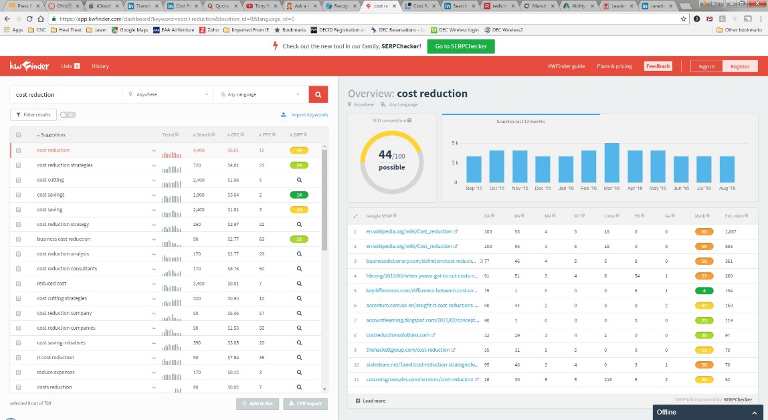
Competitive analysis
Our unique effort to build conceptual model…
Implementing opportunities for immediate innovation
costInnovative.com
OEM/Supplier relationship
Supply chain added value
Notes:
Slide #7, idea #1
Competitive analysis… Or, relationship with existing or different approach
what’s different between MEP and EPIC, cost reduction effort!
The need for immediate innovation
Or, Standard cost reduction efforts… limited
Maybe, expand on the need and use of the advisor group, sell to advisor group, why this is unique effort and opportunity to build conceptual model

Slide 19
Advisor group
The advisor group is made of industry experts as well as technical professionals
Participating members include… contact information
Talent(s)
Notes:
Slide #8, Example #1,
Advisor group and management
What unique skills are available…

Slide 20
Team
Headshot
Headshot
Name, Current Title
Name, Current Title
Past Company Logo
Title or Relevant Function
Impressive Achievement
Past Company Logo
Title or Relevant Function
Impressive Achievement
Past Company Logo
Title or Relevant Function
Impressive Achievement
Past Company Logo
Title or Relevant Function
Impressive Achievement
9
Notes:
Slide #8, Idea #1

Slide 21
Current status, fish bone
EPIC
OEM
Added value
Business Development
Honda NAP
Honda R&D
PDM Health
New Technology
Innovative cost reduction model
Build model
Build advisor group
Notes:
Slide #9, Example #1
Current status and milestones, meetings with Honda R&D and PDM Health
Conceptual model
Fishbone diagram
Milestones
Maybe use of funds, next meeting or presentation, $$ funds to build conceptual model

Slide 22
Current Status,Fishbone
PDM Health
Supply chain added value
Honda
Contacts
Relationships
Meeting
Cost reduction model
Model details
Survey details
Preeta
Research assistant
SP Global
ARMS
New market development
Notes:
Slide #9 Example #2
*License software model to supply chain management

Slide 23
Data analytics, creating opportunities…
Survey
Effort
Forecast data
Events & timing
ROI
Solutions
Creating opportunities for immediate innovation, by developing cost reduction solutions across suppliers with related processes.
Piece Price Reduction
4-Year forecast
Notes:
Slide #10, Idea #1
Maybe include an overall graphic or image that defines purpose and objective

Slide 24
Creating opportunities for immediate innovation, by developing cost reduction solutions across suppliers with related processes.
Forecast data
GAP Analysis
ROI
Immediate Innovation
$3B Supplier base
$95M Required cost reduction
$22M Collaborative effort
Common process
Best Practices
4-Year forecast
$Cost reduction
Notes:
Slide #10, Idea #2
Value process – explain the value of the pain you alleviate…
The goal is to utilize the strength of the supplier group
“Re-Building supplier relationships, supply chain added value, supplier group strength” Leveraging the strength of the supplier group”
“Creating opportunities for immediate innovation, by developing cost reduction solutions across suppliers with related processes”
Maybe purchase map “case study” graphic circle with map inside

Slide 25
Join Us!
Our Purpose is to fund innovation through mutual benefits.
Our Objective is the alignment of cost reduction Technology and cost improvement requirements.
Our Mission is to provide new market opportunities.
Jason Gallion
P: +1 (614) 286-5142
E: Jason.Gallion@EPICpwr.com
565 Metro PL
Dublin, OH 43017
Notes:
Slide#10, Example #1
Building the advisor group…
What this effort is about and the opportunity it presents

Slide 26
Appendix
List of detailed info
Automaker proposal example (details)
FAQ (get advisors input)and rev1 venture capital
Challenges
Why now?
18 month plan
Notes:
Slide #11, just text…
Provide appendix details during second meeting

