Slide 1
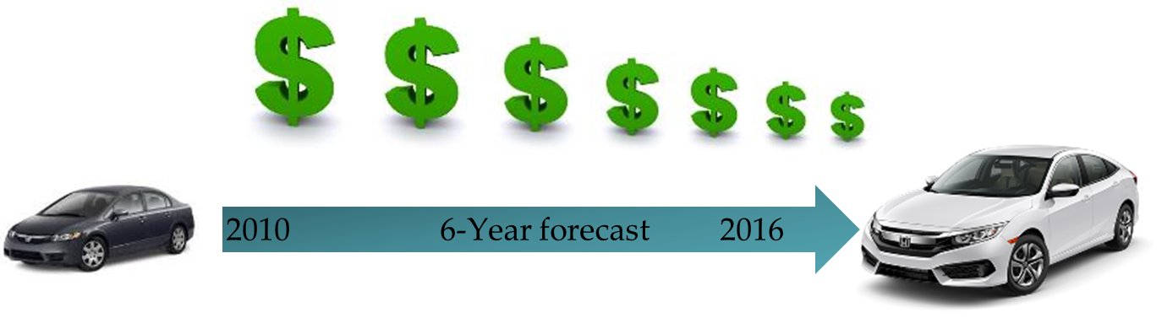
Creating opportunities for immediate innovation,
by developing cost reduction solutions across suppliers with related processes.
By Jason Gallion, Cost Reduction Specialist
December 2nd, 2016
Notes:
The tag line is for Honda as well as SP Global “What does it mean?” “Going beyond traditional cost reduction methods” tag line for Honda
For SP Global… “Innovating Manufacturing” or “ Integrating Innovation…”

Slide 2
Increasing pressure to reduce costs has created a strain on supplier relations.
Suppliers are left alone with very little or no support from the OEM

Slide 3
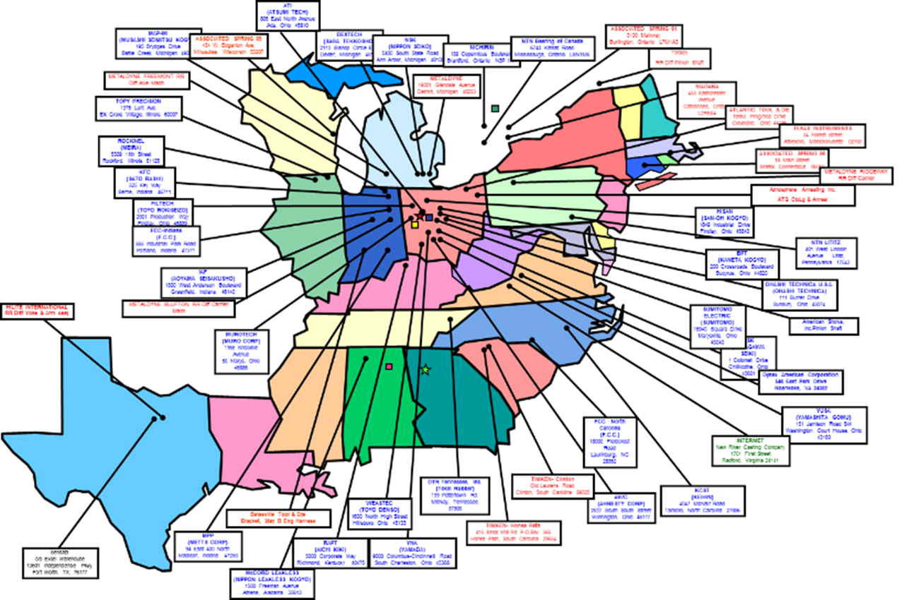
Case Study…
47 Automotive suppliers, NAFTA
$3Billion dollar supplier base
$95Milllion dollar required annual cost reduction
A supplier survey was created to identify actual cost reduction impact. The survey identified gaps between the cost reduction target and individual suppliers actual effort. A set of questions was created to help identify areas of impact, ability to implement cost reduction, and the capability to measure results.
Notes:
The group of suppliers of automobile parts have been given a mandate to reduce the prices of their products by 3% in order to maintain their preferred supplier status. They have implanted the price reduction; however, they have not yet reduced their costs for this price drop to be financially viable and their companies to continue to be profitable. The overall reduction in costs that the entire supplier community needs to achieve is a little over $95 Million. The cost reduction effort so far has been less than 10% of that amount. There is an urgent need to achieve the cost improvement of $95 Million in the immediate future.

Slide 4
Supplier survey, gap analysis
Reported areas of impact towards annual cost reduction requirements
Categories:
-Raw material
-Machine process
-Assembly
-Components
-Packaging
-Tooling
-Quality
Impact:
-Energy
-Productivity
Add legend with color red to green best to poor
Notes:
We will also need to examine the measures taken by those who have been successful in achieving a significant or high degree of cost improvement in the different areas. This data can then be used to understand where the other suppliers with poor cost improvement in each area need to direct efforts and plan a strategy around the information thus gained.

Slide 5

Supplier survey, data
Areas of impact
Aptitude
Measure
Capital
Technical
Resources
Event
Energy
Productivity
Red = poor effort
Green = best effort
Minimal effort…What is missing?
What separates good vs poor effort?
Technical know how?
Resources, manpower?
An event, the right timing?
Notes:
We will also need to examine the measures taken by those who have been successful in achieving a significant or high degree of cost improvement in the different areas. This data can then be used to understand where the other suppliers with poor cost improvement in each area need to direct efforts and plan a strategy around the information thus gained.

Slide 6
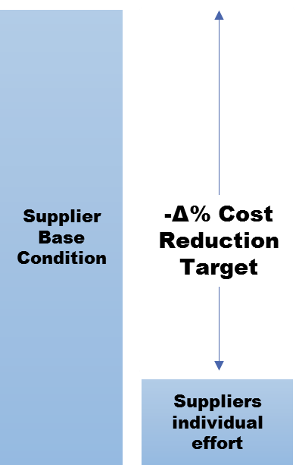
Individual supplier effort is not enough
$5.7M Actual impact on cost reduction
$96M Required cost reduction
Missed cost reduction targets, supplier accepts loss and is forced to operate with lower margins
Notes:
The data further reveals a lack of consistency in the areas in which suppliers have achieved the cost improvement. For example, some suppliers have achieved a high degree of cost improvement in Assembly, while others have either achieved a small degree of cost improvement or none at all. There is no available data to understand this inconsistency.

Slide 7
Innovative Supplier Cost Reduction
The goal is an alignment of innovative cost reduction technology and cost improvement requirements across the supplier group
Forecast data
GAP Analysis
ROI Requirements
Immediate Innovation
Common process
Best Practices
$Cost reduction
Notes:
The solution…Innovations in technology are available to the suppliers to achieve cost improvements.

Slide 8
Collaborative effort
Leveraging the power of a $3B supplier base
Identifying a healthy effort towards $95M cost reduction targets
Using the maximum group effort of $23M to influence cost reduction innovation
Impact
Production Forecast
ROI Development
Supplier Group Survey
New Model Events

Slide 9
Strength
Target
$96M
Max Effort
$23M
$3B supplier base
Managing cost is more than mere price reduction. It is a longer term strategy and requires a more collaborative effort towards cost reduction.
Notes:
Clean up or remove

Slide 10
Supplier collaborative effort
Sustainable Cost & Competitive Advantage
Co-operation
Collaborative
Immediate innovation
Assured cost reductions
Collaborative cost reduction
Notes:
Our commitment to Honda is to develop assured cost reduction, immediate innovation
The next step beyond the most advanced supplier relationships

Slide 11


Going beyond even the most advanced supplier collaboration and innovative models and inviting strategic innovation opportunities
Forecast data
ROI Presentation
Identified opportunities
Project Planning
Innovative Technology
Opportunities
Solutions
Integrating technology providers into the cost improvement strategy

Slide 12
Collaborating at an even greater level to achieve momentous cost reduction goals.
R&D
Industry
Forecast data
Identified opportunities
ROI Presentation
Project Planning
Innovative Technology
Supplier Group
Opportunities
Solutions
Universities
Technical
Advisors
Solution Categories:
Raw Materials
Material processing
Machining
Assembly
Packaging / Transportation
Tooling & Capital
Inspection & Testing

Slide 13
Best practices, collaborative effort
Incorporating best practices and shared success, supplier groups can achieve momentous cost reduction
Raw Materials
Material processing
Tooling & Capital
Machining
Assembly
Packaging / Transportation
Inspection & Testing

Slide 14
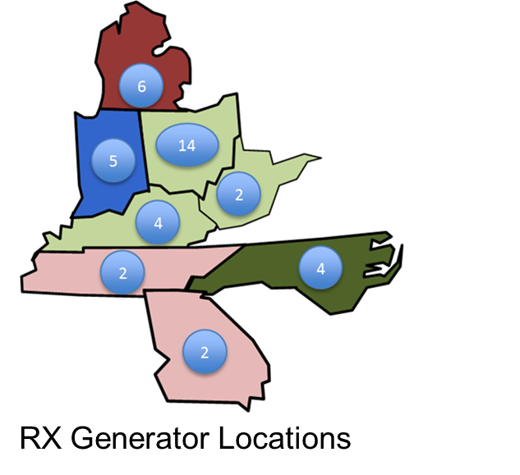
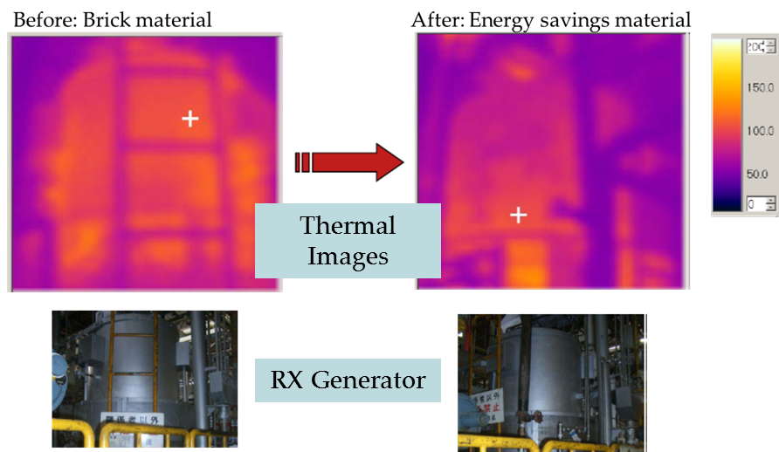
Project example, new material
Heater Element and Insulation Material Retrofit Kit Development
Existing material
Energy savings material
40 Installations, one engineered solution
22% Energy reduction per install
$1.8M Savings impact on supplier group
Brick insulation
Ceramic fiber insulation

Slide 15
One example, and many others
Leveraging best practices

Slide 16
Project planning, forecast data, ROI, GAP analysis
The products and services provided will support cost reduction objectives.
Which includes, a proven mathematical methodology for preparing ROI proposals.
Example:
  Using a variety of research methodologies, and applied best practices we can provide support in the following areas:
    Identified opportunities
    ROI presentation
    Project planning
Forecast data
Project planning
Innovation
ROI presentation
GAP Analysis

Slide 17
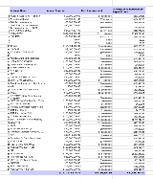










Data analytics
Survey
Effort
Forecast data
Events & timing
ROI
Solutions
Piece Price Reduction
2010 6-Year forecast 2016

Slide 18
Next step
Build advisor group
Proposal for Honda
Jason’s relationship with Honda NAP
Meeting with Honda R&D purchasing

Slide 19
Join us!
Our Purpose is to fund innovation through mutual benefits.
Our Objective is the alignment of cost reduction Technology and cost improvement requirements.
Our Mission is to provide new market opportunities.
Contact Information
Jason Gallion
P: +1 (614) 286-5142
E: Jason.Gallion@EPICpwr.com
565 Metro PL
Dublin, OH 43017

