Slide 1

Building Automaker/Supplier Relations
An Innovative plan for cost reduction
By Jason Gallion, Cost Reduction Specialist
E: Jason.Gallion@EPICpwr.com
P: +1 (614) 286-5142
Columbus, Ohio
Notes:
Slide #1, Example #1
Re-building supplier relationship for Honda
Building the OEM & Supplier relationship
Notes:
the dollar $ signs should descend big to small from left to right
Ok, to keep your design work
Larger auto graphics are ok, keep arrow with “forecast”, remove “4-year”
Title implies…What we'll do for you and change text to “Re-building OEM/Supplier Relations “An innovative plan for cost reduction”
At least a 30 point font for all titles

Slide 2
Increasing pressure to reduce costs has created a strain on supplier relations.
Often, suppliers are forced to operate with shrinking margins.
Notes:
Slide #2, Example #1
Problem opportunity
Notes:
Your design is very nice keep
Remove the JG logo
Change text to “Often, suppliers are forced to operate with shrinking margins.”

Slide 3
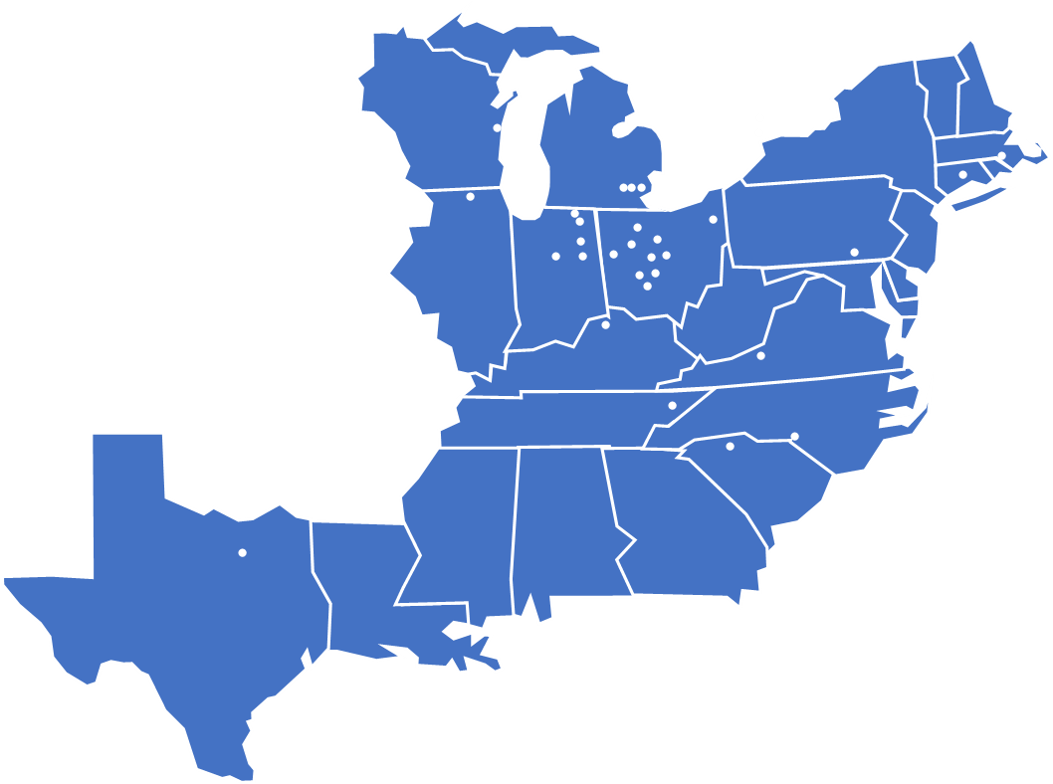
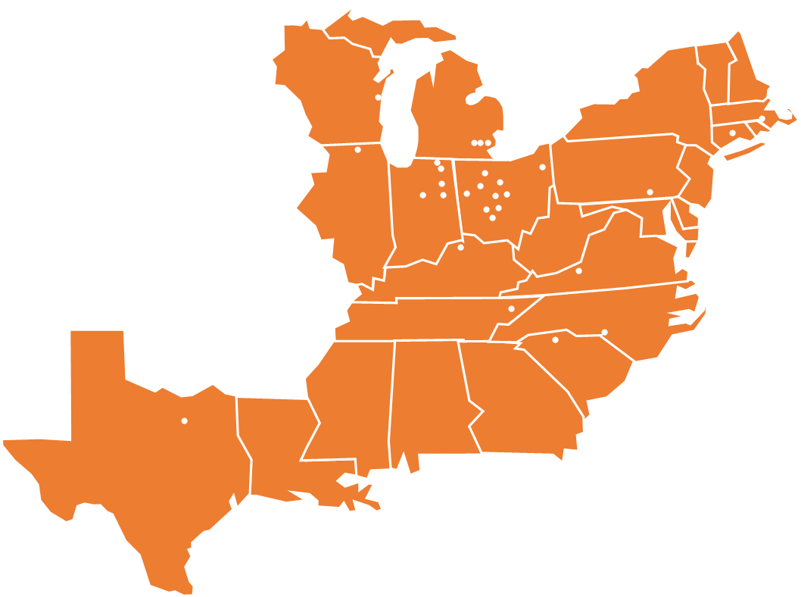
Re-build Automaker/Supplier relations
Build on supplier group strengths
Create collaborative efforts
Notes:
Slide #3, Example
Value process – explain the value of the pain you alleviate…
Solution… this often sounds like the company mission“…creating immediate innovation by…”
“Re-Building supplier relationships, supply chain added value, supplier group strength” Leveraging the strength of the supplier group”
Focused supplier group effort…
The goal is to utilize the strength of the supplier group, integrate innovation
Notes:
Replace map, see new map on next slide, ok to change color of map to match graphic
Change text and font

Slide 4
Notes:
Use this map with graphic on slide #4, ok to change color to match theme

Slide 5
Collaborative Effort
Leveraging the power of a $3B supplier base
Establishing the maximum effort towards $95M target
Applying the maximum $23M group effort
Connect, collaborate, integrate innovation
Impact
Area of impact
Energy
Productivity
Survey data
Best practices
Innovation
Applied innovation
Raw Materials
Machine process
Assembly
Packaging
Tooling
Quality
Components
Innovation
Supplier X,Y,Z
Supplier A,B,G,F
Forecast
Events
$95M Target
Notes:
Slide#4, Idea #1
Magic, secret sauce, leverage strength of supplier group, magic behind the product…
Creating opportunities for immediate innovation, by developing cost reduction solutions across suppliers with related processes.
Leveraging supplier strengths…
Or this is the Value proposition, supplier survey + best practices
Also!, the unique advisor group!!!
**Keep 7 or 8 or combine value & magic = production forecast + ROI +Survey + Events = Innovative impact!

Slide 6
Collaborative Effort
Leveraging the power of a $3B supplier base
Establishing the maximum effort towards $95M target
Applying the maximum $23M group effort
Connect, collaborate, and integrate innovation
Impact
Area of impact
Energy
Productivity
Forecast
Events
Survey data
Best practices
Innovation
Applied innovation
Raw Materials
Machine process
Assembly
Packaging
Tooling
Quality
Components
Innovation
Supplier X,Y,Z
Supplier A,B,G,F
Common
Process
Notes:
Slide#4, Idea #2
Magic, secret sauce, leverage strength of supplier group, magic behind the product…
Creating opportunities for immediate innovation, by developing cost reduction solutions across suppliers with related processes.
**Give suppliers a choice, and a voice to cost reduction!
Leveraging supplier strengths…
Or this is the Value proposition, supplier survey + best practices
Also!, the unique advisor group!!!
**Keep 7 or 8 or combine value & magic = production forecast + ROI +Survey + Events = Innovative impact!
V graphic

Slide 7
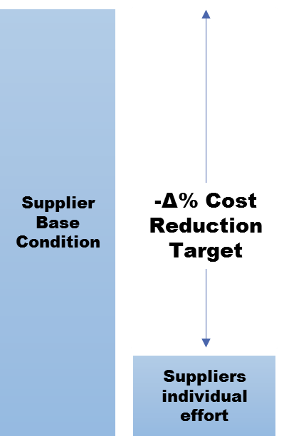
Survey Data
Gap analysis
Missed opportunities
Notes:
Slide #5

Slide 8
Creating opportunities for immediate innovation, by developing cost reduction solutions across (multiple) suppliers with related processes.
Areas of impact
Key Drivers
Result
Capital
Technical
Resources
Event
Energy Savings
Productivity increase
Supplier Survey
How were they successful?
Minimal effort…What is missing?
What separates best vs poor effort?
Technical know how?
Resources, manpower?
An event, the right timing?
Red = poor effort
Green = best effort
Notes:
Slide #6
We will also need to examine the measures taken by those who have been successful in achieving a significant or high degree of cost improvement in the different areas. This data can then be used to understand where the other suppliers with poor cost improvement in each area need to direct efforts and plan a strategy around the information thus gained.

Slide 9
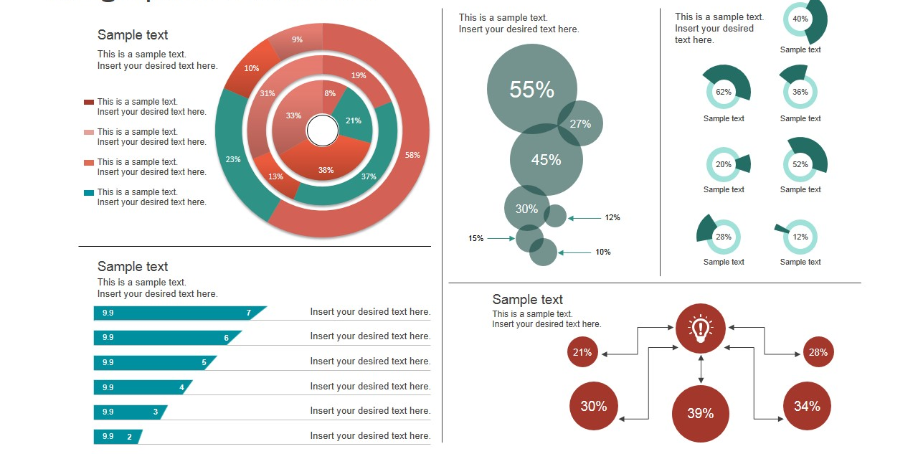
Supplier Dashboard
Web access to best practices
Calculation tools
Shared best efforts
Means to implement best practices
Notes:
Slide #7

Slide 10
Technical Advisor Group, Value Items
Manufacturing Traceability and Supply Chain Management tool:
Imagine, with the touch of a button, knowing the exact airbags that went on 11.5 million vehicles. We have an exclusive partnership with the Silicon Valley start up that is making this tech
Additive Manufacturing or AM, the use of using 3D printer technology will decrease costs of tooling, jigs and fixtures. AM has improved development of complex geometries in tooling, help reduced scrap, and decrease time to market.
Capital expenditure planning and capital budget development
Notes:
Slide #8, Example #1,
Advisor group and management
What unique skills are available…

Slide 11
Business Model
Advisors,
R&D Industry,
Supply Chain Consultants
Supplier Survey Analysis
Cost Reduction,
OEM & Supplier relationship
Cost Reduction, Supplier Dashboard
OEM
Suppliers
Supply Chain Management
Key
Partners
Key
Activities
Value
Proposition
Customer
Relationships
Customer
Segments
Advisors
R&D Industry
Supply Chain Management Partnerships,
Direct Sales
Key
Resources
Channels
Conceptual Model
Dashboard Maintenance
Supplier Survey Analysis
Innovation Integration
Data Analysis
Cost Structure
Revenue Streams
Notes:
Slide #9

Slide 12
Conceptual Model
Supplier
Dashboard
New Model
Added value
Business Development
Automaker/OEM
Supply Chain Management
New Technology
Innovative cost reduction
Notes:
Slide #10, Example #1
Current status and milestones, meetings with Honda R&D and PDM Health
Conceptual model
Fishbone diagram
Milestones
Maybe use of funds, next meeting or presentation, $$ funds to build conceptual model

Slide 13
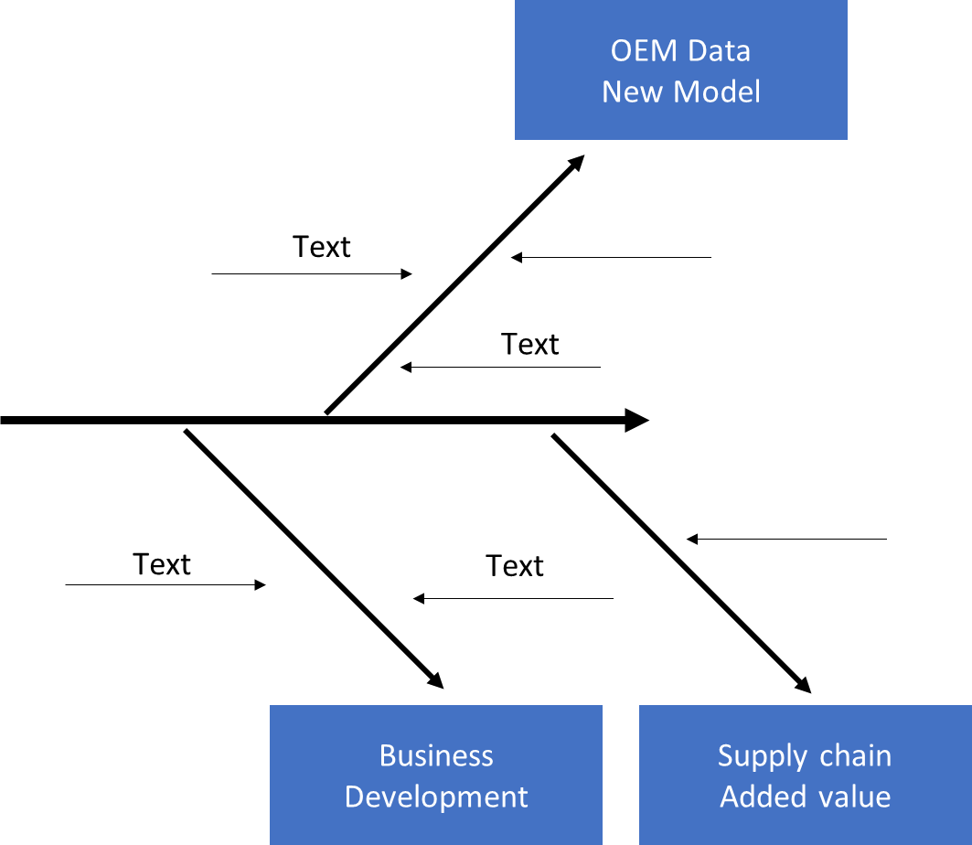
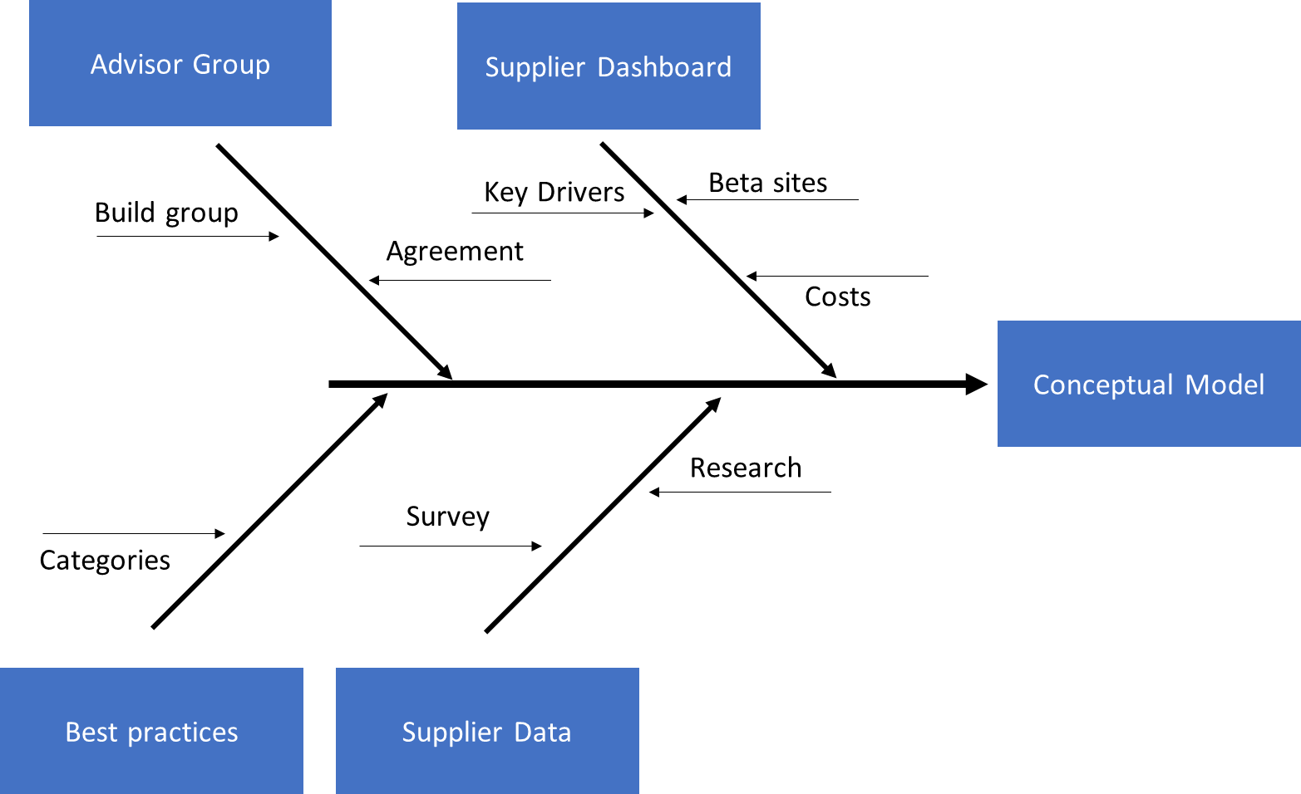
Development
Notes:
Slide #11, combined left & right

Slide 14
Advisor Group
Supplier Dashboard
Key Drivers
Beta sites
Build group
Agreement
Costs
Conceptual Model
Research
Survey
Categories
Best practices
Supplier Data
Notes:
Slide #11, text and graphic
Hyperlinks – Jim Ford…

Slide 15
OEM Data
New Model
Text
Text
Text
Text
Business Development
Supply chain
Added value
Notes:
Slide #11 Right, text & graphic

Slide 16
Collaborating at an even greater level to achieve momentous cost reduction goals.
Forecast data
Identified opportunities
ROI Presentation
Project Planning
R&D
Industry
Innovative Technology
Supplier Group
Supplier Survey
Opportunities
Solutions
Universities
Technical
Advisors
Solution Categories:
Raw Materials
Material processing
Machining
Assembly
Packaging / Transportation
Tooling & Capital
Inspection & Testing
Notes:
Slide #12

Slide 17
Thank you!
Our Purpose is to fund innovation through mutual benefits.
Our Objective is the alignment of cost reduction Technology and cost improvement requirements.
Our Mission is to provide innovative opportunities.
Jason Gallion
P: +1 (614) 286-5142
E: Jason.Gallion@EPICpwr.com
Apollo Technology, LLC 3960 Brown Park Dr. Ste. C Hilliard, OH 43026-1161
Notes:
Slide#13, Example #1
Building the advisor group…
What this effort is about and the opportunity it presents

Slide 18
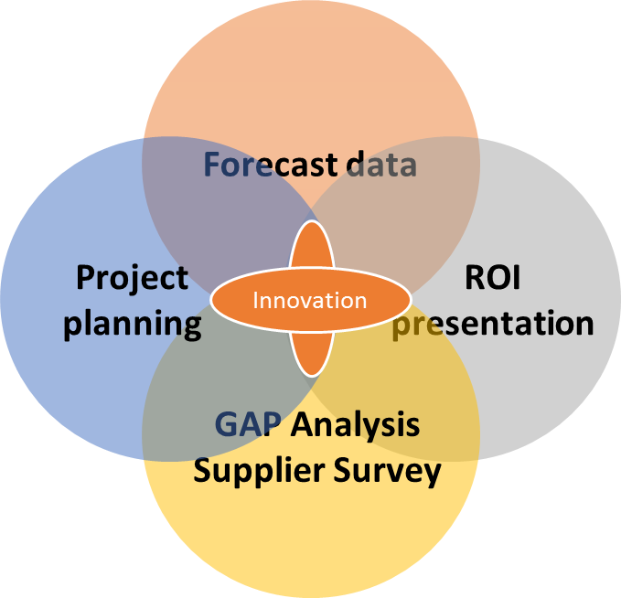
Appendix
Current status, details
Supplier survey
Conceptual Model
Technical Advisors
Automaker/OEM Proposal
FAQ
Challenges
Competition
Why now?
18 month plan
“Collaborating at an even greater level to achieve momentous cost reduction”
Notes:
Slide #14,
Provide appendix details during second meeting
FAQ (get advisors input)and rev1 venture capital

