Slide 1
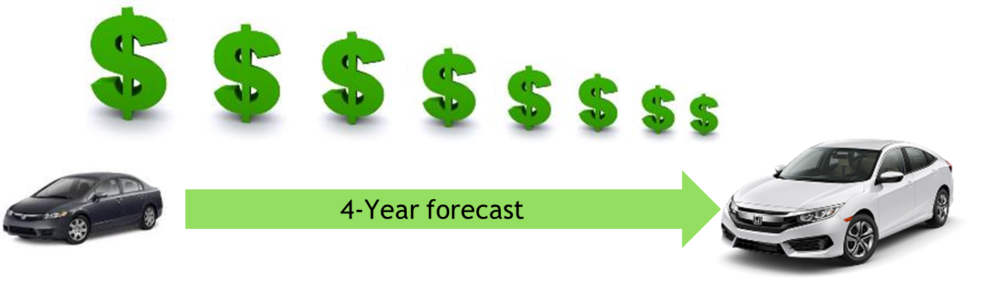
Re-building Automaker/Supplier Relations
An Innovative plan for cost reduction
By Jason Gallion, Cost Reduction Specialist
E: Jason.Gallion@EPICpwr.com
P: +1 (614) 286-5142
Columbus, Ohio
Notes:
Slide #1, Example #1
Re-building supplier relationship for Honda
Building the OEM & Supplier relationship
Notes:
the dollar $ signs should descend big to small from left to right
Ok, to keep your design work
Larger auto graphics are ok, keep arrow with “forecast”, remove “4-year”
Title implies…What we'll do for you and change text to “Re-building OEM/Supplier Relations “An innovative plan for cost reduction”
At least a 30 point font for all titles

Slide 2
Increasing pressure to reduce costs has created a strain on supplier relations.
Often, suppliers are forced to operate with shrinking margins.
Notes:
Slide #2, Example #1
Problem opportunity
Notes:
Your design is very nice keep
Remove the JG logo
Change text to “Often, suppliers are forced to operate with shrinking margins.”

Slide 3
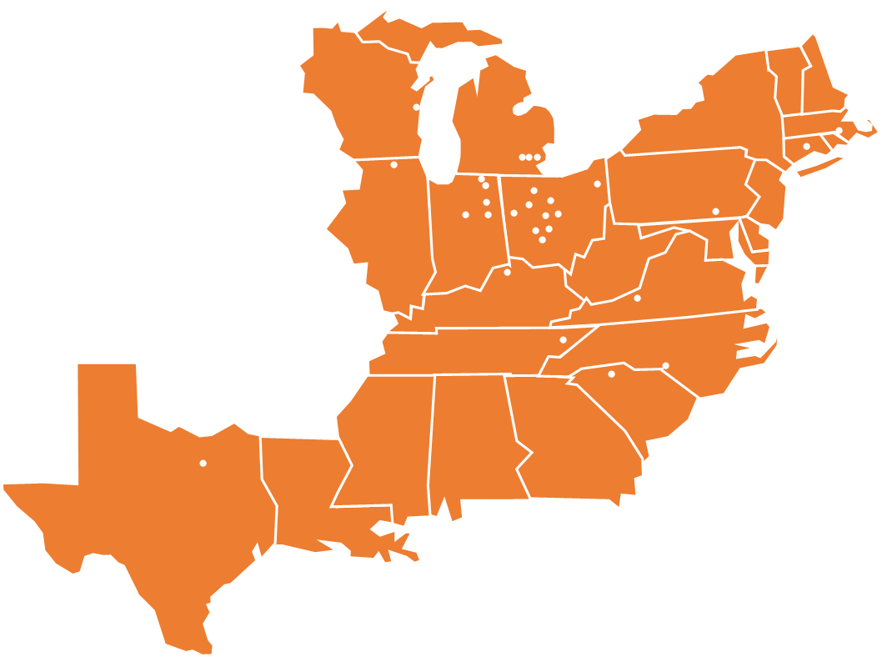
Re-build Automaker/Supplier relations
Build on supplier group strengths
Create collaborative efforts
Notes:
Slide #3, Example
Value process – explain the value of the pain you alleviate…
Solution… this often sounds like the company mission “…creating immediate innovation by…”
“Re-Building supplier relationships, supply chain added value, supplier group strength” Leveraging the strength of the supplier group”
Focused supplier group effort…
The goal is to utilize the strength of the supplier group, integrate innovation
Notes:
Replace map, see new map on next slide, ok to change color of map to match graphic
Change text and font

Slide 4
Notes:
Use this map with graphic on slide #4, ok to change color to match theme

Slide 5
Collaborative Effort
Leveraging the power of a $3B supplier base
Establishing the maximum effort towards $95M target
Applying the maximum $23M group effort
Connect, collaborate, integrate innovation
Impact
Area of impact
Energy
Productivity
Survey data
Best practices
Innovation
Applied innovation
Raw Materials
Machine process
Assembly
Packaging
Tooling
Quality
Components
Innovation
Supplier X,Y,Z
Supplier A,B,G,F
Forecast
Events
$95M Target
Notes:
Slide#4, Example #1
Magic, secret sauce, leverage strength of supplier group, magic behind the product…
Creating opportunities for immediate innovation, by developing cost reduction solutions across suppliers with related processes.
Leveraging supplier strengths…
Or this is the Value proposition, supplier survey + best practices
Also!, the unique advisor group!!!
**Keep 7 or 8 or combine value & magic = production forecast + ROI +Survey + Events = Innovative impact!

Slide 6
Collaborative Effort
Leveraging the power of a $3B supplier base
Establishing the maximum effort towards $95M target
Applying the maximum $23M group effort
Connect, collaborate, integrate innovation
Impact
Area of impact
Energy
Productivity
Survey data
Best practices
Innovation
Applied innovation
Raw Materials
Machine process
Assembly
Packaging
Tooling
Quality
Components
Innovation
Supplier X,Y,Z
Supplier A,B,G,F
Forecast
Events
Notes:
Slide#4, Example #2
Magic, secret sauce, leverage strength of supplier group, magic behind the product…
Creating opportunities for immediate innovation, by developing cost reduction solutions across suppliers with related processes.
Leveraging supplier strengths…
Or this is the Value proposition, supplier survey + best practices
Also!, the unique advisor group!!!
**Keep 7 or 8 or combine value & magic = production forecast + ROI +Survey + Events = Innovative impact!
V graphic

Slide 7
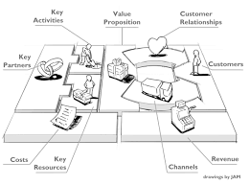
Business model
Supplier survey
Cost reduction
Automaker, OEM
Supply chain added value
New business development (Innovation development)
Notes:
Slide #5, Example #1
Business model, create graphic
Notes:
1. If you can make a graphic like this one let me know

Slide 8
Conceptual Model
Survey
Effort
Forecast data
Events & timing
ROI
Solutions
Forecast data
Cost reduction model
1. Supplier Survey
2. Tactical, Potential or costs of efforts
3. Execution, Integrating innovation
Project planning
ROI presentation
Innovation
GAP Analysis
Supplier Survey
Automaker, OEM
Supply chain added value
New business development (Innovation development)
Creating opportunities for immediate innovation, by developing cost reduction solutions across suppliers with related processes.
Notes:
Slide #6, Example #1
Go to market plan, list first customers, true believers the very first true believers!
**could use feedback from MEP CDME John, or PDM, or Honda R&D
Share conceptual model, how suppliers benefit from assured cost reduction…
Best practices, MEP resources…CDME collaborations… National Network for Manufacturing Innovation, Advanced Manufacturing National Program Office
Next steps… Build advisor group, build conceptual model, proposal for Honda & PDM
Maybe V graphic… I’ll provide a sketch of what I’m thinking…
1. Strategic...Supplier survey, what it is currently, and best practices 1A. Strong or weak effort vs available technology. agile assessments, level of difficulty to implement, some travel
2. Tactical...What it could be. Potential with existing technology, RX gen example Requires travel
3. Execution...Where it should be, applied technology, or technologies to develop over 1-4 years. Identify Difficulties to implement or develop Partnership with tech providers, materials development , create blue paper for write patt Air Force base Manage solutions, engineered proposals, cost reduction data, measure results **what EPIC will facilitate, DOWA did not have the engineering resources to provide cost solution, EPIC partnership with State to fund engineering, CDME built engineered solution EPIC coordinated manages installation or implementation
4. Assured cost reduction, not the solution but the big target goal

Slide 9
Competition
[Low Thing]
[High Thing]
Our unique effort to build conceptual model…
Implementing opportunities for immediate innovation
US
Logo
[High Thing]
Logo
Logo
OEM/Supplier relationship
Supply chain added value
[Low Thing]
Logo
Logo
We are stronger than the competition in [key differentiators].
We are threatened by the competition in [honest worries you have].
10
Notes:
Slide #7, Example #1

Slide 10
Team Value, Technical Advisor Group
Top 15 in the world VMware engineer, that has ran virtualization solutions for Cardinal Health, Nationwide, and Abercrombie to name a few.
Manufacturing Traceability and Supply Chain Management tool: It is a proprietary, block chain cryptography, traceability software and hardware solution. This is industry 4.0 tech.
Imagine, with the touch of a button, knowing the exact airbags that went on 11.5 million vehicles. We have an exclusive partnership with the Silicon Valley start up that is making this tech
Additive Manufacturing or AM, the use of using 3D printer technology will decrease costs of tooling, jigs and fixtures. AM has improved development of complex geometries in tooling, help reduced scrap, and decrease time to market.
Capital expenditure planning and capital budget development
Notes:
Slide #8, Example #1,
Advisor group and management
What unique skills are available…

Slide 11
Current status, fish bone
EPIC
OEM
Added value
Business Development
Honda NAP
Honda R&D
PDM Health
New Technology
Innovative cost reduction model
Build model
Build advisor group
Notes:
Slide #9, Example #1
Current status and milestones, meetings with Honda R&D and PDM Health
Conceptual model
Fishbone diagram
Milestones
Maybe use of funds, next meeting or presentation, $$ funds to build conceptual model

Slide 12
Current Status, Fishbone
PDM Health
Supply chain added value
Model
Survey
Honda
Contacts
Relationships
Meeting
Cost reduction model
Model details
Survey details
Preeta
Research assistant
SP Global
ARMS
New market development
Notes:
Slide #9 Example #2
*License software model to supply chain management

Slide 13




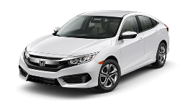





Creating opportunities for immediate innovation, by developing cost reduction solutions across suppliers with related processes.
Forecast data
GAP Analysis
ROI
Immediate Innovation
$3B Supplier base
$95M Required cost reduction
$22M Collaborative effort
Common process
Best Practices
$Cost reduction
4-Year forecast
Notes:
Slide #10, Idea #2
Value process – explain the value of the pain you alleviate…
The goal is to utilize the strength of the supplier group
“Re-Building supplier relationships, supply chain added value, supplier group strength” Leveraging the strength of the supplier group”
“Creating opportunities for immediate innovation, by developing cost reduction solutions across suppliers with related processes”
Maybe purchase map “case study” graphic circle with map inside

Slide 14
Thank you!
Our Purpose is to fund innovation through mutual benefits.
Our Objective is the alignment of cost reduction Technology and cost improvement requirements.
Our Mission is to provide innovative opportunities.
Jason Gallion
P: +1 (614) 286-5142
E: Jason.Gallion@EPICpwr.com
Apollo Technology, LLC 3960 Brown Park Dr. Ste. C Hilliard, OH 43026-1161
Notes:
Slide#11, Example #1
Building the advisor group…
What this effort is about and the opportunity it presents

Slide 15
Appendix
Current status, details
Example, supplier survey
Technical Advisors
Automaker/OEM proposal
FAQ
Challenges
Why now?
18 month plan
Notes:
Slide #12, just text…
Provide appendix details during second meeting
FAQ (get advisors input)and rev1 venture capital

