Slide 1
BATCHbAKER.cOM
Bringing Local Bakers to You

Slide 2

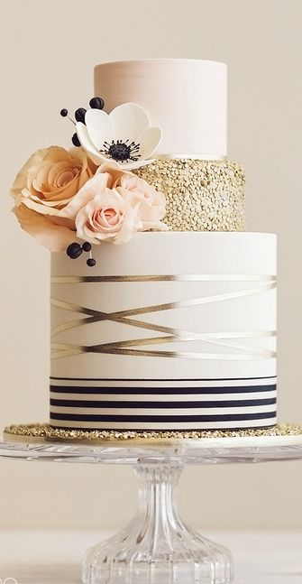
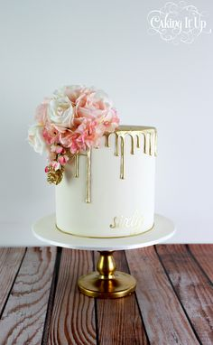
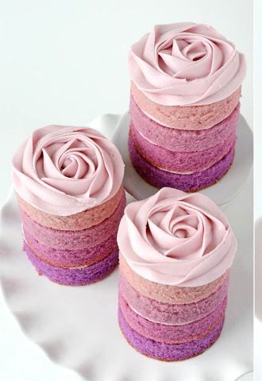
BatchBaker.com
About Us | Categories| Browse Projects| How it Works
Log In
BECOME A BATCHBAKER
POST OR SEARCH FOR YOUR DESSERT

Slide 3
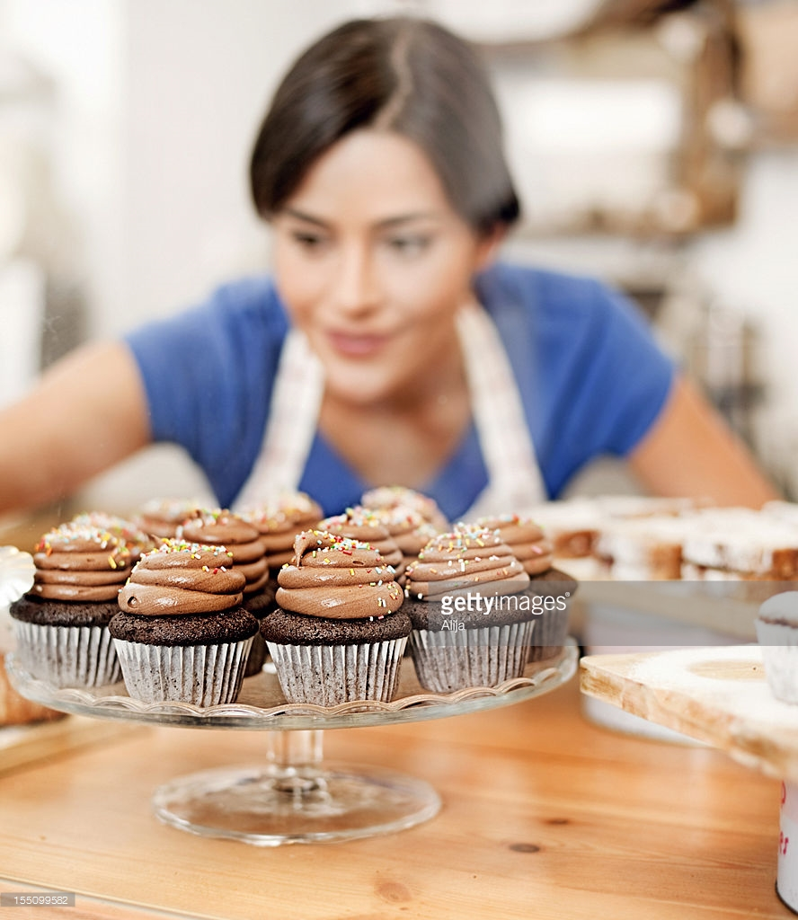
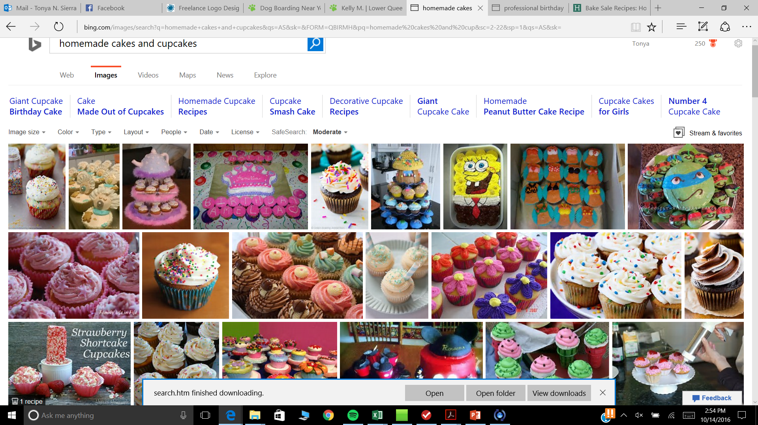
BECOME A BATCHBAKER
Page Features:
Can hover over photos to zoom
Photos scroll automatically
Click on Photos to see description
Logos for Gluten free/Nut Free
Full questionnaire to create Profile
Setup Profile Information
Profile Photo
Description – Something about themselves/baking quote
Experience Level – Home Baker (years) or Professional
Baking Status: Active OR Be Back Soon (Deactivate Mode)
REVIEWS
Neighborhood, City, State, Zip
Specialties displayed as Icons (Cupcakes, Cakes, Pies, Pastries, Cake Pops, Cookies, Gluten Free, Nut Free)
Food Handlers Permit - Yes/No/Pending
Business License - Yes/No/Pending
Nut Free – Are you willing to provide nut free option and follow strict guidelines?
Upload Photos of Baked Goods – Min 1 to No Max

Slide 4
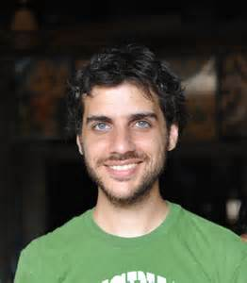

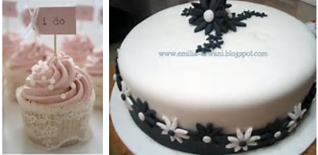
preview local bakers
POST or SEARCH FOR A DESSERT
Search for Baker, Specialty, Location, etc
JACOB M.
Good Things Come to Those that Bake…
Experience Level – Home Baker 6 years
***** 4 REVIEWS
Queen Anne, Seattle, WA, 98101
Specialties = Cupcakes, Cakes, Pies, Pastries, Cake Pops, Cookies, Gluten Free, Nut Fee
EMMA S.
Stop hating. Start Baking <3
Experience Level – Professional
**** 13 REVIEWS
Kirkland, WA, 98029
Specialties = Cupcakes, Cakes, Cake Pops, Cookies
Page Features:
Can search by type of baked good, each photo will be linked back to baker.
Filter by location, rating, experience level.
Experience Level = Novice, Intermediate, Professional
Can’t Find Exactly What You Need?
Post Your Project

Slide 5
Post or Search for a dessert
Page Features:
Drop down box for Baked Good Category
Calendar pop up for date/Time
Email Generated for Baker within 20 miles
Project is listed in a page where Bakers can go in to view/accept projects
POST YOUR PROJECT
Name
City
Baked Good Category
Date/Time Needed
Description of Project
Submit
EMAIL GENERATED FOR BAKERS WITHIN VICINTY
PROJECT LISTED ON INTERNAL PAGE FOR BATCHBAKERS TO VIEW/BID

Slide 6
Projects for BATCHBAKERs
Page Features:
Bakers can view just photos and click to view project descriptions.
Will have messaging capabilities to chat with client regarding project details.
Can sort by field.
Default Sorted by Days until Event – Urgent projects
DesignCrowd has similar format
BROWSE BATCHBAKER PROJECTS
ONCE BAKER SUBMITS BID FOR PROJECT, EMAIL GENERATED TO CUSTOMER TO VIEW BATCHBAKER PROFILE, CUSTOMER THEN ACCEPTS OR DECLINES BID
BID

Slide 7
Payment
Order System
BID ACCEPTED
System recommends to meet in public place for delivery, or extra fee for home delivery via Client or UberEats
ORDER SYSTEM – PayPal, Credit Card
Terms and Conditions must be agreed upon by both Baker and Client
FAQs Link (Tipping, returns policy, delivery, Shelf Life, storage tips, etc)
4% Paid by Customer as Transaction Fee and 5% deducted from Baker’s Transaction Price = 9% to BatchBaker.com
Outputs confirmation email
Reminders to Baker’s to stay on schedule, encourage communication with Customer

Slide 8
About batchbaker
I love to bake. Baking is an art and a creative outlet for so many people. There are hundreds of talented bakers who bake as a hobby. I would love to tap into all the similar stay-at-home or working moms/dads, small bakeries that enjoy to baking for others and help them make extra income while do so. They love to document and present their art as well and social media has been a decent place for that. Having a community that supports this type of creativity and artistry would be wonderful to create and be a part of.
As someone who loves to attend and throw parties, I know I am not the only one who sees the same baked goods at so many events. Being a mom myself, I don’t always have time to bake a cake and would love the option to have a cake created for me, that is customized… that is special. Whether it is a sweet treat for myself or to share with my loved ones, a place I can go to browse for inspiration, support and purchase would not only be an enjoyable experience but a time saver!
I am excited to be the “matchmaker” between bakers and their customers and to help give families and friends sweet memories that can last a lifetime. It is my goal to put my love for baking and the act of bringing people together into a beautiful platform that delivers a beautiful and exciting solution for so many people.

