Slide 1
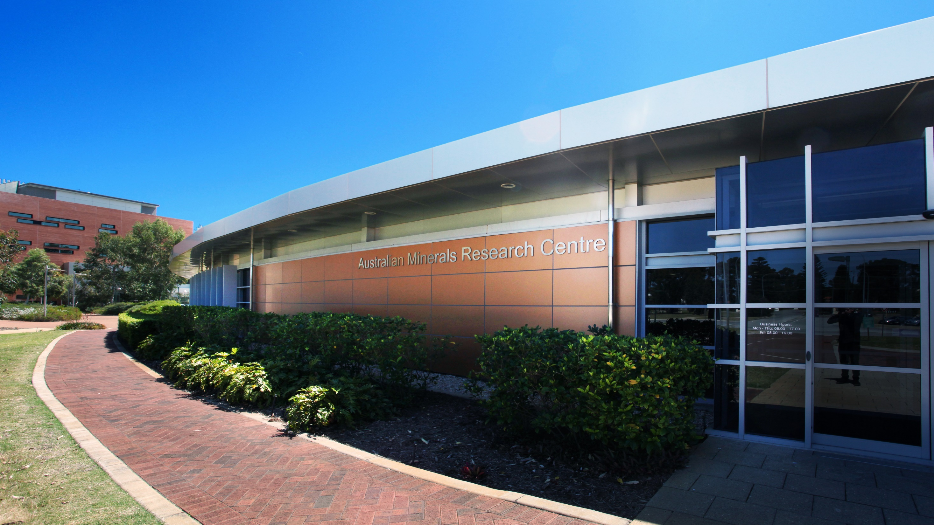
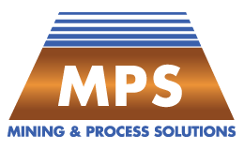
Innovative Thinking & Technology
Australian Mineral Research Centre
7 Conlon Street, Waterford
Western Australia 6152
www.mpsinnovation.com.au

Slide 2
Content
Business Snapshot
Our Technology
Commercialisation Strategy
Q&A
1
2
3
4

Slide 3
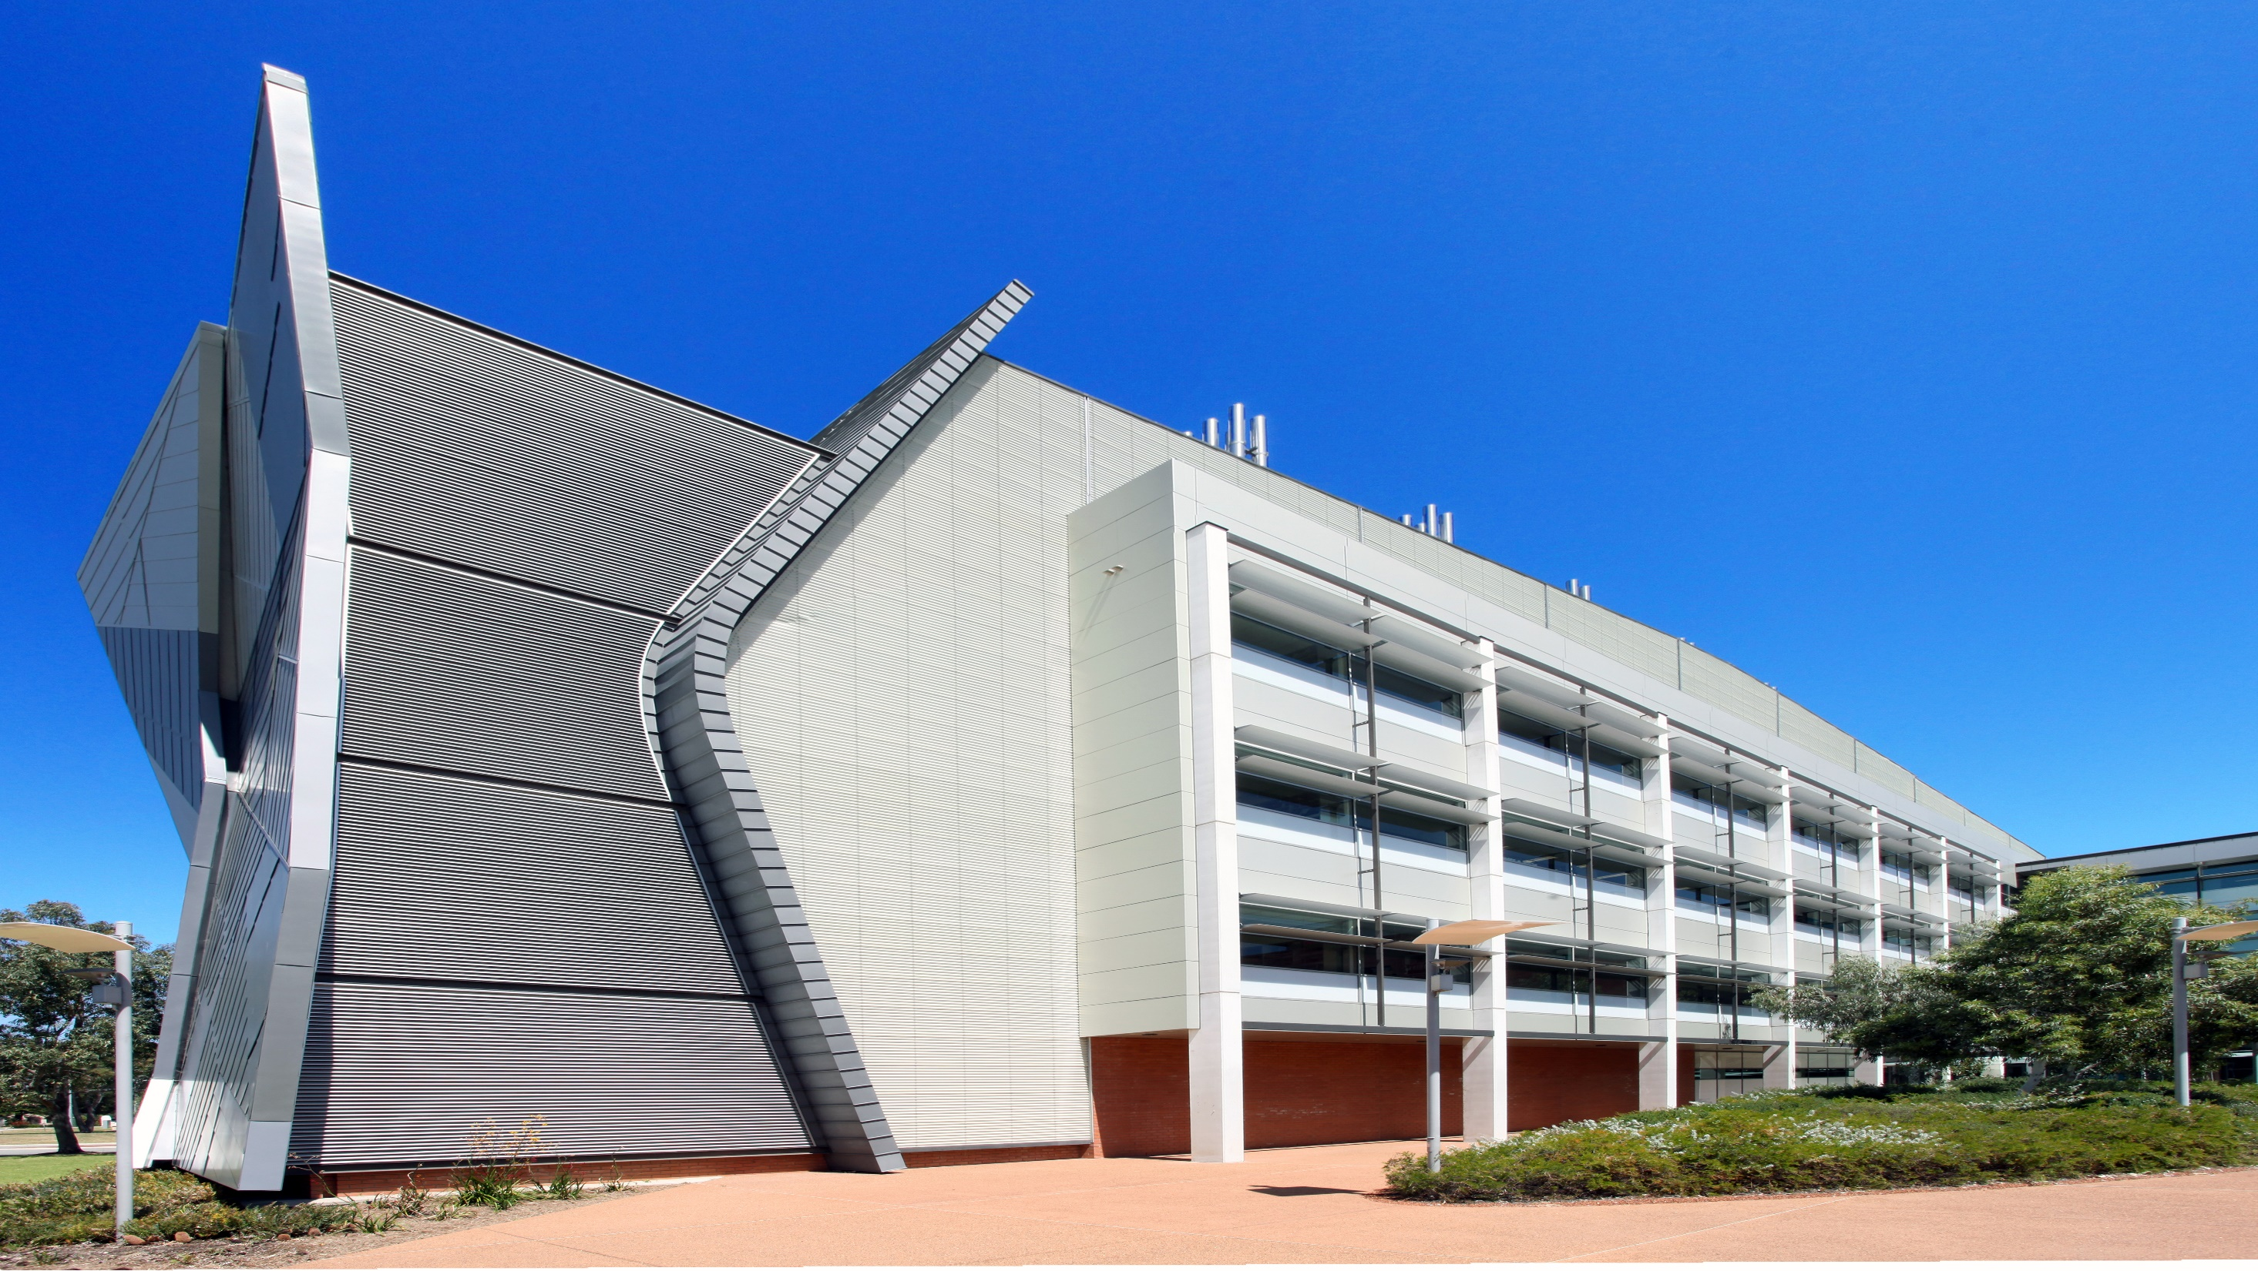
1
Business Snapshot

Slide 4
Our Business – A snap shot
Formed in 2014. Privately owned and funded to date;
We have experience, know-how, and exclusive access to game changing technologies protected by international patents;
Supportive Commercialisation Partnership with Curtin University – a globally recognised research and development organisation;
8 Staff (some part-time); Wide network of associates build around the business;
Headquartered at the Australian Mineral Research Centre (Perth) as part of a collaborative research agreement with CSIRO;
Commissioned agents/project seekers in Santiago (Chile), Toronto (Canada), and Vietnam (SE Asia); Additional agent discussions and test centres being progressed in other jurisdictions.

Slide 5
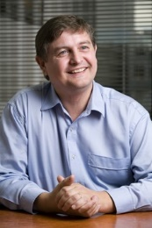
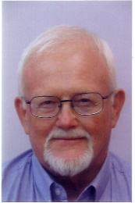
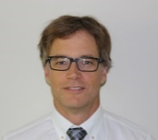
Our Business – The Management Team
Ivor Bryan, Managing Director
BE Mining (First class Hons), MAusIMM, MAICD
Over 35 years’ experience in the mining industry with executive management roles in mining operations, project management, technology and consulting;
First class honours degree in Engineering (Mining) obtained from the University of Sydney;
Previous track record in business development: Co-Founder, major shareholder, and Executive Director, of RMDSTEM, a respected consultancy that serviced the mining industry for over 16 years;
Clients included global industry leaders (Vale, BHPB, Rio Tinto), junior and mid-caps, and Australia’s leading resource based research and technology developers.
Frank Trask, Technical Director
B.Sc. Geological Engineering (Mining Option), MSc. Mining Engineering. Montana School of Mines, Butte, Montana, USA
Over 50 years experience in the mining industry;
Built and operated successful business, Kalgoorlie Lime and Chemical Company, supplying reagents to mining operations in the Gold fields of Western Australia
Fulfilled roles as Director, Managing Director, Senior Exploration Geologist, Pit Geologist, Mine Geologist, and Lecturer at the Western Australian School of Mines;
Vast experience in the areas of operating pilot plants, heap leaching of copper, and chemical systems for processing of metals;
Expertise in Geo-metallurgy and process selection specifically for different copper mineralogical domains;
Credited with the discovery of the Yakabindie Nickel deposit.
Tim Newton, Operations Director
BEng. (Chemical Engineering), MSc. (Mineral Economics), Grad. Dip. (Extractive Metallurgy), MBA (Int. Business - China)
Over 20 years of experience in the international mining industry
Diverse background covering a range of precious, base and energy metal projects in Australia, South America and Asia.
Core experience in complex hydrometallurgical facilities, particularly copper heap leach SX-EW, nickel laterite HPAL, zinc refining and uranium circuits.
Previously co-founder and director of Simulus (Perth), delivering engineering studies, process simulations, test management and due diligence assessments to a wide range of mining industry clients.
International experience includes management of metallurgical projects on refractory gold operations in China.
Manages MPS Flow sheet development and costing

Slide 6
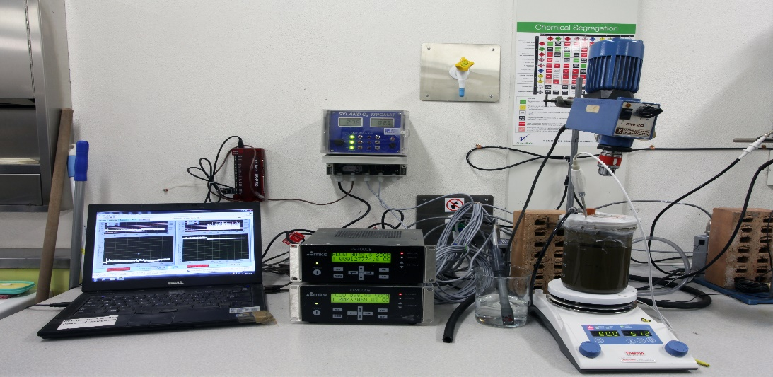
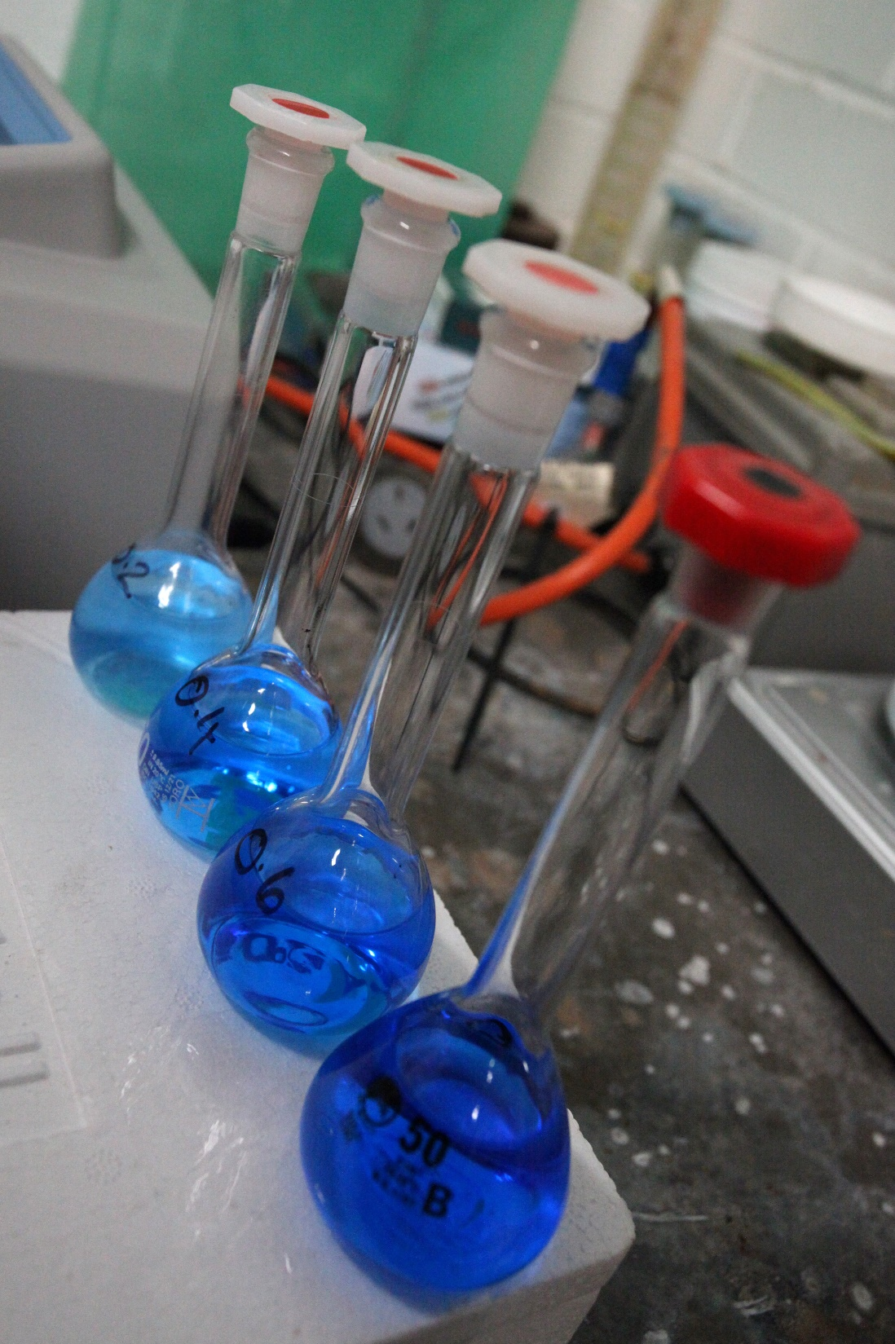
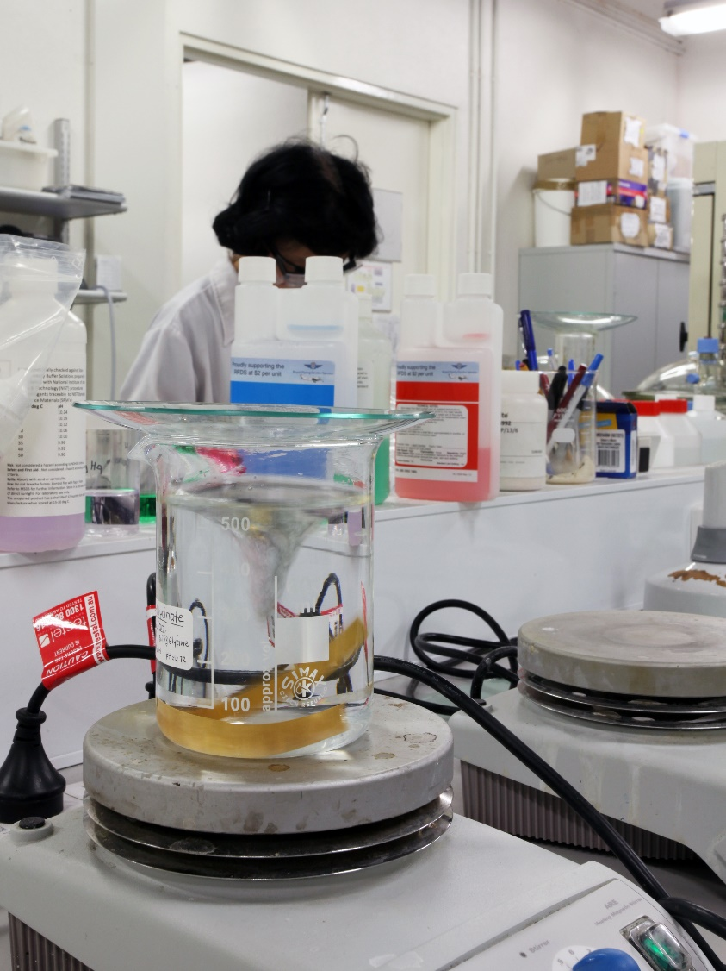
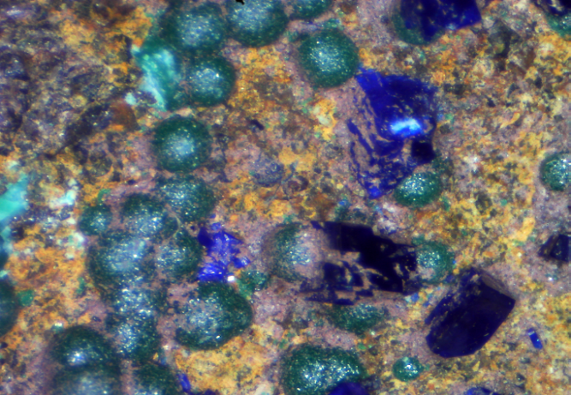
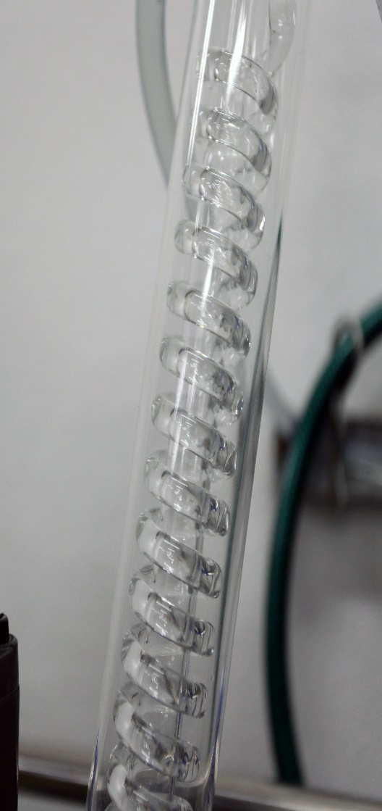
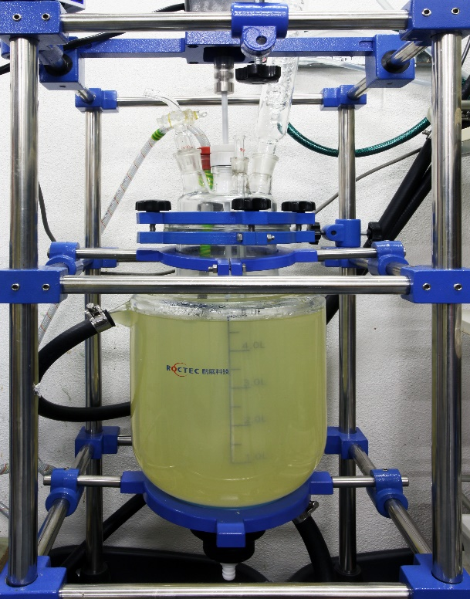
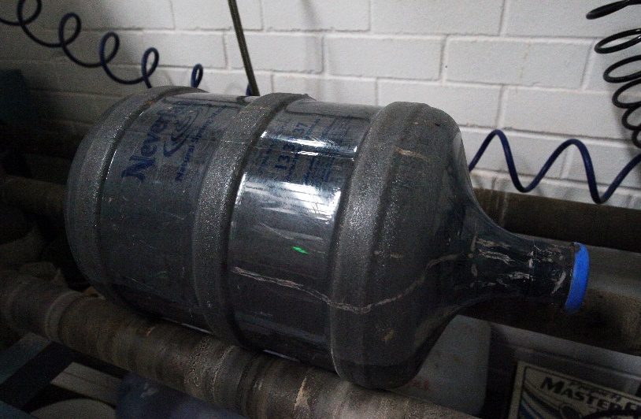
2
Our Technology

Slide 7
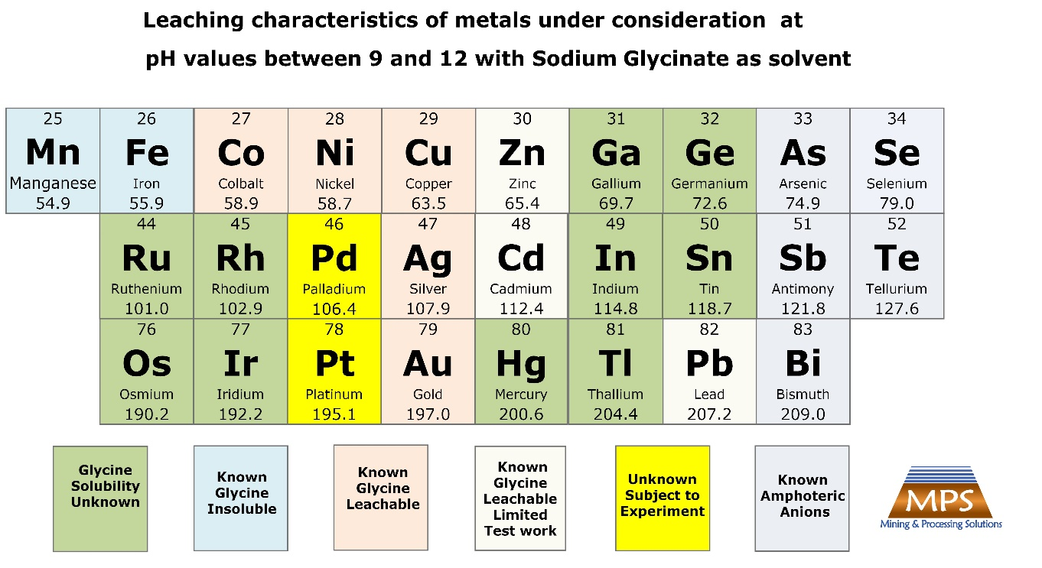
Our Competitive Advantage – Exclusivity on a Patented Step Change Leaching Technology
The Glycine Leaching Process is a disruptive and step change technology for base and precious metals
It uses an environmentally benign lixiviant (unlike acid and cyanide). It is biodegradable and edible!
Is commercially available in bulk and in different grades;
Is uniquely selective in leaching valuable base and precious metals (doesn’t leach gangue minerals like Iron and Manganese). Faster than acid in leaching copper sulphides;
It is not chemically consumed so as a primary reagent it is fully recoverable and recyclable* – providing a major advantage in operating costs;
Operates in an Alkaline system – no special materials of construction (e.g. stainless steel for acid leaching). Low capital costs;
Doesn’t cause slumping in heap leaching (unlike acid which reacts with gangue minerals undermining heap integrity);
* Apart from normal process losses

Slide 8
Our Technologies – Base and Precious Metals Leaching Applications
GlyLeachTM
Turns Orphan Deposits and Wastes into Viable Opportunities
Leaching of base and precious metal ores and tailings
Particularly suitable to oxides and transition ores but also attractive for some sulphides
GlySmeltTM
A Mine-to-Metal Production Solution
Leaching of Concentrates – capture precious metal value
On site alternative to transporting and exporting bulk concentrates to Smelters
GlyMineTM
The Enabler to In-place and Insitu Leaching
ISL or In-Place Leaching of base and precious metals
Step change capability to turn remote stranded deposits into viable projects
Removal of As from concentrates exceeding threshold values
Could be the enabling Lixivant due to its environmentally benign nature
GlyCatTM
Catalysed Leaching for Mixed Precious and Base Metal Deposits
Substantial reduction in cyanide for Au/Ag ores where copper content ‘Preg robs’ cyanide
Opportunity for reagent suppliers to commercialise as a hybrid reagent with a disruptive business model
Recovery of both base and precious metals in same flow sheet
GlySlagTM
Turning Waste Slags into Metal
  Stockpiled copper slags around the world typically contain 1% copper that cannot be recovered efficiently with conventional processes
  GlySlagTM recovers 90% of copper in most slags

