Slide 1

M3 Software Overview

Slide 2
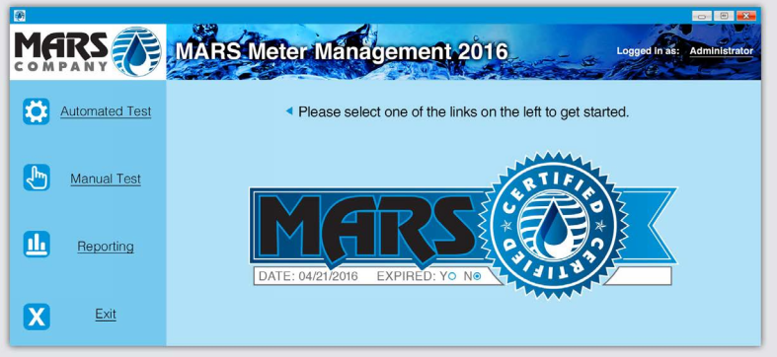
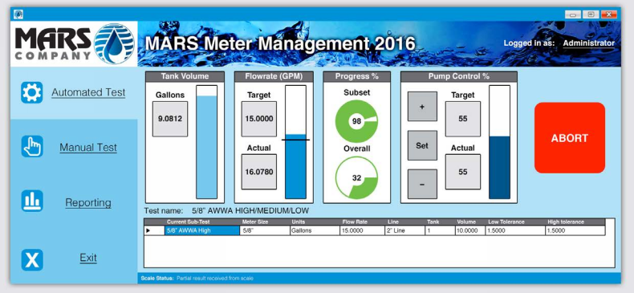
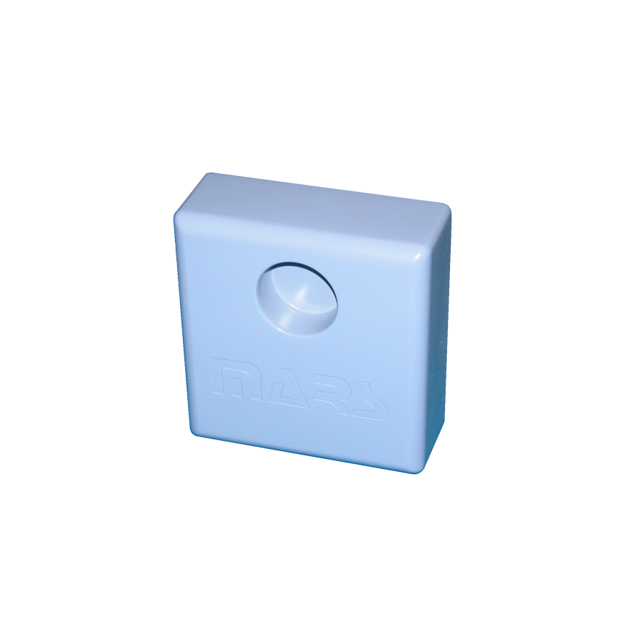
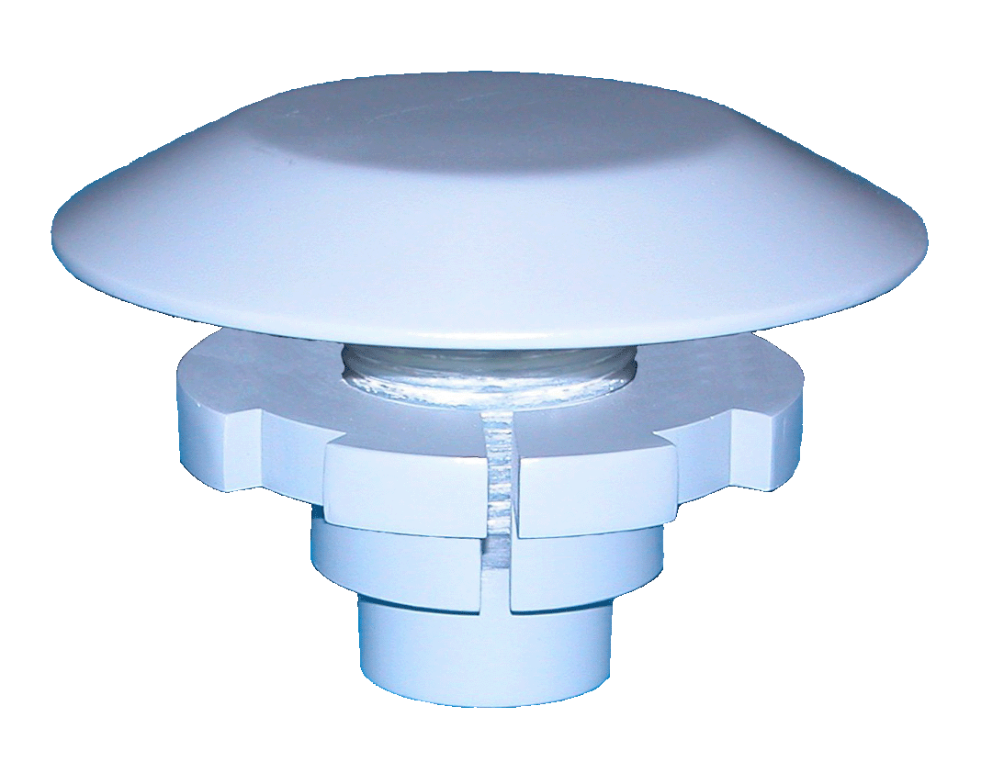
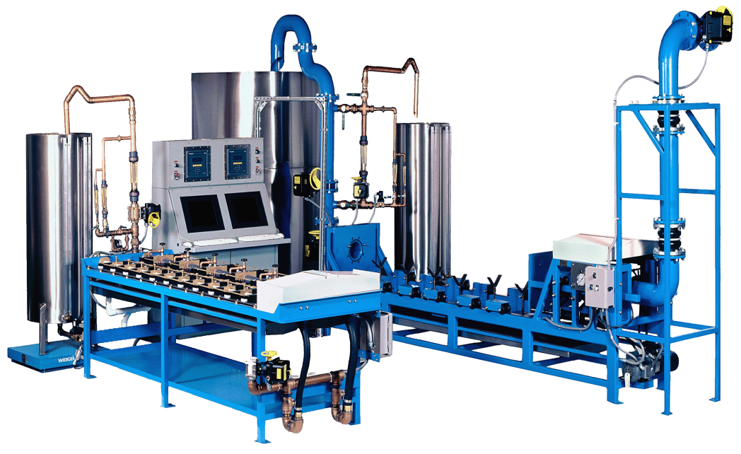
MARS Company Overview
Founded in 1988
Privately Held Corp.
Water Meter Testing & Technology Expertise
Patented Water Meter Testing Systems & Software Technology
Innovative AMR/AMI Technology Products and Software Solutions
Water System Specialty And Fabricated Products
Industry Experience
Innovation & Technology Leadership – 16+ Patents Issued / Pending
30K Sq. Ft Advanced Production Facility
30 Employees
Experienced Management Team
Headquartered in Ocala, Florida

Slide 3

Water Meter Testing Systems & Software
Water Meter Testing Systems (aka Test Benches)
Technology and Innovation Industry Leader
3 Test Bench Configurations – Large, Mobile Truck Tester and Medium/Small
Water Meter Testing Software – MARS Meter Management (M3)
Key Features & Benefits
Run Unmanned Tests To Increase Efficiency And Reduce Errors
Integration With Other Enterprise Network Systems (I.E. ERP Systems)
Designed To Be Used With Handheld Tablet Devices For Ease Of Data Input
Automated Operation Eliminates Operator Errors
Perfect For Small And Scalable For Regional Test Facilities
Expedite Customer Service Inquiries
Generate Custom Reports For Legal Litigation
Easy For IT To Manage
AWWA M6 Standards Compliant

Slide 4
M3 Enterprise Software
M3 Software Version 1 Currently Available (Discontinued EOY 2016)
NEW Enterprise M3 2016 Software
Enterprise Software Architecture & Database Design
Extensible Platform Design For Future Enhancements
Modular Software Components
Core Platform Software Comes in 3 Configurations
Large Bench (3” Meters +)
Mobile Truck Tester
Small / Medium Bench (< 3” Meters)
Optional Software Modules
Advanced Connectivity
Custom Test, Reporting & Export

Slide 5
M3 Software Features

Slide 6
M3 Support Plans

Slide 8
M3 Pricing

Slide 9
M3 Software Overview
Optional
Modules
Advanced Connectivity
Custom Test, Reporting & Export
Large
Test Bench
Core
Platform
Software
Mobile Truck
Tester
Small Test Bench

Slide 10
M3 Legacy vs Enterprise Feature Comparision

