Slide 1

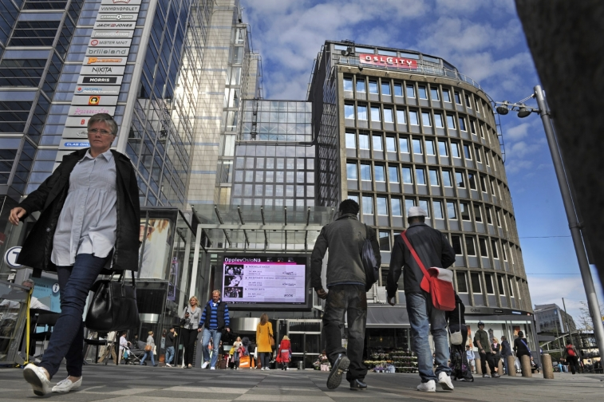
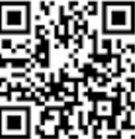


Shared app and digital services to innovate destinations and retail
Physical web IOT
Blockchain loyalty
AI & bigdata
$
Notes:
https://www.vendhq.com/university/retail-trends-and-predictions-2016 Dekker mye av det vi sier…

Slide 2


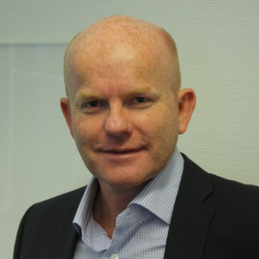

Experienced Management Team – experienced entrepreneurs
Morten Rynning
Co-Founder
MBA
25 years as advisor within digitizing and business development
Founder /CEO of CyberWatcher – international marketing intelligence – exiting 2 times
CEO in Solid Media Group. Scandinavian Digital Marketing agency – hyper growth and M&As
VVSkupp. Norway’s biggest Net shop within Bath rooms. Gaselle
Harald Jellum
CTO & Chairman Co-Founder
25 years as serial Entrepreneur within
Internet, Mobile and Big Data
Employed 300 persons and raised more than 70m USD
Board member & owner in several technology companies
Per Arne Friestad
CEO
25 years of IT and management
Founded Bwise Commerce (B2B/EDI Provider for the sporting industry)
Experienced manager within retail, logistic, finance and software
Has operated and grown several businesses in Scandinavia as well as in Asia.
In addition: Fantastic programmer team – lead programmers and CT

Slide 3

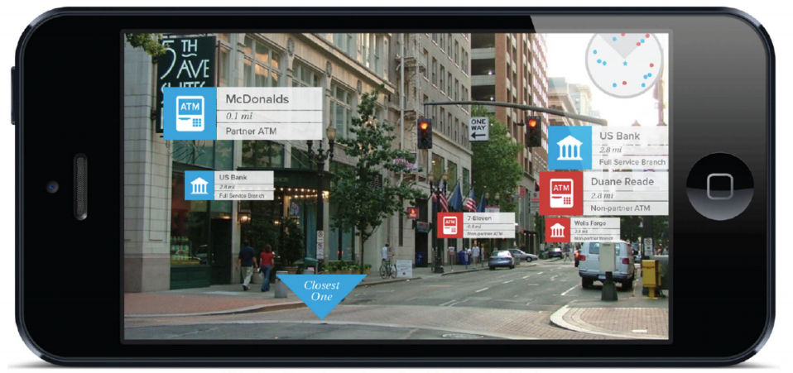

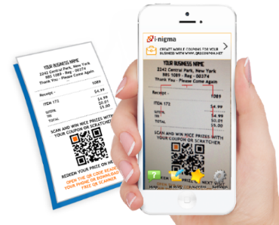
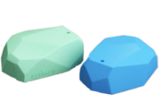
Digitalizing challenge requires innovation:
IOT app&platform to innovate Smart Cities, shopping and fintech
Digitalizing destinations and cities – helping retail face ecommerce
Mobile loyalty program with mobile loyalty banking
Shared app and infrastructure: Mobile assistance with multi brand & multi functionality
Notes:
http://socialmediaweek.org/blog/2016/02/10-stats-artificial-intelligence-foreshadow-future-society/
http://www.gartner.com/newsroom/id/3198917
http://www.marketsandmarkets.com/PressReleases/social-business-intelligence-bi.asp
http://www.marketsandmarkets.com/PressReleases/loyalty-management.asp

Slide 4

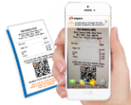
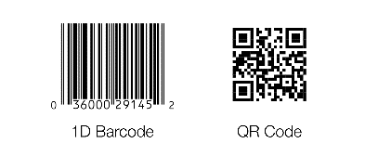






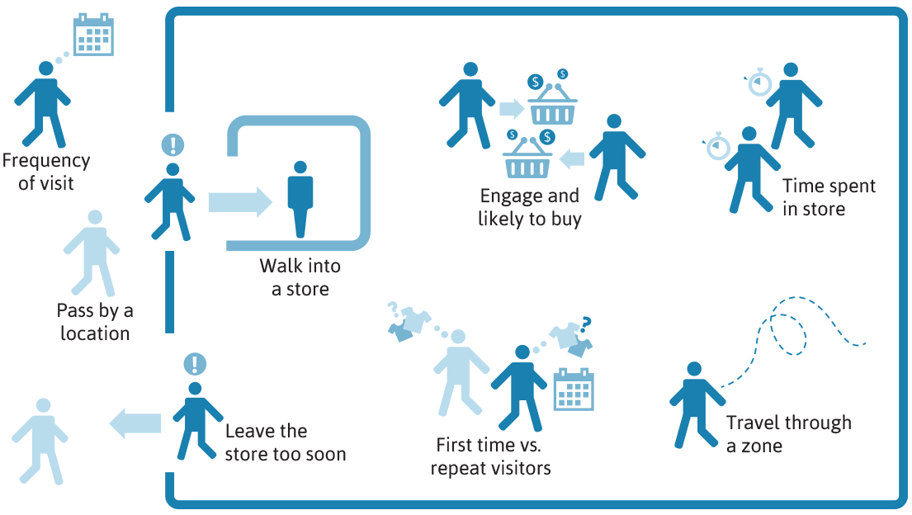

Shared app-platform for shopping:
Covering Digital guide, shopping, loyalty and gaming – across brands
Open app for brands to sign up and join – to be generic Shopping app for users
Digital guide & info
(guide, fact track, chat)
My page, e receipts
(Club hub, receipt & warrant log, Shopping list)
Social shop & travel
(reviews TripAdvisor, share)
Loyalty and bonus
(subscription, discount, bonus score)
Social buying
Shopping app’en (Tripadvisor for reisenæringen)
og
Mobil markedskanal Innsikt kundereisen
Entertainment & games
(find, engage, entertain
AG, VR, win)
VIP - high end
(extra service,
Personal assitance)
Feedback
(mobile feedback,
Test launch to VIP, surveys)
Loyality mobile banking
Blockchain «currency», redeem, loan, credit, mobile payment
Insight omnichannel
(Tracking behaviour
Client base/profile)

Slide 5


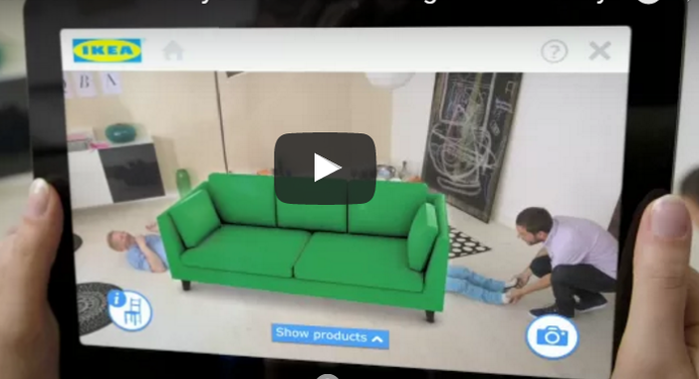



Improved customer experience
QR, barcode and info-pop ups
Instore shopping assistance
42% of consumers use mobile while shopping instore
Checking prices and reviews
Inspiring video of product usage
Link to net shop: facts and delivery
Expert chat and online assistance
Customer care
Augmented reality
Support at home – interior
Suggestions for products fitting
Feedback

Slide 6
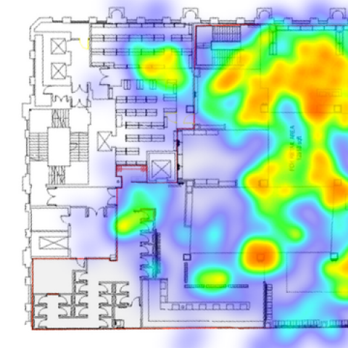
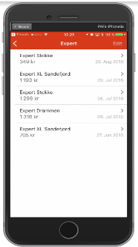
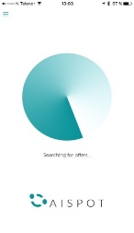
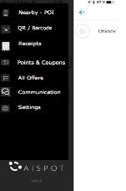
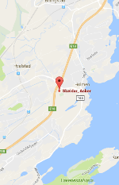
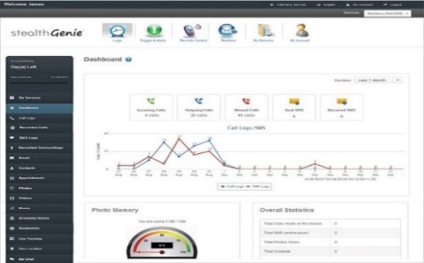
Insight: Track and understand clients in retail and destinations
– as with e-commerce
Downtown/destination Inside malls and each single outlet
Measure and insight through:
Geofence, Beacons, QR
Wifi
Laser and movement tracking
Social media
Efficient marketing
Location, mobile
ROI

Slide 7
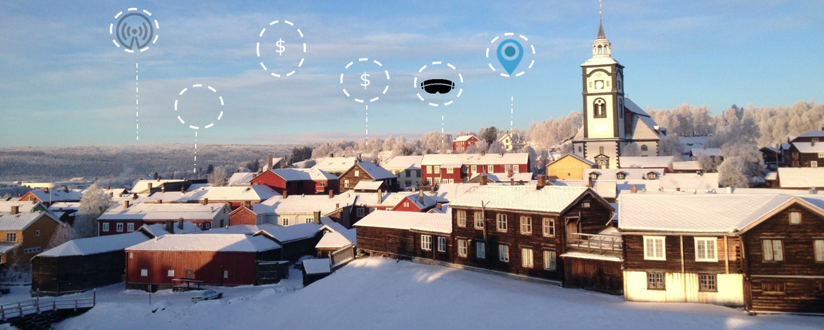
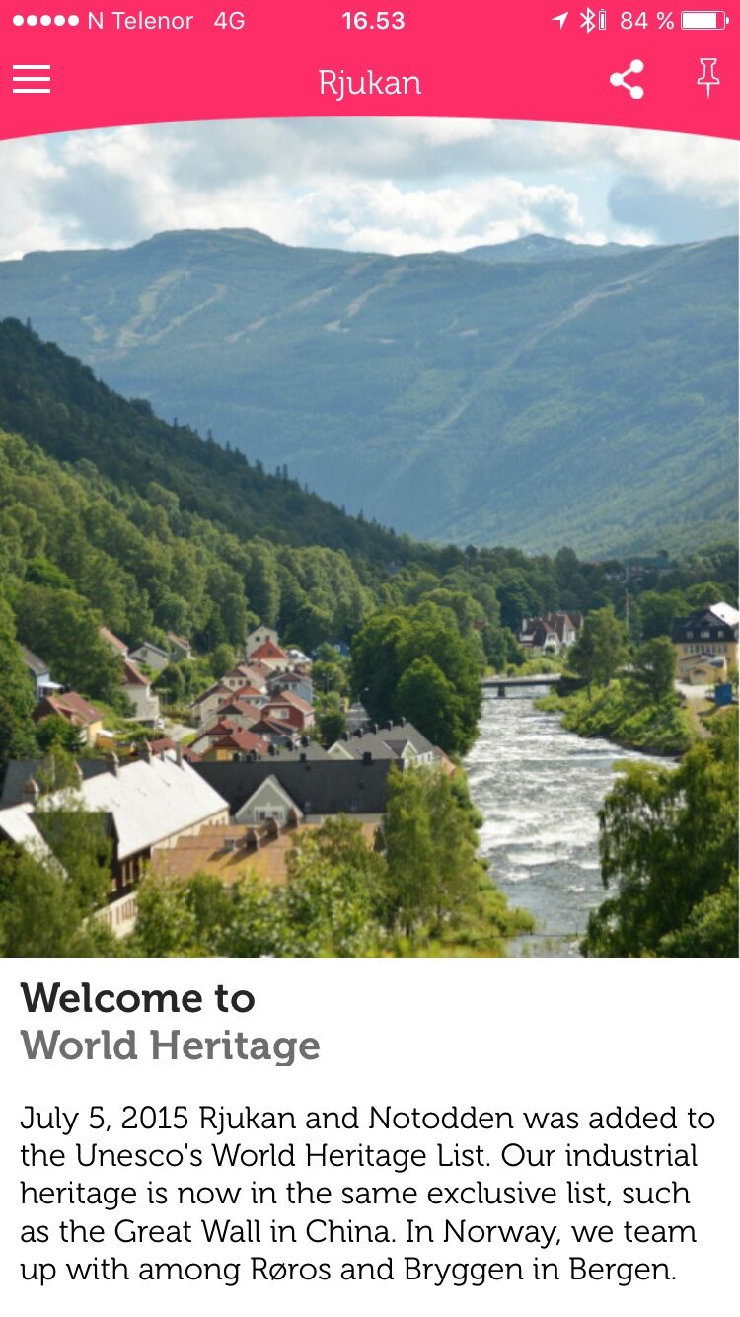
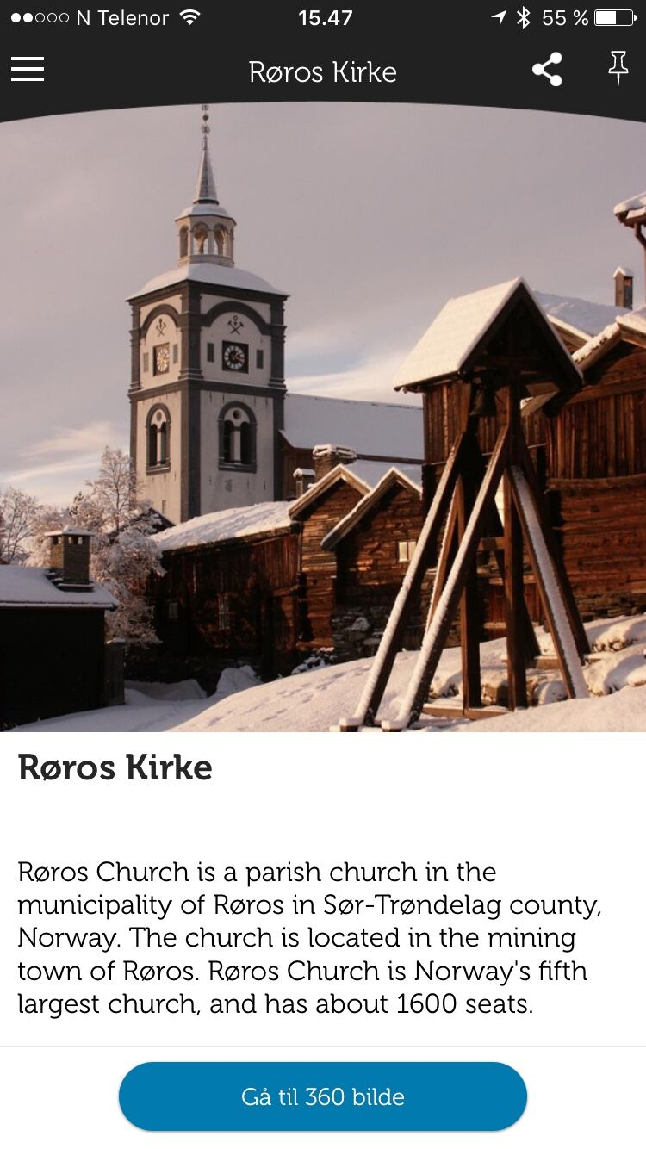
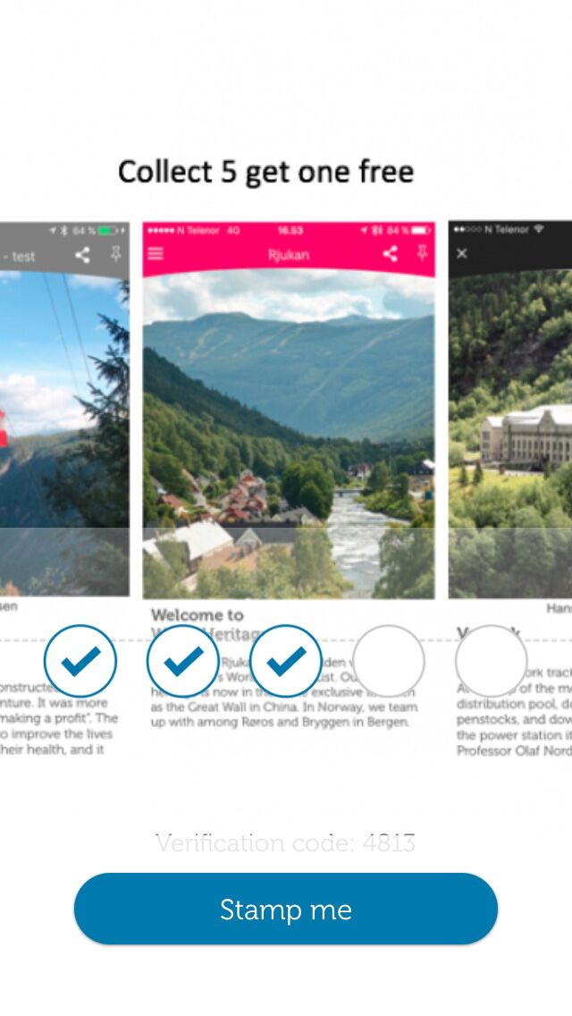
Digitalizing the Unesco destinations Røros and Rjukan
Digital event map – and digital guiding through each mobile
Geofence nearby
Beacon spots
Loyalty point
Røros
Digital guide via mobile - across attractions and tourist services
Map over digital services nearby - wifi, VR, mobile-hides etc
Rjukan plus Norwegian destinations
Open loyality program and Røros or Visit Norway
Blockchain, mobile currency, loyalty bank

Slide 8



Emerging mobile, iot and loyalty to cover Retail needs
Mobile Dialog/Digital Marketing
Fluxloop
IoT
Loyalty
Travel programs
Dsafe
Maincard
Standalone
Beacons, QR/Barcode Scanner projects
Insight/ AI analysis
8

