Slide 1
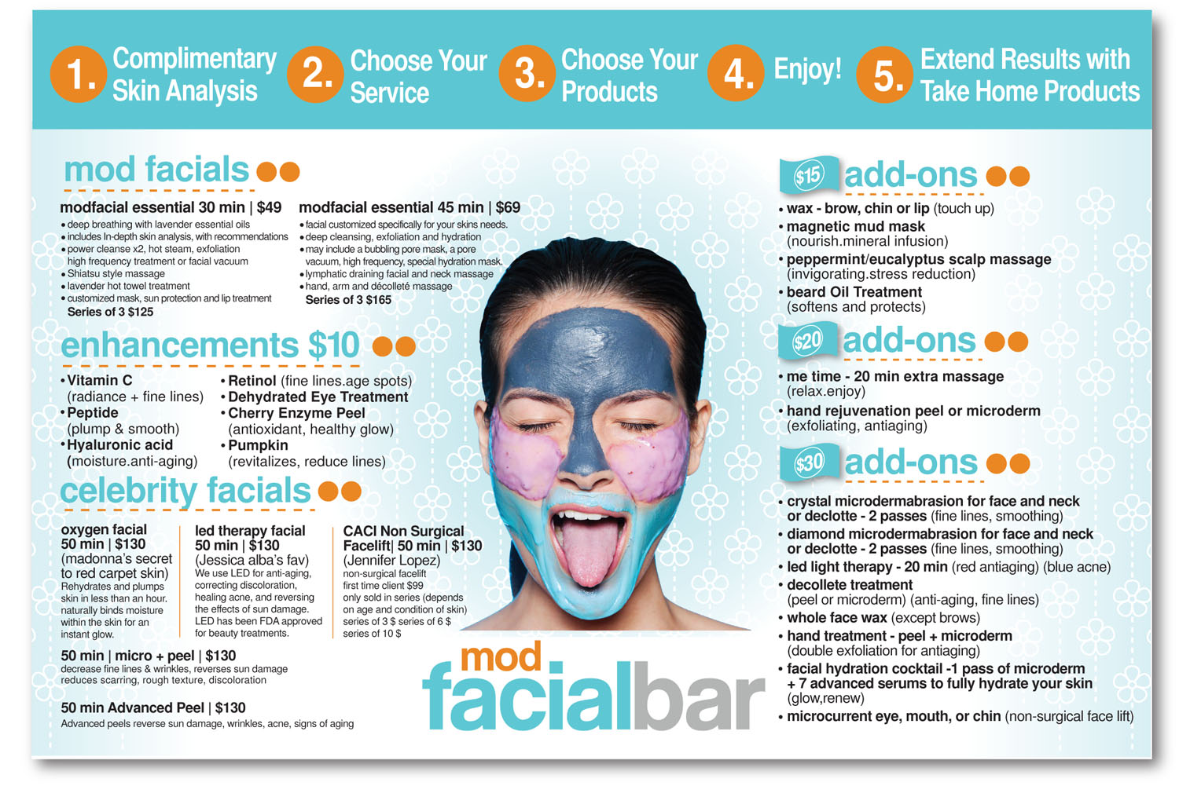
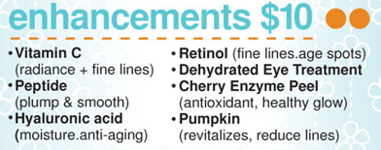

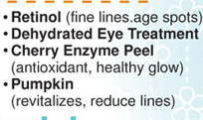
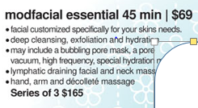
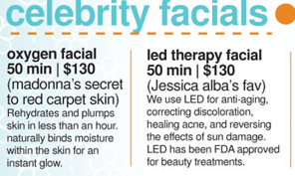
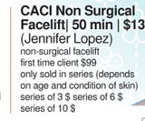
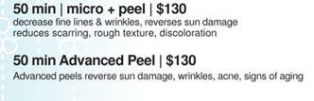
1. choose your facial
2. complimentary skin analysis
3. choose enhancements/products (advice given)
4. relax + enjoy
5. extend results with take home products
$15
$20
$30
…need more aggressive results?
Notes:
Hi, I apologize that last direction was not 100% clear. We’ve made an image to help explain this new direction…so scratch what I wrote previously.
Change the steps 1 – 5 as is shown in the yellow boxes at the top.
Remove the woman image from the menu (this gives us more space to work with)
Stack the two mod facials on top of each other.
Move enhancements over and stack those as well.
Add orange arrows to show the flow…we want them to select a facial, then select an enhancement, then select an add-on. The more they add the more money we make…
Keep celebrity facials at the bottom, but fill more towards the right.
Add some sort of a way to distinguish the celebrity facials area from the rest of the menu. Celebrity facials are the most expensive…we kind of want it to look special. I thought maybe an orange box around it, but I’m not a designer…an orange box may suck, so please use your judgment.
Write “…need more aggressive results?” as a note or something above celebrity facials. The thought is, if they need more aggressive treatment then they’ll pay more for the celebrity facials.
Remove the dollar bill icon in front of “add-ons” then add the $15, $20, and $30 text only at the end of the word add on. (keep the orange dots at the end)

