Slide 1



Brand Presentation
Providing Innovative & Safe Solutions in:
                ● Bedtime!
                ● Bath time!
                ● On-the-Go!
Presented by:
NDW Products Inc.
Noah Diamond ● noah@ndwproducts.com ● (416) 951-0792

Slide 2

About Us
At Baby Works™, we pride ourselves in developing practical, innovative and safe products that work for you and that work for your baby.
Since 1995, our team of industry experts has been providing innovative & safe solutions to help make parents’ lives easier. Our unique range is a culmination of 25+ years of industry knowledge through research & innovation. From cleverly designed maternity and toddlers pillows, to bedding, bath and products for on-the-go, here you’ll find QUALITY, CONVENIENT & COMFORTABLE solutions to carry you through the many milestones of pregnancy and beyond.

Slide 3
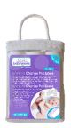
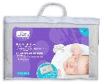
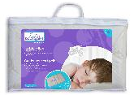
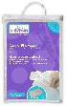
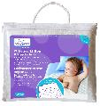
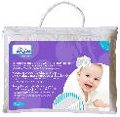
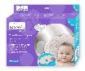

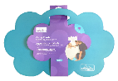
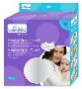
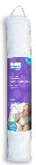
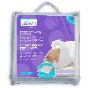
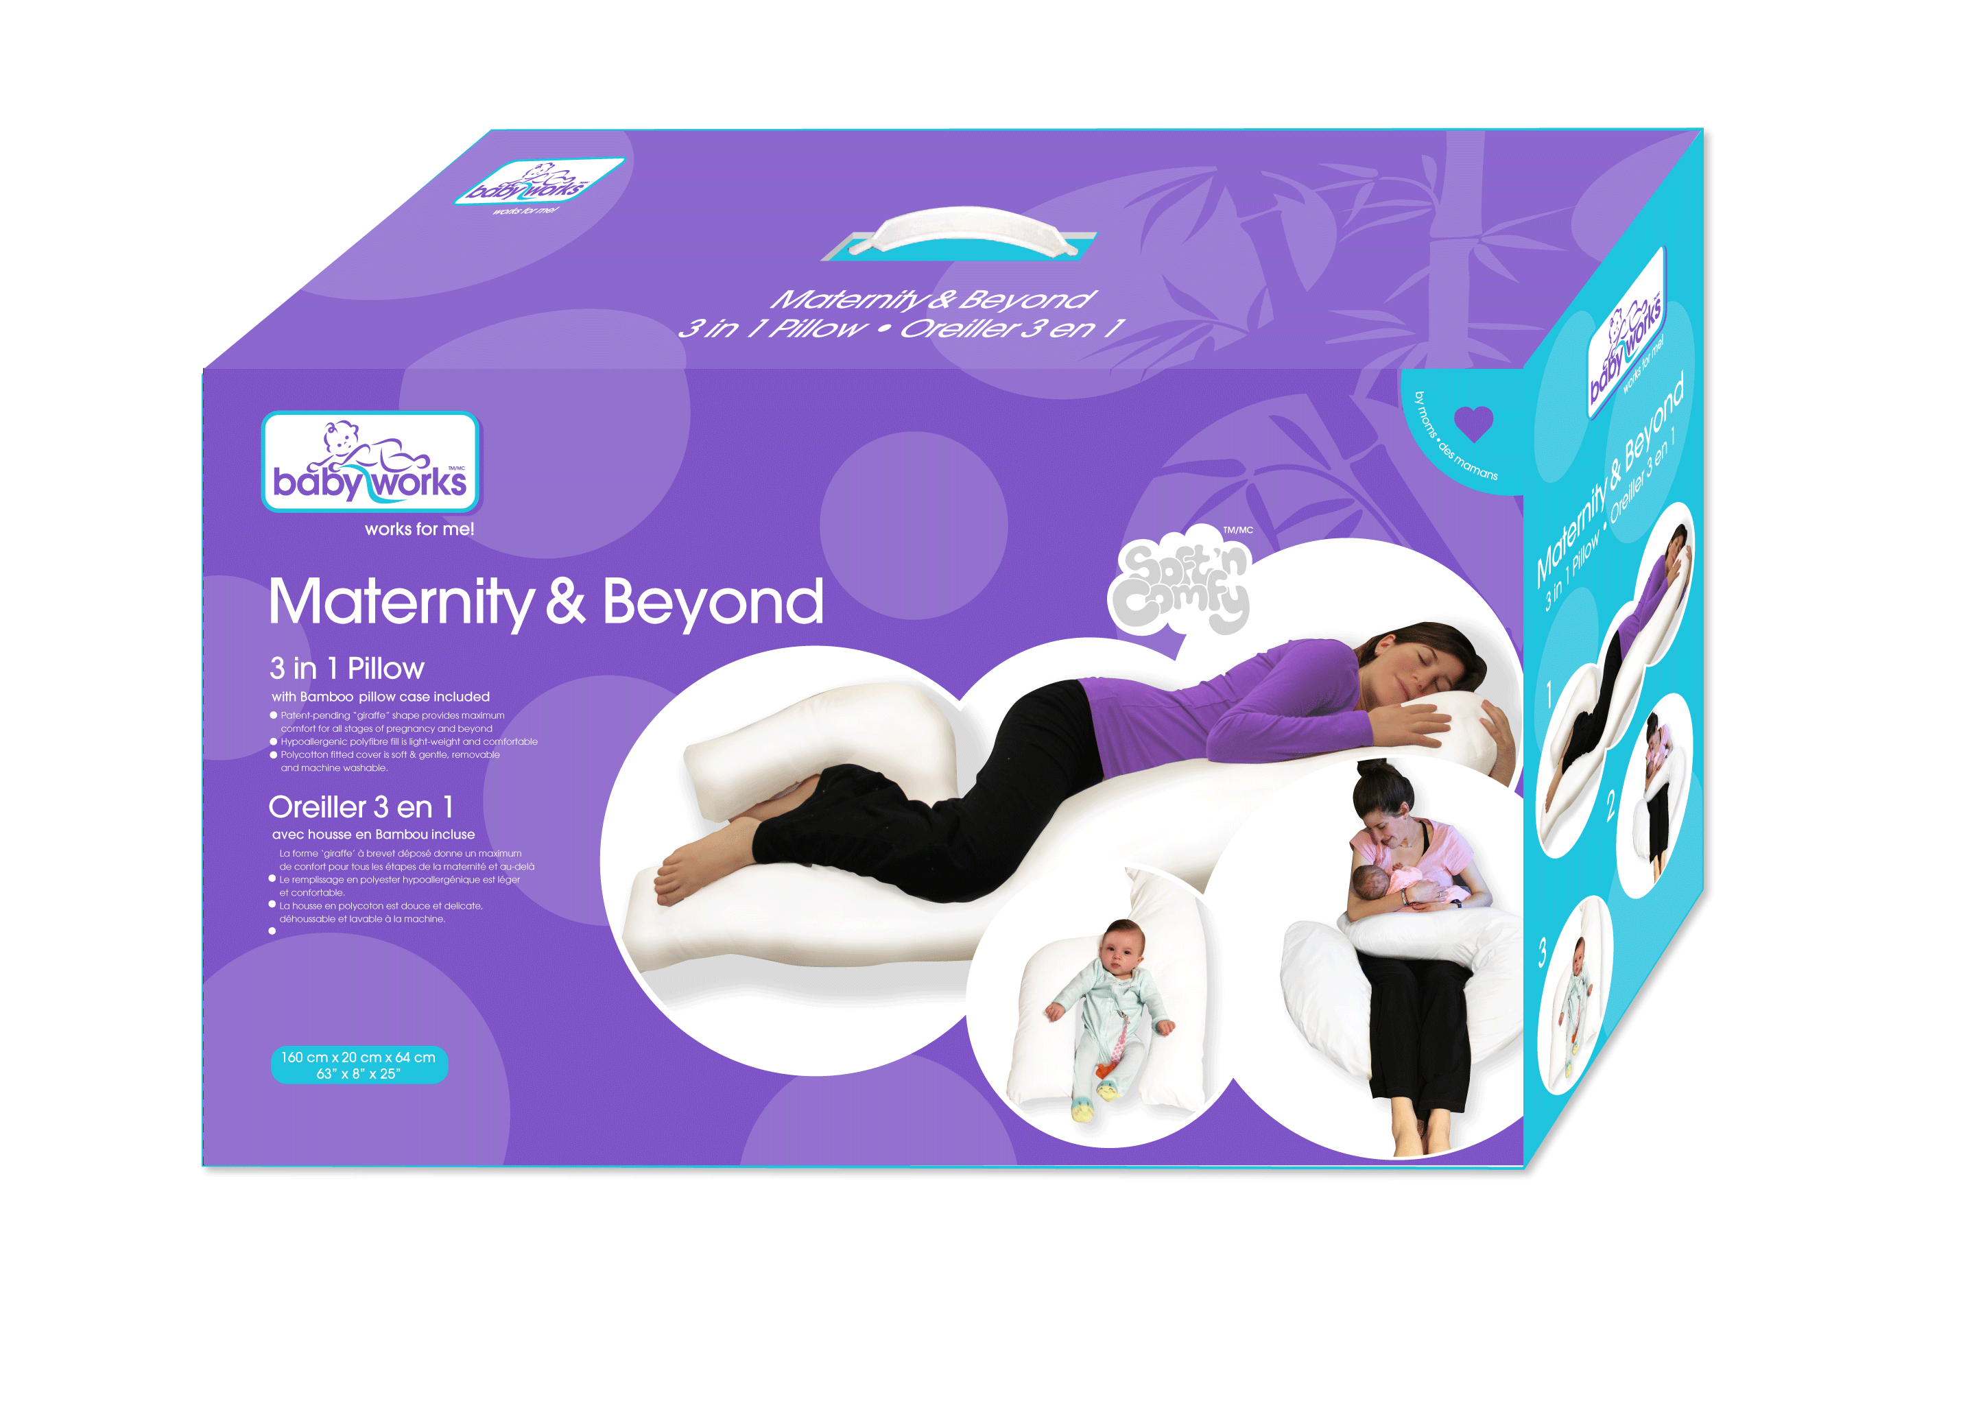
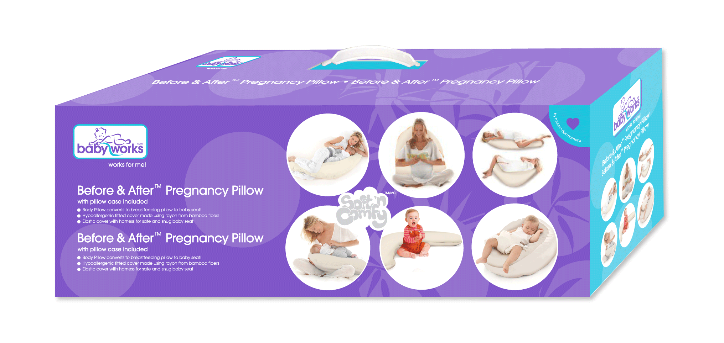
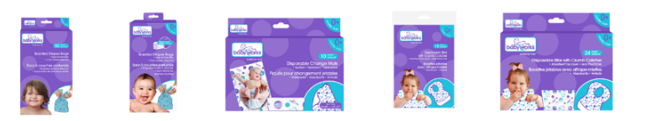
Range
Bed
Cloud 9™ Head Support
Baby’s 1st Pillow
Toddler Pillow
Toddler Pillow Case
Waterproof Mattress & Sheet Protector
Quilted & Fitted Bamboo Crib Mattress Protector
Bamboo Change Pad Liners – 3pk
Bath
Bamboo Washcloths – 6pk
Bamboo Hands Free Hoodie™ Towel
Cloud 9™ Comfy Kneeler
Mommy
Pregnancy Wedge
Maternity & Beyond™
3in1 Pillow
Before & After™
Pregnancy Pillow
Flexi™ Pillow
Disposables
Scented Diaper Bags 50ct
Scented Diaper Bags 200ct
Disposable Change Mats 10pk
Disposable Bibs with Crumb Catcher 12pk
Disposable Bibs with Crumb Catcher 24pk

Slide 4

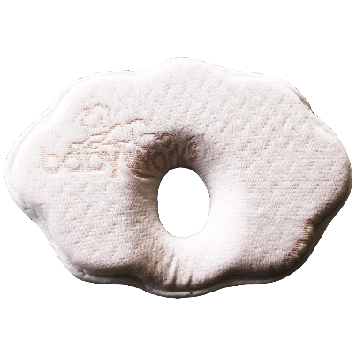
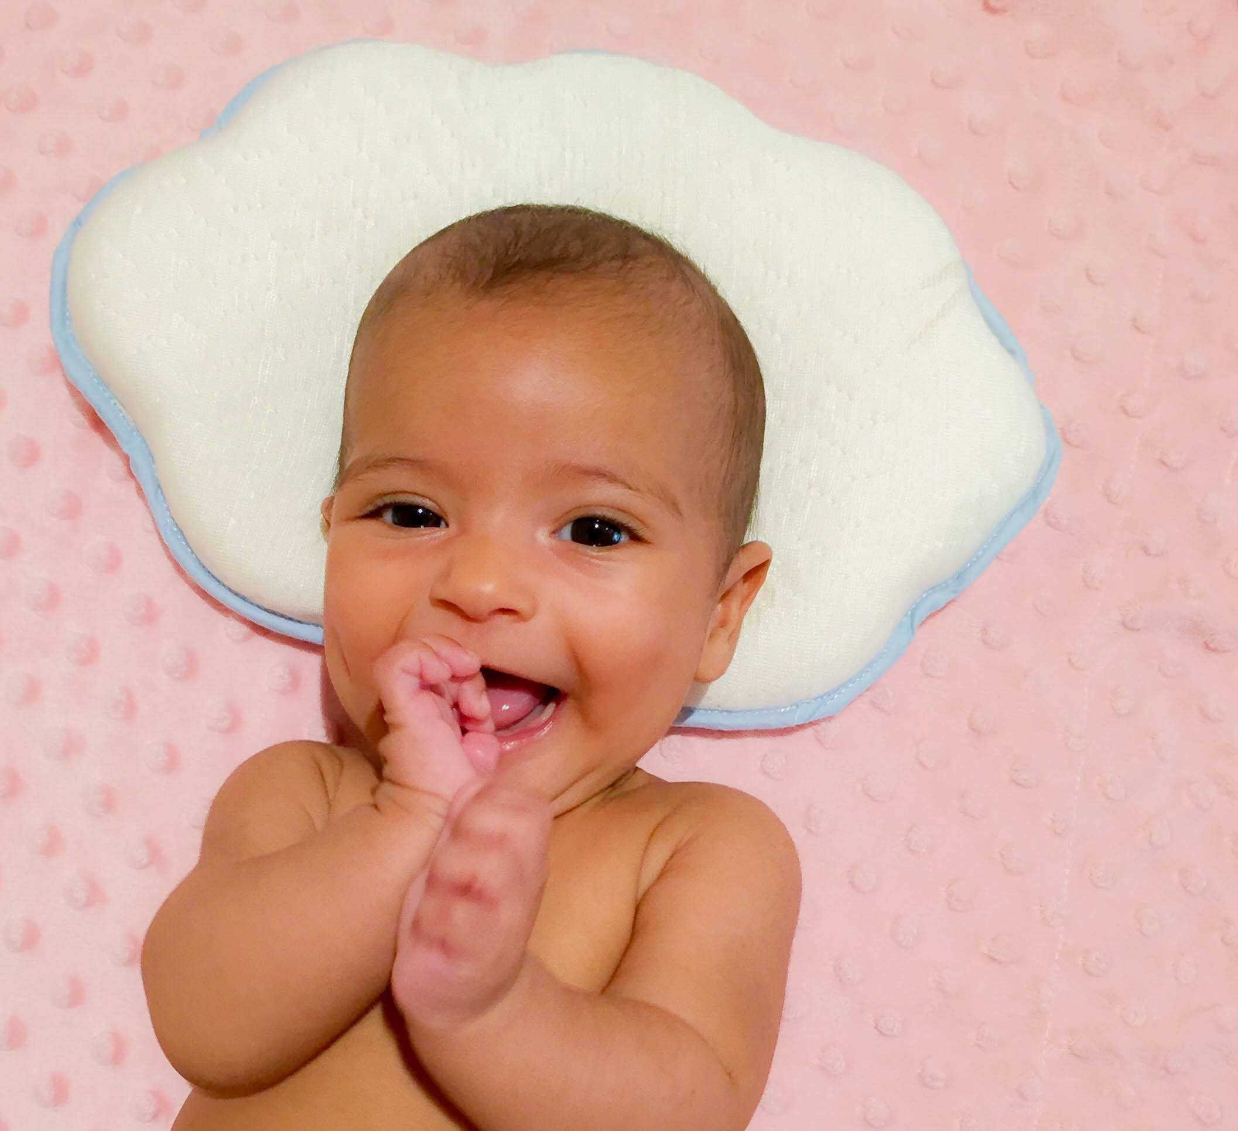



Bedtime!
Cloud 9™ Head Support
Specially designed to support baby’s head
Helps relieve pressure on cranium
Perfect for use in a stroller, car seat, bouncy seat and swing
Hypoallergenic fitted cover made using rayon from bamboo fibers
Stays cool & thermo-regulating
11cm x 7cm support perfect for back of baby’s head!!
0 months +
19.13 x 23.05
7.5” x 11.04”

Slide 5
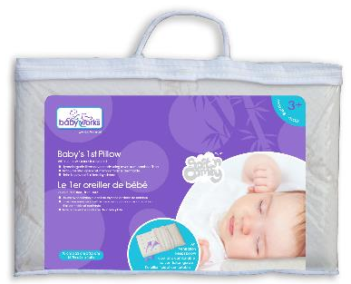
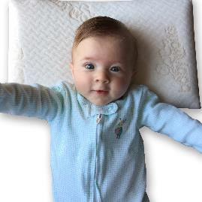
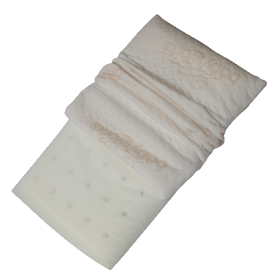
Bedtime!
Baby’s 1st Pillow with Bamboo Pillow Case
Hypoallergenic fitted cover made using rayon from bamboo fibers
Airflow treated open-cell memory foam is breathable
Helps to prevent flat-head syndromeStays cool & thermo-regulating
3 months +
40 x 23 x 3 cm
15.7” x 9.05” x 1.37”
Removable & washable cover!

Slide 6
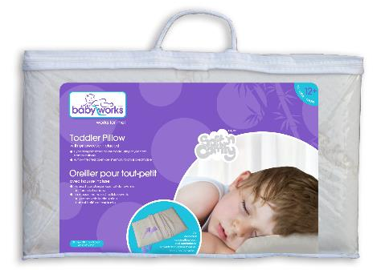

Bedtime!
Toddler Pillow with Bamboo Pillow Case
Perfect size for toddlers’ comfort & support
Hypoallergenic fitted cover made using rayon from bamboo fibers
Airflow treated open-cell memory foam is breathable
Stays cool & thermo-regulating
12 months +
50 x 30 x 5.5 cm
20” x 12” x 2.2”
Removable & washable cover!

Slide 7

Bedtime!
Toddler Bamboo Pillow Case
Replacement cover is same as original pillowcase
Hypoallergenic fitted cover made using rayon from bamboo fibers
Stays cool & thermo-regulating
24 months +
50 x 30 x 5.5 cm
20” x 12” x 2.2”
Removable & washable cover!

Slide 8

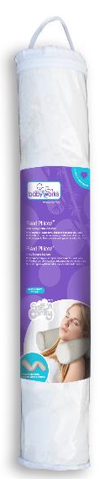
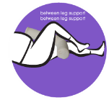
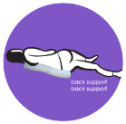
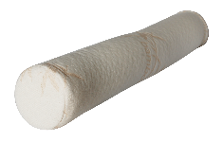
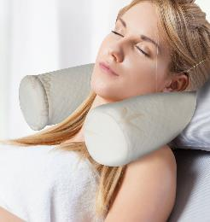
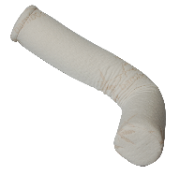

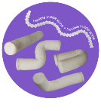
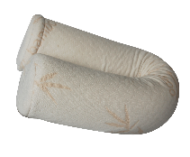
Bedtime!
Flexi Pillow with Bamboo Pillow Case
Multipurpose “magic spine” bends and adjusts to any shape
Versatile and can be used in many positions for added comfort
Hypoallergenic fitted cover made using rayon from bamboo fibers
Airflow treated open-cell memory foam is breathable
Ideal for neck support, lumbar support and hip alignment
Stays cool & comfortable
63 x 10 cm
25” x 4”

Slide 9
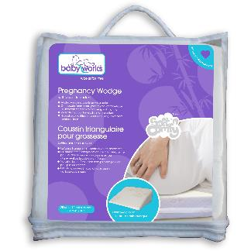
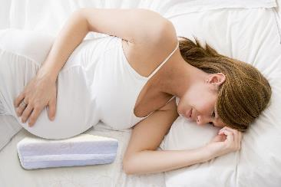
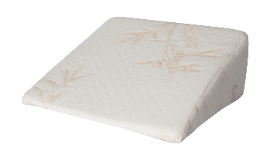
Bedtime!
Pregnancy Wedge with Bamboo Cover
Orthopedic foam provides maximum comfort & support for side sleeping
Hypoallergenic fitted cover made using rayon from bamboo fibers
Use between your legs for aligning hips and spine
Elevate your feet while resting or feeding
Level any surface
Stays cool & comfortable
25 x 10 x 10 cm
10” x 10” x 4”

Slide 10
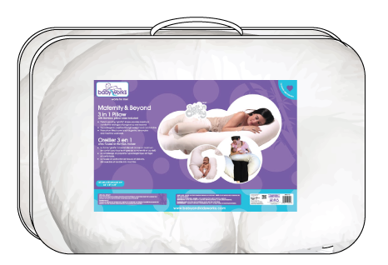
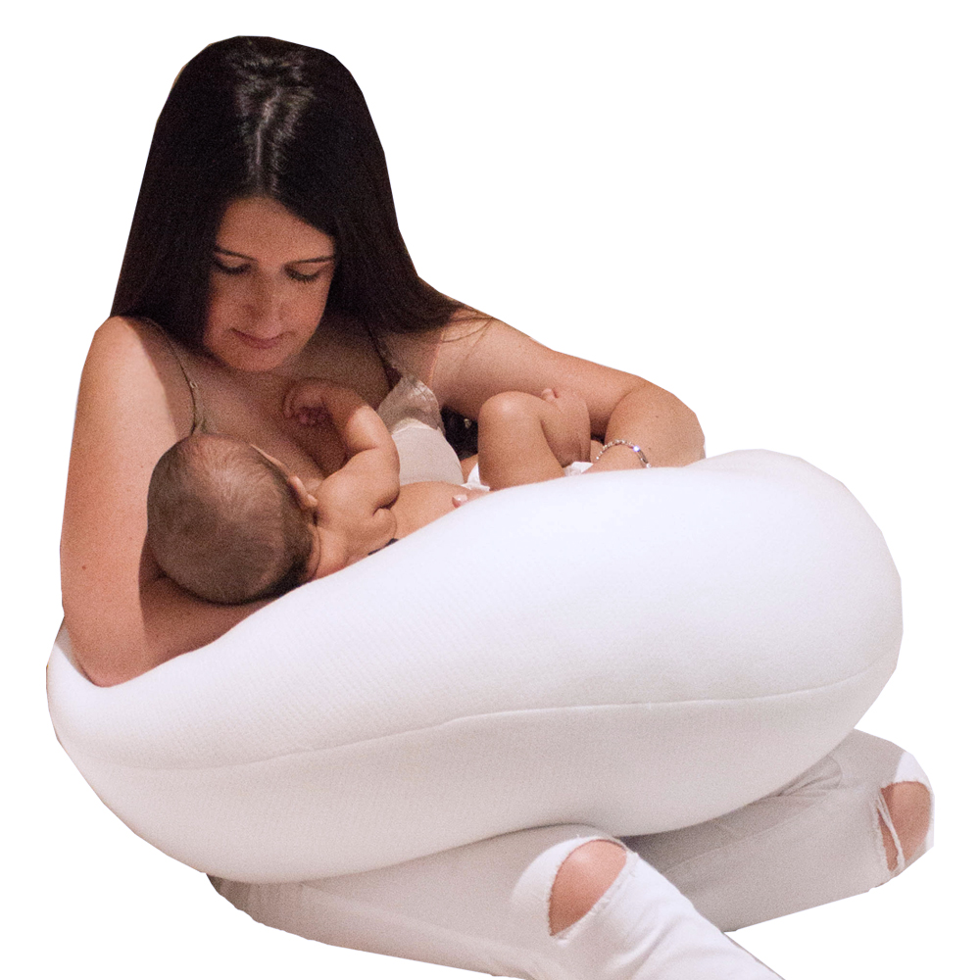
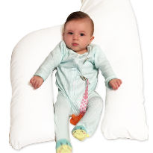
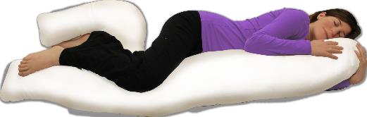
Bedtime!
Maternity & Beyond 3in1 Pillow with Bamboo Cover
Provides maximum comfort for side sleeping
Support between legs and thighs for hip, back and lumbar support
Hypoallergenic polyfibre fill is light-weight and comfortable
Hypoallergenic fitted cover made using rayon from bamboo fibers
Stays cool & thermo-regulating
1
2
3

Slide 11
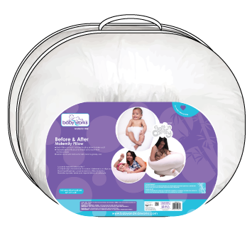
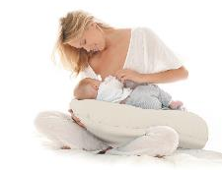
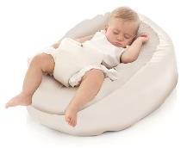
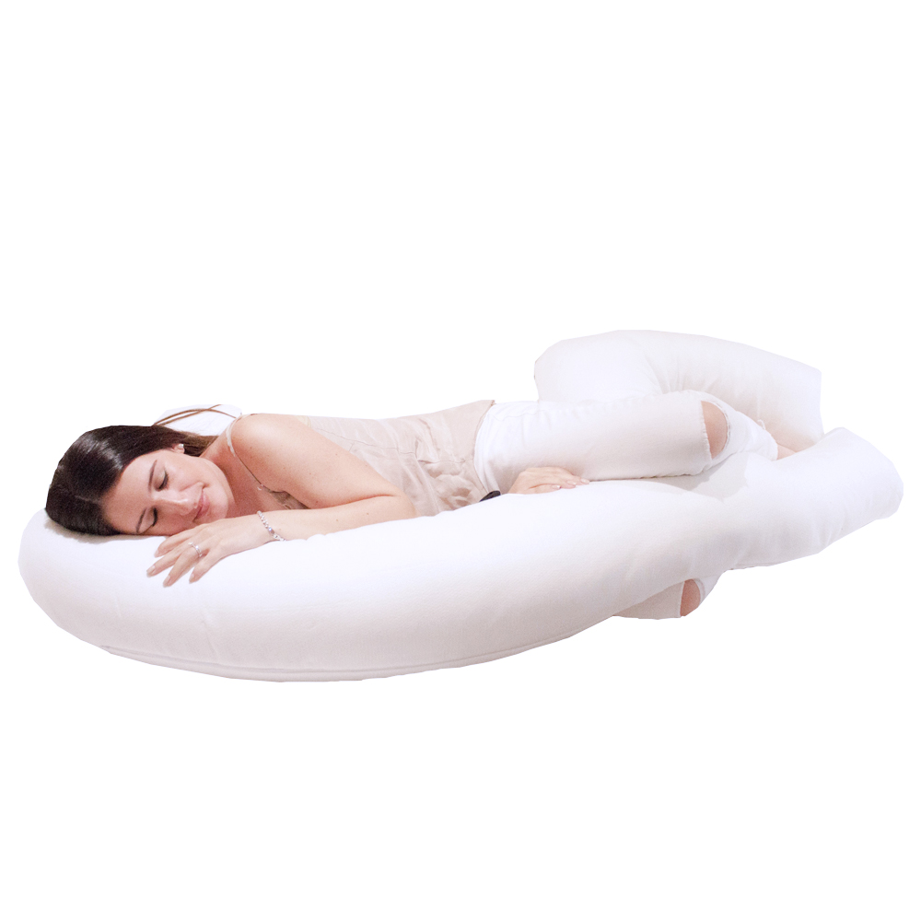
Bedtime!
Before & After Pregnancy Pillow with Bamboo Cover
Body Pillow converts to breastfeeding pillow to baby seat!
Hypoallergenic fitted cover made using rayon from bamboo fibers
Elastic cover with harness for safe and snug baby seat
1
2
3

Slide 12
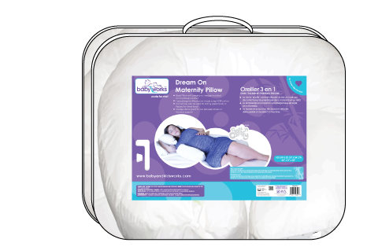
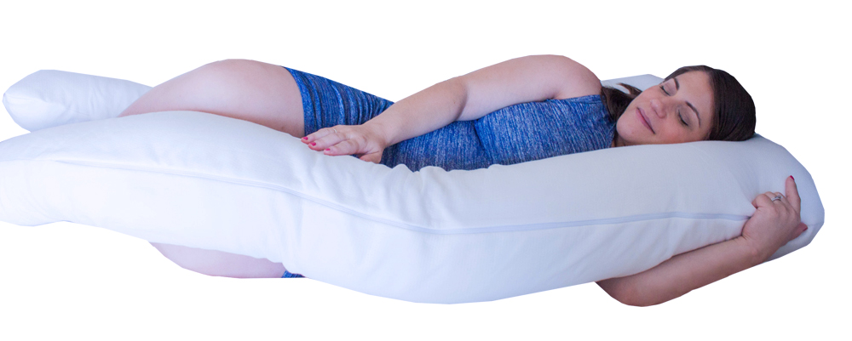
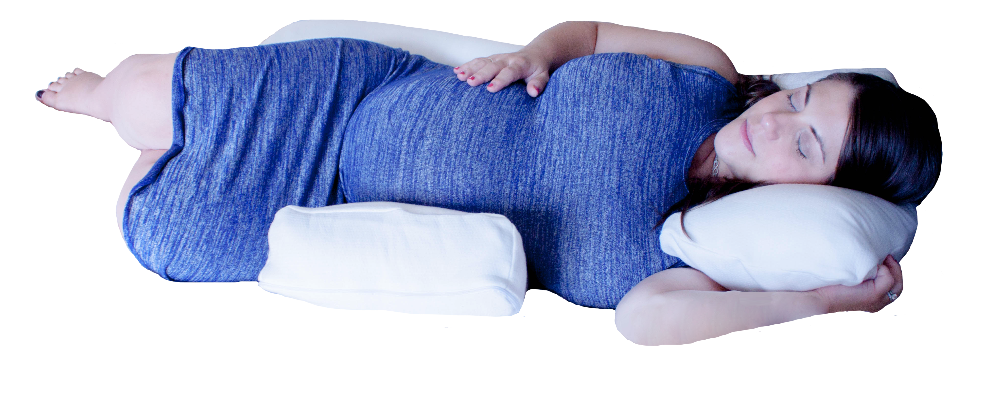
Bedtime!
Dream On Pregnancy Pillow
Body Pillow with pregnancy wedge included for total body comfort
Hypoallergenic fitted cover made using 100% cotton
Curved top can be used for resting upper body or flipped for lower body
Wedge also is great for use between knees or for back support

Slide 13
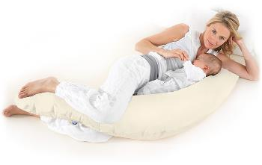
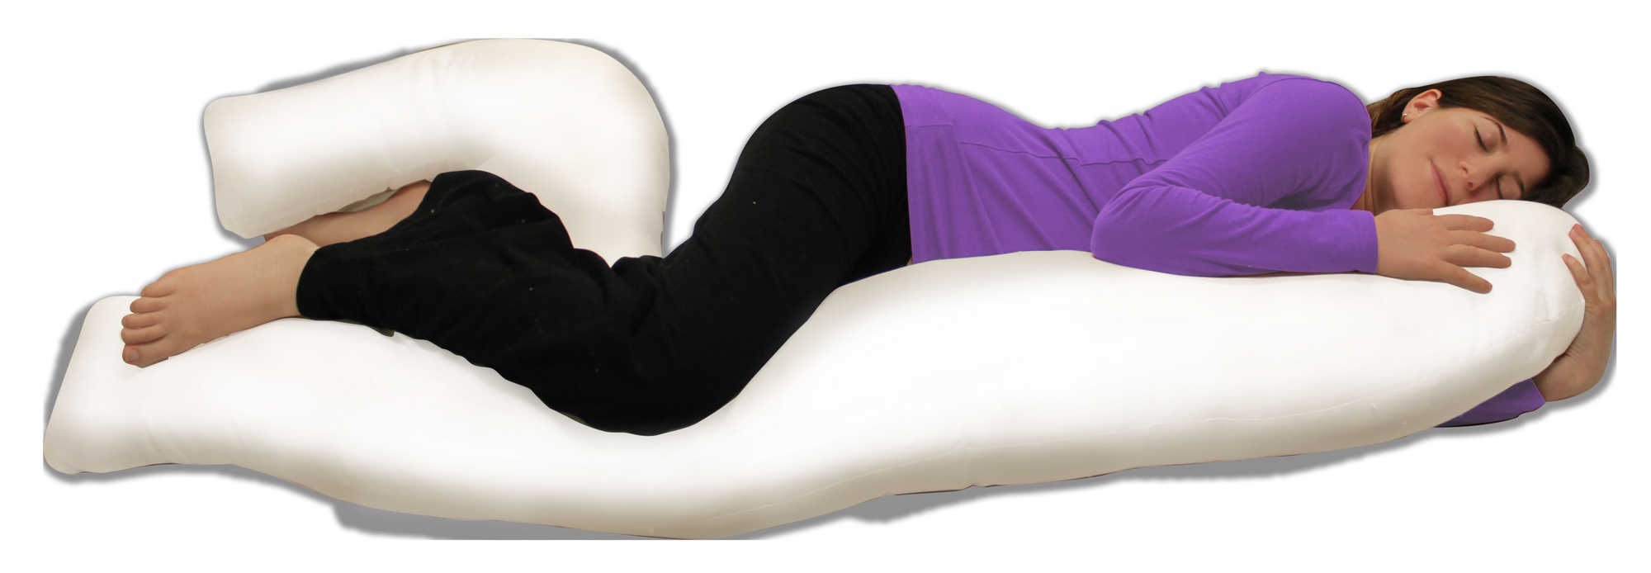
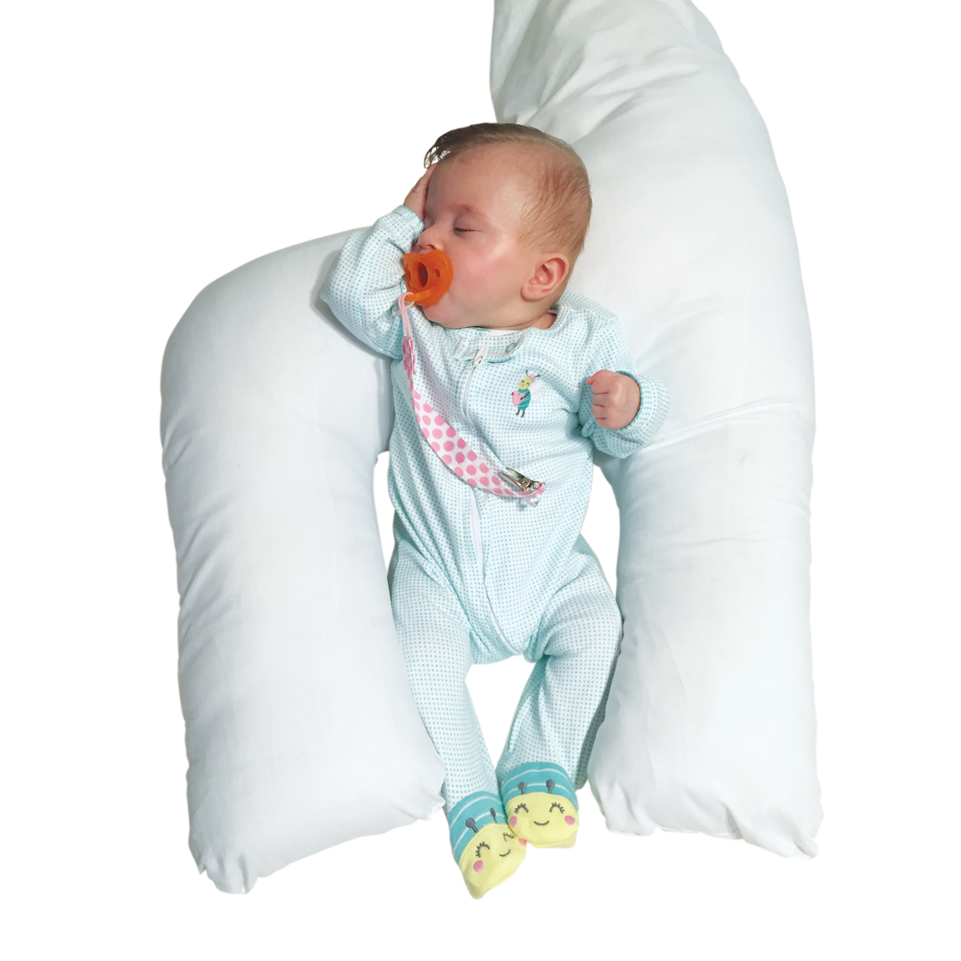
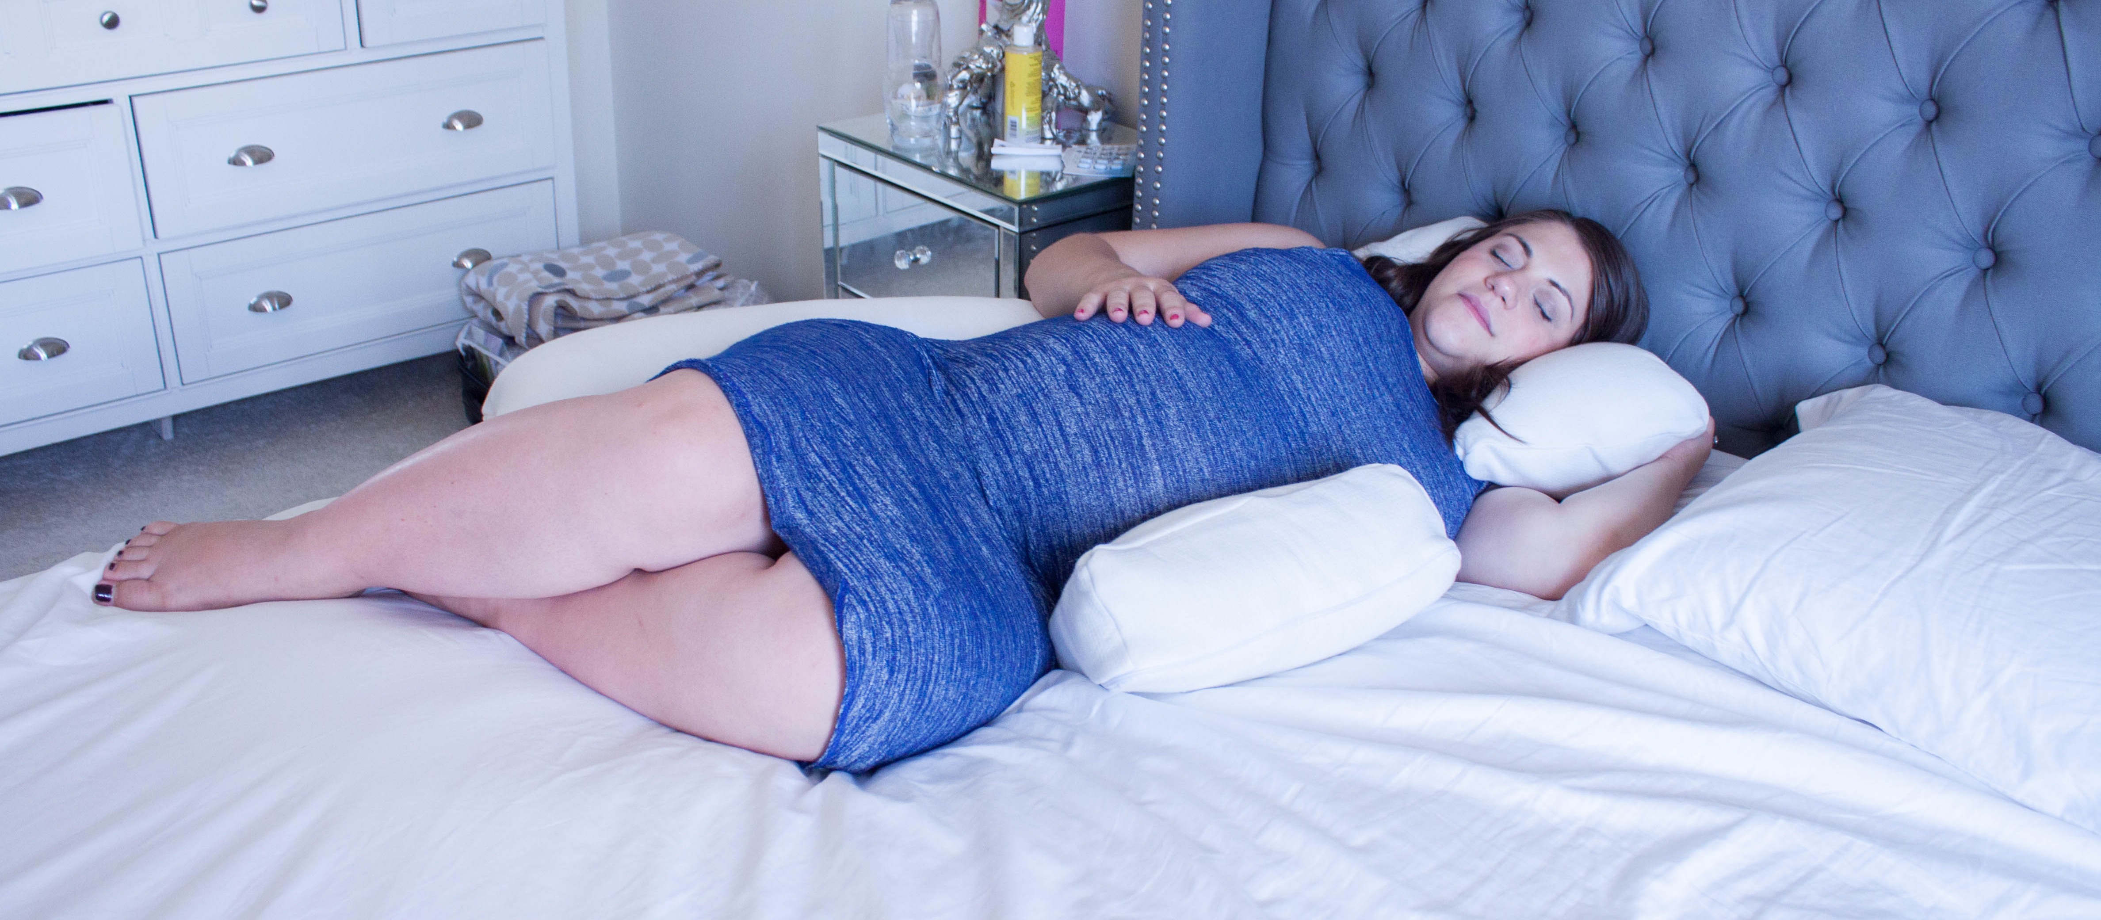
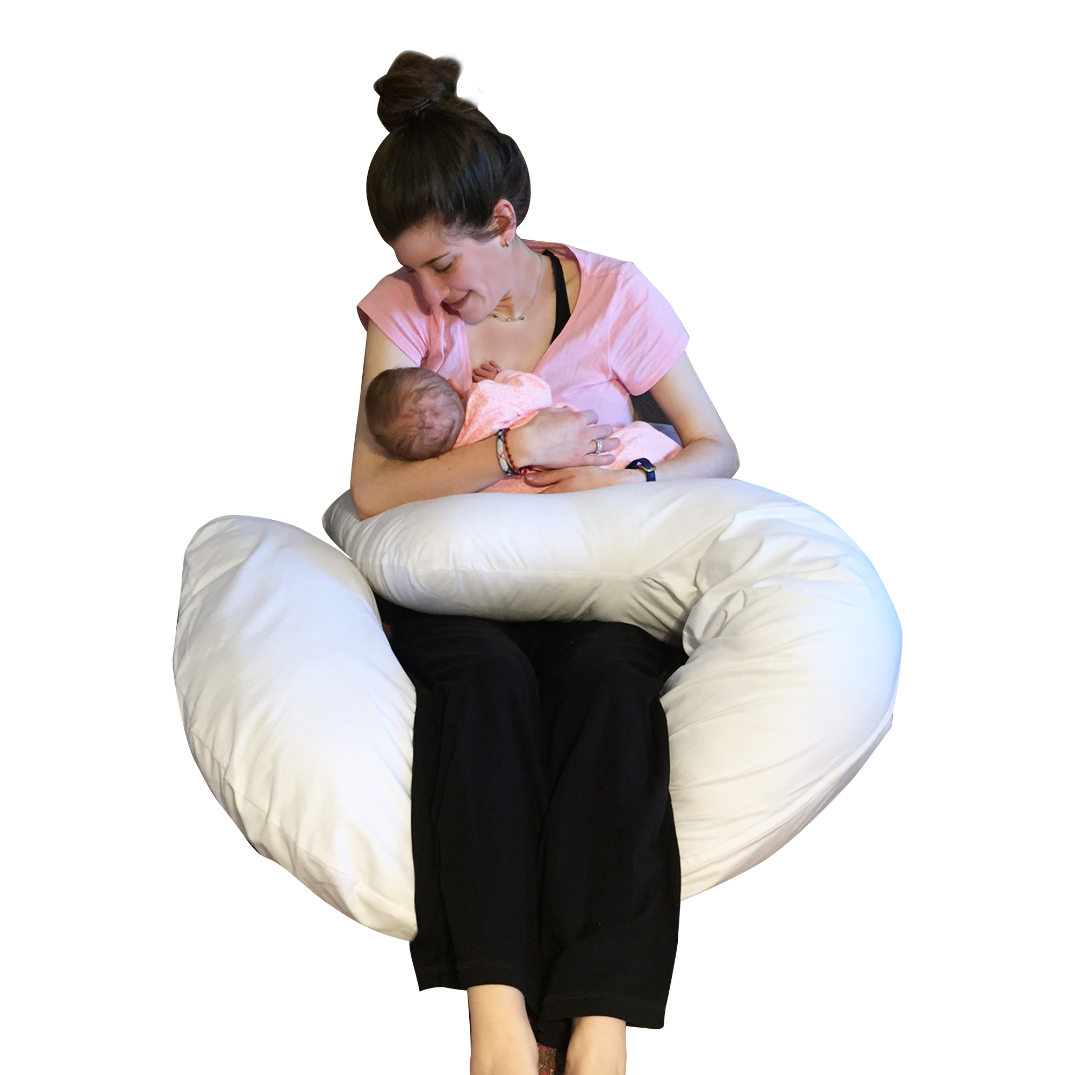
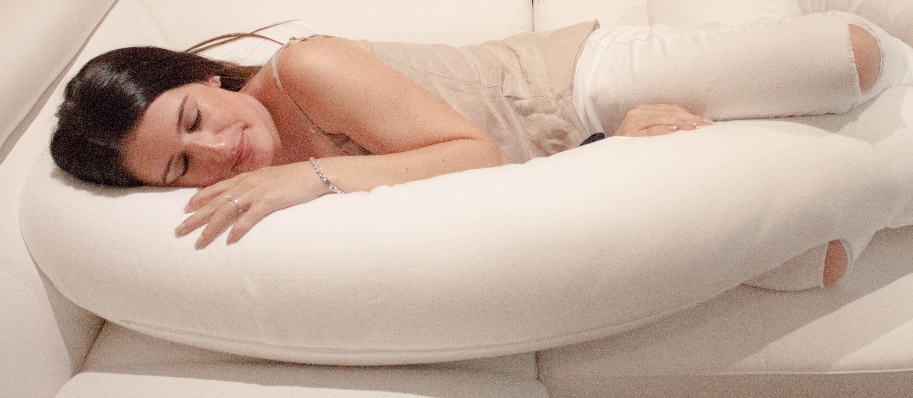
Bedtime!
Maternity & Beyond™ 3in1 Pillow with Bamboo Cover
Before & After™ Pregnancy Pillow with Bamboo Cover
Dream On™ Pregnancy Pillow with Cotton Cover
Patent-pending “giraffe” design for multi-use
Can be used as a body pillow, feeding pillow and baby positioner
Provides exceptional support for side sleeping with support for knees, legs and hips!
Crescent shaped body pillow snaps together at each end and comes with a seat cover and harness to become a baby lounger
Also can be used as a feeding pillow with the ability to snap the pillow closed behind your back for a comfortable and secure breast-feeding experience
Body Pillow with pregnancy wedge included for total body comfort
Hypoallergenic fitted cover made using 100% cotton
Curved top can be used for resting upper body or flipped for lower body
Wedge also is great for use between knees or for back support

Slide 14
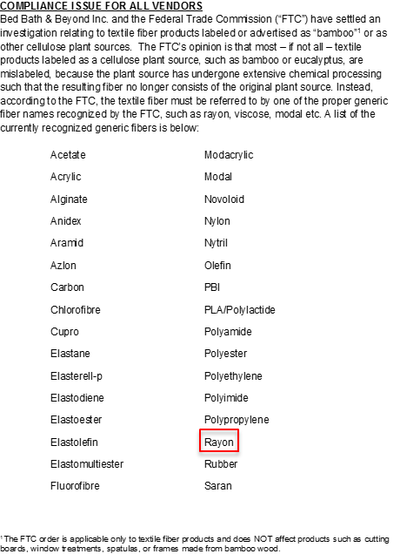
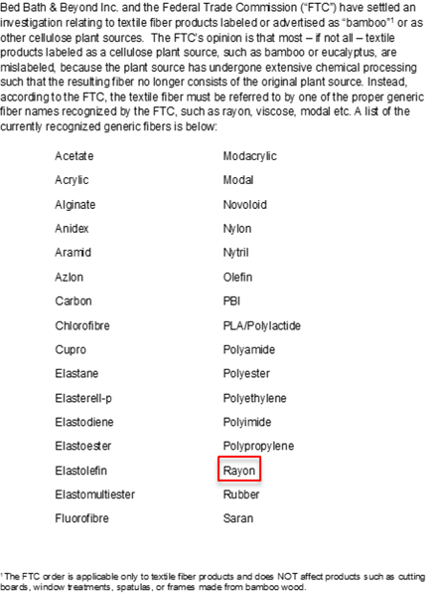





Bedtime!
Packaging Concept
Pregnancy Wedge
Toddler Pillow
Flexi™ Pillow

Slide 15


Bedtime!
Waterproof Mattress & Sheet Protector
Protects mattress and keeps bed sheets dry throughout toilet training
Use in any size bed!
100% waterproof with non-slip backing
Soft quilted poly-cotton surface with tuck-in flaps is
absorbent
Bleachable, machine washable and dryable
Keeps bed sheets dry!
75 x 85 cm
29.5” x 33”

Slide 16


Bedtime!
Quilted & Fitted Bamboo Crib Mattress Protector
Antibacterial & hypoallergenic protector made using rayon from bamboo fibers
Ultra soft and regulates to baby’s body temperature
Helps to prevent dust mites and mold from breeding in the mattress
Breathable & waterproof liner that is super absorbent
Economical and environmentally-friendly: Machine washable and dryer-safe
PVC-free, phthalate free and PBDE free
Keeps bed sheets dry!
130 x 70 cm
52” x 28”

Slide 17



Bedtime!
Bamboo Change Pad Liners
Antibacterial & hypoallergenic liners made using rayon from bamboo fibers
Large ultra soft and extra absorbent surface for larger babies too!
Economical and environmentally-friendly: Machine washable and dryer-safe
Can also be used as burp cloths or to be placed on car seats, swings, bouncy seats and highchairs to catch messes
Economical 3pk
62 x 33 cm
25” x 13”

Slide 18



Bdth time!
Cloud 9™ Comfy Kneeler
Extra-large ergonomic design to protect knees and legs
Made of thick & durable water-resistant foam
BPA Free & Phthalate Free
PDQ of 6 units!
48 x 30cm
18.9” x 11.8”

Slide 19


Bdth time!
Bamboo Washcloths 6pk
Made of rayon from bamboo fibers
Super absorbent and spectacularly soft
Hypoallergenic and perfect for sensitive skin
Generous 8”x8” size is ideal for bath time or mealtime!
Economical 6pk
20 x 20 cm
8” x 8”

Slide 20


Bdth time!
Bamboo Hands Free Hoodie
Premium & luxurious comfort & absorbency
Extra large hooded towel perfect for toddlers too!
Unique apron design features pull-over neck hole & Velcro fastens around parents’ backs to make “hands free”
Soft & cozy rayon from bamboo & organic cotton terry
Perfect for toddlers too!
100 x 100 cm
39.4” x 39.4”

Slide 21


On-the-Go!
Disposable Change Mats
Quilted, Absorbent & Leak-proof
Ideal and convenient for use at home or while on-the-go!
Comfortable on baby’s skin & prevents liquids from seeping through!
10pk

Slide 22




On-the-Go!
Disposable Bibs with Crumb Catcher
Quilted, Absorbent & Leak-proof
Ideal and convenient for use at home or while on-the-go!
Comfortable on baby’s skin & prevents liquids from seeping through!
12pk & 24pk

Slide 23




On-the-Go!
Scented Diaper Bags
Easy tie handles
Easy diaper disposal
Convenient solution for soiled diapers
Baby powder scented helps to neutralize odours
50pk & 200pk
4 x 50ct inner grab bags!

Slide 24



NPD
Extra-Long Anti-Slip Bath Mat
Extra-long for 30% more coverage than conventional bath mats
Covers entire bath surface for added safety for bathing 1 or 2 active children
ANTI-MICROBIAL, Mold & Mildew Resistant
BPA Free, Non-toxic, phthalate free, latex free, Hypoallergenic, Machine Washable
Fits the entire tub!
40cm x 100cm!

Slide 25


Thank You!
Presented by:
NDW Products Inc.
Noah Diamond ● noah@ndwproducts.com ● (416) 951-0792

