Slide 1
Almonds Ville

Slide 2


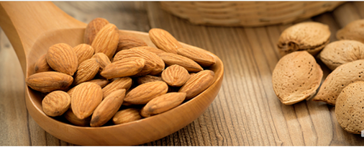
Logo looks simple
Need to have either an almond tree, or abstract almond bean like an example below in the logo. Picture looks elegant but the font is more in bold kind of style. The tree needs to make customer recognize that it is almond tree. The customer needs to feel the freshness of the product.
Layout: picture photo in the middle but open for other ideas
Inspirational Photo – great quality almond roasted from the oven daily – focus on freshness
The product is the fresh roasted almond (100% imported). It is roasted with perfect degree of heat and duration. Our process with fresh roasted from the oven daily makes our product unique taste (both smell and texture). In addition, there will be popular seasoning added to make it more tasty. Target customer is female customer (22-34 years old) who loves almond and need some tasty snack with no oil.

