Slide 1

Your home in Central London

Slide 2
Because you can’t bake cookies in a hotel room!

Slide 3
About us
At Merino Hospitality, we offer outstanding serviced houses and apartments in locations that are both central and peaceful. All our properties are both luxurious and homely and offer an experience far superior to a stay in a hotel or other corporate housing. In this brochure we will introduce you to each of our luxury properties, you can also find more information on our website. Our exclusive properties can be found in two addresses; Star Yard at Chancery Lane and a quiet Mews near Russell Square – Colonnade.
Caio and Louise Merino met during their studies at Les Roches Hotel Management School in Switzerland. After gathering knowledge and experience working for a variety of luxury brands such as the famous Savoy and Marriott Grosvenor Square Hotels in London, Burberry PLC, Casa Fasano in Sao Paulo and Hotel La Residencia in Mallorca, the couple created Merino Hospitality to fulfil their passion for hospitality and the demand for a private and comfortable alternative to hotels.
All our properties are extremely private and secure. Your comfort starts with our bespoke line of handmade mattresses, pristine bed and bath linen, Aromatherapy Associates and Pecksniff’s toiletries, SONOS audio system, complimentary WiFi, tailor-made welcome baskets, fresh fruits on arrival, basic amenities for kitchen/laundry and much more, all as standard. Access to a range of classic cars for hire, private chef, cooking classes, executive transfers and concierge services are but a few of the other services we have to offer to our guests.
We can be best defined as delivering the professionalism of a hotel and the convenience of serviced apartments in the exclusiveness of your own address in town, with the friendliness and knowledge of a local host.

Slide 4
COLONNADE Russell Square WC1
Located in a quiet and traditional cobbled mews street just around the corner from Russell Square tube (Piccadilly Line), in the charming neighbourhood of Bloomsbury, Midtown*, are our two three bedroom houses and 2 two bedroom houses. ‘Mews’ is a primarily British term formerly describing a row of stables, usually with carriage houses below and living quarters above, built around a paved yard or court, or along a street, behind large city houses, such as those of London, during the 17th and 18th centuries. Today most mews stables have been converted into dwellings, some greatly modernised and considered highly desirable residences.
Euston, King’s Cross and St. Pancras stations are only a 10-minute walk as are the British Museum, Covent Garden, Soho, the West End, Coram’s Fields and much, much more. It is also worth exploring the Brunswick Centre and Lamb’s Conduit Street for some interesting shops, cafes, restaurants and supermarkets.
*Midtown, “the square mile ’twixt West End and City — once such a dreary wasteland of traffic canyons and pallid office drones — is buzzing in a way that it has not since its Twenties heyday!”
Evening Standard

Slide 5
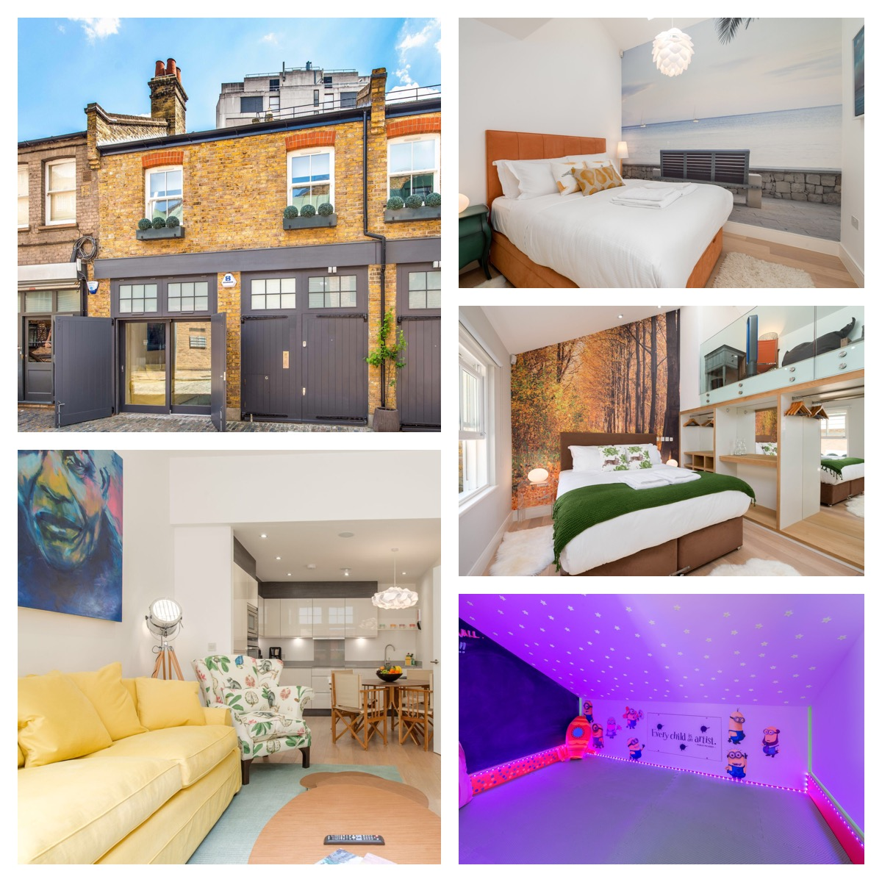
Orchid Way
This former coach house opens onto a quiet, cobbled street just a short walk away from London’s West End. - Open-plan living/kitchen - Two large double bedrooms - Mezzanine with futon & office area - SONOS audio system - Two spacious bathrooms - Washer/dryer and dishwasher
Underfloor heating throughout
Wine Cellar
Private parking space
Skylight windows
Secret children’s play den
Electronic Safe
944 Sq Ft – 87.81Sq M
4
2
2
2
BOOK NOW

Slide 6
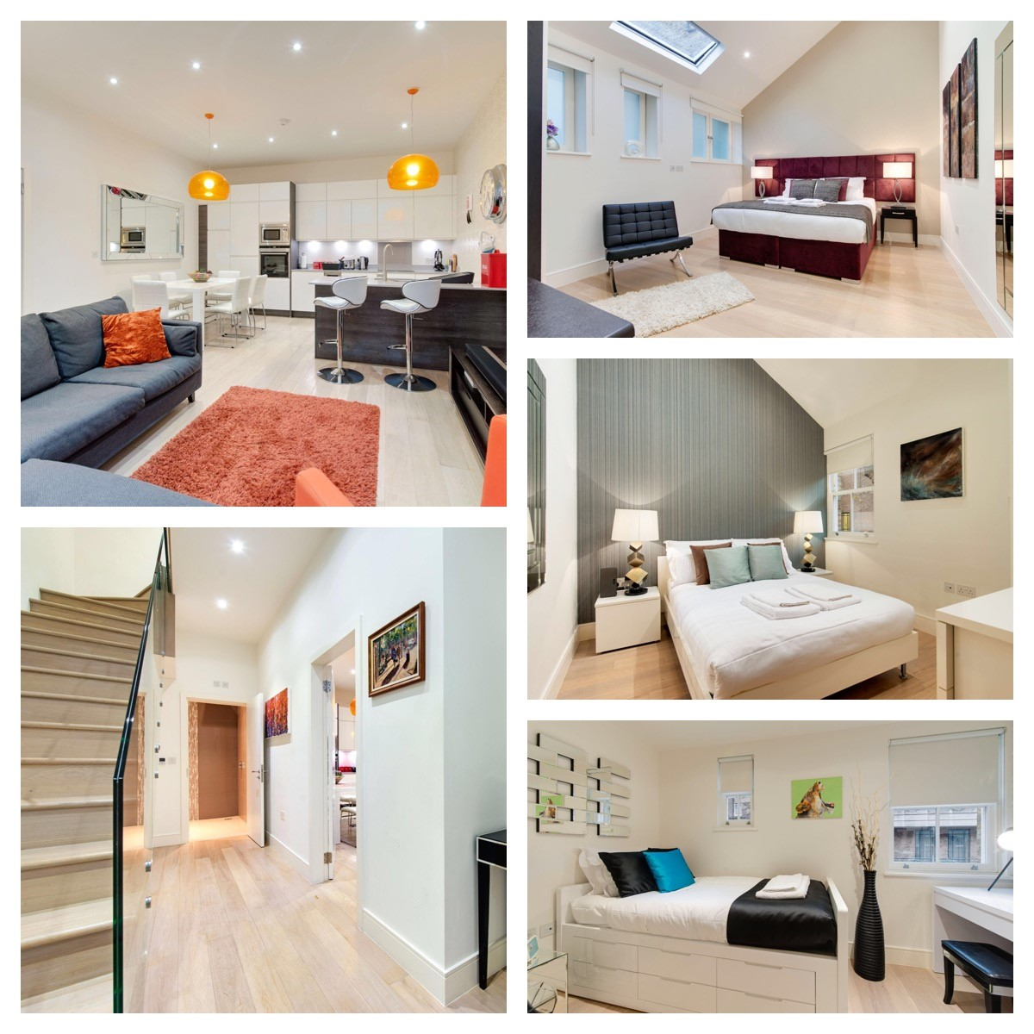
The Old Coach House
This modern transformation of a former coach house offers plenty of space and comfort to spoil everyone in your party.
Large open-plan living/kitchen area
Two double bedrooms
One twin bedroom
Two bathrooms.
SONOS audio system
Fully equipped, modern kitchen
Washer/dryer and dishwasher
Private parking space
Underfloor heating throughout
Wine cellar
Electronic Safe
1036 Sq Ft – 96.24 Sq M
6
3
2
2
BOOK NOW

Slide 7
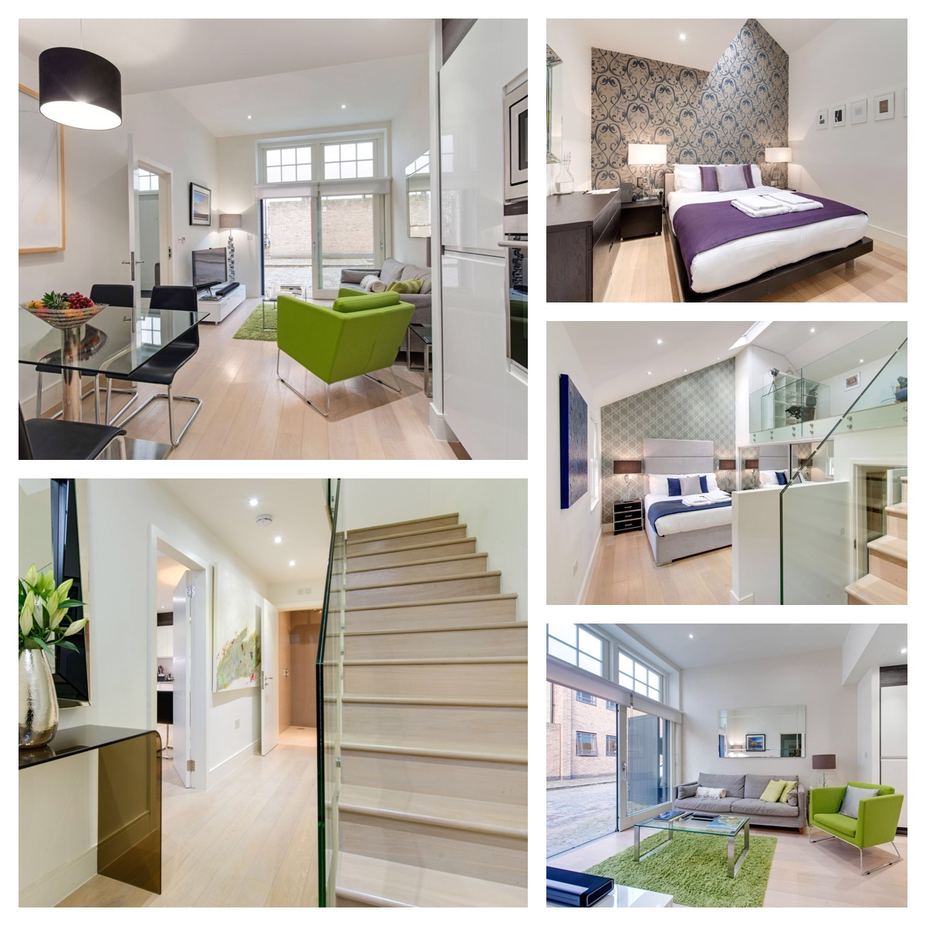
Bloomsbury Pearl
A modern central London home with all comforts in mind.
Open-plan living/kitchen area
Two king-size bedrooms
Mezzanine with double futon & office area
Two spacious bathrooms
SONOS audio system
Washer/dryer and dishwasher
Private parking space
Underfloor heating throughout
Wine Cellar
Electronic Safe
944 Sq F – 87.81 Sq M
4
2
2
2
BOOK NOW

Slide 8
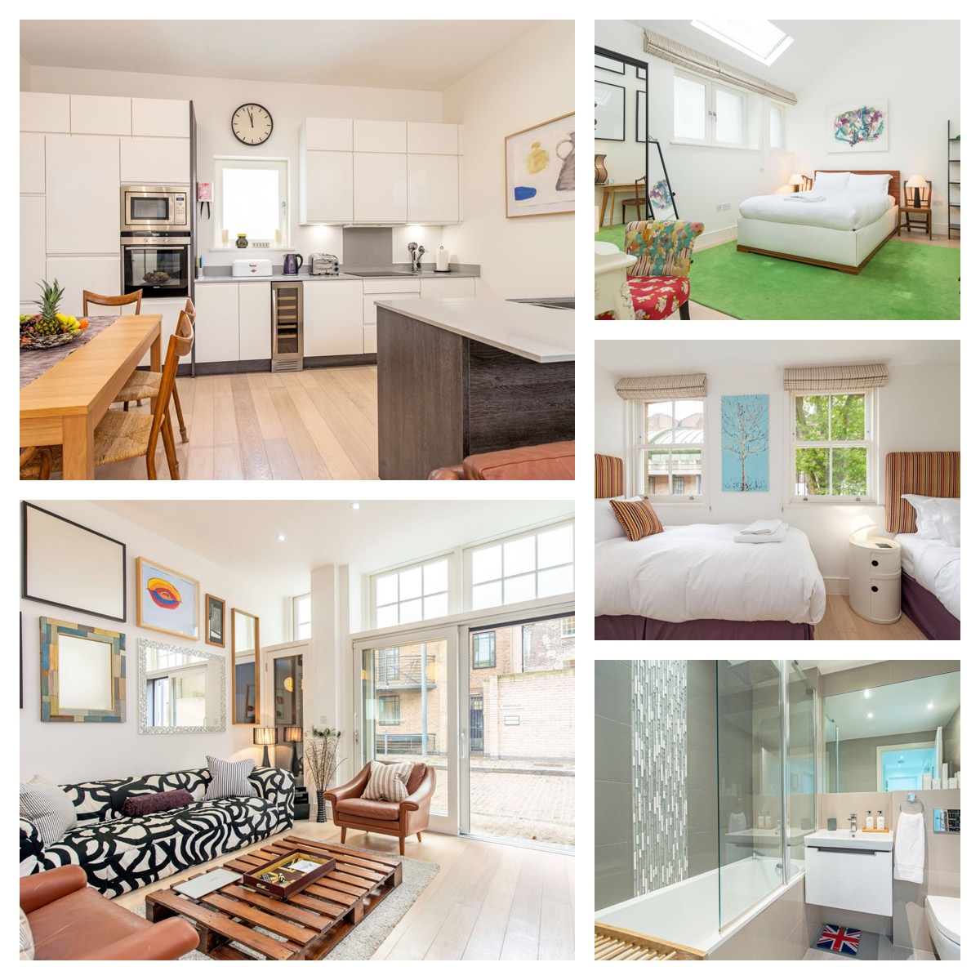
Best of Times
A beautiful three bedroom house for you to enjoy great experiences in Central London with family, friends or colleagues.
Large open-plan living/kitchen area
Two double bedrooms
One twin bedroom
Two spacious bathrooms
Washer/dryer and dishwasher
Underfloor heating throughout
Private parking space
Wine cellar
Electronic Safe
1028 Sq Ft – 95.50 Sq M
6
3
2
2
BOOK NOW

Slide 9
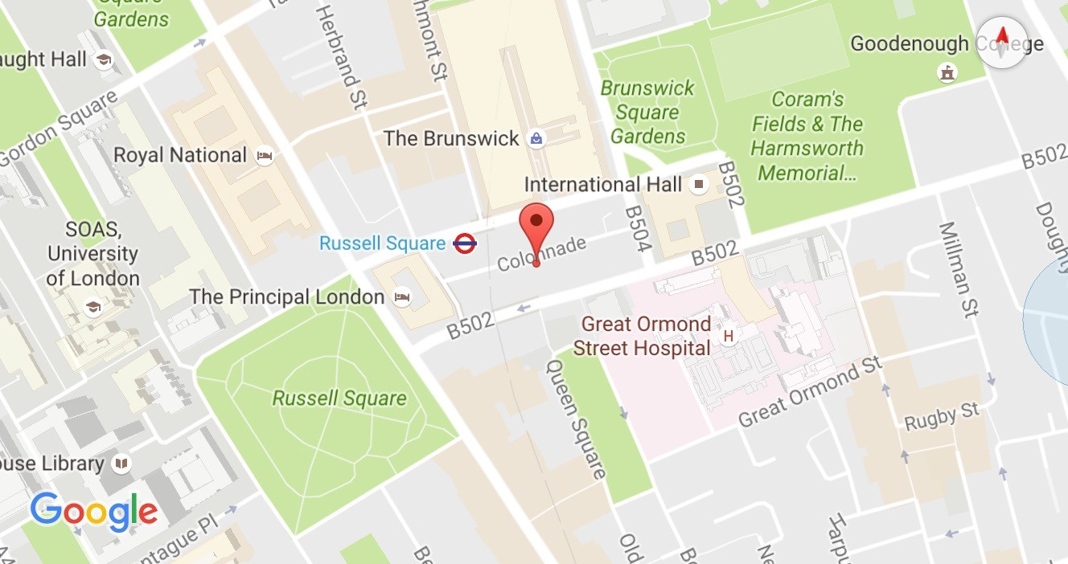
COLONNADE – GETTING HERE
Airports (by car):
London City Airport – 20 mins
Heathrow – 1 hour
Gatwick – 1 hour 30 mins
By Train :
Kings Cross St Pancras – 15 mins walk
Euston – 15 mins walk
Farringdon – 15 mins walk
By Tube:
Russell Square ( Piccadilly ) – 2 mins walk
Holborn ( Piccadilly/ Central )– 8 mins walk

Slide 10
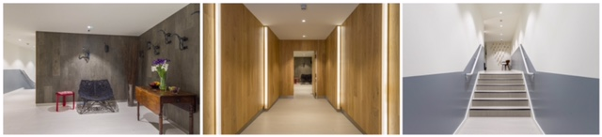
STAR YARD Chancery Lane WC1
Situated at 4 Star Yard, nestled between Chancery Lane, Lincoln’s Inn and the Royal Courts of Justice are a selection of only five stunning 1&2 bedroom apartments. In our exclusive building we have two One Bedroom Apartments and three Two Bedroom Apartments. All units are both luxurious and homely and offer an experience superior to a hotel or other corporate housing. Star Yard is just five minutes from Holborn (Central and Piccadilly lines) and Chancery Lane (Central line) Tube Stations and a short walk from both the West End and City.

Slide 11
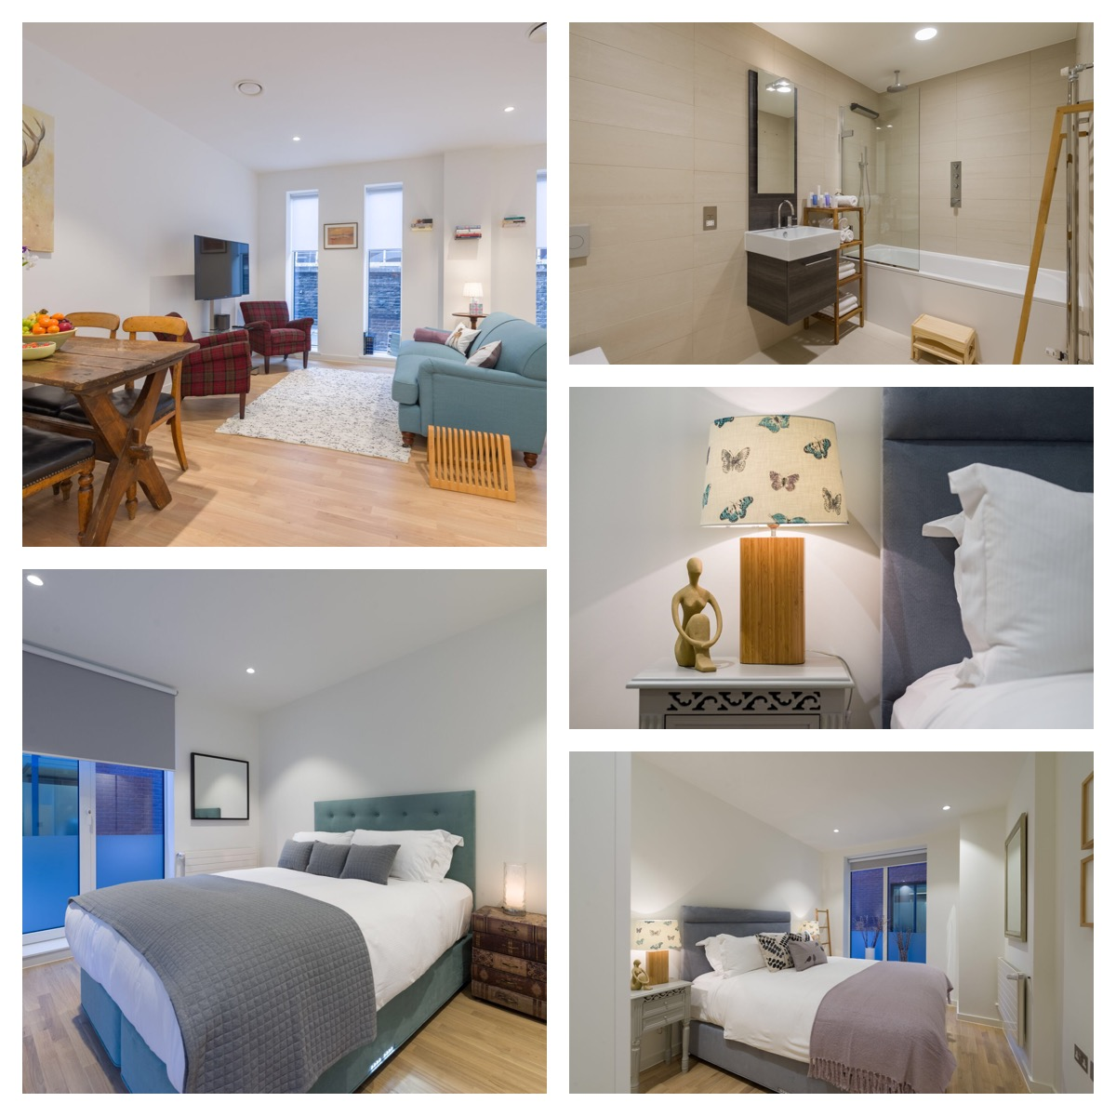
Natural Imagination
Relax in the tranquillity of nature and literature: - King size beds, handmade mattresses. - Spacious fitted wardrobes. - Floor to ceiling windows. - SONOS audio system. - Fully equipped, modern kitchen - Full size bathroom with large bath and overhead rain shower - Utility room with washer/dryer. - Electronic Safe
- 678.13 Sq Ft 63 Sq M
4
2
1
1
BOOK NOW

Slide 12
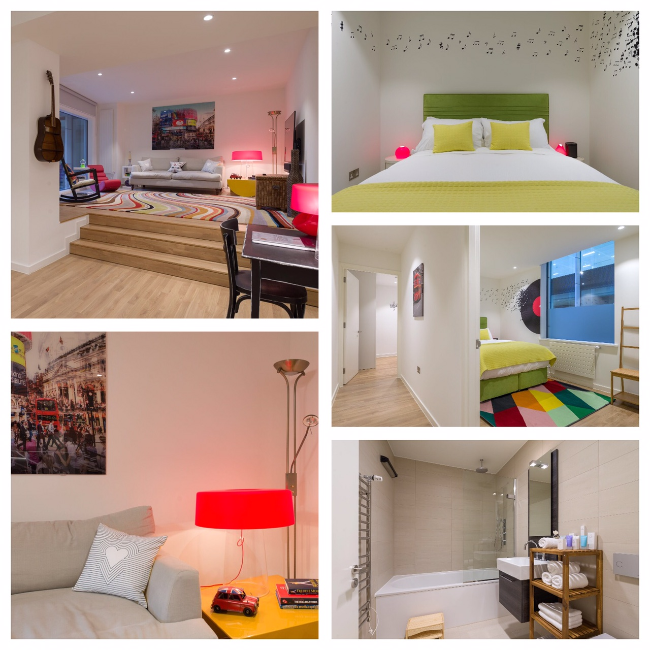
Amp London
Full of music and bright colours, this apartment seeks to spark the creative vibe within you :
King Size beds with handmade mattresses.
Fitted wardrobes with ample storage
Floor to ceiling picture windows.
SONOS audio system.
Fully equipped, modern kitchen.
Two spacious bathrooms
Utility area with washer/dryer
Electronic safe
905 Sq Ft – 84 Sq M
4
2
2
2
BOOK NOW

Slide 13
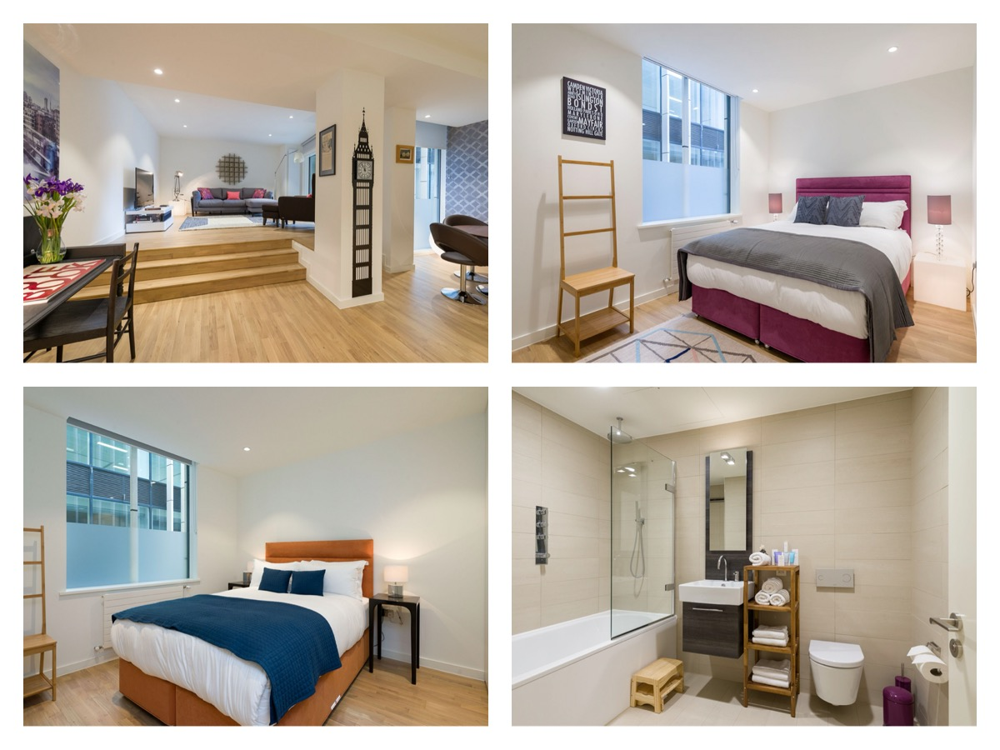
Eye of London
This sophisticated apartment celebrates the extraordinary architectural and engineering creations of the world we live in:
King Sized Beds with handmade mattresses
Two spacious bathrooms (one en-suite).
- Fully equipped, modern kitchen
SONOS Audio System.
Bespoke handmade mattresses.
Utility room with washer/dryer
Electronic Safe
990 Sq Ft – 92 Sq M
4
2
2
2
BOOK NOW

Slide 14
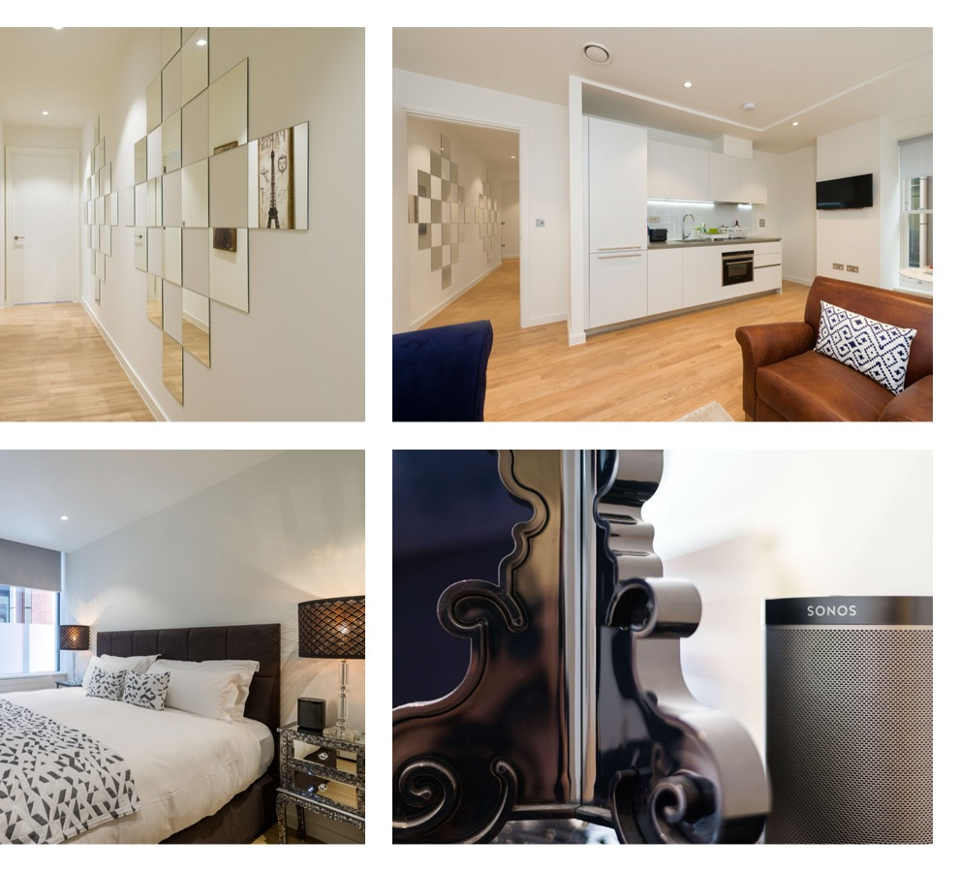
Times of Reflection
A luxurious one bedroom apartment which echoes the sophisticated elegance of the 1920s:
Super king size bed with handmade mattress
Fitted wardrobes with ample storage
Fully equipped, modern kitchen
Floor to ceiling windows.
Full size bathroom with large bath and overhead shower
Utility room with washer/dryer.
Electronic Safe
538.20 Sq Ft – 50 Sq M
2
1
1
1
BOOK NOW

Slide 15
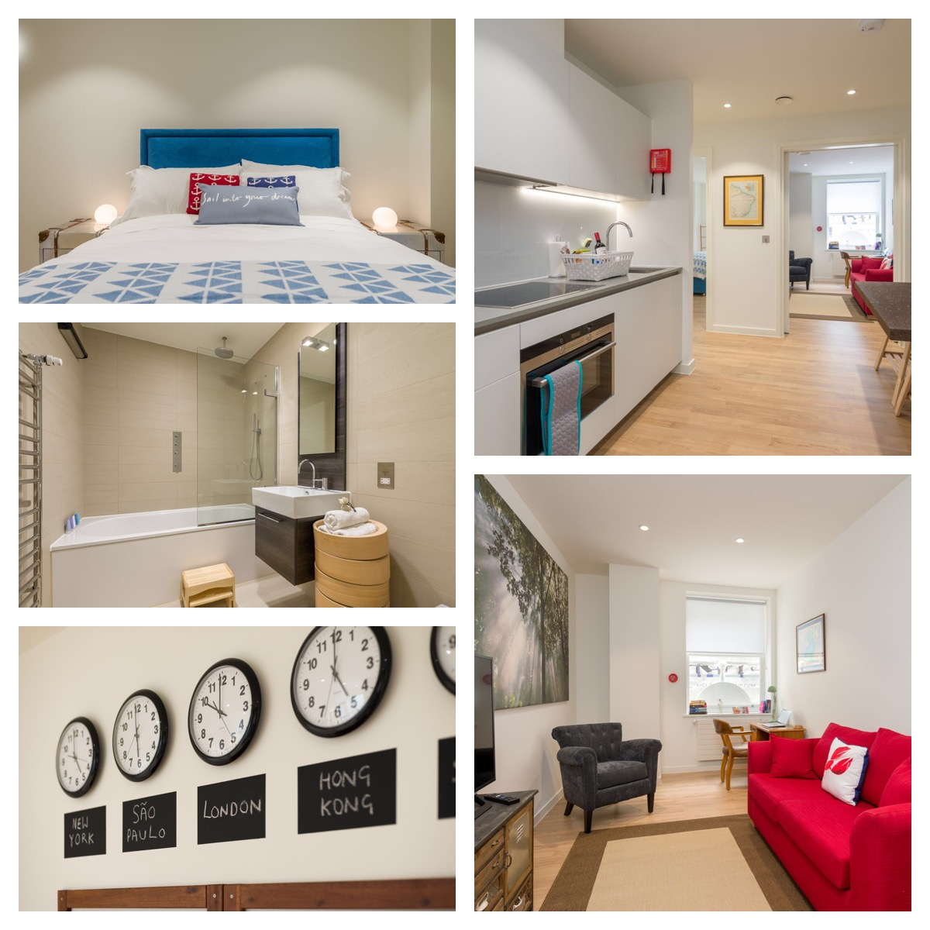
Sails of Discovery
Inspired by travel and discovery, this apartment seeks to awaken your inner explorer:
King size bed with handmade mattresses.
Fully equipped, modern kitchen and dining area
Full size bathroom with large bath and overhead shower
Separate sitting room with desk
Meditation area.
Utility room with washer/dryer
Electronic Safe
538.20 Sq Ft – 50 Sq M
2
1
1
1
BOOK NOW

Slide 16
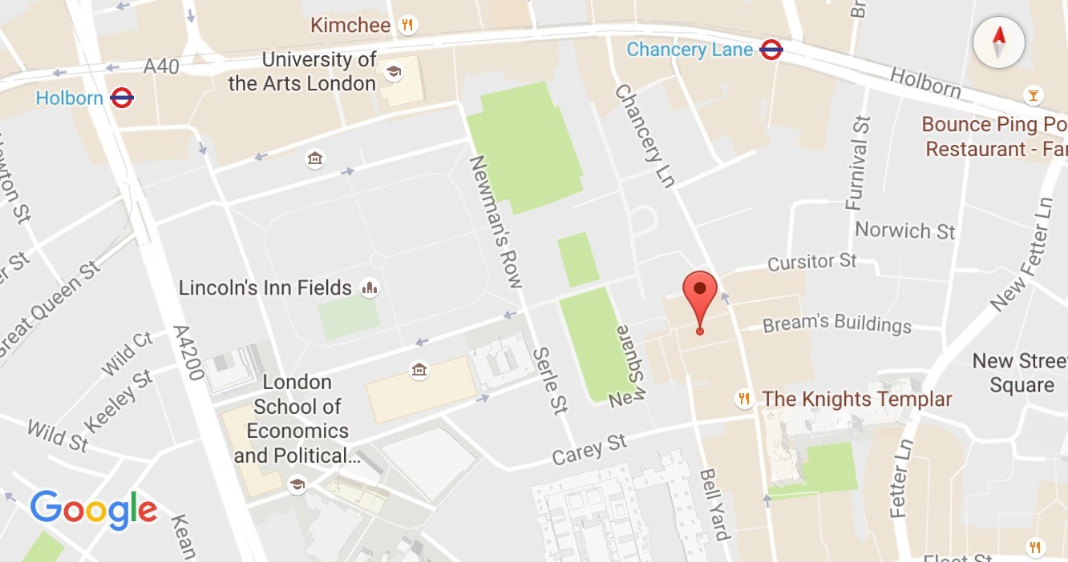
STAR YARD – GETTING HERE
Airports (by car):
London City Airport – 20 mins
Heathrow – 1 hour
Gatwick – 1 hour 30 mins
By Train :
Waterloo Station – 15 mins walk
Farringdon Station – 10 mins walk
Euston/Kings Cross – 25 mins walk
By Tube:
Chancery Lane ( Central ) – 5 mins walk
Holborn ( Piccadilly/ Central )– 7 mins walk

