Slide 1
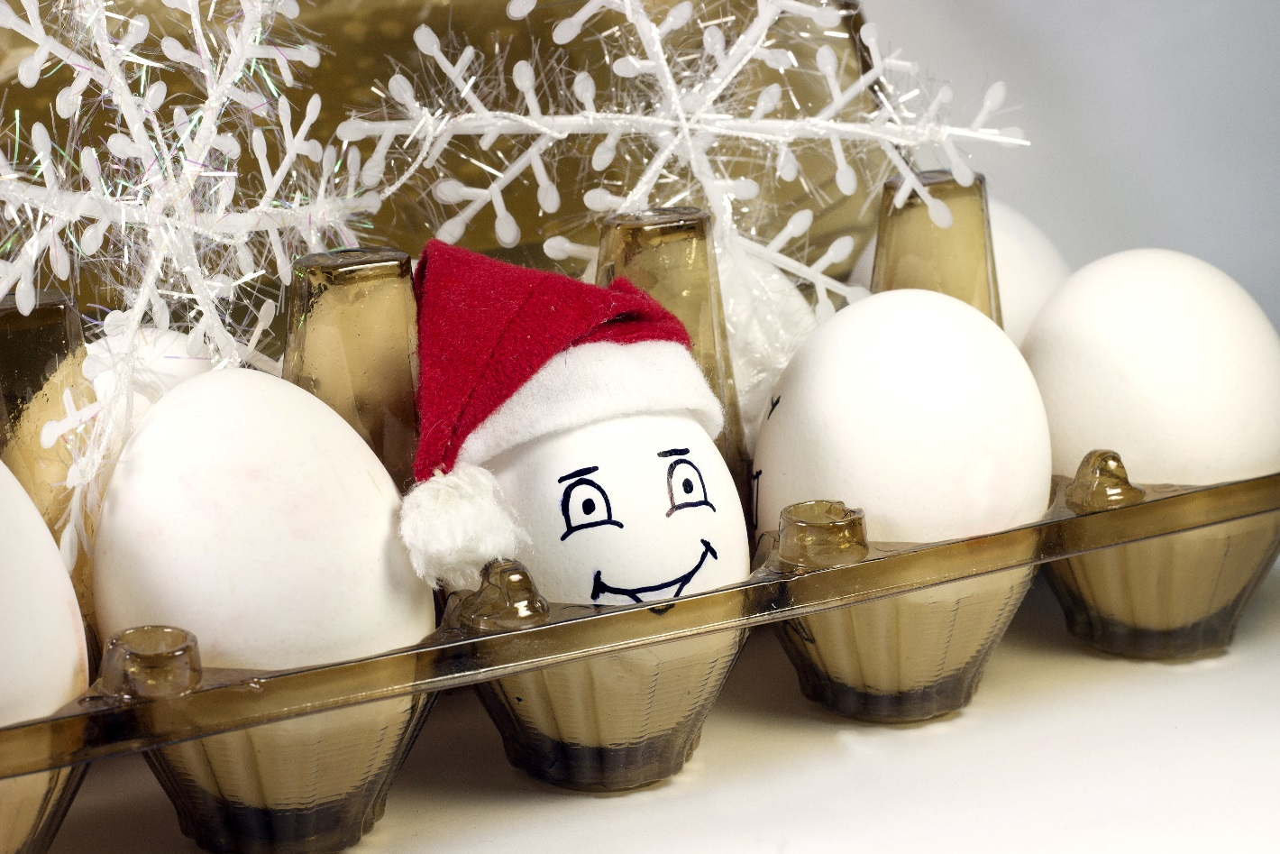

Worried About Deflation?
Think Seasonal General Merchandise for Eggstraordinary Profits
Visit our exciting Fall/Winter 2017 Showroom
representing over 4,000 items from 350 factories
Scheduling appointments now for January─March, 2017
Contact Mike Sims, VP Business Development at msims@fareastbrokers.com or call 904-332-9006

