Slide 1
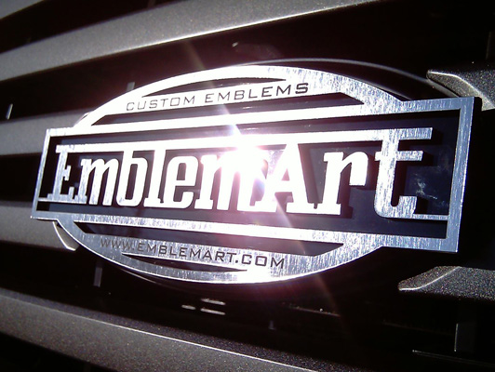


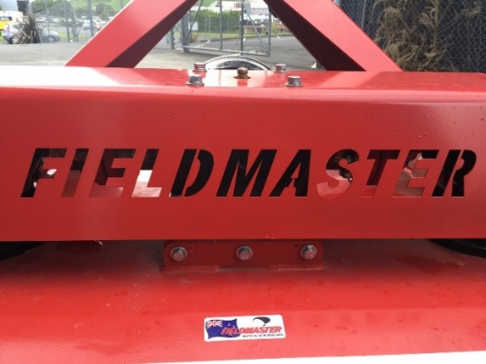
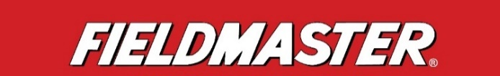


We need a graphic design for a badge/logo that we can use in our catalogue and also for stickers to stick on to the outside of packaging.
d) Examples of badges that we like:
a) Copy for badge/logo:
PREMIUM EQUIPMENT
FIELDMASTER
60 YEARS STRONG
b) Current Fieldmaster logo:
(note: badge font doesn’t have
to match this logo)
c) Current Fieldmaster stamp
on equipment:

