Slide 1
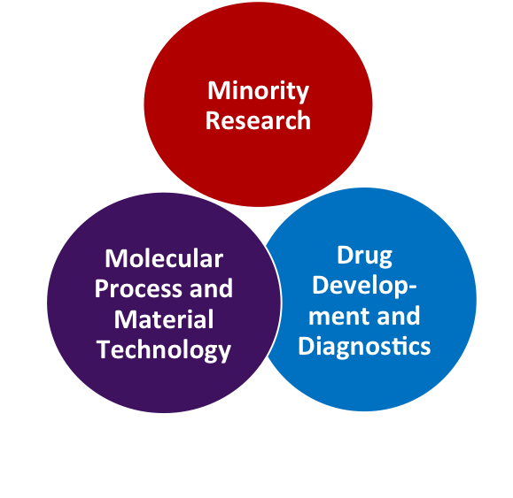
Minority Roles and Rights in Society
The Sea
Nature, Society &
Industrial Management
Chemical Engineering in the Bioeconomy
Bioimaging & Materials and Technolgies for Health
Notes:
Currently, Åbo Akademi University has identi ed the following focal areas of research:
• Minority research
• Molecular process and material technology
• Drug development and diagnostics (in partner-
ship with the University of Turku)
Expanding from the Finland Swedish perspective towards an internationally relevant pro ling around minority issues is a key ambition for Åbo Akademi University during the coming strategy period.

