Slide 1

Embassy Partnership Plan
October 18, 2016

Slide 2
Who Is Tuzola?
Tuzola was founded by Elias Mwita, Athman Mwanga, both from Tanzania. Both have over 10 years of experience in the travel industry. We believe our platform is second to none when it comes to airfare affordability. Our simple installment payment options gives you the high level of flexibility which is currently not available in the market when it comes to international travel. We have partnered with over 400 airlines to deliver the best prices possible to our customers. Our team of travel agents is ready to assist you on the phone you can rest assured we're with you every step of the way to make sure your trip is flawless.
Why Are We Different?
Installment Payments
Flexible Payment Options
Hold Flights – To Make Deposits
Best Fares
Create Custom Solutions For The Community
Seamless Integration of Booking Flights and Installments Plan
B2B Platform Extends Our Business Model to Other Agents

Slide 3

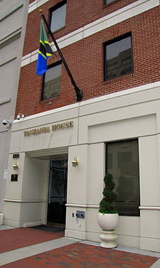

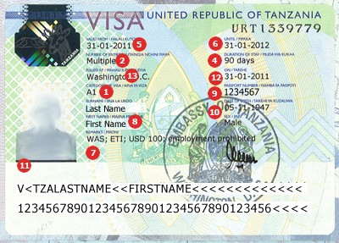

Current Embassies
Exceptional Customer Service Has Lead To Endorsement

Slide 4
Goal
To Increase Number of Embassies Served By Offering A Compelling Package of Both Customer Service and Lowest Cost
Dedicated Customer Service Representative Trained to Book Airfare, Hotels, Cars 24/7. On Call 24/7 For Emergencies.
Lowest Pricing On Airfare, Hotel, Cars Provided Through Automated Travel System
Payment Terms On All Travel Bookings. Net 30 Days
Embassy Rewards Program – Book 25 Tickets A Year And Receive 1 Free Ticket For Ambassador or Staff
Minimum Three Year Contract To Receive Benefits

