Slide 1
MOCKUP – “SLIDE FACTORY”
Our value proposition
Who are we
Pricing
Contact
Our clients
USPs: Cost/Speed/Quality
registration
Animation
Gallery of finished work
Free Pilot
References: logo’s of corporate clients
See the website for https://www.movemeon.com/
12
145
20.000
1540
Countries active
Corporate
Clients served
Slides
produced
Free lance
consultants served
All social media links: Facebook, twitter, linkedin, instagram

Slide 2
Our Value proposition
The main objective of Outsourcing PowerPoint service is to reduce the cost significantly without compromising quality. SLIDE FACTORY helps the customers to achieve this by providing high-quality presentations (management consulting golden standard, cfr McKinsey, BAIN & Co standards) at a fraction of the corporate or external consulting cost. Outsourcing presentation execution and design services to SLIDE FACTORY offers benefits not only in terms of cost reduction, but also in increased productivity and a guaranteed Quality Standard by former Management consultants from the leading Strategy houses (ex BAIN&co)
SLIDE FACTORY offers PowerPoint creative services in the following two categories.
1.Ad-hoc support
2.Dedicated support
Ad-hoc support
Requests with quick turnaround time will be considered as Ad-hoc requests. Client can pre-book capacity with us for this sort of requests.
Dedicated support
When extra service is required to prepare a workshop or an executive presentation for the next day, we will “upgrade” your ideas to a top management look&feel standard,

Slide 3
Animation
Before
After

Slide 4
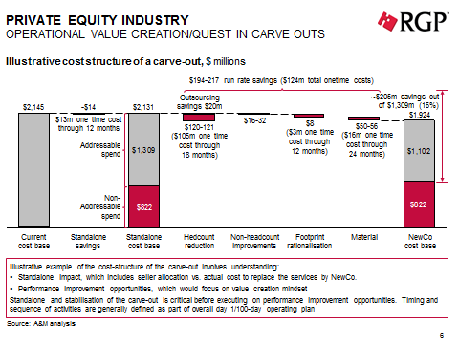
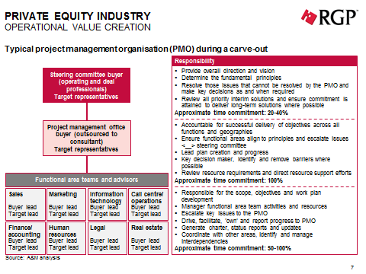
Gallery of finished work

Slide 5
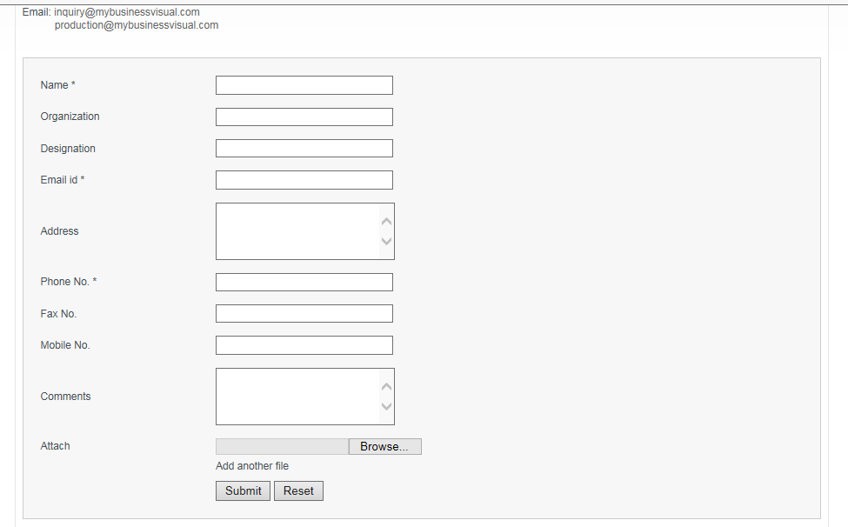
registration

