Slide 1

MINDFIELD
The Science of People

Slide 2

Well-being is having a profound impact in the workplace
Wellness = $$$

Slide 3
The high cost of low
employee engagement
Actively disengaged
employees annually cost the U.S.
$370
Billion
27%
of employees are actively engaged
54%
of disengaged employees report that work has a negative impact on
58%
of companies cite low employee engagement as the biggest obstacle to behavior change
54%
of employees plan to leave when the economy improves

Slide 4

Corp
Wellness needs to be a
business strategy
Business
Unit
Functional / Departmental
Employee Wellness

Slide 5

Corporate Wellness is the “New Black”

Slide 6
WHY IS IT IMPORTANT?
Company retreats are an investment in the company growth
Corporate retreats prevent stagnation and burn-out
Teams can bond and re-energize
Healthy balance between mind, body & soul
Tremendous learning and cross-departmental collaboration
Think ‘outside the square’
Corporate retreats are crisis prevention
Effective leadership and management of internal teams

Slide 7
Mindfield is a new-age corporate wellness platform that explores each aspect of wellbeing: mind, body and soul
We focus on renewing employees’ enthusiasm, care for self, mindfulness, equanimity, happiness, enhancing communication effectiveness, team work, leadership skills as well as replenishment and relaxation
SIGN UP FOR THE MINDFIELD ADVANTAGE:
We offer uniquely designed retreats, incorporating careful attention to ensure overall well being
Retreats conducted at our state-of-the-art European-style mansion-The Estate

Slide 8
Our Value Proposition
Corporate Connect
Leadership development
Individual Connect
Stress management
Conflict management
Nature Connect
Restoration effects
Personal excellence
Team building
Unleashing potential
Personal development
Healthy balance between mind, body and soul
Cross-departmental collaboration
Stability
Sustenance
Beautiful, and quiet location
Enjoying native plants, flowers and vegetation
Spiritual growth

Slide 9
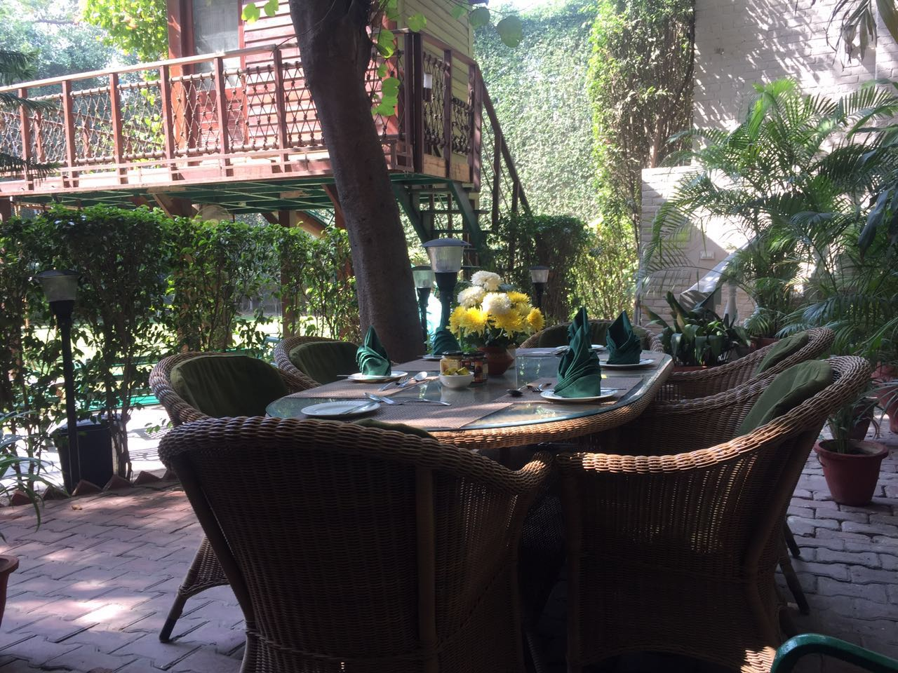
Infrastructure

Slide 10
WHY US?
50 + years of cumulative experience under once roof
Senior Counsel to work with leadership teams; average experience of the team is a decade
  Experts at designing results-based, proven programs based on your needs
Integrate high-tech and high-touch, conventional wisdom with holistic wellness, emerging behavioral models to create engaging and effective consumer experiences.

Slide 11
OUR PROCESS @ WORK
Process
Customize
Follow Through
Retention
Analyse
We ask questions and gather information to map out a unique retreat that will create memories you and experiences

Slide 12

Employees who get out of the office and
in touch with nature show an increase in productivity, creativity and overall well-being,”

