Slide 1
Logo brief
October 2016

Slide 2
Situation
Partners in Performance (a/k/a PIP) is a global management consulting firm who specializes in Rapid, Sustainable results for large organizations.
We have deep experience in heavy industry, and are the global leader in mining; but we also do a lot of work in multiple – non industrial – industries across the globe.
We have 500 consultants around the world.
We have done very little formal marketing to promote the brand, and opposed to our cohort of consulting forms like McKinsey, BCG, and Bain we are relatively unknown in most geographies (e.g. U.S.A., Europe) and we have almost zero social media presence.
The purpose of this effort is to generate a possible logo design for us – we are working through a broader brand exercise, but are keen to get new ideas on what our logo could look like.

Slide 3
PIP in a nutshell…
Who we are… Global, frontline-focused consultancy Deep background in heavy industry, roots mining Results oriented Pragmatic, operator-biased Diverse, eclectic and a bit irreverent | What we do… Deliver rapid, sustainable results Align organizations from front line to CEO Ensure client is managing for value everyday Help them transform the way they think and work
How we do it… Work at an operational and tactical strategy level Actively participate in the operations of our clients Put heavy emphasis on real time coaching Share the risk (happy to do “pay for results” work) | Why we do it… To unleash potential in our clients, each other and ourselves To Make a difference to clients way beyond what we deliver in results

Slide 4
PIP in key words and phrases (1/2)
PIP is . . .
Practical
Low fuss
Reliable
Simple and fast
Hands on
Lean
Malleable – open to alternative options
Dynamic
Safety conscious
Grounded
Partnership (we’re a team)
Fun
Direct (no nonsense)
Entrepeneurial
We hire people who are:
Smart
Pro-active
Results driven
Pragmatic
Passionate
Down to earth
Adventurous
Persistent
Determined
Collaborative
Doers
Have an appetite for hustle – making things happen and happen quickly.
Nimble
Rapid
Innovative, creative
Dynamic
Engaging
Humble
Challenging the status quo
Circuit breaking
Pioneering
Building capabilities
Not your typical consultants
Effective
Trust
Persistent and determined

Slide 5
PIP in key words and phrases (2/2)
How we work with our clients:
Get it done, fast (80/20) – worry about the detail/getting it perfect later
We solve the problem and move quickly on to the next
Look for opportunities to improve our clients’ business
Use simple tools to deliver fully implemented, bottom-line improvements
Unleash the potential of the business and their employees through coaching
Transfer skills and helping people transfer the way they think and work
Partnering with our clients and the delivering of results should be the two main driving features for our logo design

Slide 6
We focus on rapidly implementing sustainable results for our clients
Tangible; bottom line; no vague concepts or reports
Lets make it exciting and getting up for in the mornings
Because its worth a lot to the client; to overcome inertia; to make an intervention economically justifiable
Implementation is tough; ensure it hits the bottom line
Hard wiring, coaching and empowering our clients to continue to improve
Client needs it; integrity demands it; requires client ownership and understanding; requires changing in the organisation; typically needs extensive coaching and support of the people; so we can be proud of our work
We don’t want to “do it to them” but support and enable their journey, their results, their growth
Results not theory; focusing on “did it work” and using that to ground us in reality

Slide 7
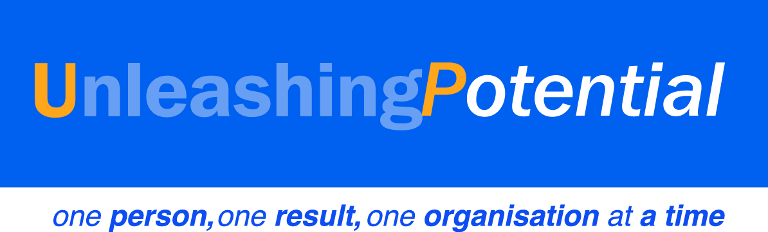
PIPs mission statement is focused on “Unleashing Potential”. . .
PIP is about. . .
Making a difference to clients way beyond what we deliver in results
Helping them transform the way they think and work
Unleashing potential they often didn’t even know they had
Growing our people so they become experts in unleashing potential – their own and others!

Slide 8
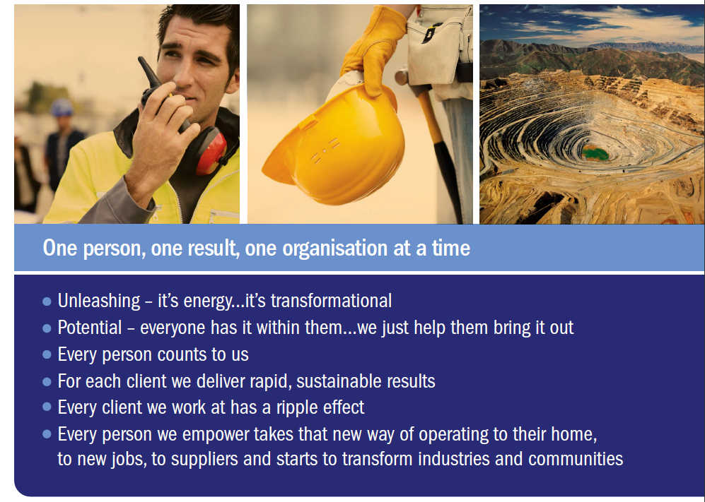
. . . we do this one person, one result, one organisation at a time
Nic to prepare

Slide 9
There are four underlying values that help define who we are and how we work
“We do the right thing”
Even when it is not the easy thing . . .We work towards a shared understanding of what is right and wrong.
“We can answer to ourselves and others at any point that we are ‘doing the right thing’ and it’s not confined to just observing our four stated values or demonstrating we complied with a rule book”.
“We are guided by integrity, compassion and respect, courage, and responsibility”
“As simple as we can and no more”
We believe in “80/20” and “enough analysis to make a decision”.
Specificity, single points of accountability and actionable, measurable outcomes give simplicity.
There is beauty and sustainability in simplicity.
If a decision is directionally right, speed is more important than achieving the 100% analytically correct answer.
Do the Right Thing
Integrity, Compassion and Respect, Courage, and Responsibility
Simplicity and Velocity
RAPID
SUSTAINABLE
RESULTS
“We’re passionate about our clients’ and our own people’s success”
We don’t just offer solutions; we roll up our sleeves and work side by side with our clients.
We believe in the goal and do whatever is necessary to achieve it.
We take the owner’s perspective – what’s right for the business?
We believe in unleashing the full potential of our clients and our PIPers.
“We work towards No Harm in safety and environment in all that we do”
We lead by example
It is our obligation to protect ourselves and those around us
. . . and the environment in which we live
Every day we strive to achieve no harm and systematically eliminate unnecessary risks.
No Harm
Commitment and Partnership

