Slide 1
Layout V1
Double sink
Cosmetic & Medicine
Storage
TV
Open Closet
Laundry Room
Staircase
Bed
Bath
Closed Closet
Open Closet
Boiler & Storage Room
toilet
Shower

Slide 2
Layout V2
Closed Closet
Open Closet
Double sink
Cosmetic & Medicine
Storage
Laundry Room
Staircase
TV
Bath
Open Closet
Bed
Boiler & Storage Room
toilet
Shower
Open Closet

Slide 3
Layout V2
Open Closet
Double sink
Cosmetic & Medicine
Storage
TV
Laundry Room
Staircase
Bath
Open Closet
Open Closet
Bed
Boiler & Storage Room
toilet
Shower

Slide 4
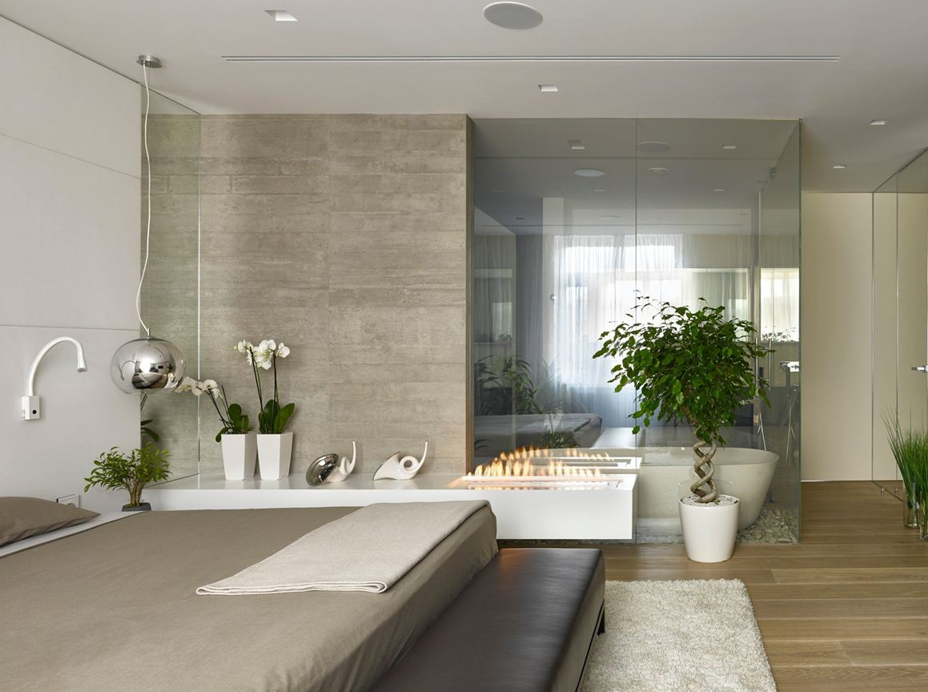






1. Open Bathroom Layout

Slide 5
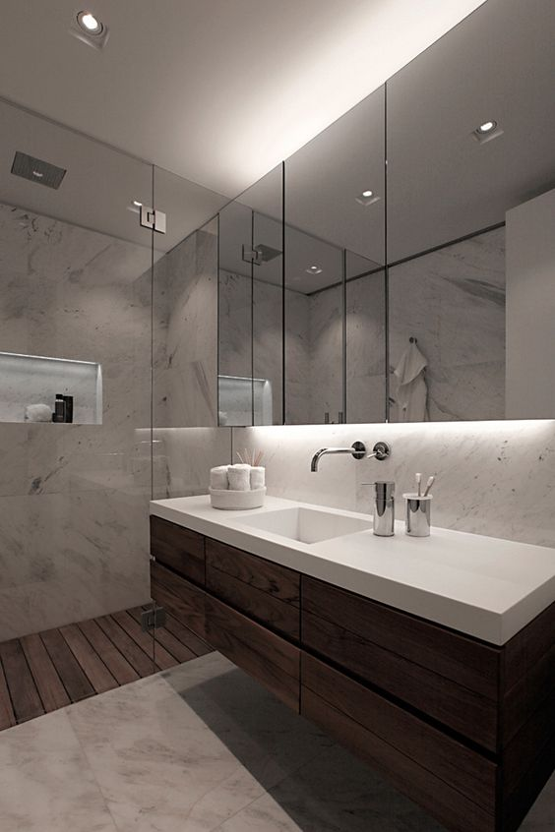
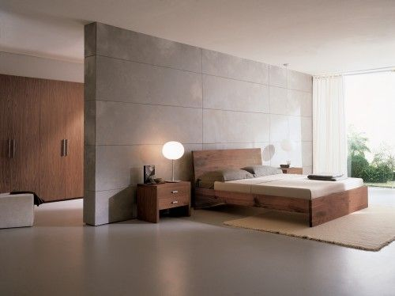
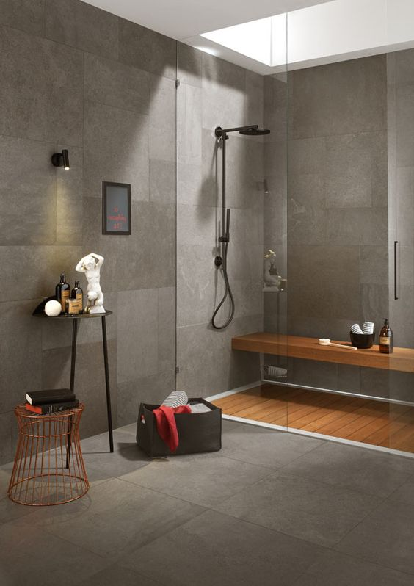
2. Color & Design Style

Slide 6
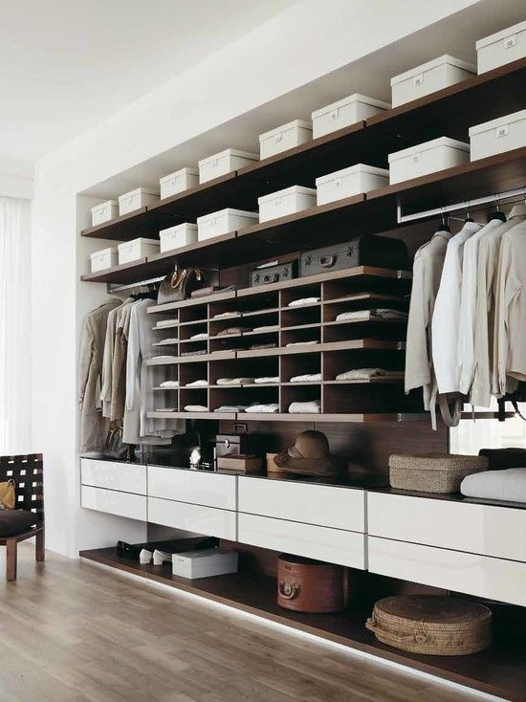
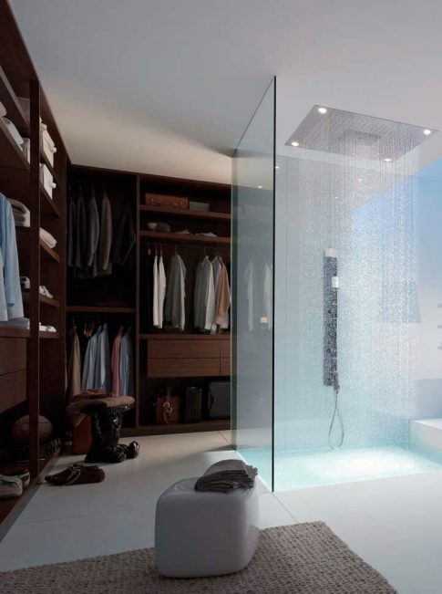
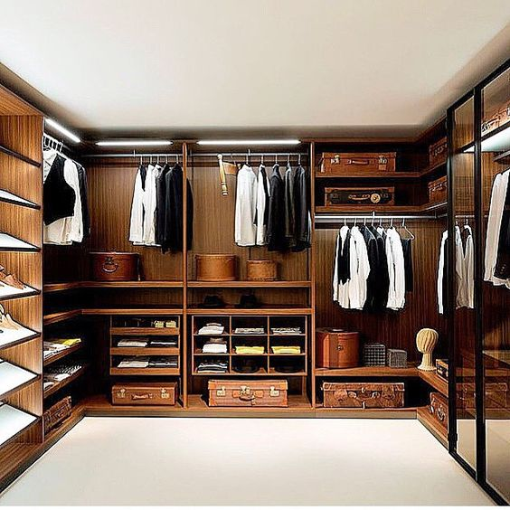
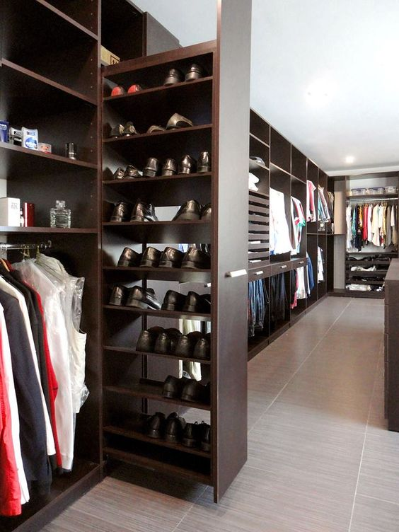
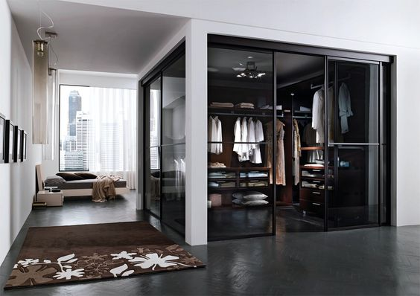
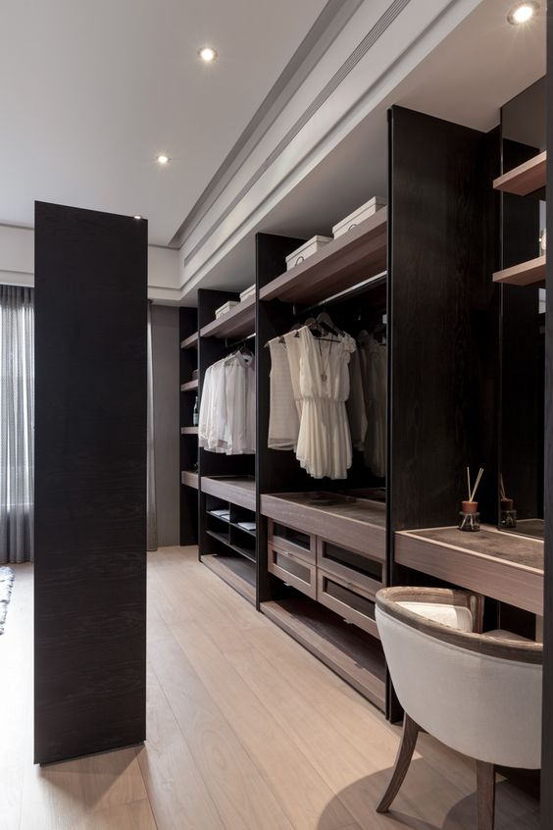
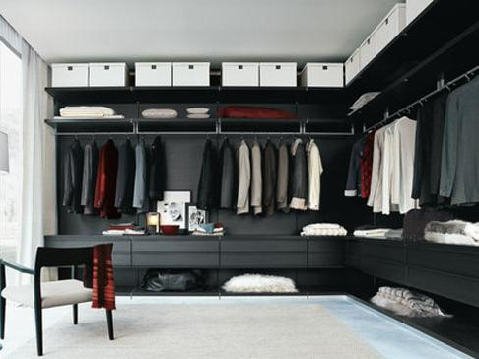
3. Open Closet

Slide 7
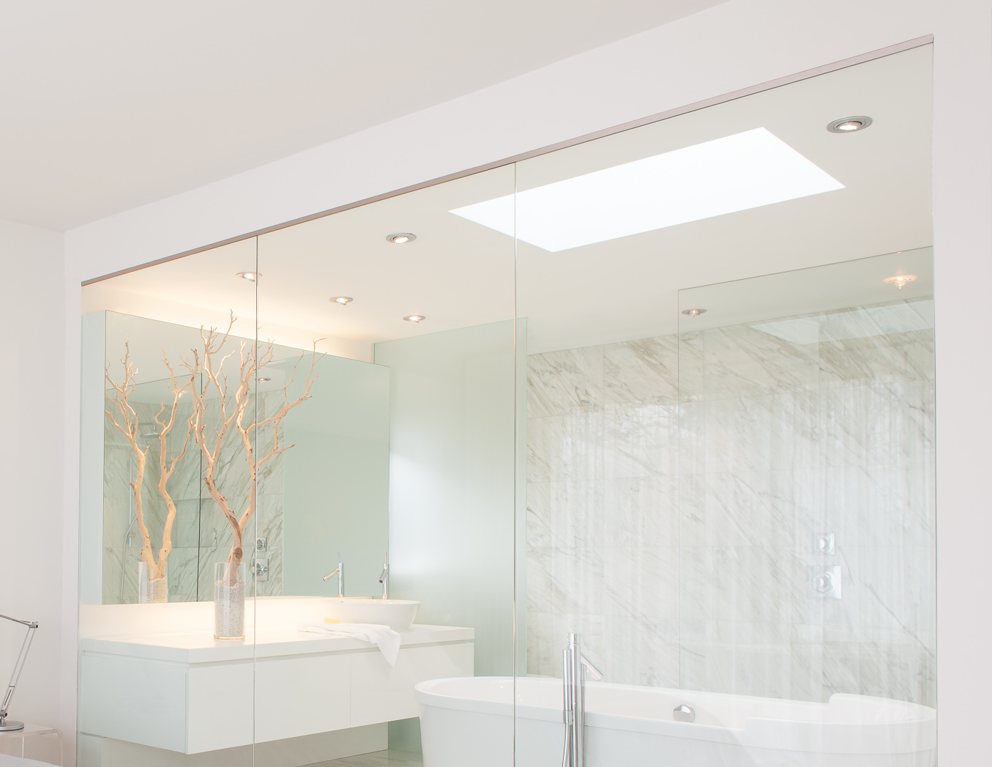
4. Super Bright Lighting

