Slide 1
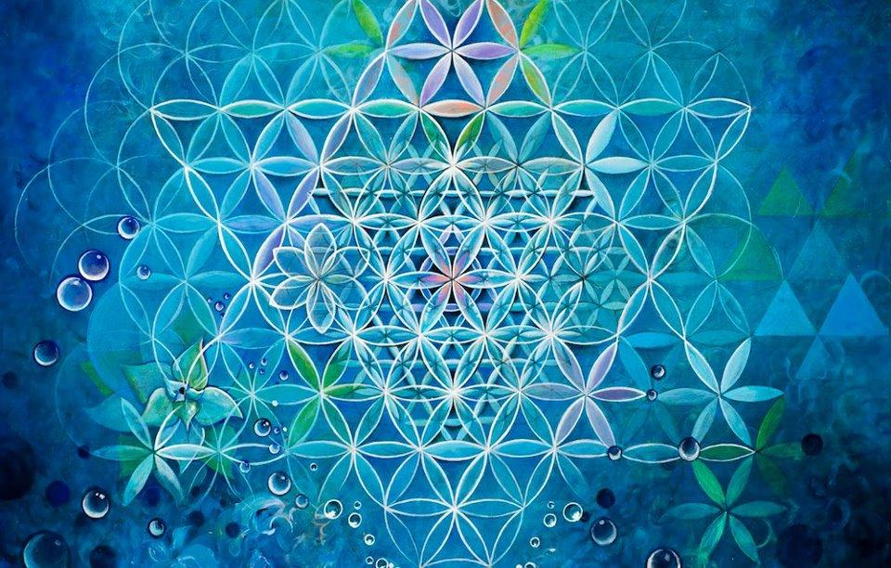
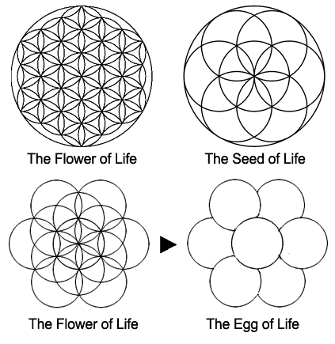
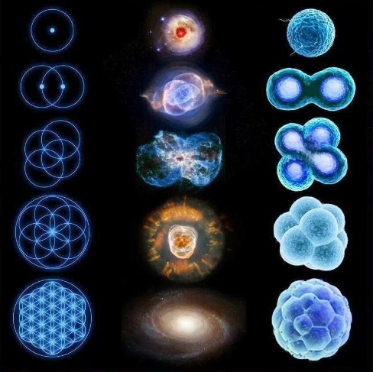
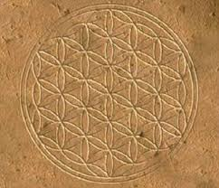
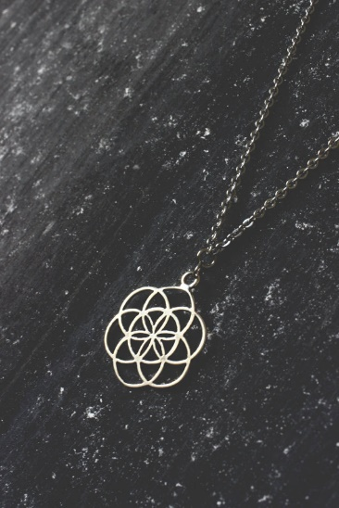
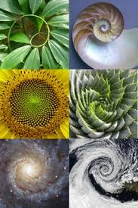
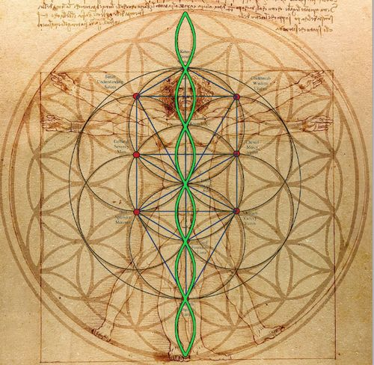
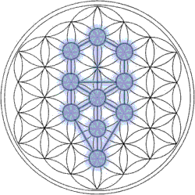
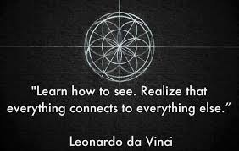
THE FLOWER OF LIFE
The "Flower of Life" can be found in all major religions of the world. It contains the patterns of creation as they emerged from the "Great Void". Everything is made from the Creator's thought.
After the creation of the Seed of Life the same vortex's motion was continued, creating the next structure known as the Egg of Life. This structure forms the basis for music, as the distances between the spheres is identical to the distances between the tones and the half tones in music. It is also identical to the cellular structure of the third embryonic division (The first cell divides into two cells, then to four cells then to eight). Thus this same structure as it is further developed, creates the human body and all of the energy systems including the ones used to create the Merkaba.

