Slide 1
Positioning your business
Initial thoughts and working session
August 2016

Slide 2
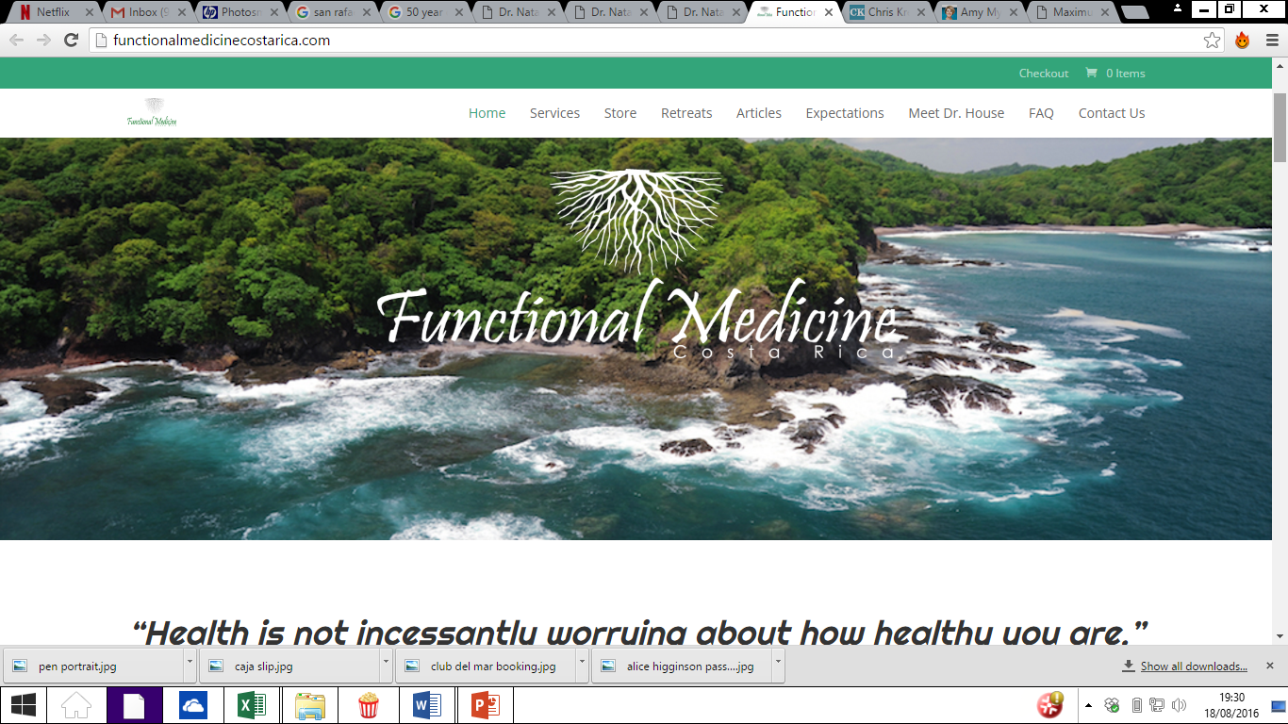

Slide 3
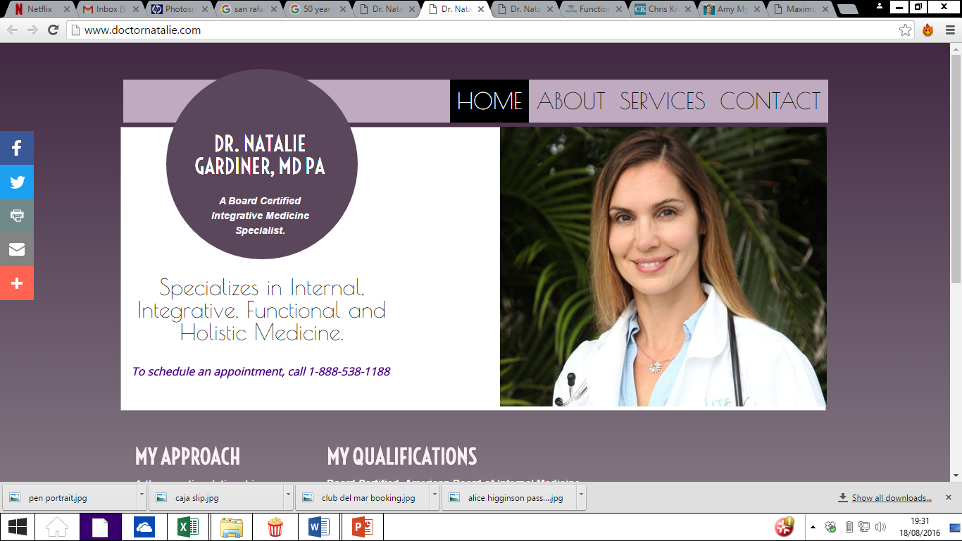

Slide 4
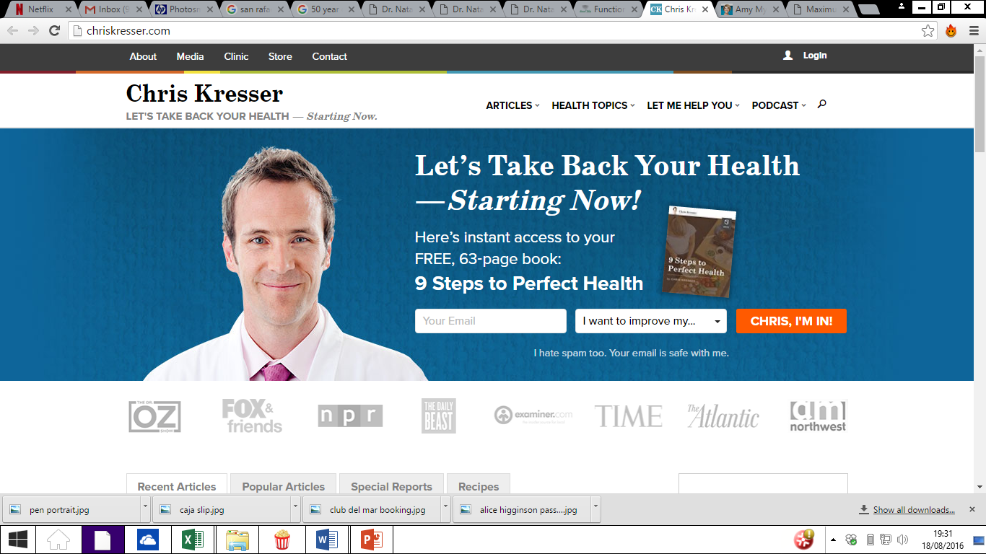

Slide 5
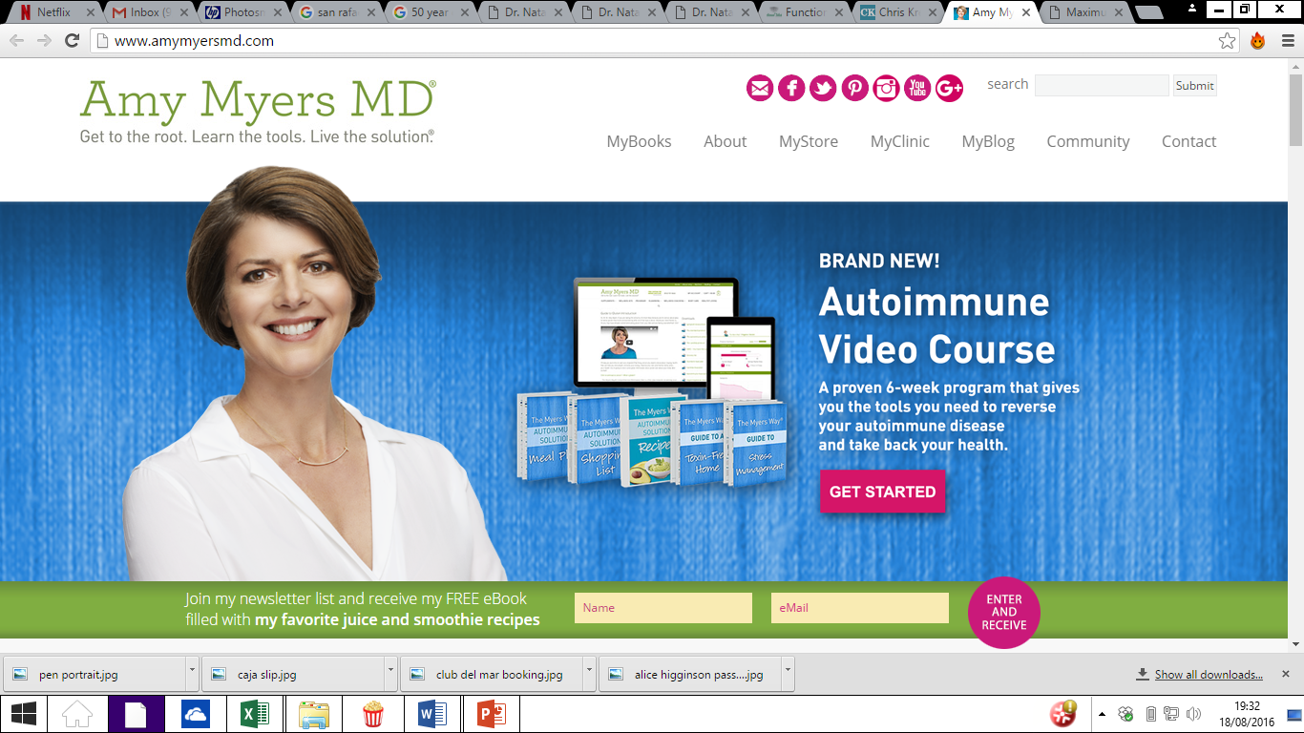

Slide 6
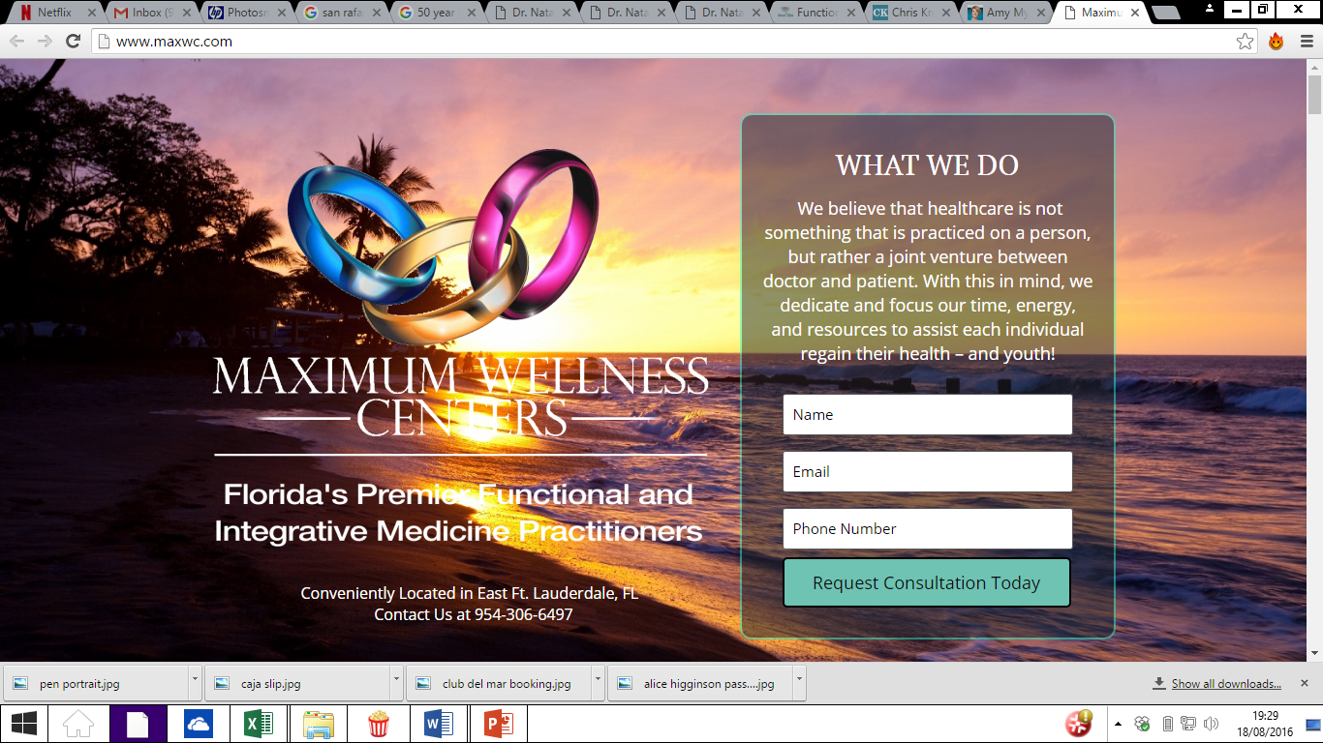

Slide 7
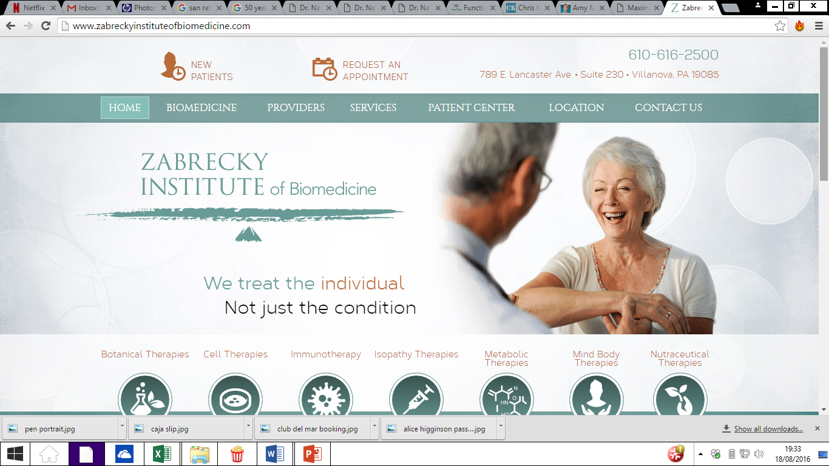

Slide 8
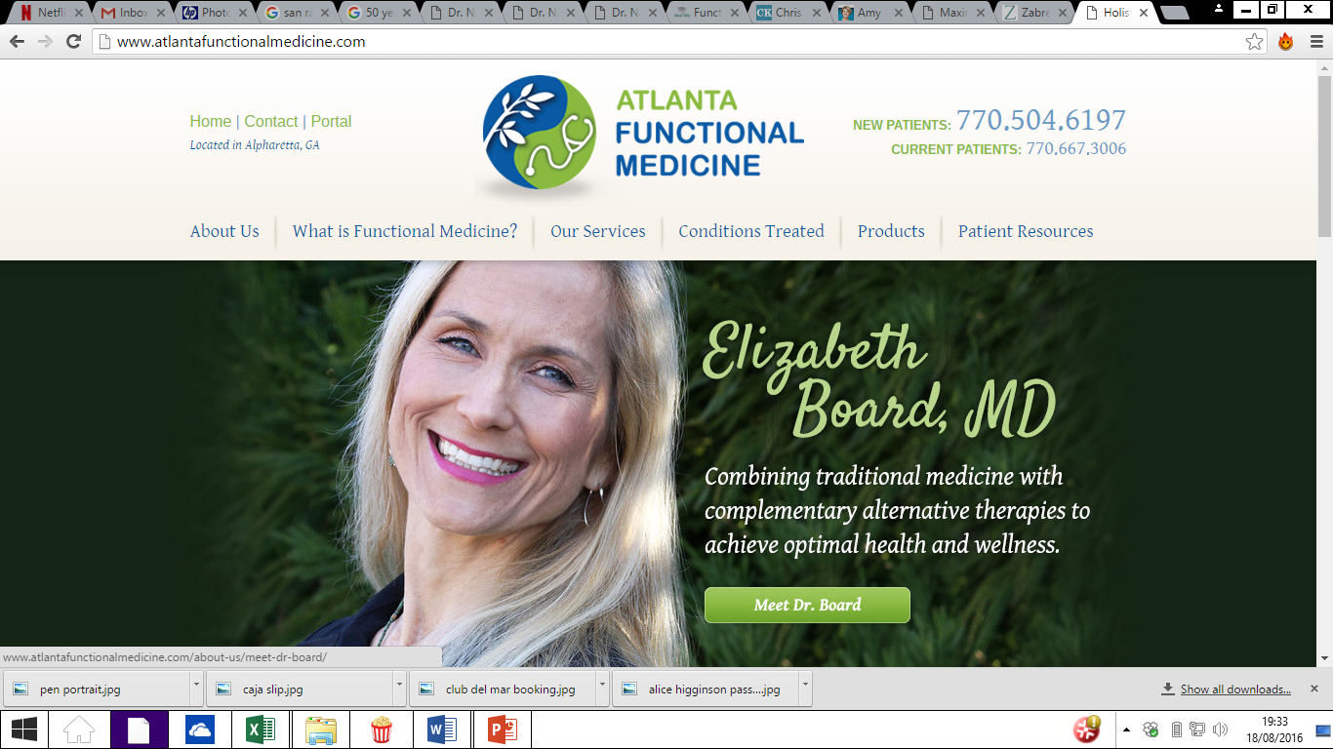

Slide 9
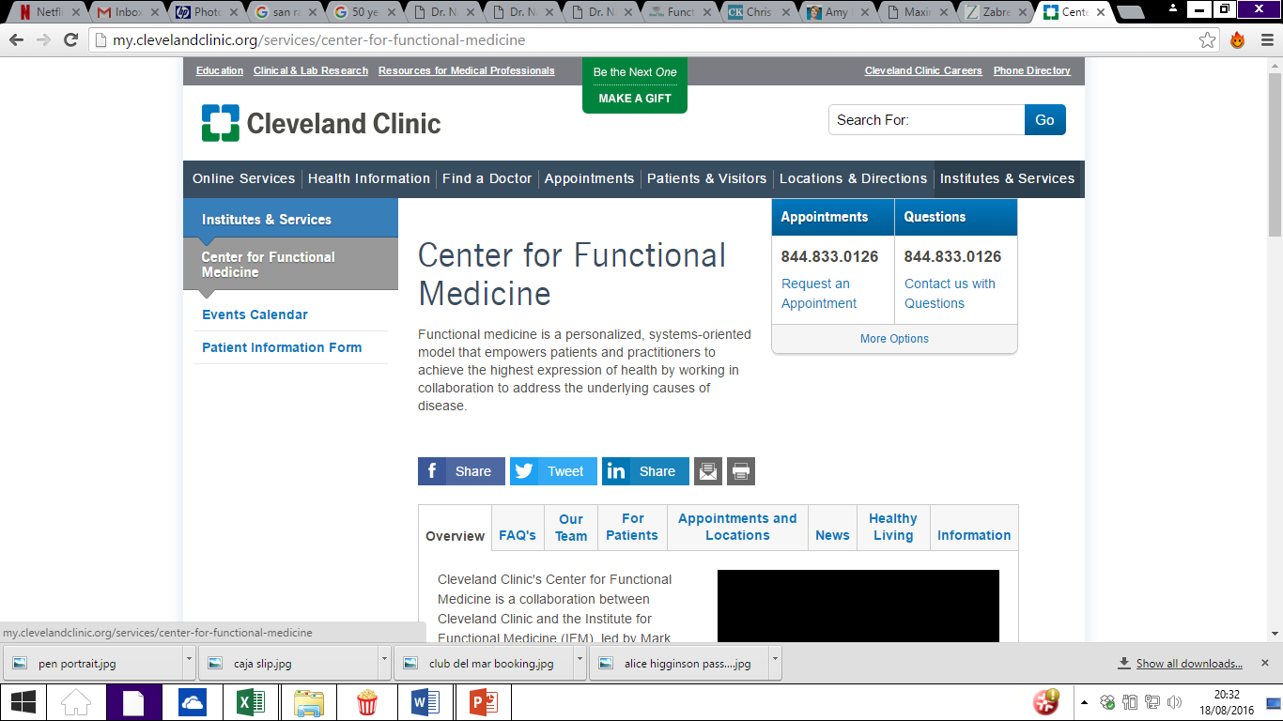

Slide 10
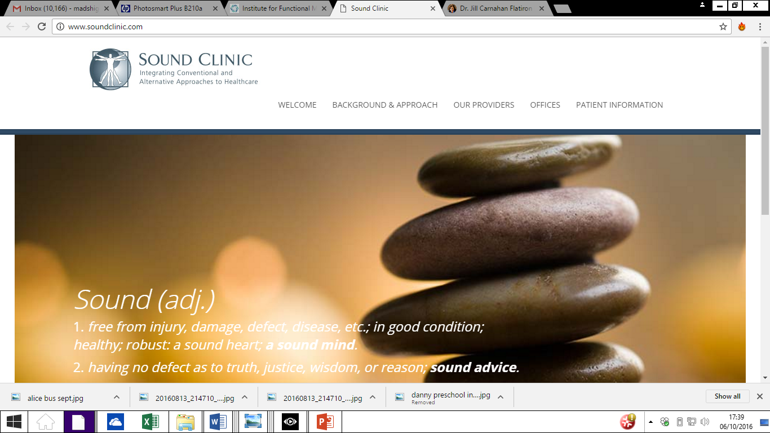

Slide 11
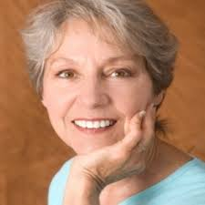
Your prospective patients
Your patients will no doubt be varied with different health problems and backgrounds, however for the purposes of developing your brand and marketing materials it is useful to focus on a ‘core target’
Portrait of your core target:
  35-65 woman
  Living in Costa Rica – ideally Central Valley
  Complex and reoccurring health problem that their doctors have not been able to get to the bottom of
  Aware of health and lifestyle
  Online savvy
  The ability to pay for your services
  Their problem: “I really want to find a doctor who will listen to my range of health concerns and help me find a lifestyle that will address them.”

Slide 12
Considerations
You are a real doctor qualified in USA and Costa Rica
Membership of the Institute of Functional Medicine
Location
Language
Business model now and in the future – How you help people (face to face, content provision, sale of supplements)

Slide 13
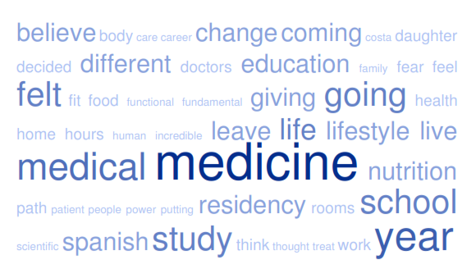
Interpreting your story

Slide 14
Medical
Medicine
Study
Education
Change
Different
Lifestyle
Live
Nutrition
Health
Fit
Food
Believe
Feeling
Giving

Slide 15
Draft Values – the Hili brand of Functional Medicine
Trustworthy
Qualified
Professional
Empathetic
Personal
Inspirational
Realistic
Transformative
Different(?)
Lifestyle/Holistic(?)
For life

Slide 16
Draft propositions
Getting to the roots of your health
Rejuvenating your health origins
Mapping your health journey
Explore the roots of your health
Discover the essence of your health
Understanding your health
Building the foundations of your health
Rejuvenating the roots of your health
Evolve your health journey
Rebuild the foundations of your health
Revitalising your health

