Slide 1

REEBIE
facebook.com/
knowbrainertrivia
LIKE US
WHILE YOU
ARE THERE…

Slide 2
H
R1
KNOW BRAINER
R2
R3
SB
@ Prince Albert
7:30pm Monday
054

Slide 3
H
R1
R2
KNOW BRAINER
R3
SB
ROUND 1

Slide 4
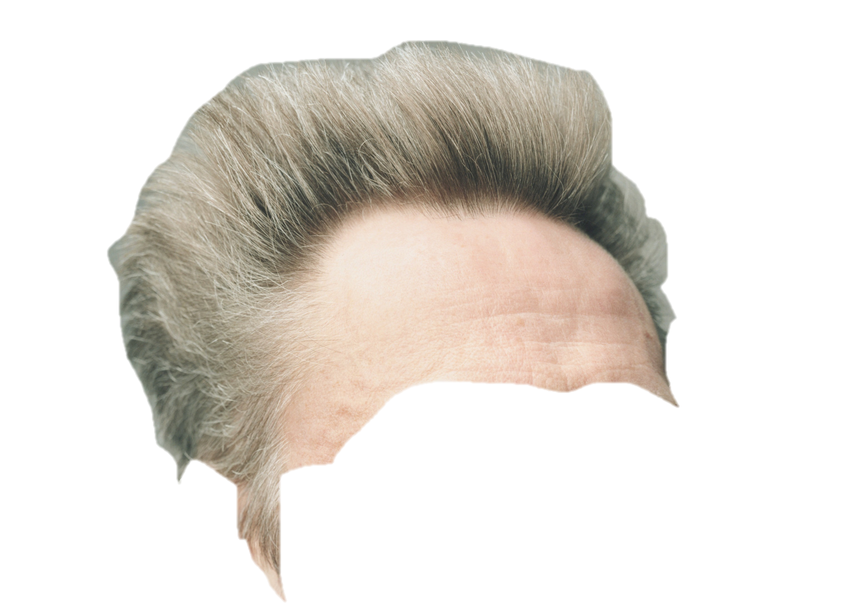
NAME THE BRAIN

Slide 5
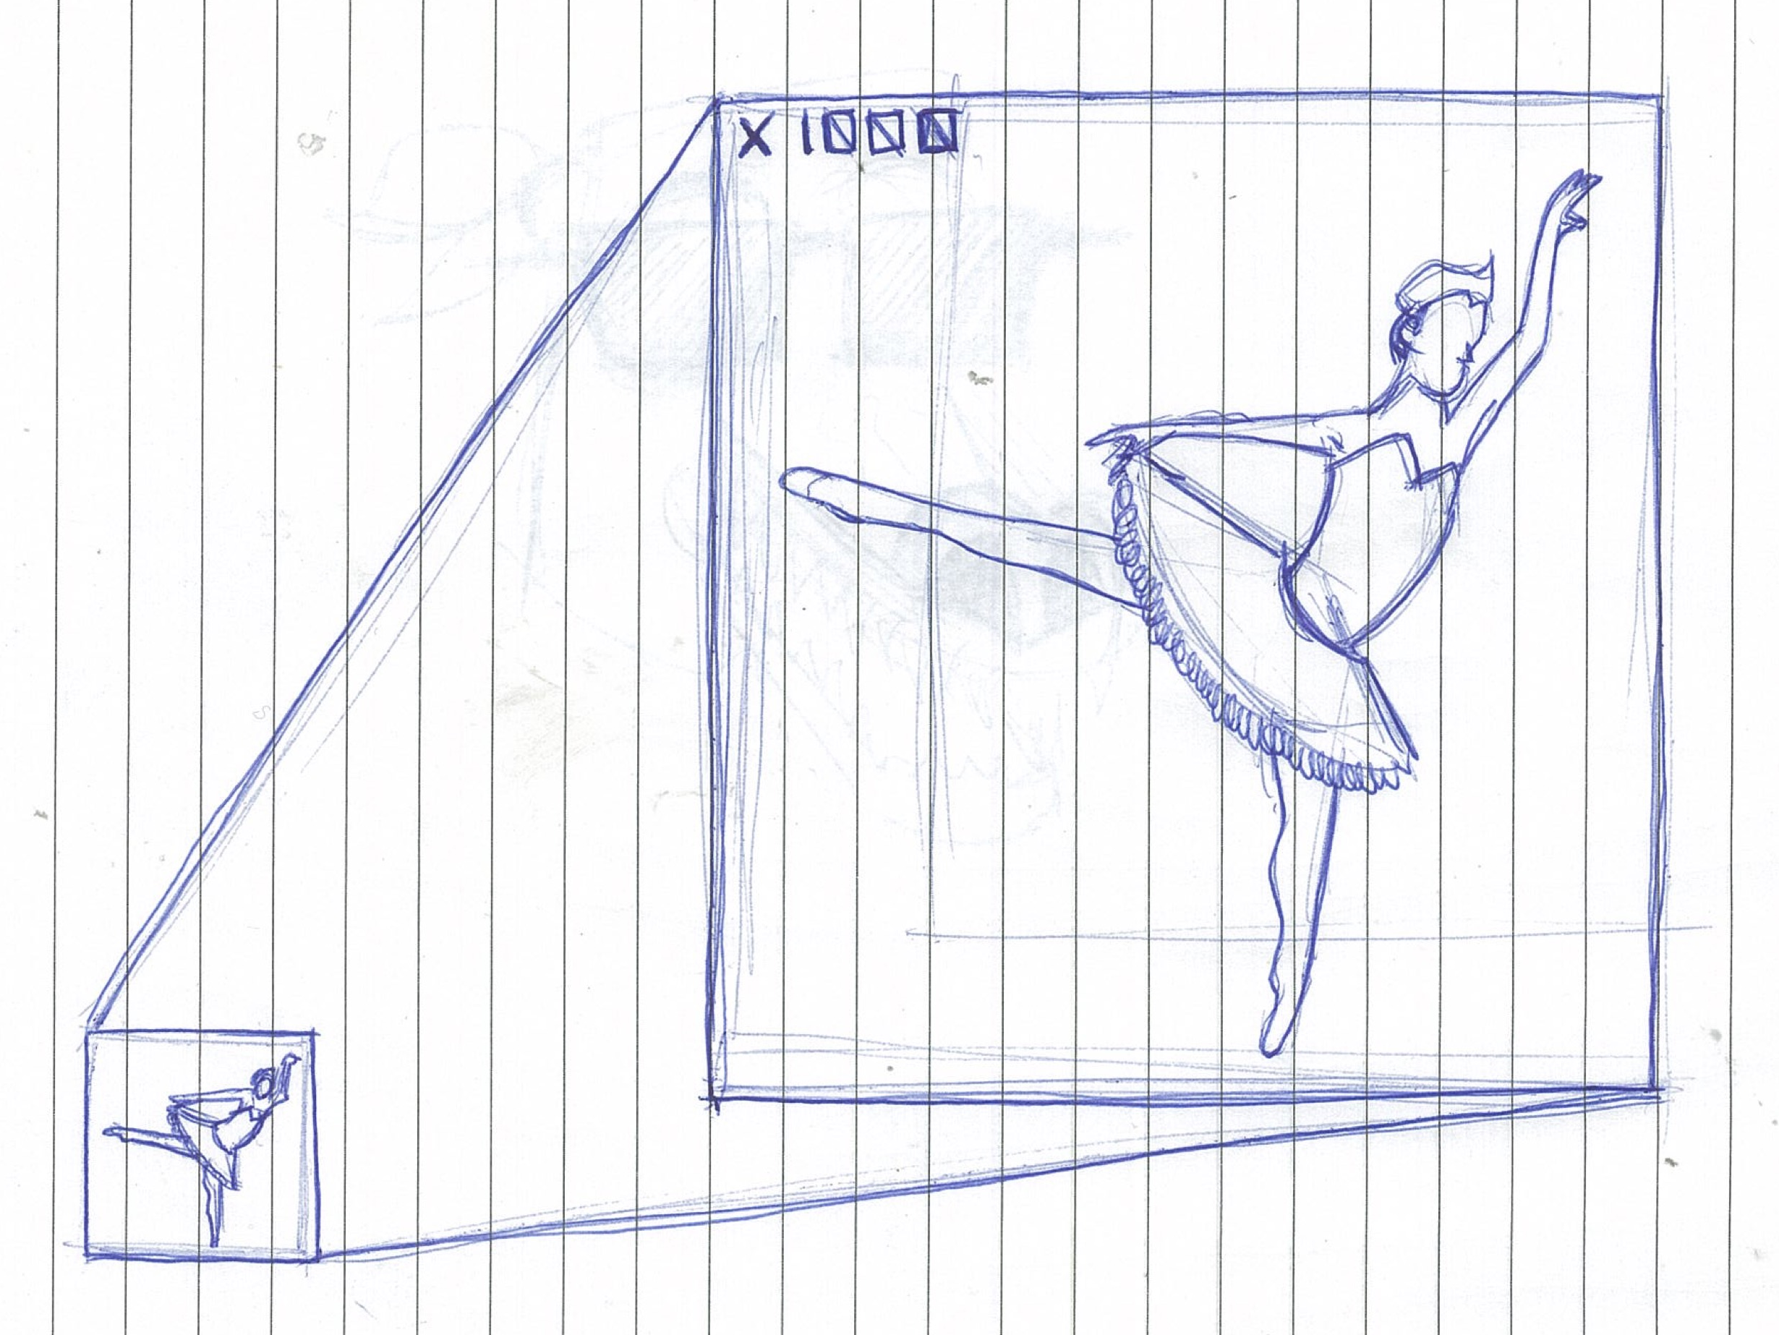
NAME THE title + artist

Slide 6
KNOW BRAINER
BONUS ROUND

Slide 7
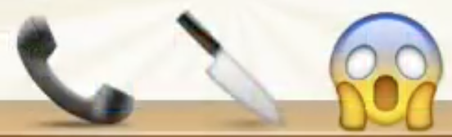
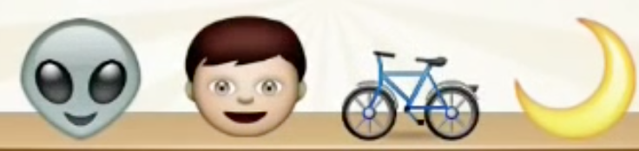

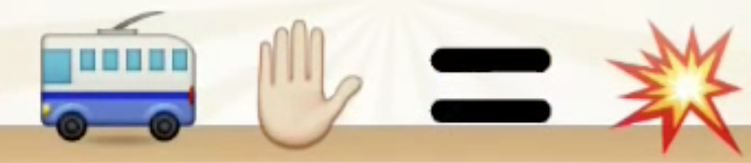
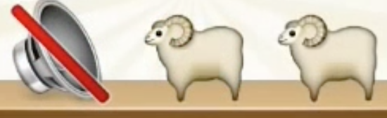
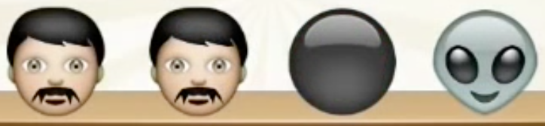
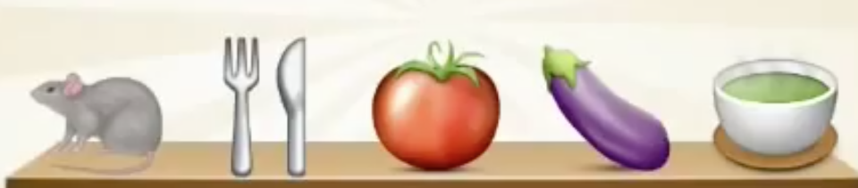
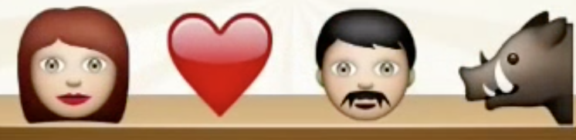
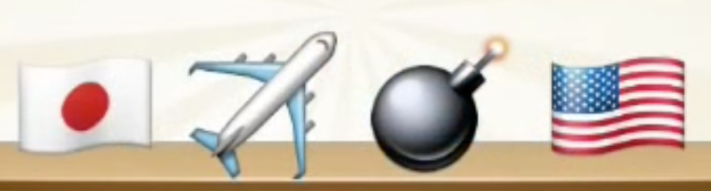
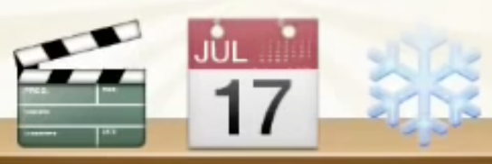
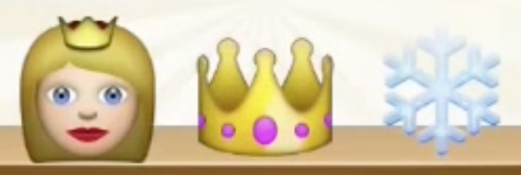
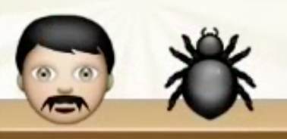
1
2
3
4
5
6
7
8
9
10
11
12

Slide 8
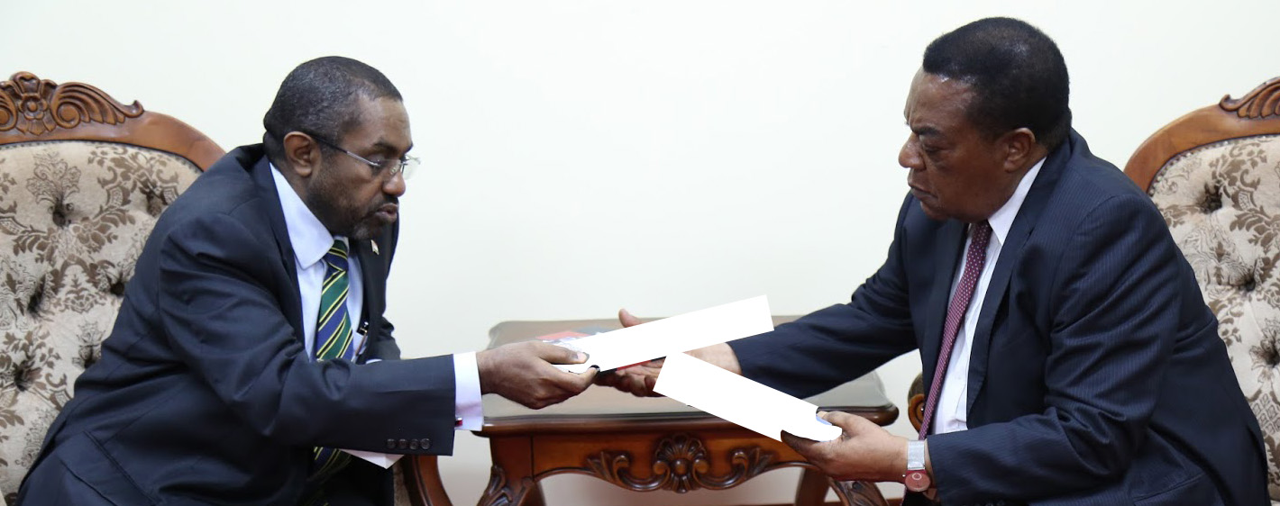
SWAP YOUR SHEETS

Slide 9
BONUS ROUND ANSWERS
SCREAM
KILL BILL
SILENCE OF THE LAMBS
BEAUTY & THE BEAST
ICE AGE
SPIDER MAN
ET
SPEED
MEN IN BLACK
RATTATOUI
PEARL HARBOUR
FROZEN

Slide 10
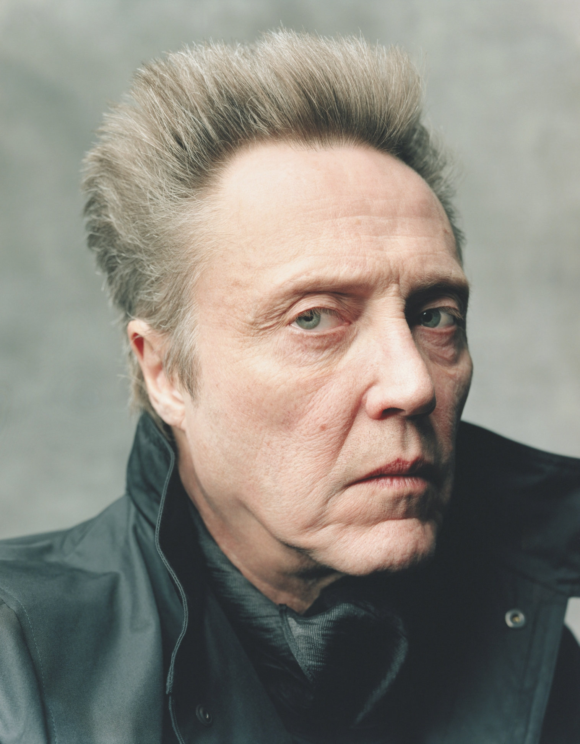
NAME THE BRAIN

Slide 11
NAME THE title + artist

Slide 12
H
R1
R2
KNOW BRAINER
R3
SB
ROUND 2
…in just a moment...

Slide 13
ANAGRAM
KISS SIN BUYERS

Slide 14
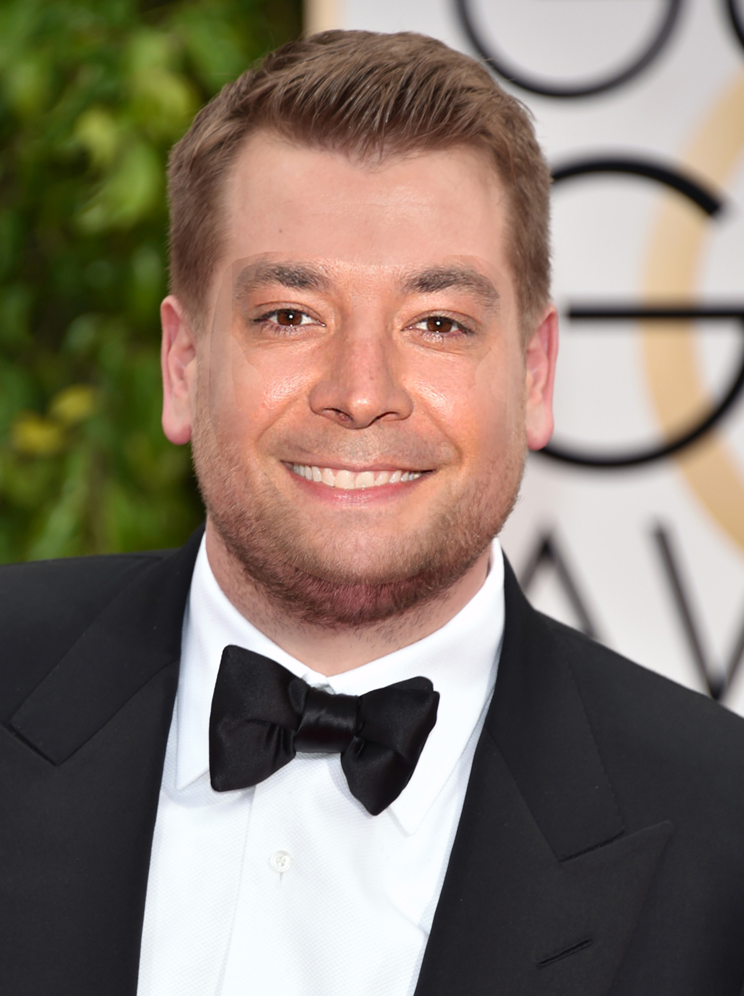
FACE MORPH

Slide 15





THEMES

Slide 16


THEMES

Slide 17
KNOW BRAINER
BONUS ROUND

Slide 18
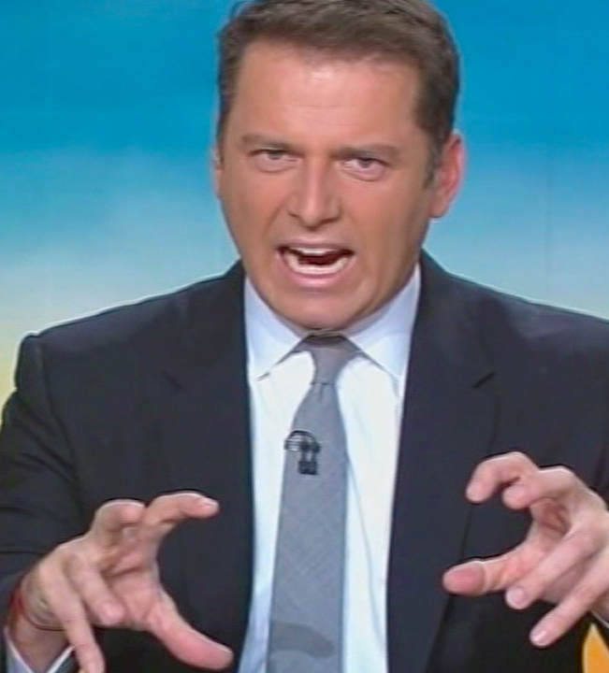
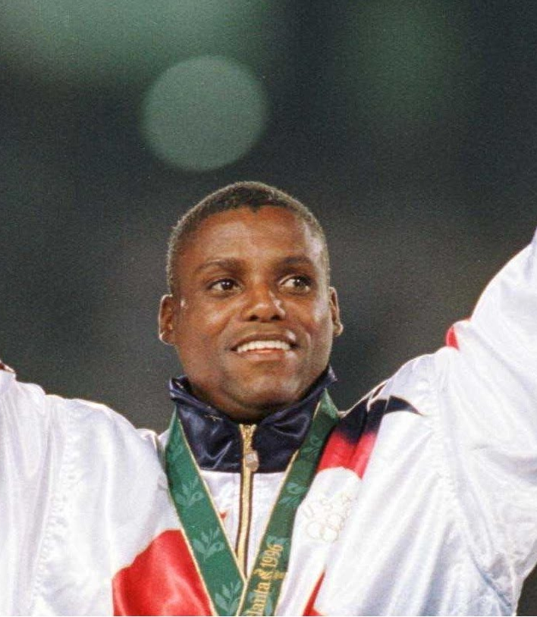
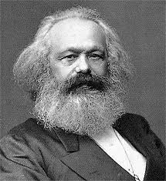
BONUS ROUND
KARL
STEFANOVIC
CARL
LEWIS
KARL
MARX
42 + 55 + 198 = 295

Slide 19

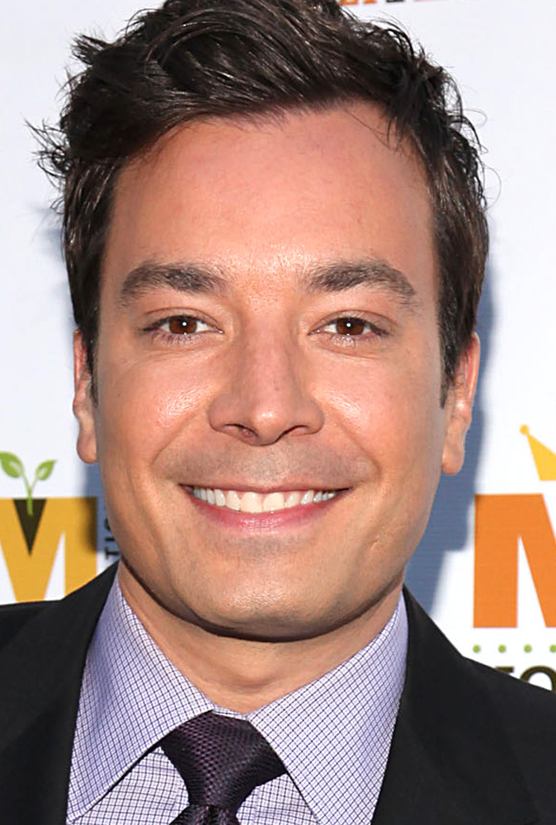
FACE MORPH

Slide 20


THEMES

Slide 21
H
R1
R2
KNOW BRAINER
R3
SB
ROUND 3
…in just a moment...

Slide 22


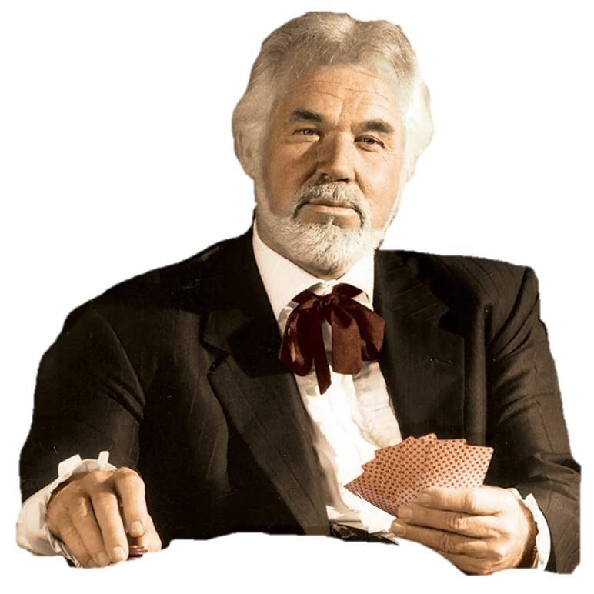
WHO WAS IT?
(MUSIC)
SHES GOT IT
(MOVIES)
5 OF 10
(SPORT)
THE
GAMBLER
LEAD THE WAY
(THE WORLD)
EVERGREEN
M
(TV)

Slide 23
DITLOID
16
O I A P

Slide 24
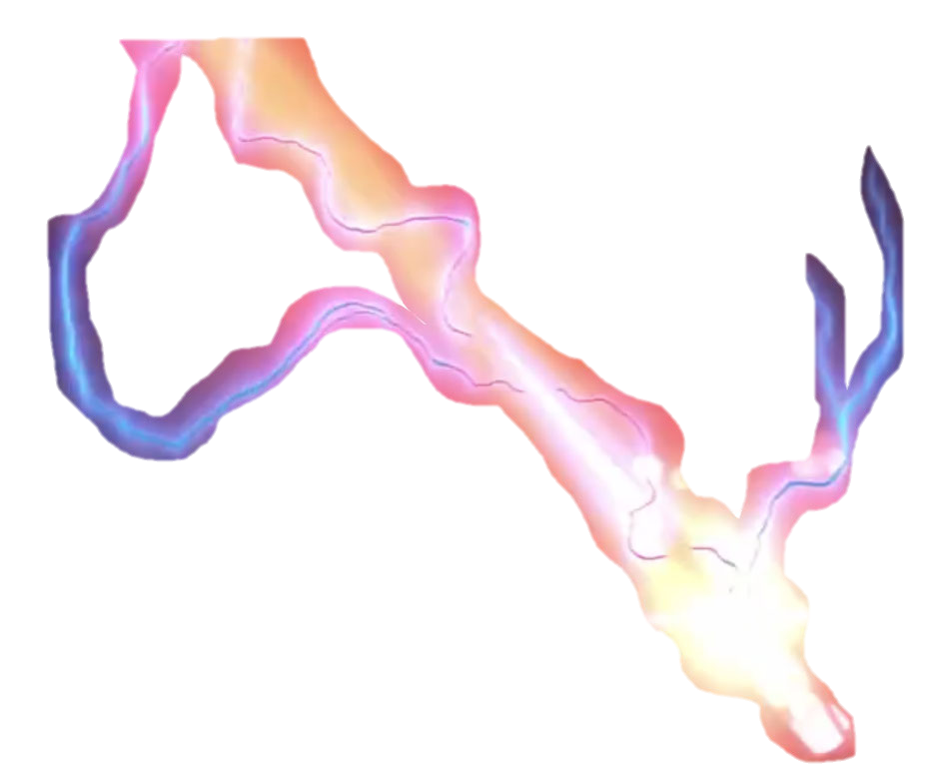
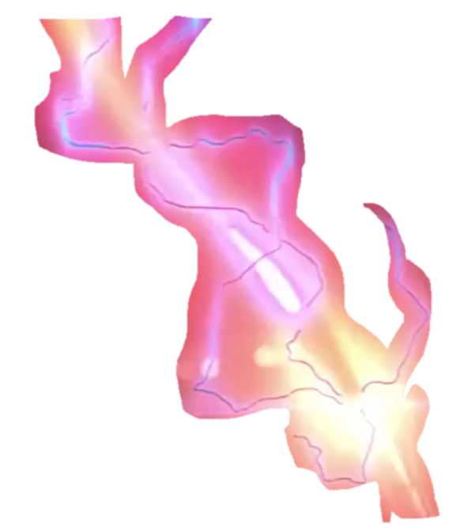

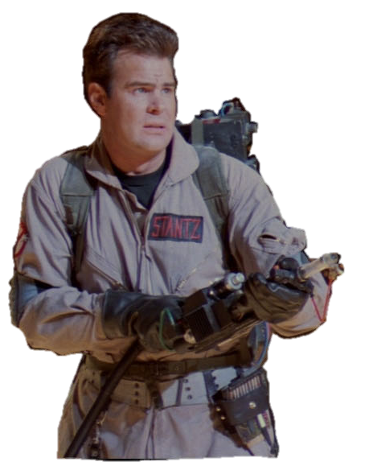
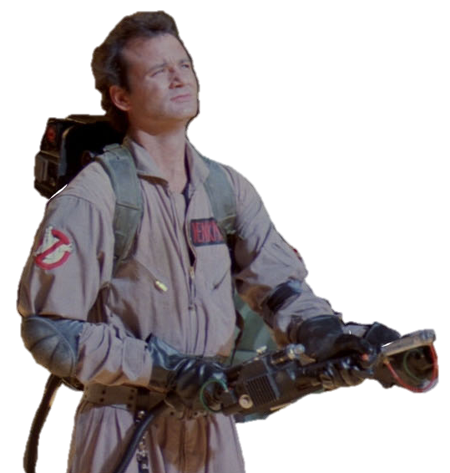

GHOST
BUSTIN’
Question

Slide 25
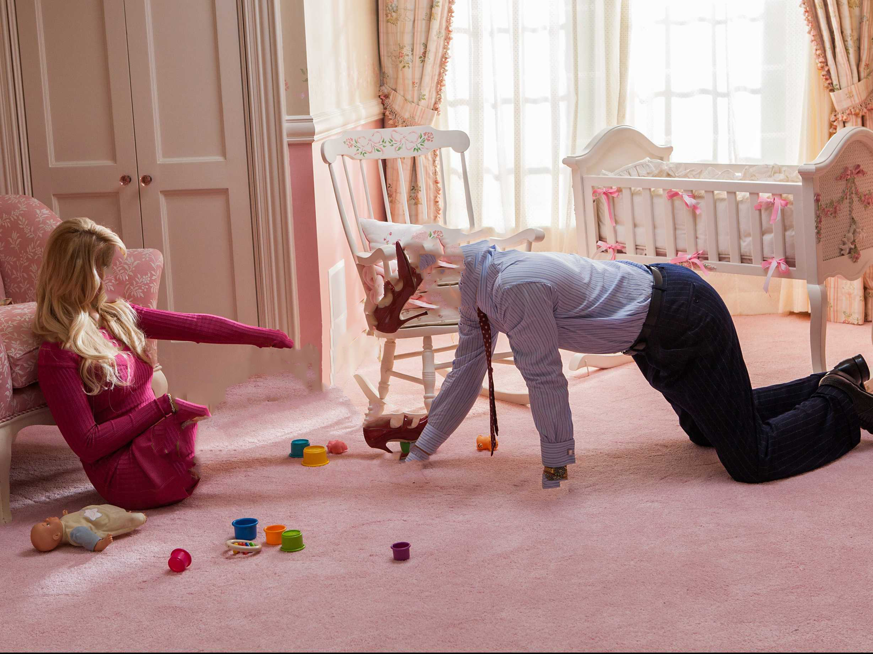
NAME THE GHOST ACTORS

Slide 26

WILLYWOOD

Slide 27
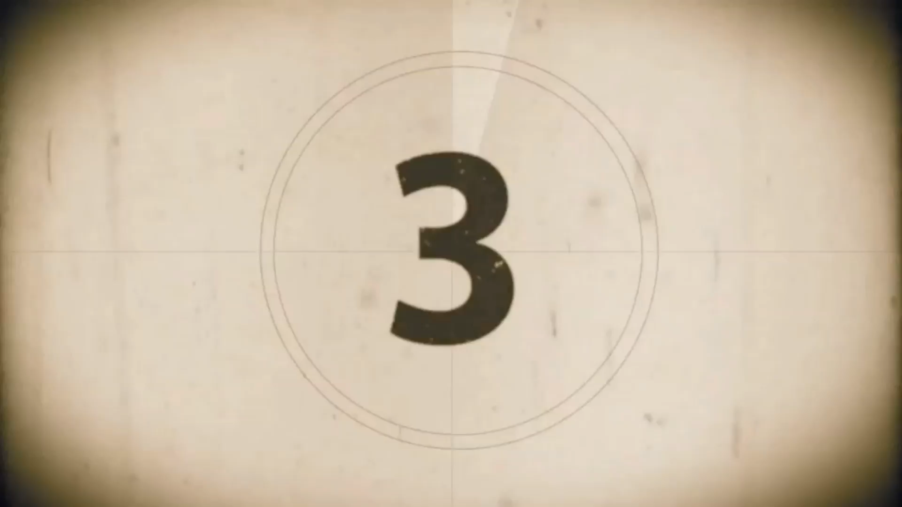

Slide 28
KNOW BRAINER
…CALCULATING…

Slide 29
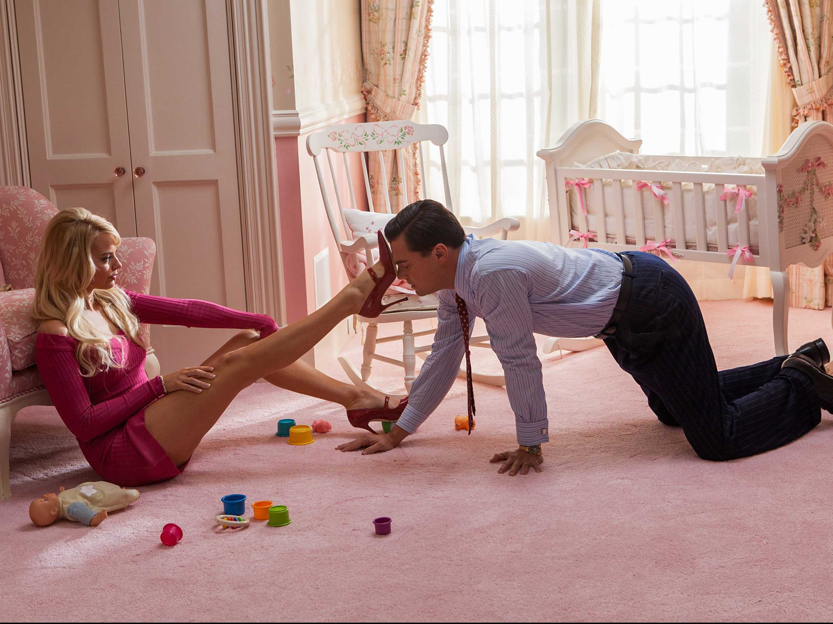
NAME THE GHOST ACTORS

Slide 30
WILLYWOOD

Slide 31
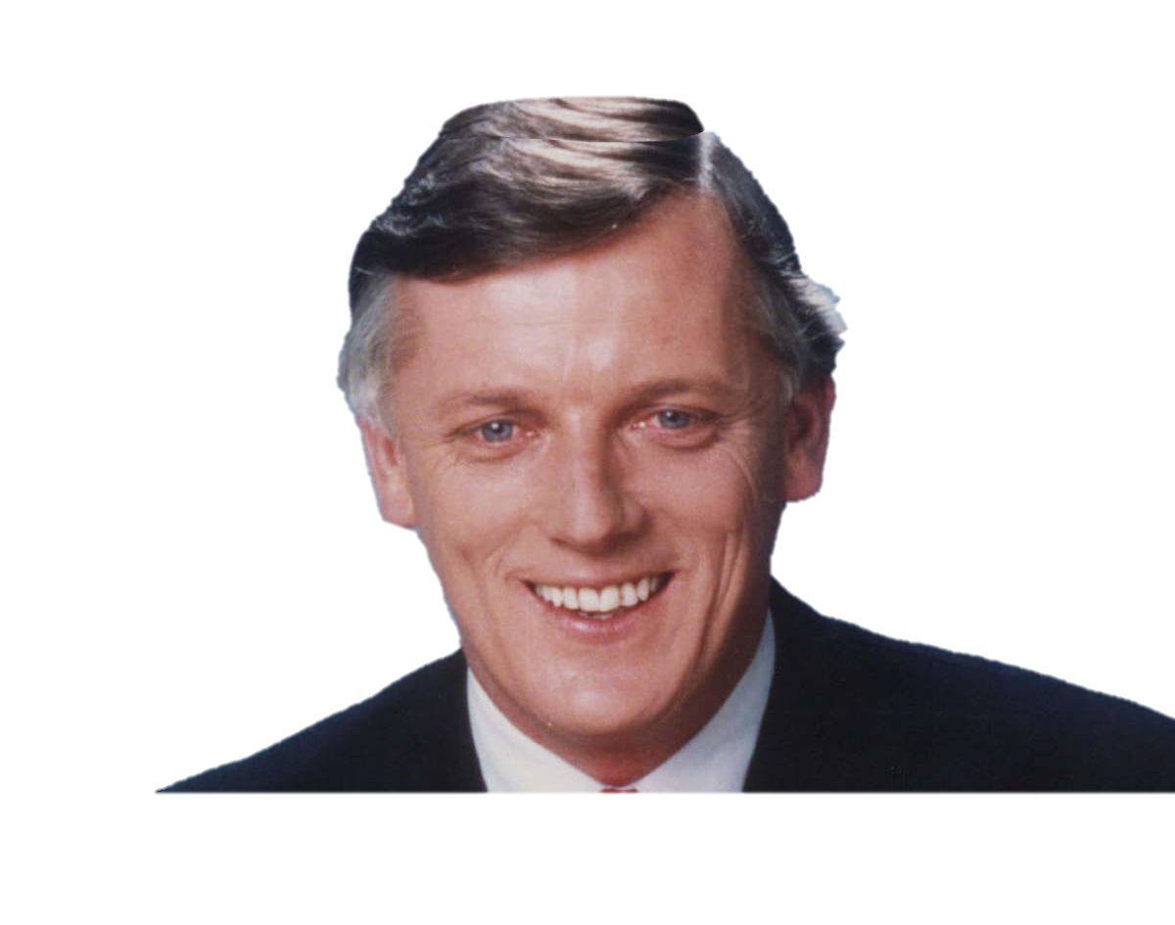
H
If you don’t want to know the scores…look away now…
R1
R2
R3
SB

Slide 32
H
R1
R2
R3
SB
1

Slide 33
KNOW BRAINER
@ Prince Albert
7:30pm Monday

Slide 34
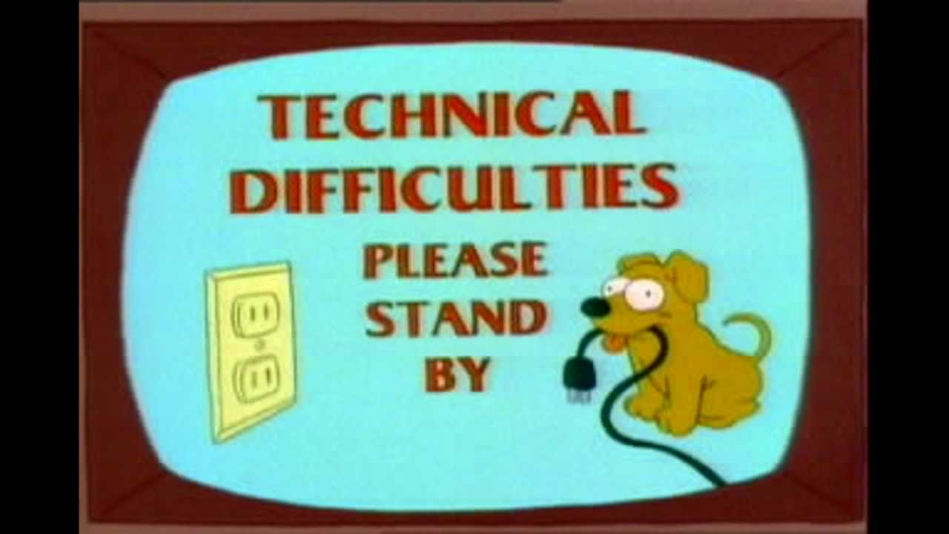

Slide 35

BONUS ROUND
facebook.com/
knowbrainertrivia

