Slide 1

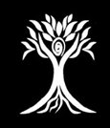
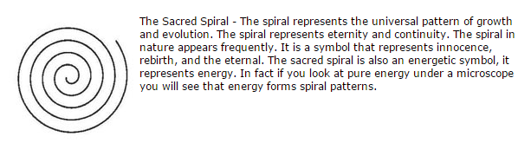
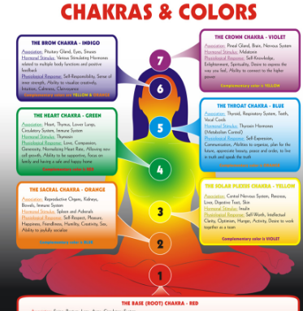
Inspiration for Logo
For the logo, I’d like to combine 3 concepts into one logo. The first concept is the tree of life. The tree of life is an ancient, mystical tree that illustrates the plant-based nature of our products. The second concept is the heart chakra. The heart chakra is always denoted by the color green and I’d like to see a body sitting in a yoga position with the heart chakra illuminated in green. The third concept is the sacred spiral. The spiral represents the “Prana” of our product line. I’d like to see the spiral incorporated into the logo (either as a part of the green chakra circle or radiating from the center like the sample image below).
Please start with a person sitting in a yoga position (similar to #2) with her arms raised to form a tree-like visual with leaves (similar to #1) and embed the sacred spiral (#3) into the visual.
2
1
3

Slide 2
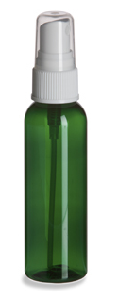

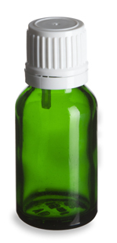
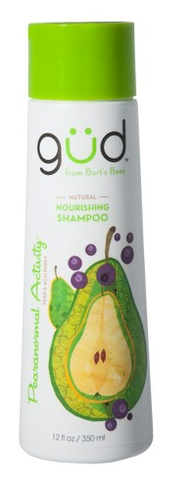
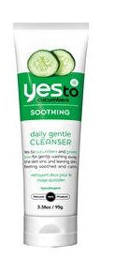
Color Considerations
The Prana Tonics products will be packaged in green bottles with white tops. The product label will either be white or clear depending on the logo design. Please design the logo using colors that will look great on a green bottle or white label.
Inspiration
1/2 ounce
4 ounce
2 ounce

