Slide 1
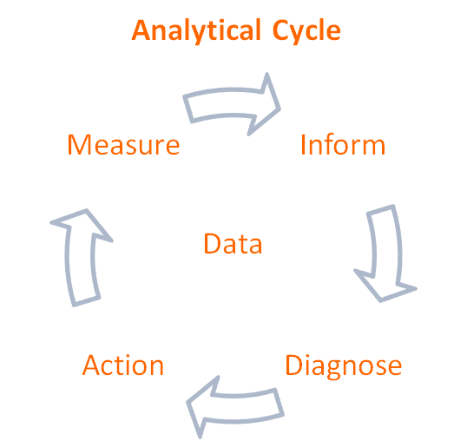
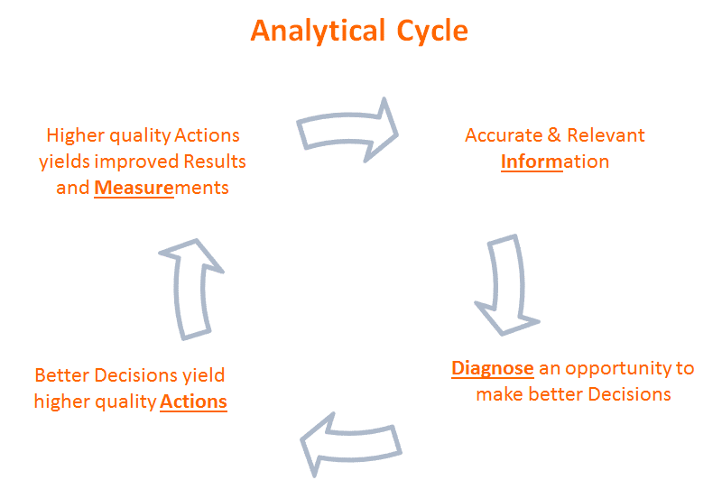

Slide 2
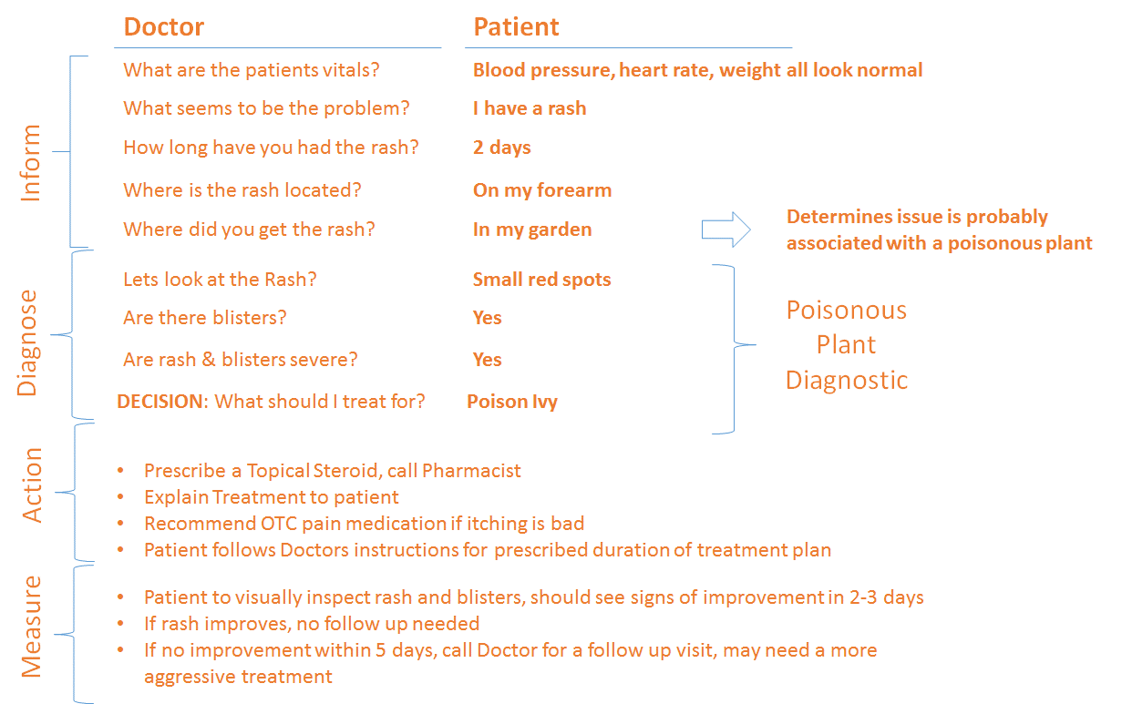

Slide 3
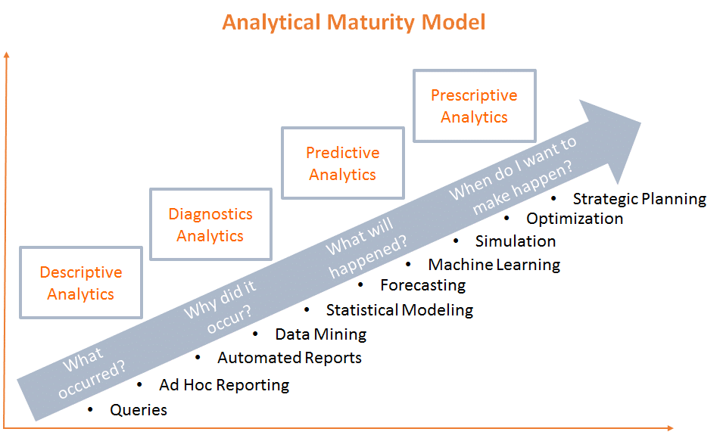
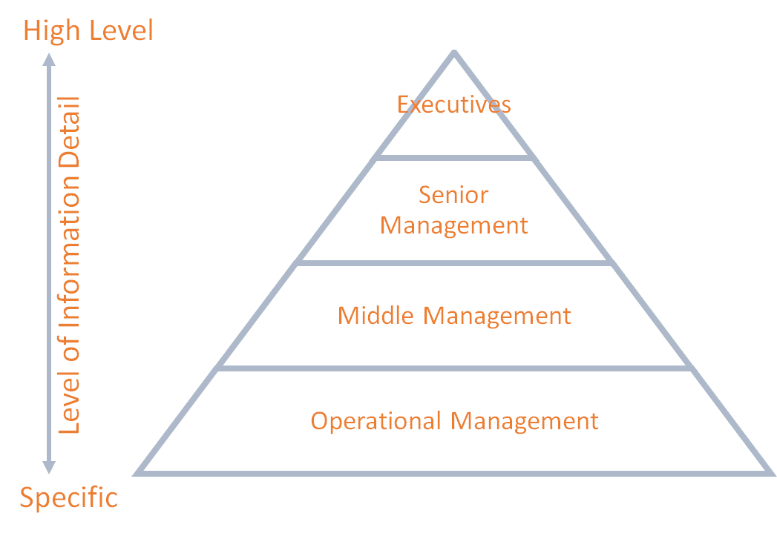

Slide 4
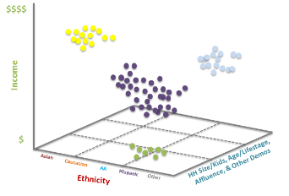
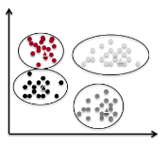

Slide 5
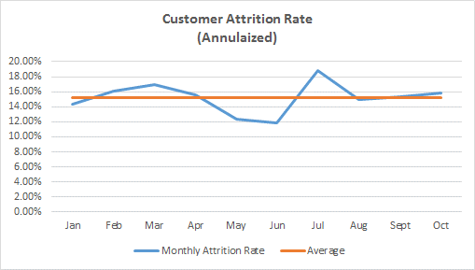
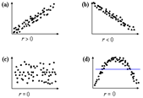
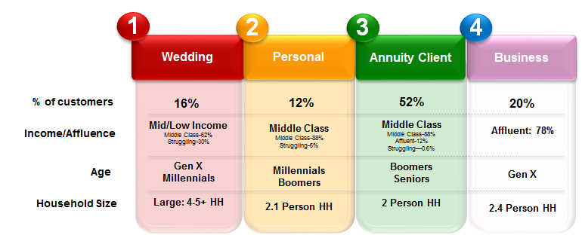

Slide 6
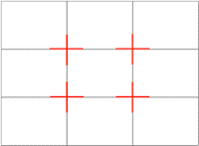
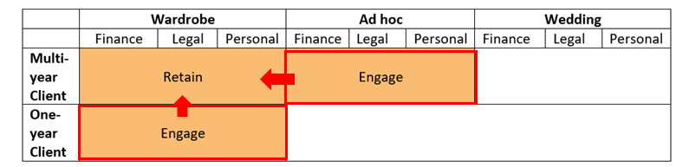
 | Wardrobe |  |  | Ad hoc |  |  | Wedding
 | Finance | Legal | Personal | Finance | Legal | Personal | Finance | Legal | Personal
Multi-year Client | Retain |  |  | Engage
One-year Client | Engage

Slide 7




Slide 8
 | Competitor A | Competitor B | Our Price
Tall Kitchen Compostable Bags | $8.45 | $9.50 | $8.89
Recycling Tall Kitchen Drawstring Clear Bags | $8.07 | $9.15 | $8.49
Recycling Large Trash Drawstring Blue Bags | $11.52 | $15.68 | $14.99
 | Month 1 | Month 2 | Month 3 | Month 4 | Month 5 | Month 6
Tall Kitchen Compostable Bags | 11,091 | 12,099 | 11,441 | 11,789 | 11,273 | 11,804
Recycling Tall Kitchen Drawstring Clear Bags | 5,928 | 6,003 | 6,189 | 6,224 | 6,431 | 6,577
Recycling Large Trash Drawstring Blue Bags | 4,334 | 4,729 | 5,035 | 5,632 | 6,101 | 6,871
Recycling Large Trash Drawstring Blue Bags | 0-30 days | 31-60 days | 61-90 days
Orders on Books | 7,896 | 5,199 | 3,388
Forecast | 7,536 | 8,265 | 9,065
Budget | 5,000 | 5,250 | 5,512
Outlet Type | Number of Stores | Current Penetration | Product Profit by Outlet Type | Opportunity Potential | Ability to Achieve
Large Grocery Store | 38,000 | 28,553 | $5.79 | $54,698.13 | Med
Convenience Retail | 64,500 | 5,211 | $6.75 | $400,200.75 | Low
Large Retail | 11,200 | 9,837 | $5.07 | $6,910.41 | Low
Organic Specialty Stores | 24,000 | 3,027 | $7.97 | $167,154.81 | High

Slide 9
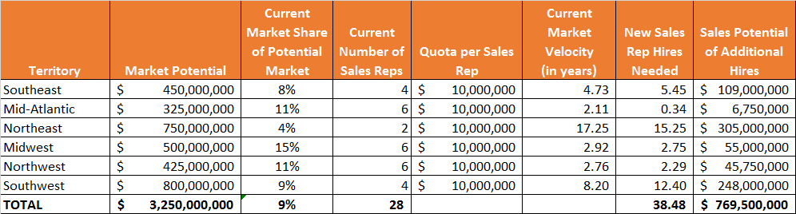
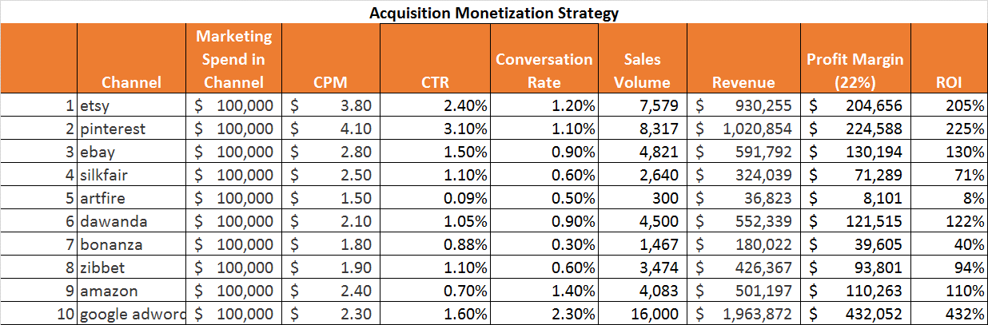
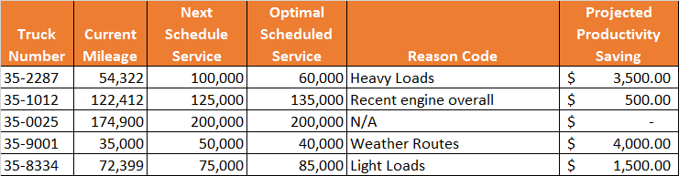

Slide 10
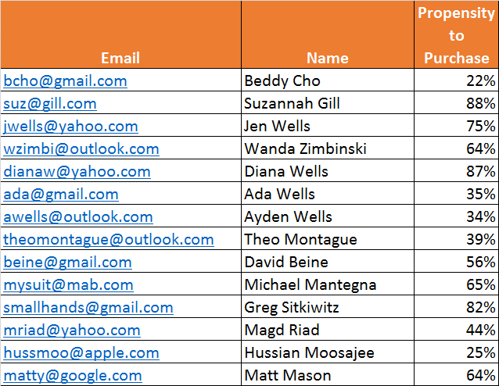
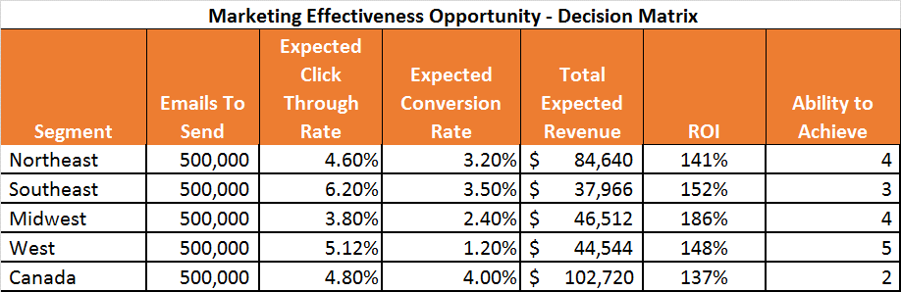

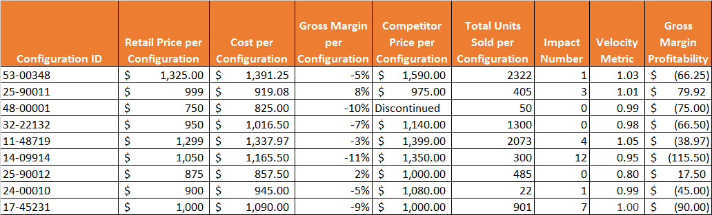

Slide 11
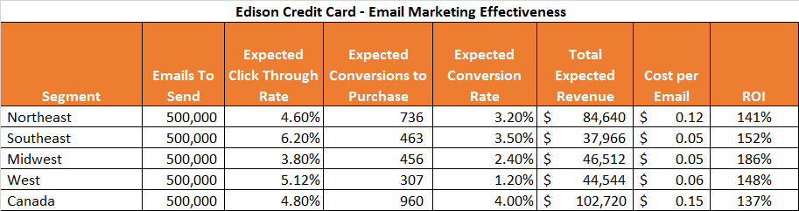
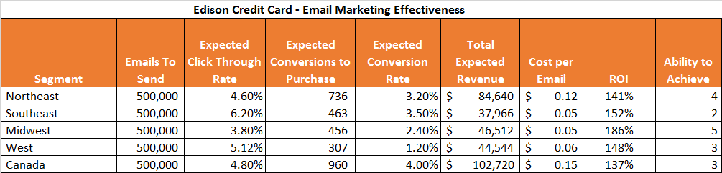
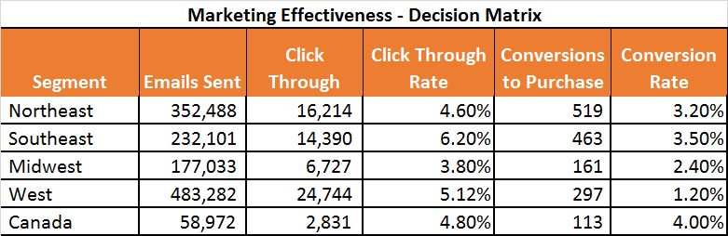

Slide 12
% spend diff | time since last order | Score Assigned | Likely to Migrate Probability
> 0 and < 30% | 0 - 6 months | High | 80%
>= 30% and < 60% | 0 - 6 months | High | 80%
>= 60% | 0 - 6 months | Low | 20%
> 0 and < 30% | 7 - 12 months | High | 80%
>= 30% and < 60% | 7 - 12 months | Med | 50%
>= 60% | 7 - 12 months | Low | 20%
> 0 and < 30% | 13 - 18 months | Med | 50%
>= 30% and < 60% | 13 - 18 months | Low | 20%
>= 60% | 13 - 18 months | Low | 20%

Slide 13
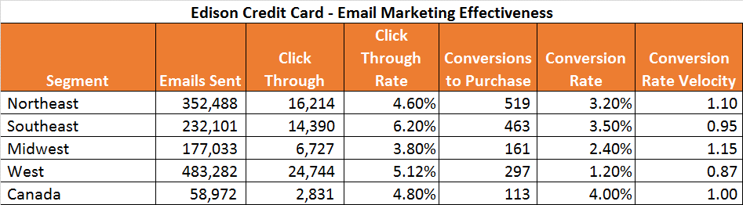
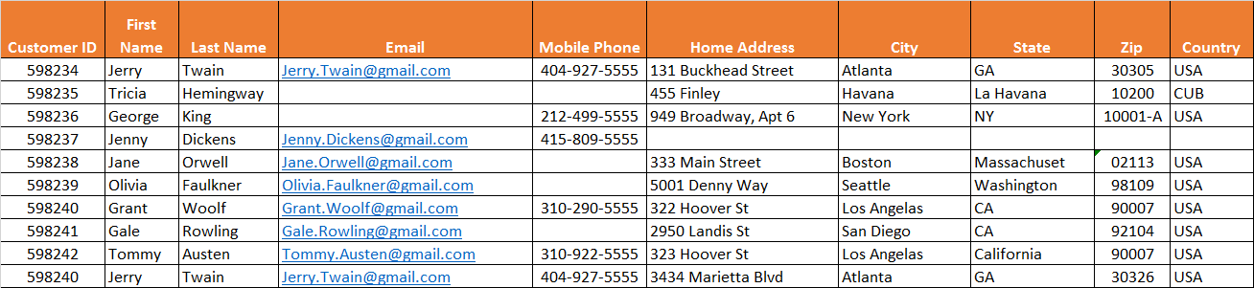

Slide 14
