Slide 1
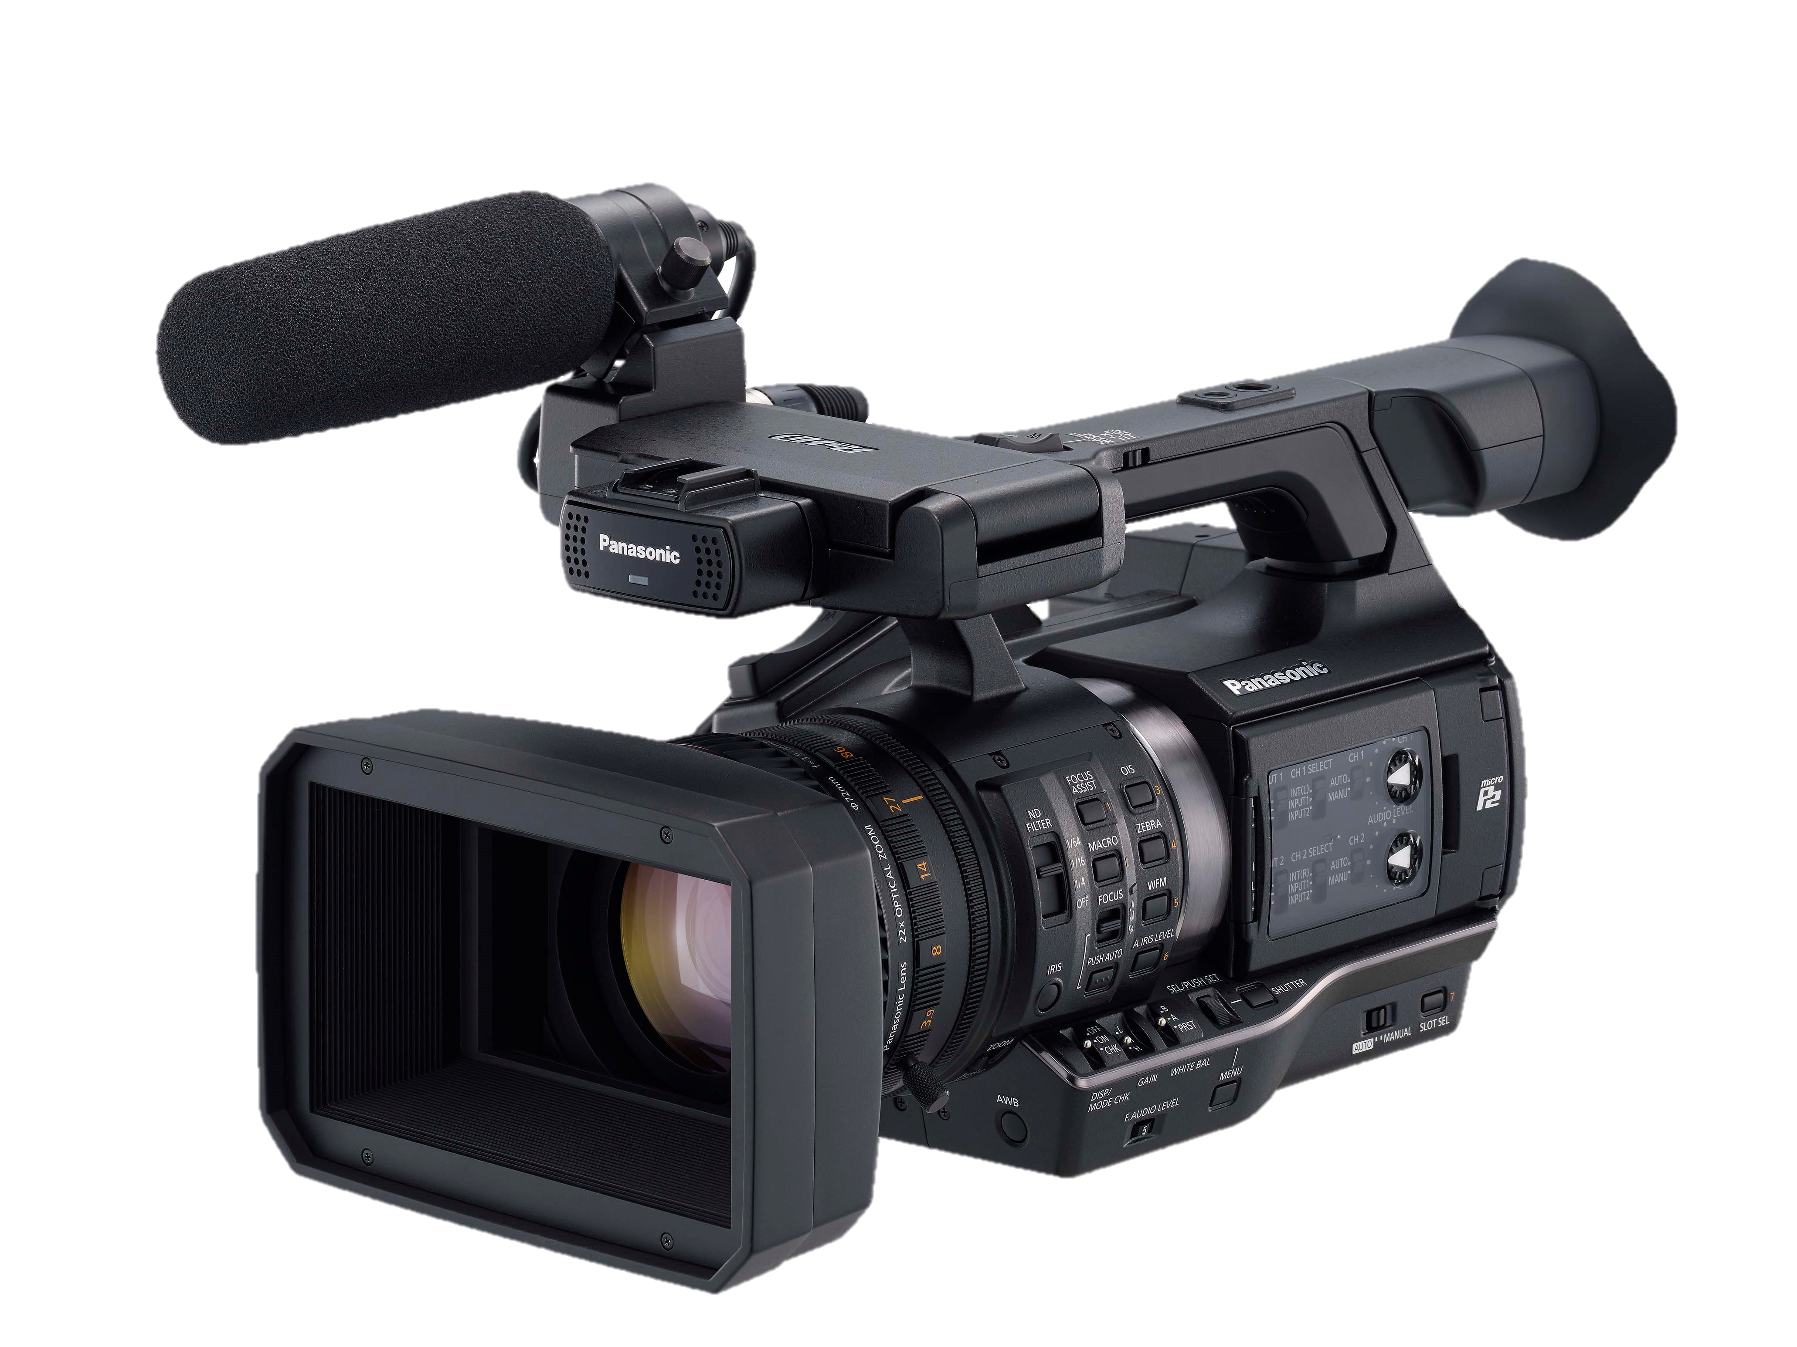




Panasonic
AJ-PX270
Features:
22x Lens
P2 Cast Compatible
LiveU compatible
10bit 4:2:2 Recording
AVC-Intra
Included:
1 x AJ-PX270 P2 Camera
1 x AJ-WM30 Wi-Fi Dongle
2 x AG-VBR59 Batteries
2 x AJ-P2M064 64GB Micro P2 Cards
20% Off!
$7528.00 ex GST
Supported by:
Offer closes November 30th 2016

