Slide 1
SVP Business Case
Sudhir Pai
Nov 2016

Slide 2

Watashi wa dare ka (私は誰か) Who am I?
Can I have a different title?
Personal Evolution
Professional Distinction
Future Potential

Slide 3
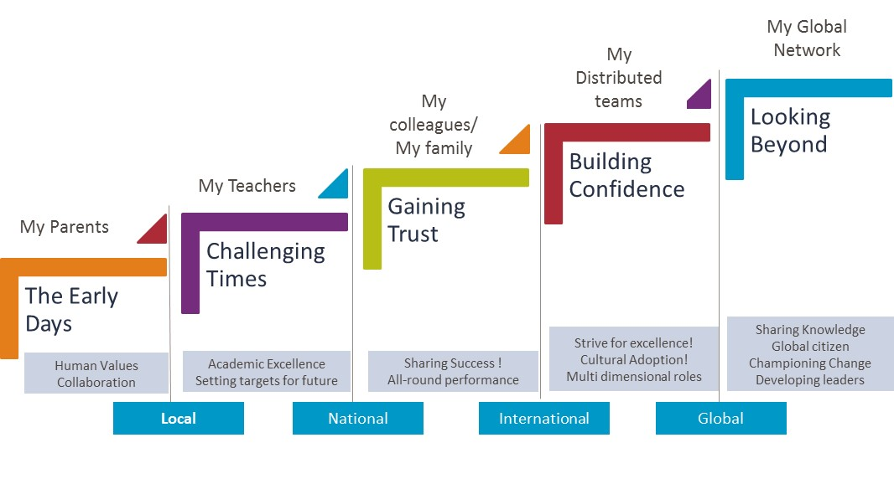

Personal Evolution
Learning the hard way
Contribution to society
Holding Hands
Integrity and Trust
Disciplined
Lifestyle
Warren McAleese, Senior IT Partner Manager, Telstra
“I have a high regard for Sudhir’s knowledge,
commitment and ethic’s. In my experience
Sudhir did an excellent job of managing Client
requirements whilst maintaining and sustaining
his team in sometimes difficult circumstances.
Sudhir was very innovative and pro active in his
delivery of the services. I would gladly have Sudhir
involved in future work.”
Paul Stickland, Program director and GM Sensis
“Sudhir is a first class Program Director who acts
in the best interest of his Client to deliver. He has
high integrity and can be trusted to deliver on what
he promises. he is not afraid to challenge and bring
new ideas, alternative approaches to the table. His
calm, efficient and professional manner makes
him an ideal partner to work with. Sudhir is an
excellent operator who is committed to mutually
beneficial outcomes.”

Slide 4

Academic excellence,
Achievements and accreditations
A gold medallist in Master of Engineering in computer science and an Electronics and Communications engineer with honors.
Adjunct research fellow for IoT at University of Swinburne
Nominated by Indian Executive Council of Australia (IEC) as a community leader for 2016
Brain behind setting up an Innovation centre (SMAC lab) for Capgemini in Melbourne launched by previous Hon. Premier of Victoria Denis Napthine.
Recipient of National Stock Exchange (NSE) award for blockchain panel regarding smart contracts in financial services.
Pursuing a future commerce course with MIT, supporting development of Fintech ecosystem
Media publications
National Stock Exchange – Blockchain conference, smart contract panel
http://futuretech2016.com/conference.html
Innovation Centre PoV:
http://www.itnews.com.au/news/innovation-centres-a-waste-of-time-resources-408184
SMAC Lab in Melbourne http://www.arnnet.com.au/article/553339/capgemini_opens_melbourne_digital_innovation_lab/
Technology Services Panel @ Media 2015
http://www.businessacumen.biz/index.php/events/media-summit-15.html
Role of CTO office:
http://www.itwire.com/business-it-news/business-technology/64489-whats-the-role-of-capgemini-australias-cto-office
Can I have a tree with multiple branches
With academics
Achievements
Accreditations Media release etc.

Slide 5
Professional Distinction
Engineering
Excellence
Distributed
Delivery
Engagement /Relationship Management
Practice Units
P&L
Chief Technology Officer
Head of Innovation
Regional
Chief Technology Officer
Global, FSSBU
International
Mobility / Global Value
Professional
Versatility

Slide 6
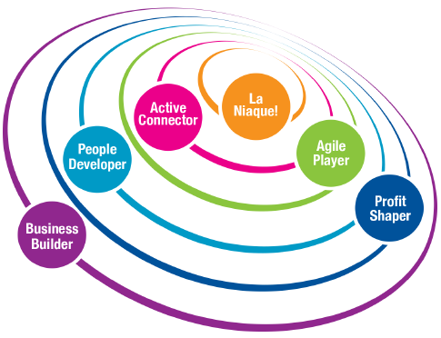
LEADING ALL THE WAY: LA NIAQUE
Never Give-up
Winning fire – Mobilise clients and teams
Strong resilience and drive to overcome obstacle
Positive Energy and Capgemini Values
Avid for Success
LANIQUE

Slide 7





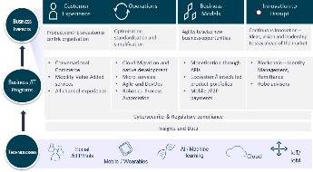









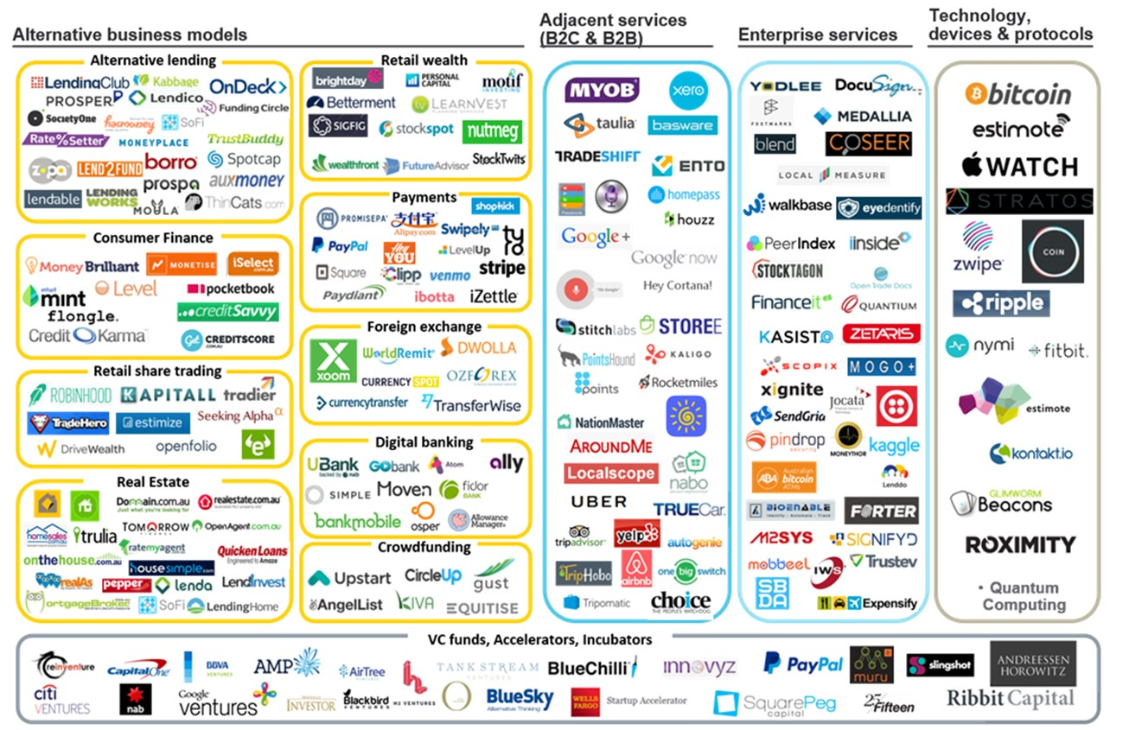
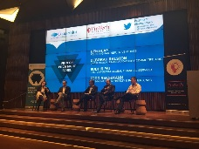
LEADING ALL THE WAY through ‘Digitally-Inspired technology leadership’
Business Builder
Unique, unconventional approach
  Customer experience
  Operational efficiency
  New business models
  Disruptive Innovation
New and repeat business: value based, Innovation led, targeting different set of client stakeholders
Agile Player
Efficiency, speed,
and simplification in all actions e.g. QBE
Adapts to market changes and competitive pressures and enables fast learning
Respects rules & aligns teams around collective performance, while taking risks and making courageous decisions
Active Connector
Change Ambassador for FS transformation
Developing communities to break silos (similar to Spotify concept)
Developing integrated solution offerings
Bringing Value through external and internal network
Unconventional partnership
People Developer
People leadership is tested during tough times
Win-win environment to inspire, attract and develop the best Talents - SFDC and AWS practices
Maximising individual potential – Exceeds and Role Models
Coach, mentor, Empowerment with integrity – client quotes
Marcello, Chris and Warren

Slide 8
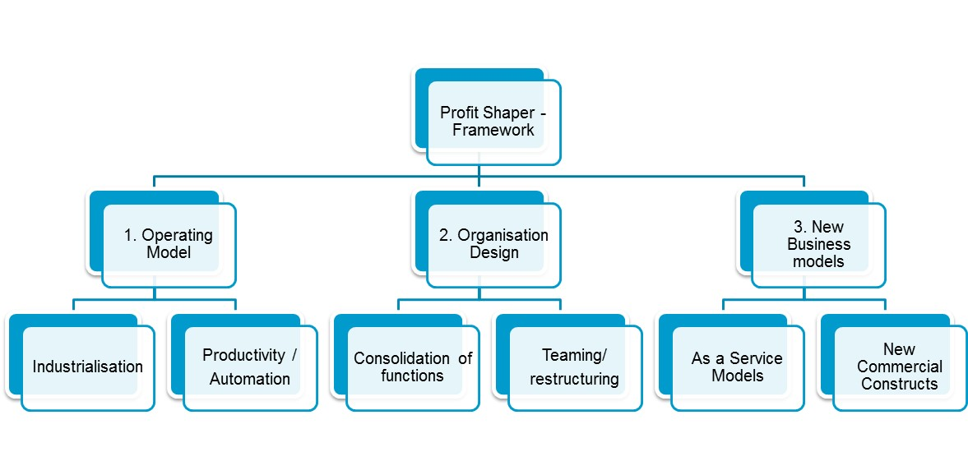
LEADING ALL THE WAY: PROFIT SHAPER

Slide 9
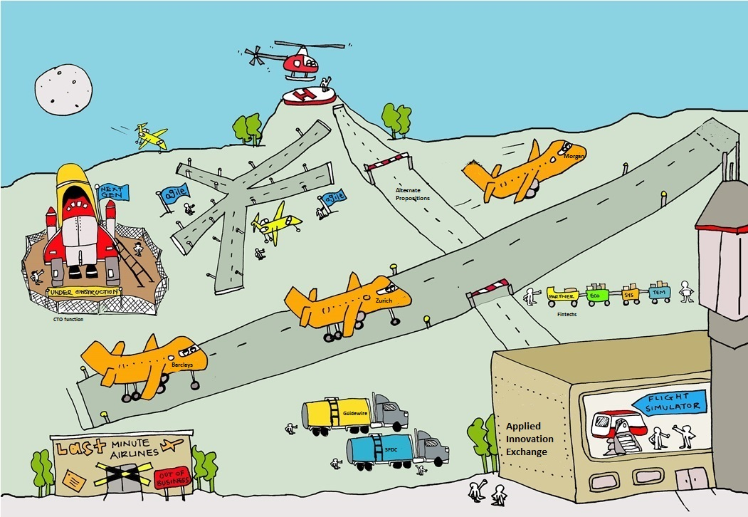

Slide 10
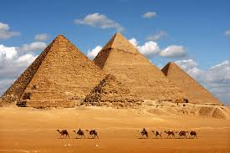

Our Business Models are changing
One-size-does not fit-all !
BiModel Business
#BMB
Change | Innovate | Disrupt
1
Traditional Business
2
New Business
Agility and Speed
Reliability
Self empowered, employee trust leading to smart decisions
Structured, Multilayer Governance
Innovate 2 Disrupt
Business-centric, Ecosystem led, iterative short term milestones
IT focus, enterprise partners, long term deals
Uncertain projects, new ways of working
Conventional process, projects with high predictability
Revenue, Brand and Customer Experience focussed
Price for performance
Disruptive
Our Past and Present !
Our Future !
Change
Innovate
Disrupt
As a change ambassador bring n the changes required in our organisation and our client’s organisation to drive new business models
As a chief Innovation Officer bring in continuous, Open Innovation to all segments of our businesses
Drive Fintech led ecosystems to sell with, Sell to generate new revenue channels
3
My Goals
CTO for Financial Services business at Capgemini to lead the journey of new business models!

Slide 11
Future Potential

Slide 15
Personal Evolution
The Early Days
Challenging Times
Gaining Trust
Building Confidence
Looking Beyond
My Global Network
My Distributed teams
My colleagues/My family
My Teachers
My Parents
Strive for excellence!
Cultural Adoption!
Multi dimensional roles
Sharing Knowledge
Global citizen
Championing Change
Developing leaders
Human Values
Collaboration
Academic Excellence
Setting targets for future
Sharing Success !
All-round performance
Local
National
International
Global

Slide 16
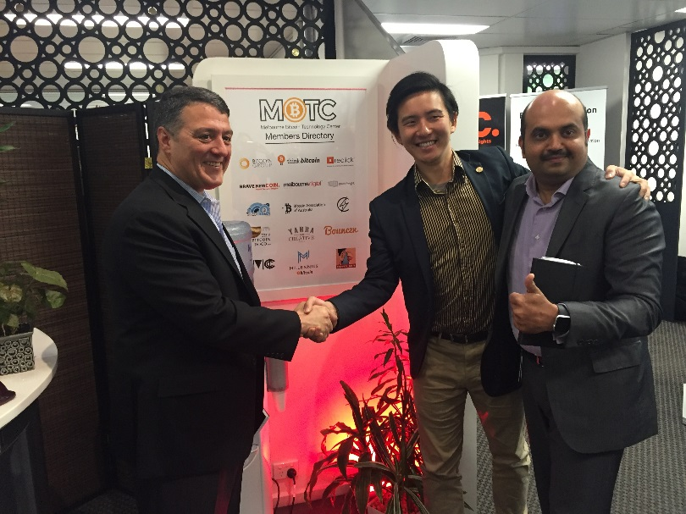
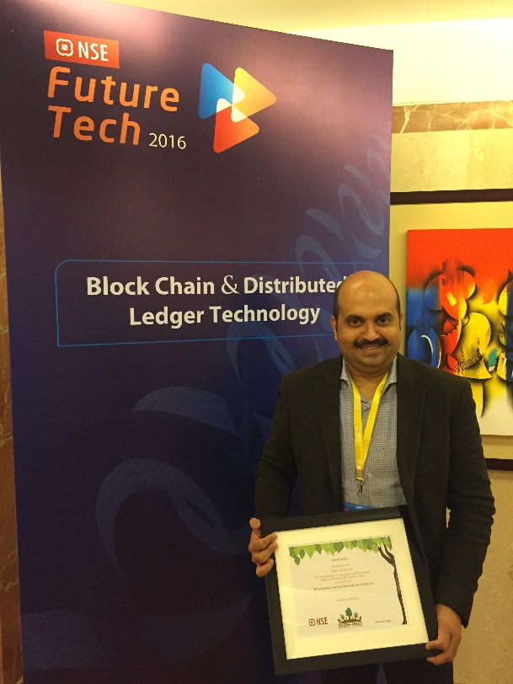
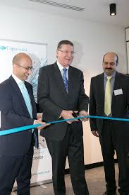
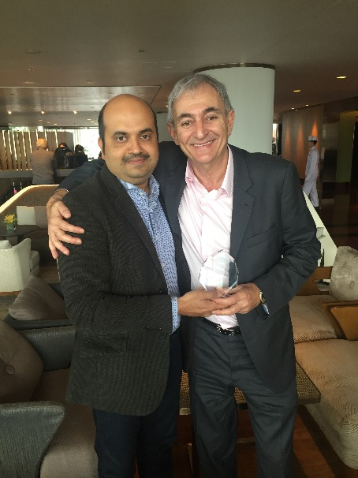
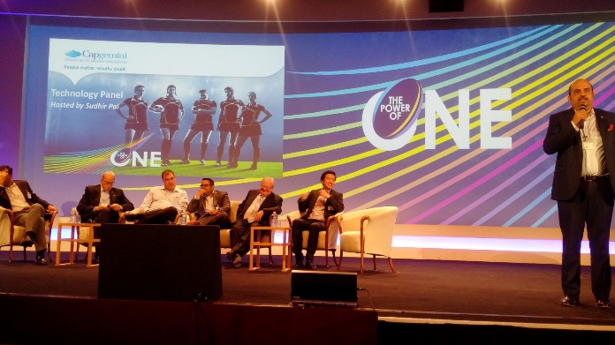
Partnership with Blockchain Group
With premier of Victoria, launch of SMAC lab
Innovation of the year 2016
Capgemini APAC chairman
VP event 2016 - Panel

Slide 17
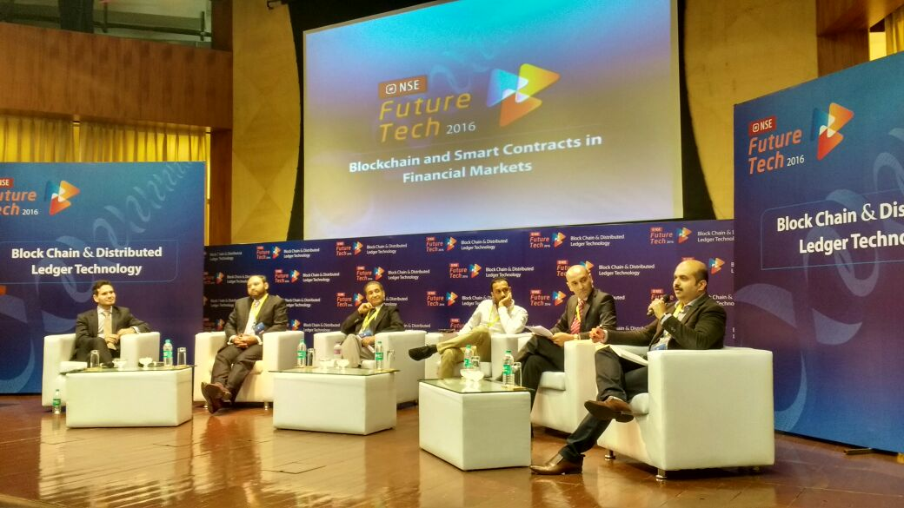
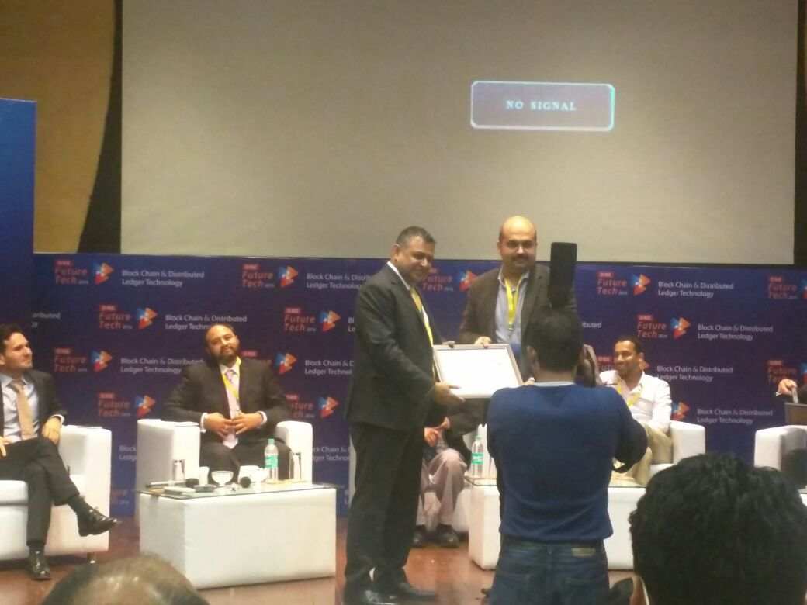

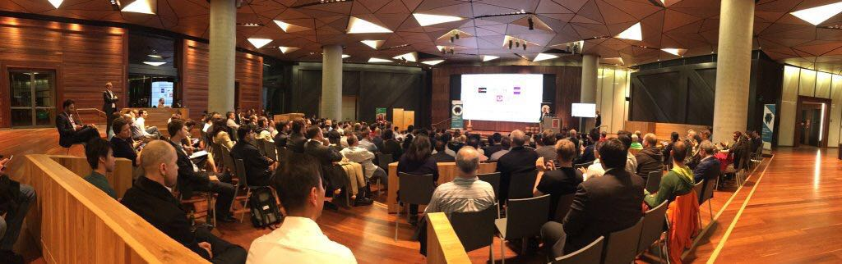
NSE Blockchain event
NSE Blockchain event
Fintech event Melbourne- Panel

Slide 18
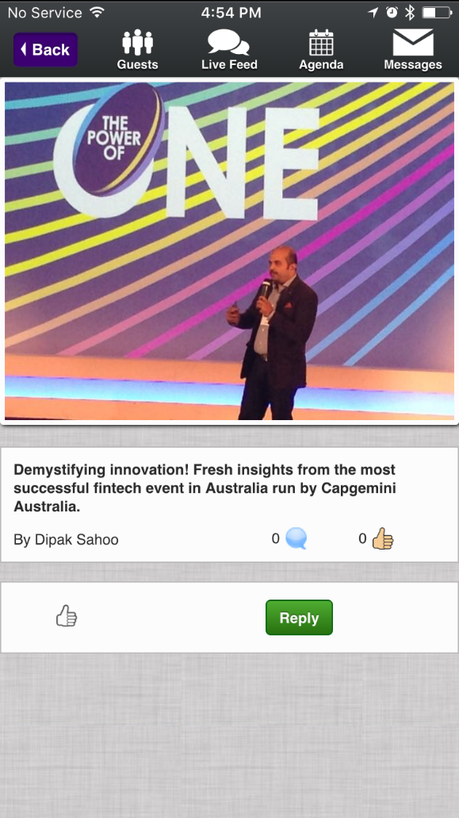
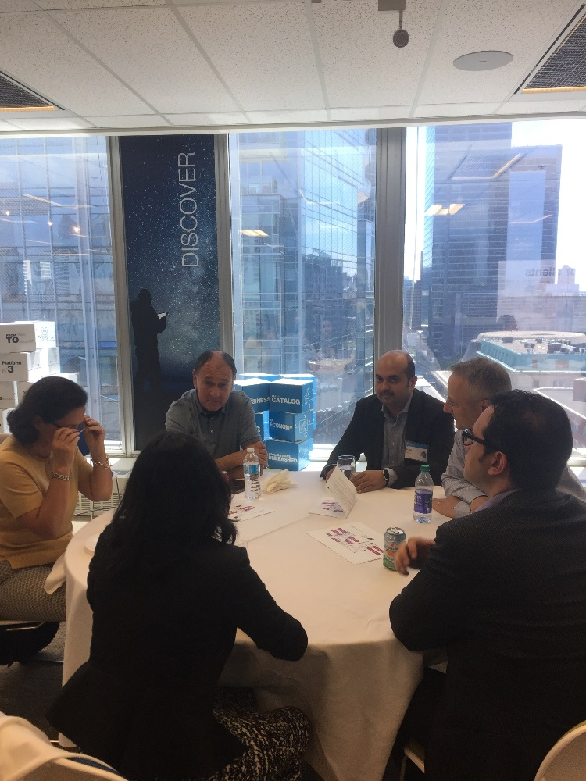
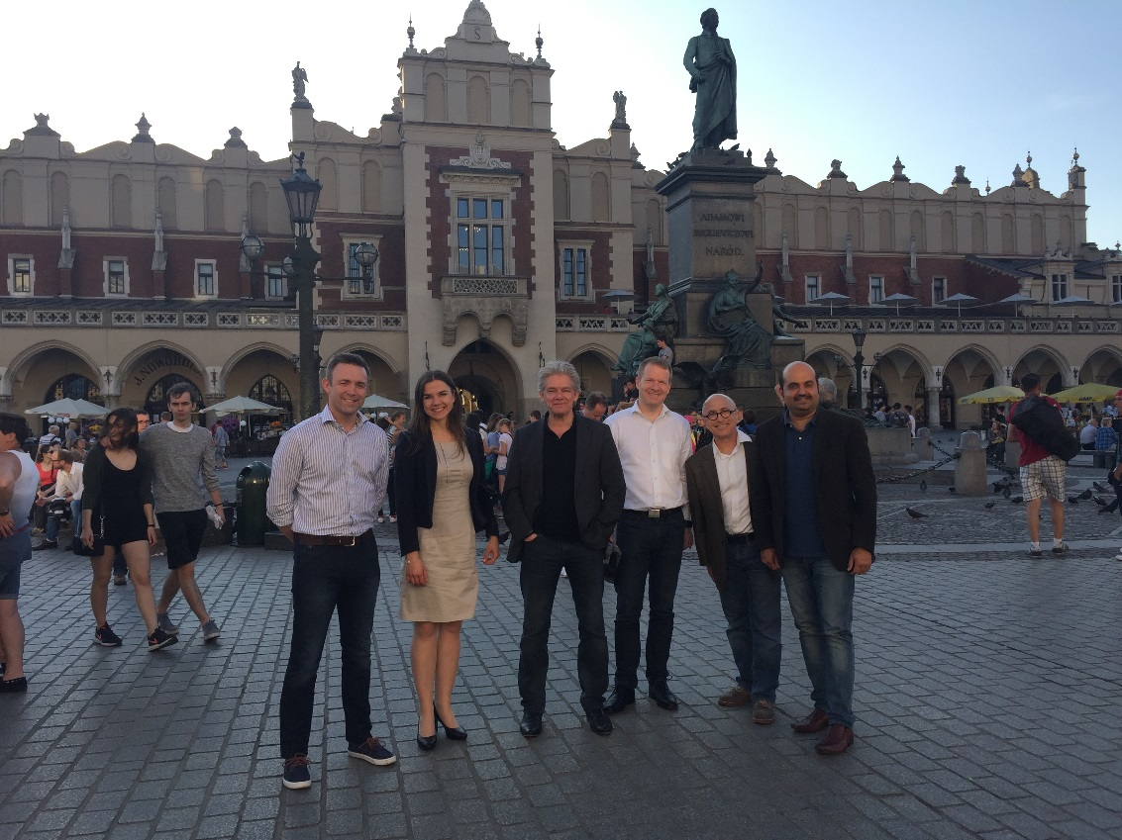
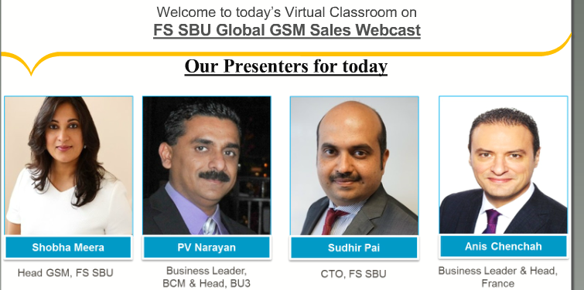
Fintech insights to VP’s
AIE Centre Toronto launch
With Group CTO network
On Sales Webcast

