Slide 1

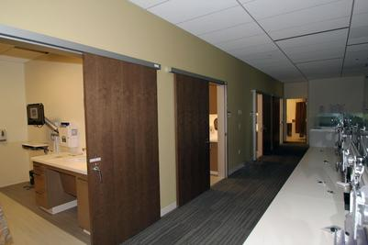
We didn’t invent the barn door, we just perfected it!
Modern sliding door system for hospitality, medical, assisted living and Office Now STC tested

Slide 2

We can make your project a reality!

Slide 3

Professional & Reliable
Our staff of industry professionals specialize in Medical, Hospitality, and Assisted Living projects throughout the country. Our office locations in Colorado and Arizona allow us to provide a quick turnaround on pricing and product. Our seasoned team is ready to meet and exceed you project needs and expectations.

Slide 4

Integrity and Quality
Mission statement:
Family owned and operated, we offer a wide variety of services at the highest level of quality. We will see your project through from concept to completion. We are a team member first and foremost.

Slide 5
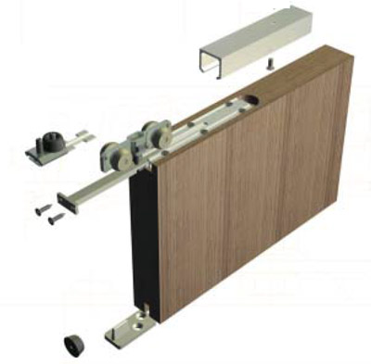
One of the most secure, quiet, and safe barn door systems on the market
Our sliding doors are fully sealed for sound and light…soft close, soft open, quiet and ADA compliant.
Unlike most systems our Serenity line is LEVER lockable by key or privacy
No loud banging, no smashed fingers.
Retrofit almost any opening.
No visible sight line.

Slide 6
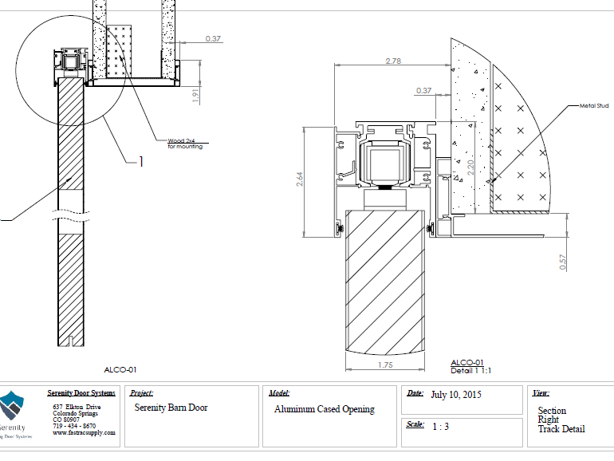
Barn Door Aluminum Cased Opening – Right section detail

Slide 7
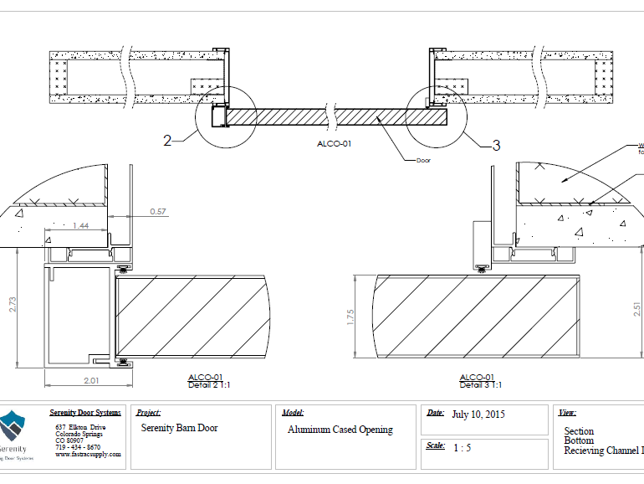
Barn Door Aluminum Cased Opening – Bottom section receiving channel

Slide 8
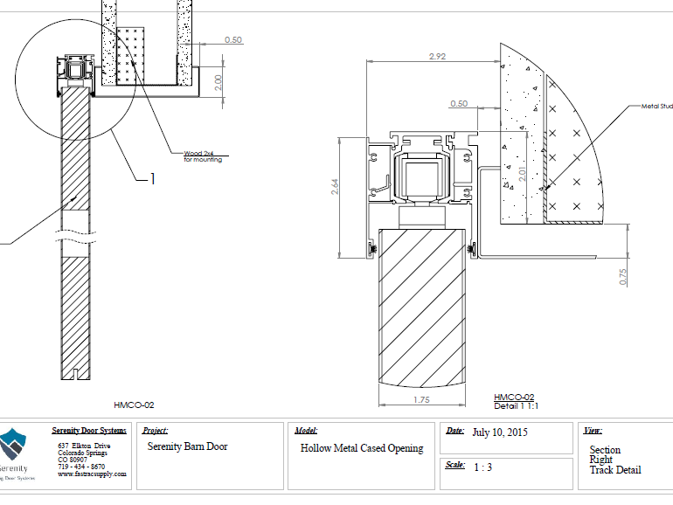
Hollow Metal Cased Opening – right track detail

Slide 9
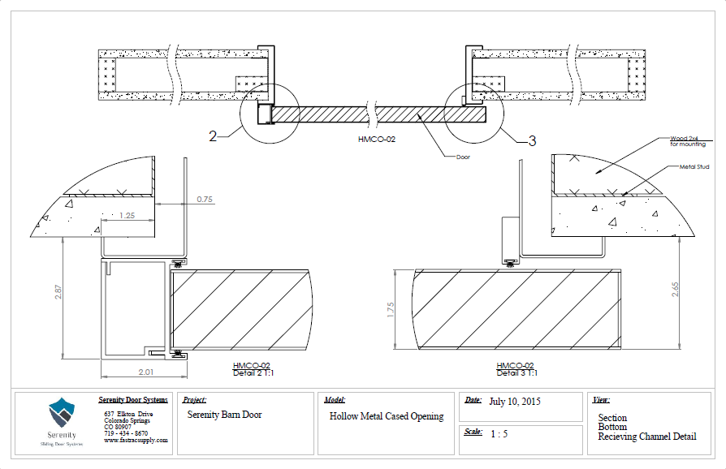
Hollow Cased Opening – Bottom section receiving channel

Slide 10
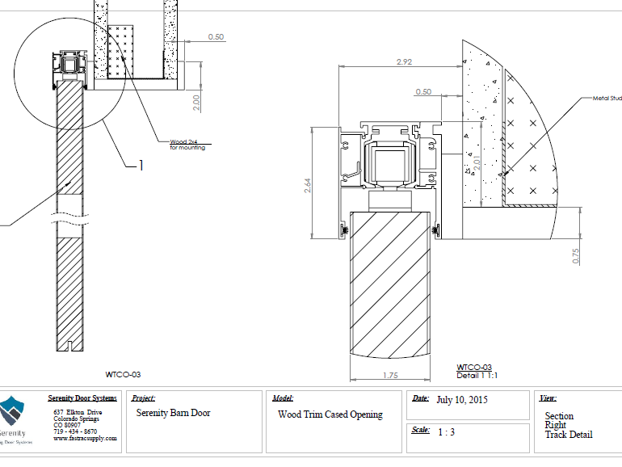
Barn Door Wood Trim Cased Opening – Right section track detail

Slide 11
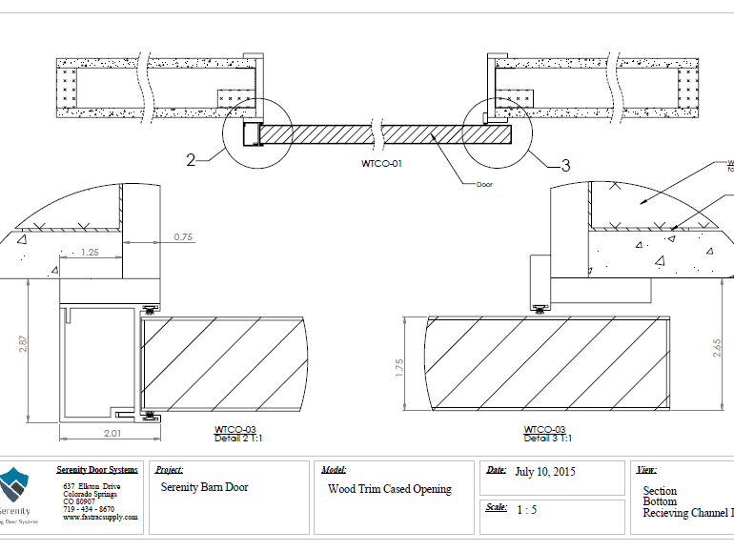
Barn Door Wood Trim Cased Opening – Bottom section receiving channel

Slide 12
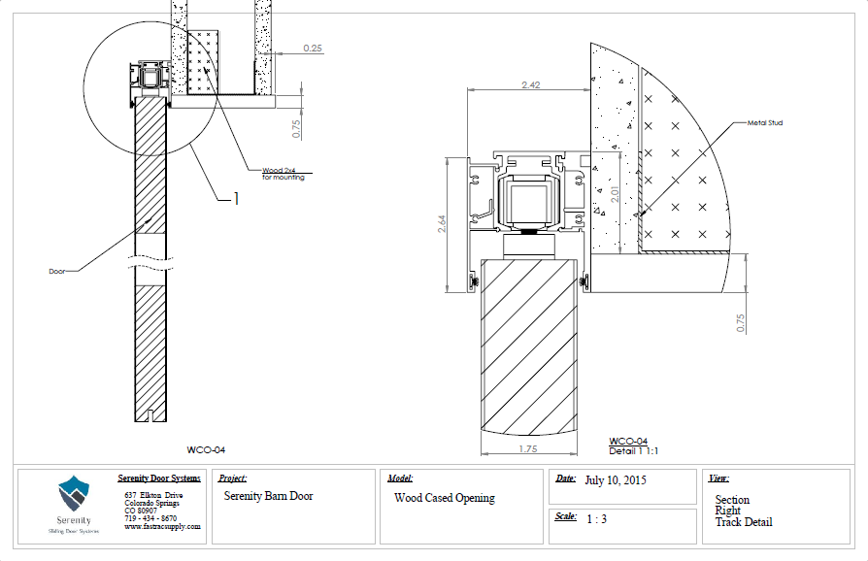
Barn Door Wood Cased Opening – Right section track detail

Slide 13
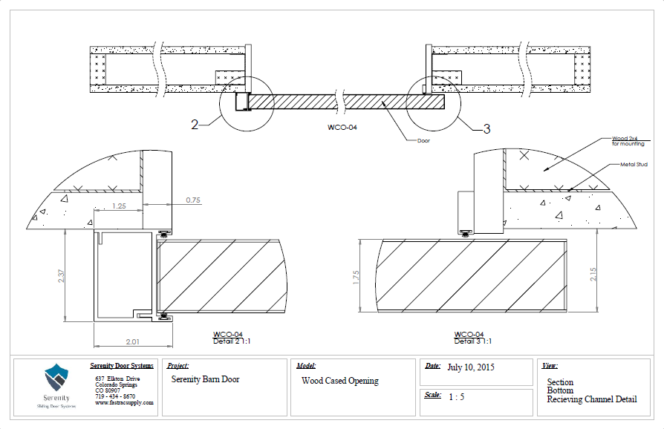
Barn Door Wood Cased Opening – Bottom section receiving channel

Slide 14
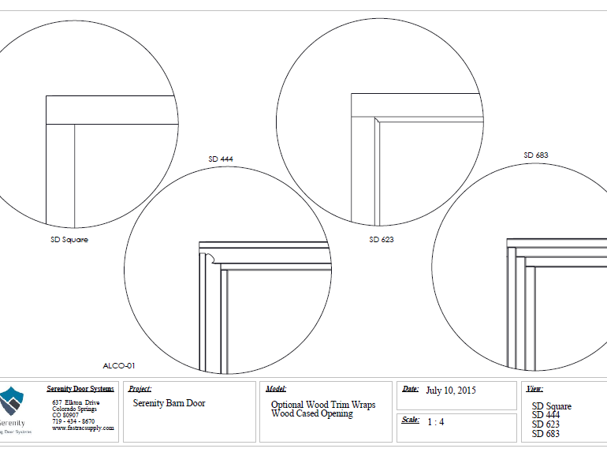
Barn Door Optional Wood Trim Wraps – Wood cased opening

Slide 15
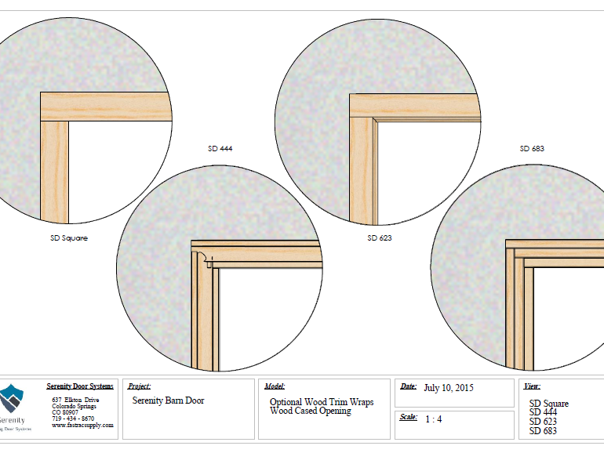
Optional Wood Trim Wraps – Wood cased opening

Slide 16
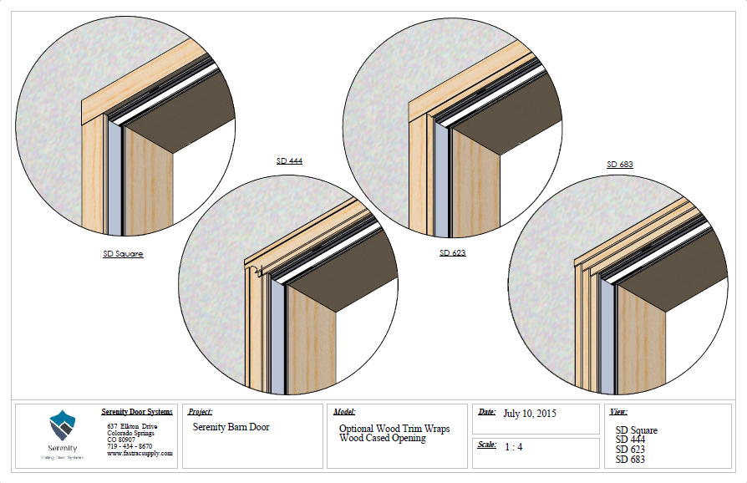
Optional Wood Trim Wraps – Wood cased opening

Slide 17
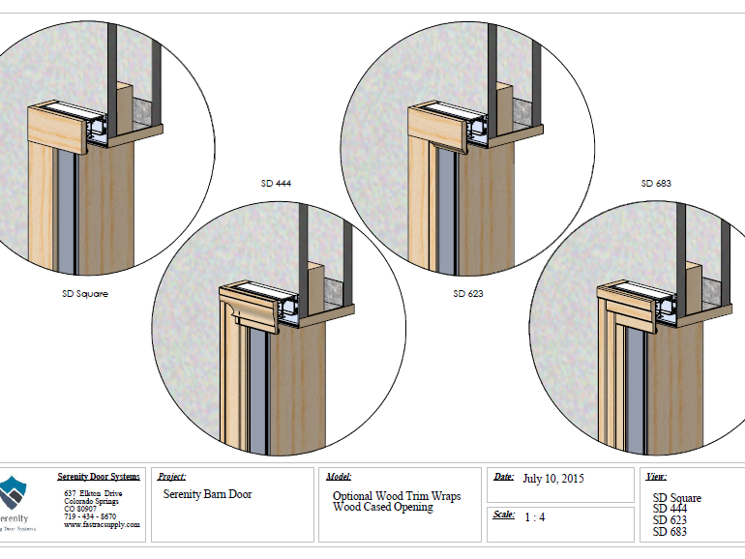
Optional Wood Trim Wraps – Wood cased opening

Slide 18
Optional Wood Trim Wraps – Wood cased opening

Slide 19
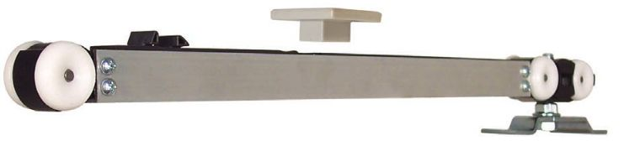
Soft Close Door A soft close is an added feature that enables a barn door to have a controlled and gentle close at either side of its travel
Safety - Gently stops the slamming of the barn door even when it is shut/open aggressively as it softly closes the barn door in a safe and quite manner.
Extends the life of your door - Slamming of the barn door is one of the major factors that decreases the life of your door. With a soft close the speed of the door closing will be controlled relieving stress to the hardware, the door, and its mounting system.
Ease of operation - There is no learning curve for people who have not previously used a barn door. The guest does not have to learn how fast or slow to close the barn door because the soft close takes care of it.
Adds to your barn door experience - It’s pretty cool!

Slide 20
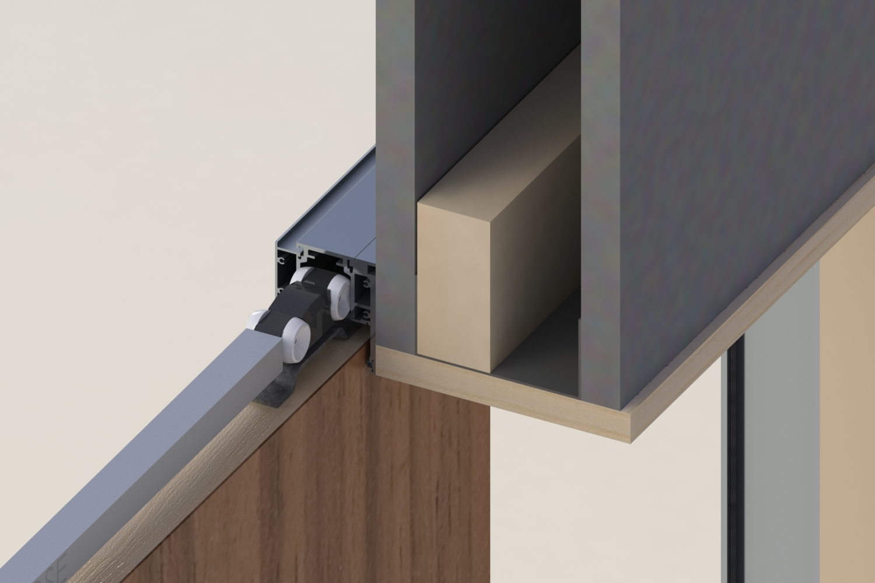
Roller System

Slide 21
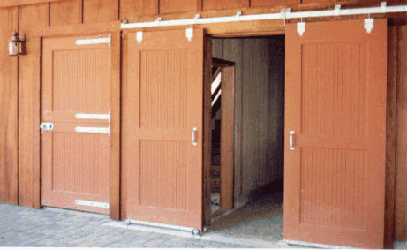
Specifications
Door info: 1-3/4 doors, with custom finishes and veneers. Engineered wood slabs. Product ships complete with door and all hardware. Doors ship prepped for all hardware.
Track info: Track is aluminum. It can be powder coated, painted, wood wrapped, or anodized. Retrofit to any opening, with or without receiving channel. Sealed for sound and light.
Hardware: Multiple options for hardware, with double door options, simultaneous opening, soft open and close options, privacy or keyed mortise or cylindrical locks, pulls, or handles.

Slide 22
Choices!
Fully sealed for light
Sound dampening
ADA Lever , Key locking for offices and secure areas
Privacy levers , occupied indicator option
Soft close, soft open standard
One of the most secure barn door system on the market
Fits almost any existing framed opening
Hollow Metal, Aluminum or Wood openings
Wood wrap or Veneer covered
Custom painted track system
Adaptable to almost any application where you have wall space.
Stile and Rail doors
Flush doors
Metal doors
Custom doors of almost any type.
Bi-parting simultaneous opening
Radius wall barn doors

Slide 23









We offer full service, and offer it fast!
With our national network of manufactures to choose from such as VT industries, Oshkosh Doors, Dorma Products , Hager Co, Rockwood, Schlage, Trimco, Cal Royal, Stanley and many other brand names. We are able to find what you need.

Slide 24
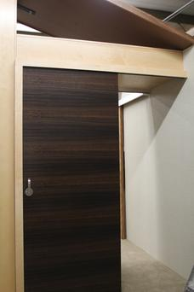
They love it!
“The liability of fingers being smashed in most current slider door systems is quite suspect. Serenity by Fastrac helps alleviate this with their top of the line soft close system”--Bill, Hospitality Contractor

Slide 25
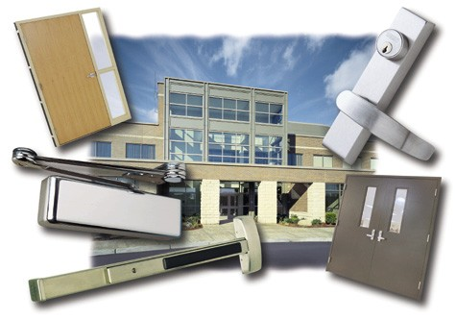
Fastrac Building Supply “The Contractors Choice” when it comes to turn key projects.
Fastrac has provided millwork, doors and specialties for tens of thousands of Hotel rooms, Medical and Office Buildings from coast to coast. Supply and install is our specialty. We understand deadlines and difficult schedules that we, as a team, must encounter. From vanities, running trim, production millwork, and bathroom specialties, to doors and hardware. We offer a wide variety of products to best meet your needs.
Sliding door systems
Hollow metal doors
Hollow metal frames
Wood doors
Wood frames
Custom millwork
Bath accessories (Partitions)
Crown and trim
Door hardware
Installation

Slide 26

Partnership! We will make you look good.
What makes us different? Attitude and discipline! Tired of the same old 6-8 weeks? Give our expedite program a try!
Why use us? Experience, attention to detail, and pride in what we do set us apart from the competitors.
As a member of your team, we don’t rest until the final room is turned. Serenity by Fastrac is a company that can be trusted.

Slide 27

WE ARE READY!

Slide 28
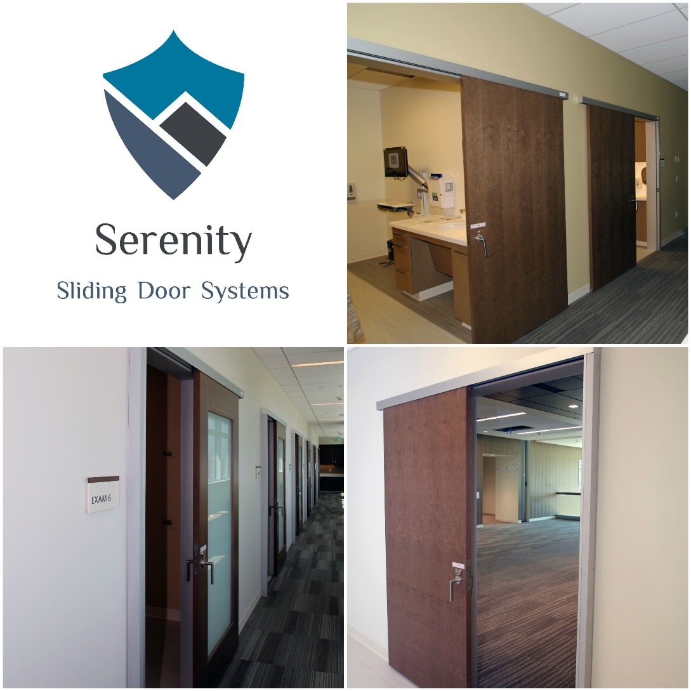
Serenity Sliding Door Systems

Slide 29
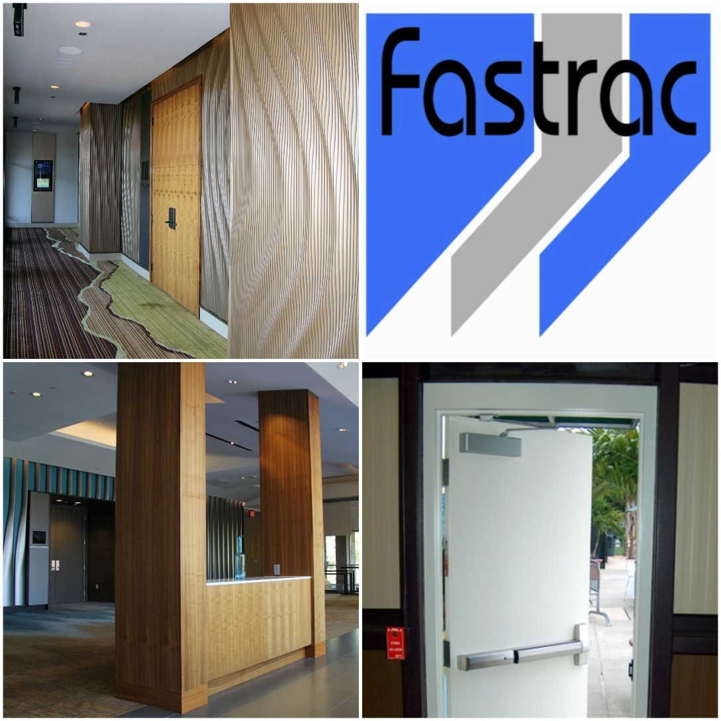
Fastrac Building Supply

