Slide 1
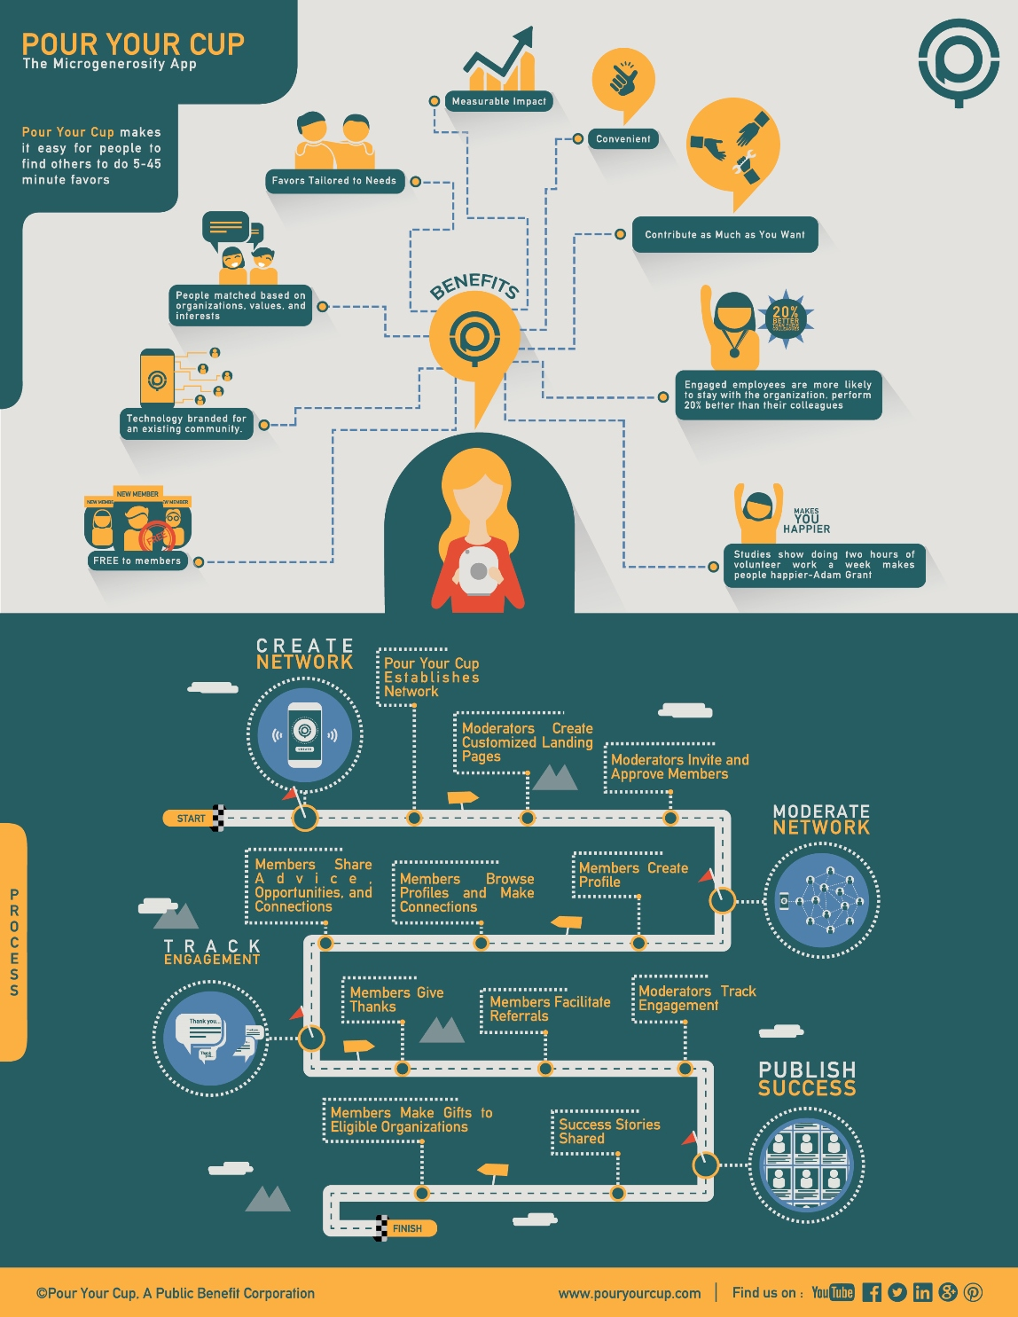
Other Changes:
All text boxes should be aligned to the left, For example:
For all text boxes please increase text size
This is an example of a left aligned text
This is an example of justified text
20%
Remove Text, to only include “20%” on the whole medal, Example:
Remove period at end
Should say: Engage employees are more likely to stay with the organization, perform 20% better than their colleagues – Gemma Robertson-Smith and Carl Markwick
Capitalize “M” in members, “Free” not “FREE”
Remove lines from text bubble, so only the “thank you” is showing in the whole bubble, see example below
Members Share Success Stories
Thank you

