Slide 1
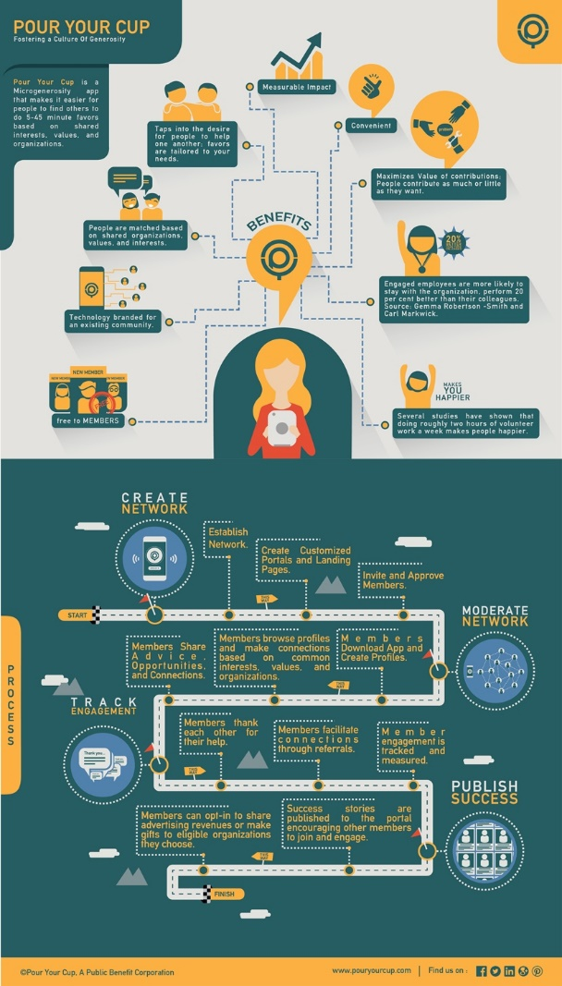
Pour Your Cup
The Microgenerosity App
Make Logo Bigger, remove orange so it is blue/green on gray, or make white logo on blue/green background.
Remove Overlap
Pour Your Cup makes it easy for people to find others to do 5-45 minute favors
Remove Oval in the middle
Favors Tailored to Needs
Contribute as Much as You Want
People matched based on organizations, values, and interests
make 20% medallion bigger
Remove the word “Source:”. “per cent” should be “%”
Free to Members (capitalize Free)
Studies show doing two hours of volunteer work a week makes people happier-Adam Grant
Pour Your Cup Establishes Network
Moderators Create Customized Landing Pages
Moderators Invite and Approve Members
Members Browse Profiles and Make Connections
Members Create Profile
Members Facilitate Referrals
Larger front bubble with “Thank You” in it.
Moderators Track Engagement
Success Stories Shared
Members Give Thanks
Members Make Gifts to Eligible Organizations
Remove words on all sign posts
Add YouTube icon
General Notes:
Format for 8.5 inch x 11 inch paper, make the point size as large as possible
Left justify all text
Remove periods (.) on all the phrases

