Slide 1

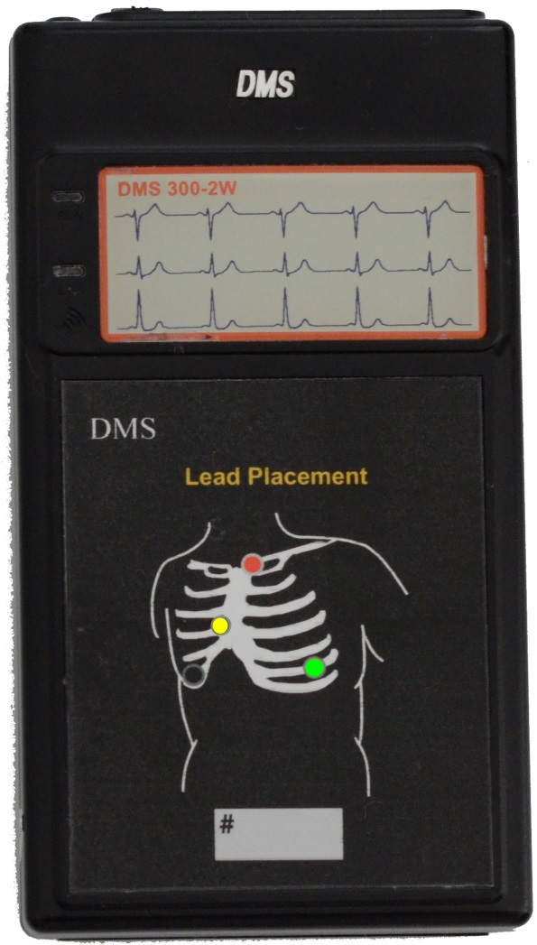
Knowledge, Experience, Quality
300-2W Wi-Fi Transmitter
Major breakthrough in long term ECG recordings. The 79a Cardiac Monitoring Software is a major step forward.
3 Electrodes = 6 ECG Leads
Wi-Fi for compatibility with all hospitals.
Battery life in excess of 72-hours. Standard Alkaline AA batteries.
Single Wi-Fi device simultaneously performs both tasks of Hospital Patient Monitoring and Holter ECG.
Standard AP units allow unlimited ECG range in the hospital.
Notes:
Top Page 1

Slide 2
Other Services
Outpatient Mobile Telemetry Monitoring
EKG Technician Rhythm & Software Training
Contact Information:
Office: (214) 550-1385
Toll Free: (844) 324-4393
Fax (214) 306-9449
Notes:
Bottom Page 1

Slide 3
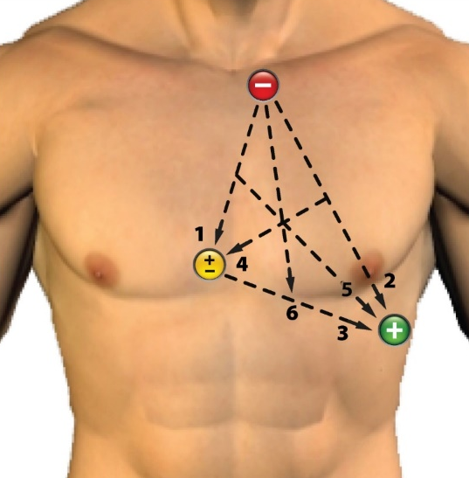
6-Lead ECG from only 3-Electrodes DMS
The below shows the simplicity of 3-electrodes providing ECG vectors of six (6) valuable looks of the electrical activity of the patient’s heart. Use the 300-2, 300-2W, 300-3, and 300-4 recorders with the 3-electrode ECG cables.
Now, all 1, 2, and 3 channel Holter ECG recorders are obsolete.
1 and 2 Lead Patch type Holter ECG recorders are now obsolete.
3 Electrodes=6-Leads
ECG Leads
“6X3”
ISCHEMIA MONITORING
1=CM1
2=CM5
3=Mv5 (m=Modified)
4=mV1
5=mV5
6=mAVF
Notes:
Top Page 2

Slide 4
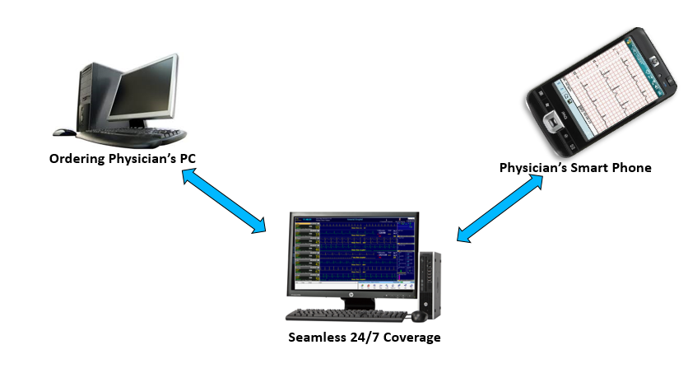
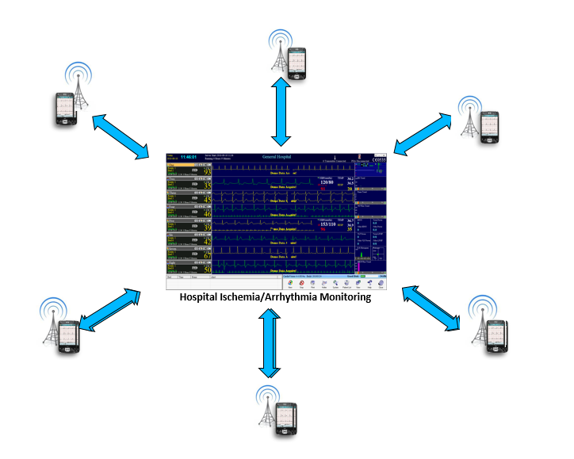
Anywhere ECG System 100% ECG Telemetry 24/7
Notes:
Bottom Page 2

Slide 5
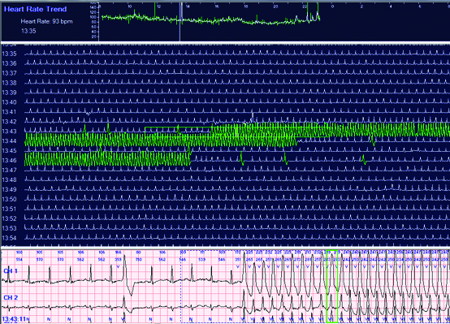
Instant Access to Full Disclosure During Real-Time ECG Monitoring
Full Disclosure is seen instantly for any patient on the second monitor display.
Any time period during a 3-day time period is instantly accessed and seen in the Full Disclosure ECG mode.
The CV Page Scan Full Disclosure works exactly the same as in Holter.
Enlarged ECG displays and ECG Strips can be viewed and printed at any time.
Full Disclosure can be built in the real-time ECG mode on the second monitor
Notes:
Top Page 3

Slide 6
One Click on the V-Tach Trend, and… the whole Picture of Sustained V-Tach
Monitor 1 continues to show real-time ECG of all patients.
Monitor 2 shows you the ECG data that you probably never get to see.
And at the end of each minute, a Holter ECG file is automatically created in the PC’s hard disk for each patient.
Notes:
Bottom Page 3

Slide 7
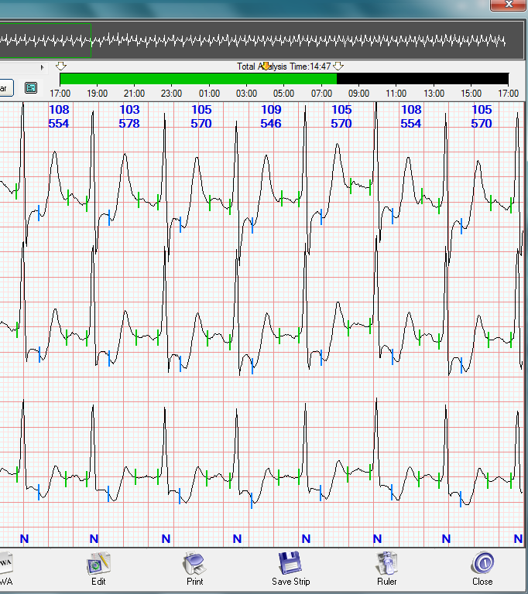
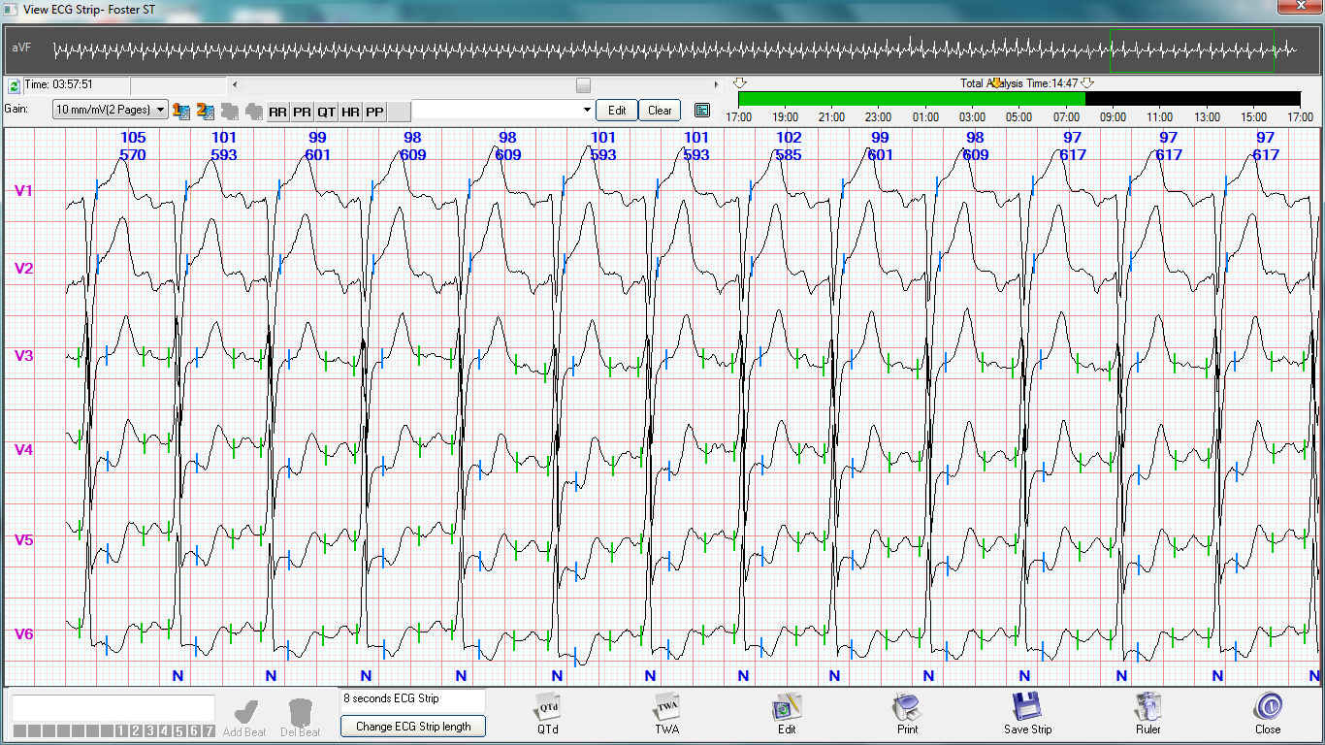
3-Lead ECG 6-Lead ECG
Notes:
Top Page 4

Slide 8
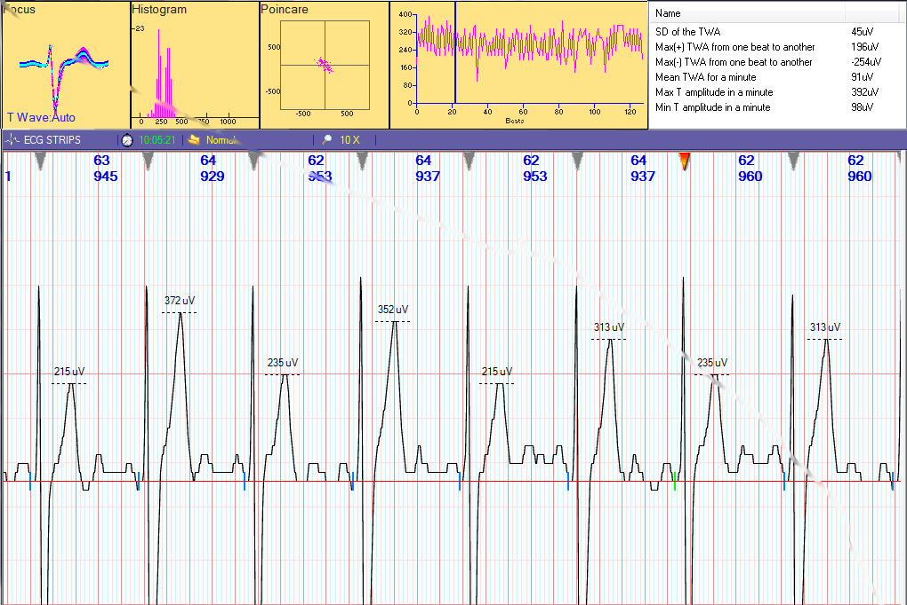
T-Wave Alternans (TWA)
TWA occurs very often, and why hide it from cardiologists.
It is included in the Holter processing of each patient.
Each T-wave in each ECG Lead is analyzed for the amplitude of the T-wave.
The Holter process takes less than 30-seconds to locate and display the ECGs showing TWA.
Notes:
Bottom Page 4

Slide 9
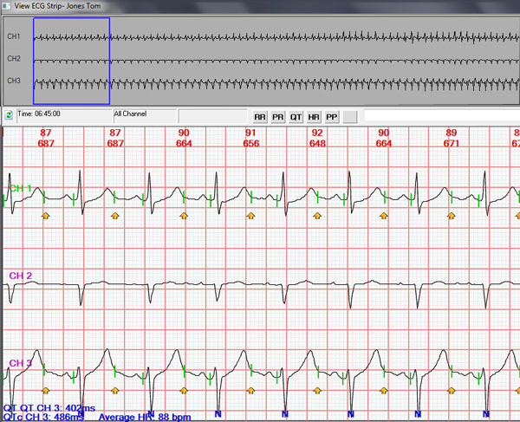
Elongated QTc
QTc analysis is provided for all ECG complexes during the monitoring time period.
Finding the Elongated QTc is a simple and quick process.
An electronic ruler is provided for verification of the data.
The yellow arrow is the 50% of R-R.
Notes:
Top Page 5

Slide 10
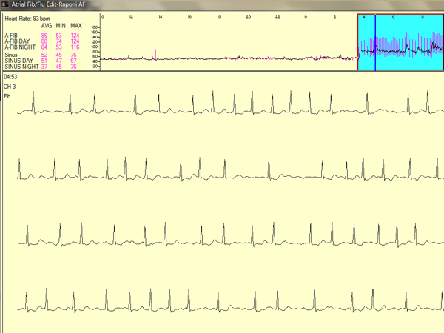
The Very Best in Atrial Fib
A-Fib detection is found in both the real-time ECG Trends and the Holter processing.
The A-Fib verification and editing are excellent….the best available.
A-Fib Burden is provided.
A unique time display shows the length of each A-Fib event.
Notes:
Bottom Page 5

Slide 11
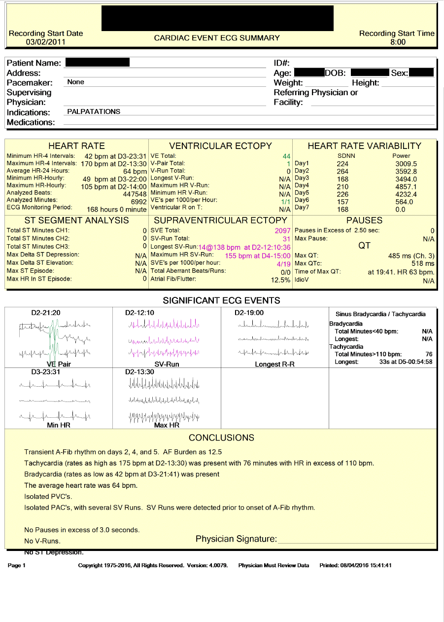
Notes:
Page 6

Slide 12
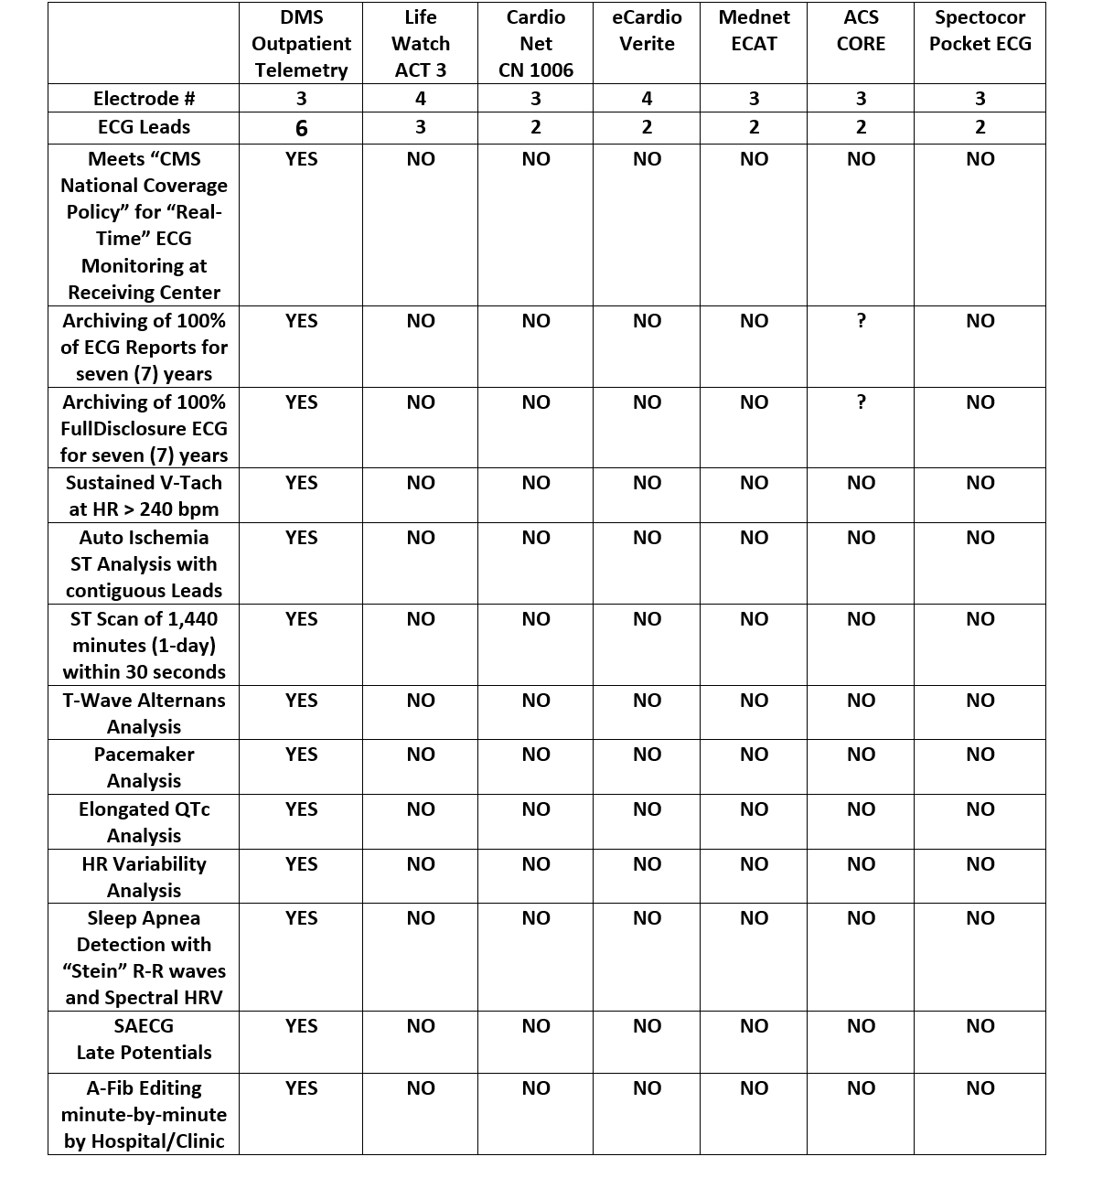
Competitive Comparisons
Real-Time Outpatient Cardiac Telemetry
Notes:
Top Page 7

Slide 13
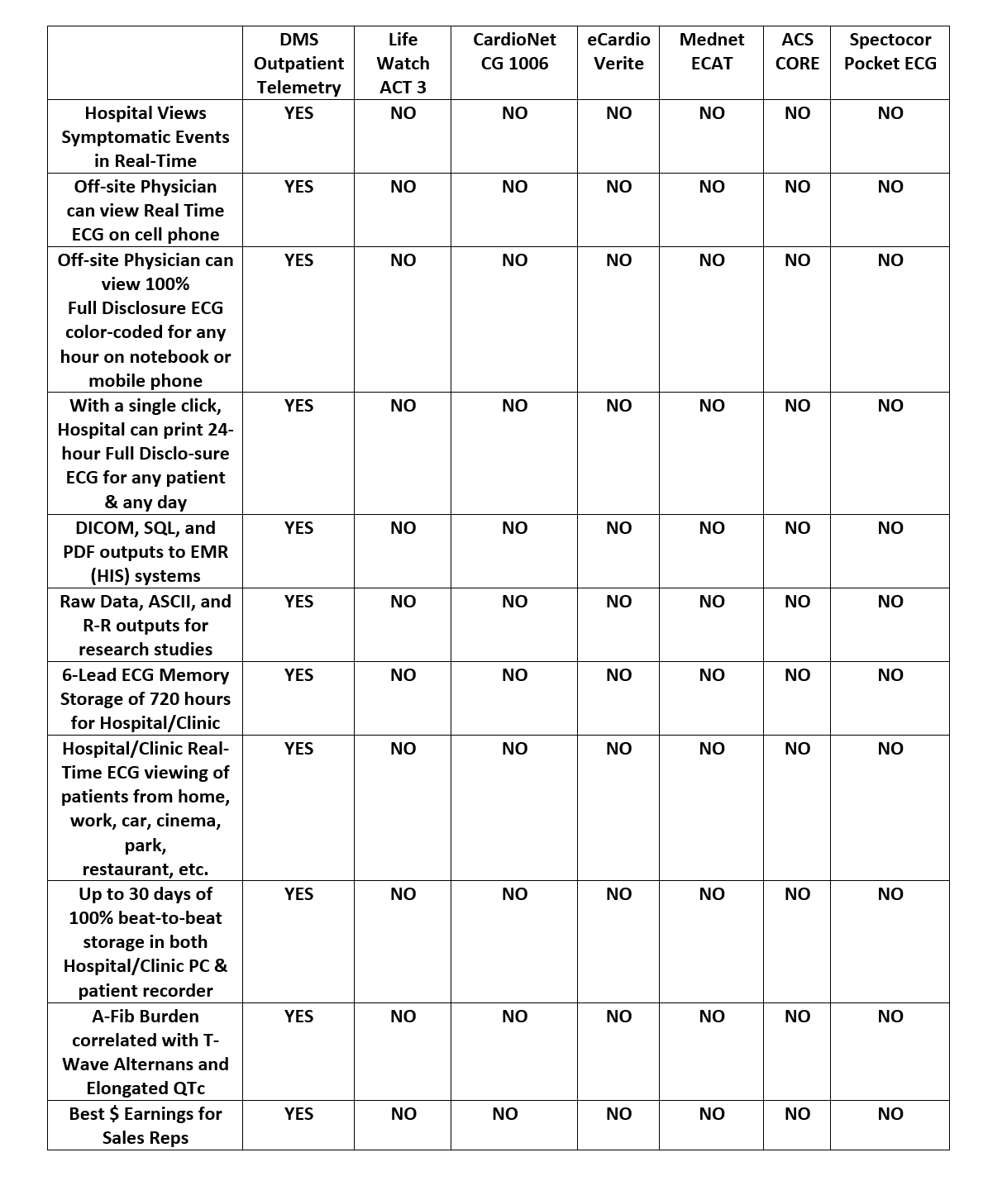
Competitive Comparisons continued…(eVital, if informed by e-mail, will make any appropriate changes)
Notes:
Bottom Page 7?????

Slide 14
Contact Information:
Office: (214) 550-1385
Toll Free: (844) 324-4393
Fax (214) 306-9449
Notes:
Bottom Page 8

Slide 15
Colors for Brochure
Sky Blue
Navy Blue
White

