Slide 1
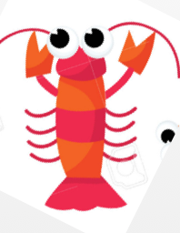
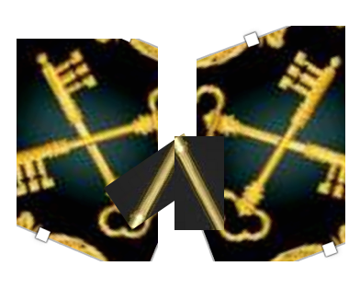


This is a “W” using the existing keys to shape out
These two should be holding the shield somehow
3 sets of wording:
Left : Wisdom
Right : Agape
Center : Wondearland
Make this like green leaves
Purple heart

