Slide 1
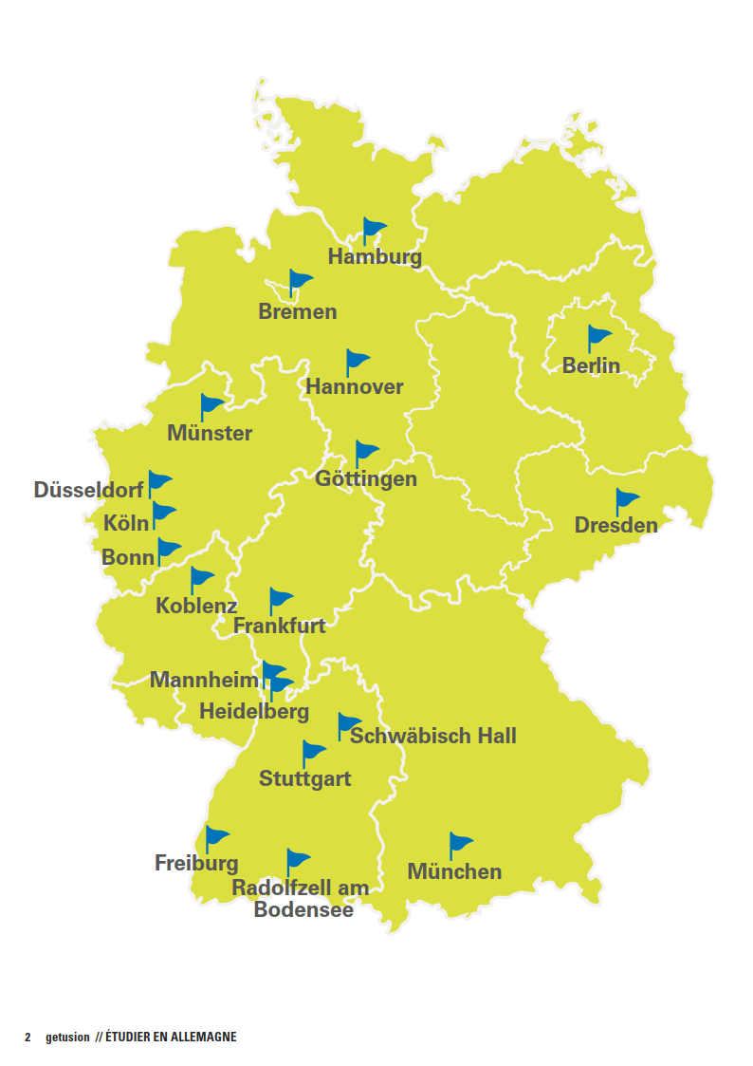

The new cities to put are :
Berlin
Bielefeld
Bremen
Dresden
Düsseldorf
Can you please create a map like the one below but with the following cities?and put it just before the first section?and with the colors of the flag of germany?
Frankfurt
Freiburg
Freising
Hamburg
Hannover
Heidelberg
Köln
Lindau
München
Radolfzell
Regensburg

