Slide 1
Further guidance

Slide 2
Grey Sauce Logo
Logo needs to be abstract like Nike or apple, the logo can be recognised without writing the name
We need to emphasise the grey sauce, it needs to be highlited and special, gamers need to feel the difference in our games because of this secret sauce
Grey sauce is a structure in the brain, if you are going to use a brain direction go for simple structures not a full structure.(abstract)
We need a creative twist on th grey sauce you don’t have to do brains, could be a sauce bottle could be a soup bowl, get creative with it.

Slide 3
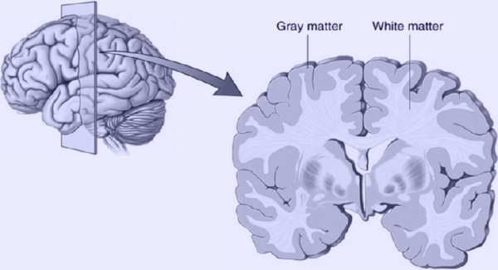
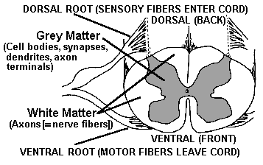
Grey matter this is just for your information.

Slide 4
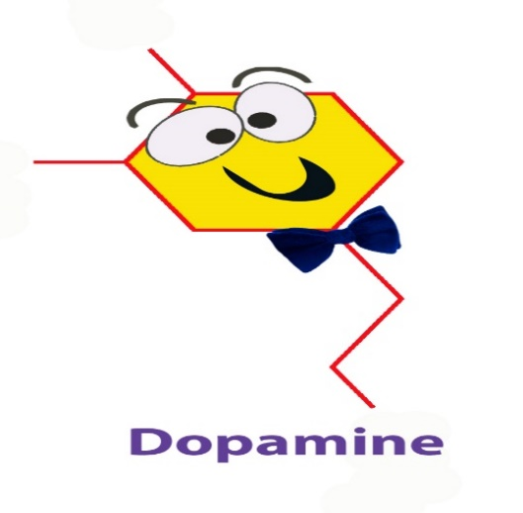
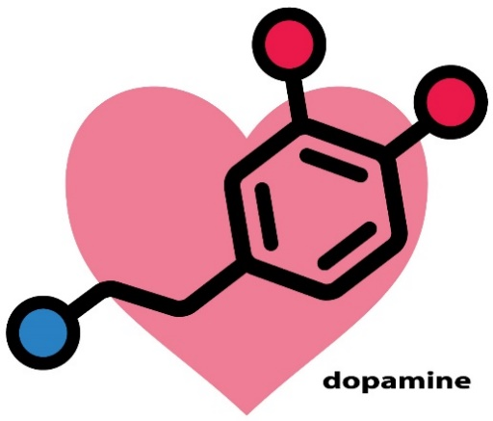
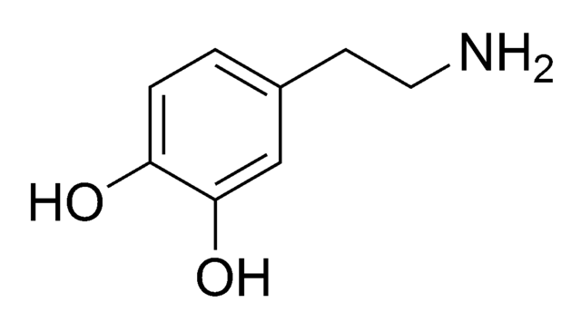
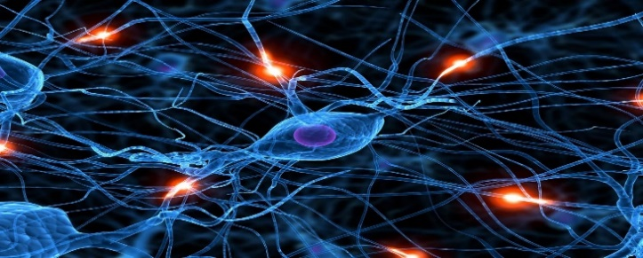
Dopamine pics and some neural network as an idea
Dopamine makes gamers happy (main ingredient in our sauce)

Slide 5
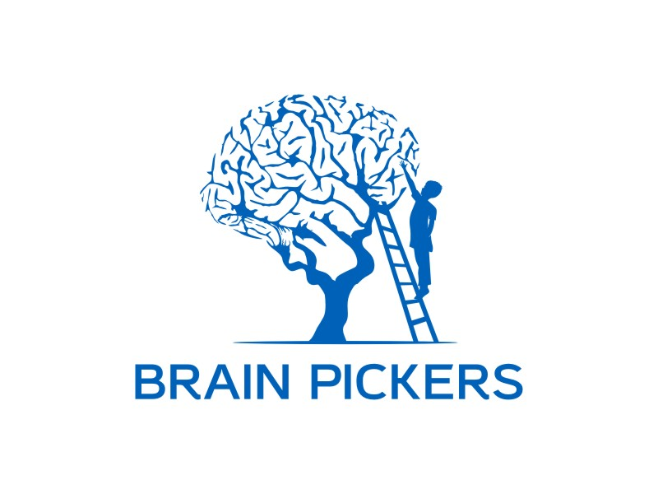




Examples of intelligent logos.

Slide 6




Logos that I love and, what I Mean by abstract.

Slide 7
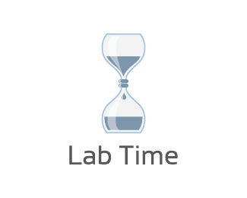


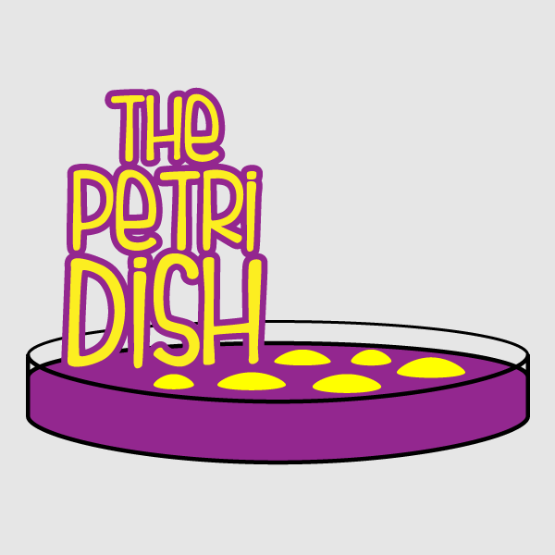
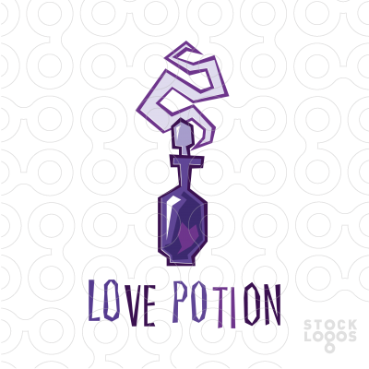

Some ideas to help

Slide 8
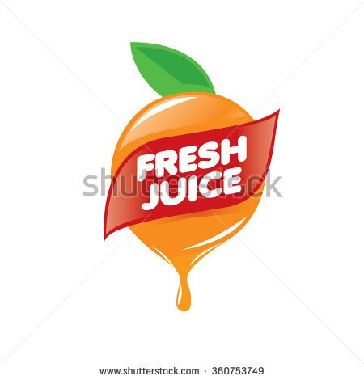
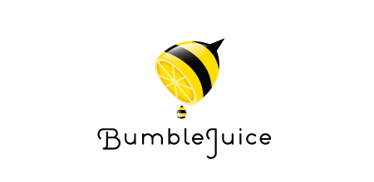
More ideas

