Slide 1

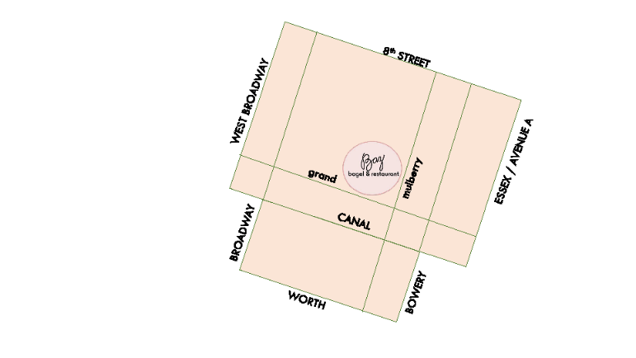
breakfast all day!
Matzoh Brei $9
scrambled eggs with matzoh
Blintzes $12
cheese crepe, sour cream, preserves
The Pancake $12
plain, blueberry or banana-chocolate
French Toast $12
challah french toast
Breakfast Fruit Parfait $9
greek yogurt, seasonal fruit, granola
eggs
Egg & Cheese Sandwich $7
two eggs and cheese on a bagel
Le Grand Breakfast $16
two eggs, latke, pancake, bacon
Bunny Breakfast $14
served with a bagel
two eggs avocado, nova salmon
Eggs a la Baz $14
two latkes, two poached eggs, nova
L-E-O $14
served with a bagel
nova ‘lox’, eggs and onion
Kitty Breakfast $14
served with a bagel
two eggs,avocado, bacon, latke
Eggs any style $7
served with a bagel
add to any egg plate:
for the table
Joyce’s Famous Latkes $10
applesauce, sour cream
Latkes FancyPants $15
nova salmon, sour cream
Whitefish & Bagel Chips $10
Deli Salad Trio& PICKLES! $10
bagel and restaurant
181 Grand Street
212 335 0609
delivery!
Monday- Friday : 7am-3:00pm
Saturday & Sunday: 8am-4:00pm
212 335 0609
soup
Matzoh Ball Soup $7
Chicken Noodle Soup $7
$2 add a matzoh ball
catering and events!
menu available at www.bazbagel.com
catering@bazbagel.com ∙
salad
Two Shot Tuna Salad $12
mixed greens, tomato, onion, avocado
HS salmon, hard boiled egg
Wellness Salad $14
mixed greens, tomato, onion, avocado
HS salmon, hard boiled egg
Everything Schnitzel Salad $16
chicken cutlet ∙ greens tomato
tomato ∙ cucumber ∙ red onion
Greek Salad $10
tomato, cucumber, red onion
Cobb Salad $14
tomato, onion, avocado
grilled chicken,
bacon, blue cheese hard boiled egg
Mixed Green Salad $9
tomato, cucumber, red onion
beverages
Seltzer! $3
Dr Brown’s Soda $3
cel-ray, root beer, cream soda,
black cherry
Coca-Cola or Diet Coke $3
Iced Tea $3
Lemonade $3
Lime Rickey $3
Saratoga Water $3
MILK SHAKE $8
Fresh Squeezed Juice $6
orange or grapefruit
Baz Brew coffee $3
Hot Tea $3
green, mint, chamomile, black
Soda float $8
root beer, cream soda,
coca-cola or black cherry
& vanilla ice cream
Egg Cream $6
chocolate, coffee, vanilla, strawberry
Latke $3
Bacon $3
Avocado $3
Tomato $.75
Horseradish $.75
Cheese $2
Gravlax $6
Nova $5
Sable $6
Onion $.75

Slide 2
bagels
Bagel: $1.75
plain, sesame, everything, poppy pumpernickel, pumpernickel everything whole wheat, whole wheat everything
Flagel: $1.95
thin pressed bagel
plain, everything, whole wheat
whole wheat everything
Gluten Free Bagel $2.50
plain, everything
baz originals
served with a pickle
sandwich favorites
served with a pickle
Grilled Cheese Deluxe $12
grilled cheese on challah bread
add bacon $3 add tomato $2
BLT $12
bacon, lettuce, tomato, mayo,
whole wheat toast
add avocado $3
Vegetarian Delight $12
sliced egg, muenster cheese, avocado,
onion, cucumber, tomato, spicy mayo,
whole wheat toast
Everything Schnitzel
Sandwich $14
tomato, lettuce, challah , mayo, mustard
Tina Turkey Sandwich$14
turkey, swiss, avocado, challah
The King $12
Peanut butter, banana, honey,
whole wheat bagel
BAZ $14
nova, scallion cream cheese, tomato onion, pumpernickel everything bagel
SuperNOVA $13
nova , vegetable cream cheese
tomato, cucumber, whole wheat everything flagel
Lunch Lady $12
egg salad, tomato, chive, poppy bagel
Rainbow Kitty $14
gravlax, cream cheese
tomato, onion, pumpernickel bagel
Mooch $16
Scottish salmon, sable
cream cheese, tomato, onion, chive
everything bagel
Art’s Ark Tuna Melt $14
tuna salad, onion, swiss
sesame bagel
The Mystic Pizza Bagel $12
tomato, mozzarella, basil
plain bagel
Gold Medal $14
Whitefish salad, capers, red onion everything bagel
Pretty in Pink $14
Nova, beet and horseradish cream cheese, dill, pumpernickel bagel
The Waldorf $12
Chicken salad, pink lady apple, lettuce, cinnamon raisin bagel
bagel sandwiches
Plain CC $3.50
Scallion CC $4.50
Vegetable CC $4.50
Beet and Horseradish CC $4.50
Tobiko Cream CC $5.00
Cucumber and Dill CC $4.50
Blueberry CC $4.50
Nova & Chive Cream Cheese $5.00
Tofu or Scallion Tofu CC $4.50
Butter $3.00
Tobiko! Tobiko! $16
nova, cucumber, wasabi tobiko, pumpernickel bagel
Avocado Toast $12
nova salmon, cucumber, lime, watermelon radish,
whole wheat bagel
Nova Salmon $11
Scottish Salmon $12
House-cured Gravlax $11
Sable $14
Hot Smoked Salmon $14
Whitefish Salad $11
Tuna Salad $9
Egg salad $9
Chicken Salad $9
fish and appetizing salads to go
(priced by ¼ lb)
available in ½ lb and 1lb
sweets
MILKSHAKES!!!!!
vanilla • black & white • strawberry $8
key lime • banana & honey $11
Chocolate Babka $3/$14
Cookie Bags $2 / $5 / $7
Black and White Cookies
Chocolate Coconut Macaroons
Chocolate or Raspberry Rugalach
Tuna $3.75
Whitefish $4.25
Egg Salad $3
Chicken Salad $3.75
Nova $8.25
Scottish $9
Gravlax $8.25
Sable $12
HS Salmon $11
Cole Slaw $3
Potato Salad $3
Cucumber Salad $3
Pasta Salad $3
+$.75 tomato, onion, cucumber, chive
caper, lettuce
+ $2 avocado +$2 Tobiko
+ $1 horseradish
+ $2 cheese (american, cheddar, muenster, swiss)
+ $2 open-faced
Menu item availability and pricing subject to change
on the side
Potato or Macaroni Salad $6
Cole Slaw + Pickle $6
Pickle Plate $5

