Slide 1

Powerpoint Template & Design Brief

Slide 2
Confidentiality Important!!
This design brief is for a new company that is still to officially launch
The brief contains details of the company’s offering & approach
It is absolutely imperative that all info is treated in the strictest confidence and not shared with anybody!!

Slide 3
Company Background
We are a new company called Media Operations Transparency (MOT)
We have both run media buying agencies for many years.
Those agencies run by multi-national organisations are becoming less and less transparent with the transactions that they are managing – clients are being significantly over-charged in many areas – especially digital media.
At the same time, our experience has told us that most clients have little understanding of how media should be planned and bought
We are making ourselves available to those clients who cant afford a full time specialist but want to ensure that they are making the correct media and marketing decisions that benefit them rather than their agency.

Slide 4
Brief Outline
We have created a new logo for the company (see cover slide & following)
We want to create a powerpoint template that:-
Captures the consistent look and feel of this logo
As well as capturing our first presentation, creates a versatile template framework that will work with a variety of slide/page layouts (text, picture & text etc) we will create over time for a variety of presentations that must always retain our consistent brand feel
Our initial credentials presentation follows across slides 7-26 – our immediate job is to apply the winning template design to this presentation
This presentation also includes about 4 slides that would benefit from the creation of some infographics to bring them to life – the look should be consistent with the powerpoint template

Slide 5
Our new logo:-
This logo should be used to inform the consistent look & feel of our presentation
The logo including words should be a consistent header or footer in the design template

Slide 6
The presentation…..
The presentation is on the following slides. The content is all there but the fonts, look & feel etc can be completely upgraded.
As outlined, we need a versatile look & feel that will continue to work across any new presentations we create in the future
Variety of slide layouts – text, graph/picture & text etc
Headings, bullet points, bullet point indent heirarchies etc
Text boxes as summaries at bottom of slide
Etc, etc

Slide 7
Solving the future

Slide 8
A universal problem has erupted
Nov
2015
2014
2016
Mediacom staff forged campaign reports to clients and sold discounted TV ads given to them by media owners, audit reveals
Mumbrella
Notes:
A burgeoning problem with transparency has emerged, especially Digital. At a traditional media level, the existence of holding company level volume rebates has emerged. But it is in the Digital ecosystem that a practice of large hidden mark-ups has been uncovered in recent times. This issue has arisen at a time that media spends are increasingly migrating to Digital, and this timing has shaken media agency trust.
There are extensive kickbacks that exist within media agencies and which result in them earning money twice for the same piece of work. First, they are paid legitimately by an advertising client who uses their expertise and buying systems to purchase media on their behalf. Second, from incentives paid to the agency by the media seller or ad tech vendor who supplies the media.

Slide 9
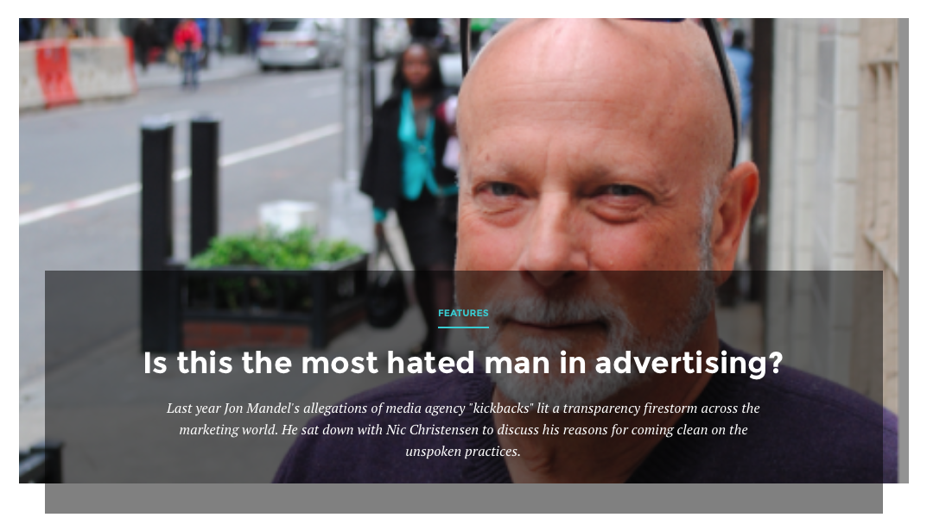
A universal problem has erupted
Nov
March
2015
2014
2016
Notes:
ANA (US) Conference October 2015 - Jon Mandel Ex CEO Mediacom USA
“This issue is cultural. The issue is they are hiding things in barter, they are hiding things in programmatic, they have all kinds of ways to hide things from their clients,”
“They recommend or implement media that is off-strategy or off-target if it works for their financial gain.”

Slide 10

A universal problem has erupted
Nov
March
July
2015
2014
2016
“Throughout the course of this study we found pockets of definitional misalignment across the programmatic ecosystem.”
Programmatic Revenue Report
Notes:
A burgeoning problem with transparency has emerged, especially Digital. At a traditional media level, the existence of holding company level volume rebates has emerged. But it is in the Digital ecosystem that a practice of large hidden mark-ups has been uncovered in recent times. This issue has arisen at a time that media spends are increasingly migrating to Digital, and this timing has shaken media agency trust.
There are extensive kickbacks that exist within media agencies and which result in them earning money twice for the same piece of work. First, they are paid legitimately by an advertising client who uses their expertise and buying systems to purchase media on their behalf. Second, from incentives paid to the agency by the media seller or ad tech vendor who supplies the media.

Slide 11
A universal problem has erupted
Nov
March
July
Feb
2015
2014
2016
More than 70% of global advertisers agree that the way an agency manages rebates is the biggest barrier to building long-term trust
ID Comms Transparency Survey 2016
Notes:
A burgeoning problem with transparency has emerged, especially Digital. At a traditional media level, the existence of holding company level volume rebates has emerged. But it is in the Digital ecosystem that a practice of large hidden mark-ups has been uncovered in recent times. This issue has arisen at a time that media spends are increasingly migrating to Digital, and this timing has shaken media agency trust.
There are extensive kickbacks that exist within media agencies and which result in them earning money twice for the same piece of work. First, they are paid legitimately by an advertising client who uses their expertise and buying systems to purchase media on their behalf. Second, from incentives paid to the agency by the media seller or ad tech vendor who supplies the media.

Slide 12
A universal problem has erupted
Nov
March
July
Feb
April
2015
2014
2016
“I don’t believe that [media agencies] have got the best interest of their clients at heart any more.”
Debbie Morrison
ISBA Director of consultancy & best practice
Notes:
A burgeoning problem with transparency has emerged, especially Digital. At a traditional media level, the existence of holding company level volume rebates has emerged. But it is in the Digital ecosystem that a practice of large hidden mark-ups has been uncovered in recent times. This issue has arisen at a time that media spends are increasingly migrating to Digital, and this timing has shaken media agency trust.
There are extensive kickbacks that exist within media agencies and which result in them earning money twice for the same piece of work. First, they are paid legitimately by an advertising client who uses their expertise and buying systems to purchase media on their behalf. Second, from incentives paid to the agency by the media seller or ad tech vendor who supplies the media.

Slide 13
A universal problem has erupted
Nov
March
July
Feb
March
June
2015
2014
2016
Whether acting as agency or principal, vast changes in technology, the complex digital supply chain, and the proliferation of media outlets provided agencies with additional opportunities to increase their profit margins beyond agency fees. This has led to disconcerting conflicts of interest and a lack of transparency.”
ANA – Transparency Report
Notes:
ANA (US) Conference October 2015 - Jon Mandel Ex CEO Mediacom USA
“This issue is cultural. The issue is they are hiding things in barter, they are hiding things in programmatic, they have all kinds of ways to hide things from their clients,”
“They recommend or implement media that is off-strategy or off-target if it works for their financial gain.”

Slide 14
A universal problem has erupted
Nov
March
July
Feb
March
June
2015
2014
2016
Advertiser association (AANA) accused of conflict of interest over media agency funding
Mumbrella
Notes:
A burgeoning problem with transparency has emerged, especially Digital. At a traditional media level, the existence of holding company level volume rebates has emerged. But it is in the Digital ecosystem that a practice of large hidden mark-ups has been uncovered in recent times. This issue has arisen at a time that media spends are increasingly migrating to Digital, and this timing has shaken media agency trust.
There are extensive kickbacks that exist within media agencies and which result in them earning money twice for the same piece of work. First, they are paid legitimately by an advertising client who uses their expertise and buying systems to purchase media on their behalf. Second, from incentives paid to the agency by the media seller or ad tech vendor who supplies the media.

Slide 15
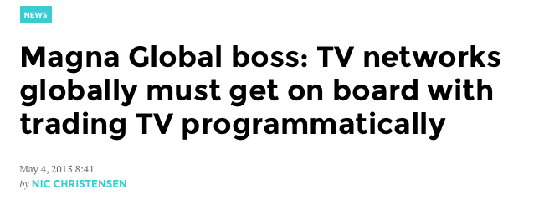
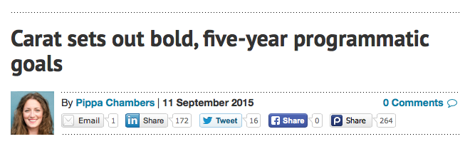
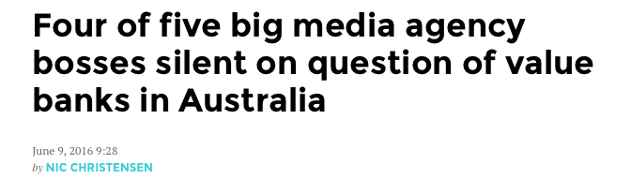

Guess what agencies are saying…..
MAGNA And Zenith: Digital Growth Fueled By Programmatic, Mobile And Video
Notes:
Unfortunately, the response from the media agency industry has not been encouraging. There has been complete silence from the largest global agencies on the transparency issues that have erupted. Furthermore, some of the industry’s most senior figures are repeatedly quoted with “increasing programmatic spends” seemingly their biggest vision piece.
Carat CEO Simon Ryan
Outlined clear plans for the media agency to be 100% digital and 40% programmatic by 2020.

Slide 16
One conclusion…….
ANA Transparency Report - June 2016
“Brands need “Chief Media Officers” to ensure media agency transparency”
ISBA - Debbie Morrison Director of consultancy & best practice
“We look at our clients and hardly any have media specialists in-house yet media expenditure tends to be the biggest second spend after capital expenditure. It is crazy. You need someone who knows how to manage viewability and media buying, or the agency can take advantage, especially with digital marketing and programmatic creating so many complications.”
Marketing Week May 2016 – Mark Ritson, Marketing Guru
“If I were a client I would not just take my media buying in-house, I’d lock the door and close the curtains too.”

Slide 17
Effective inhousing dependent on scale
$3m
$30m
Owner Driven
MD involvement
Simpler reporting
Nimble, reactive
Inhousing challenges
Complex needs difficult to execute
Building media culture to retain talent
Finding time/resource to focus on media
Stimulus from latest trends
Chief Media Officer isn’t cheap
Scale
Inhouse specialists
Inhouse buying
Technology
Infrastrucutre Investment
Global networks

Slide 18
Intersection of key issues
Media agency trust & transparency
Accelerating complexity of the media landscape
Navigating technology

Slide 19


Your Chief Media Officers
Andrew Norris
Steve Sinha
26 years global media experience
Mitchells Sydney MD – 6 years
Carat Sydney MD – 3 years
Woolworths, David Jones etc
Apple Europe – Head of Marketing
Ehrenberg Bass, Neuro
D2d data company
Founded Real Programmatic
Comfortable working with CEO/CMO/CFO/Procurement
29 years global media experience
OMD Melbourne MD – 7 years
McDonalds
Built Digital & Data resources & teams – 2 to 40
Created programmatic resources inside large groups and for small independents

Slide 20
Embedded solutions – “your people”
MD level media talent driving internal solutions
Elevate media benefits within organisation
Media is fully integrated & aligned internally
Swift decision making
Ongoing focus on ROI
Optimal & future proofed outcomes for structures, partnerships & contracts

Slide 21
Future proofing your media needs
Optimise
Investigate
Transform

Slide 22
Future proofing your media needs
Strategic Review
Commercial & Service Model delivery
Transparency Audit
Contracts
SLAs and T&Cs
Optimise
Investigate
Transform
Ongoing Media Management
Internal Culture
Focus on ROI
Education
Hiring & Retention
Appraisals & KPIs

Slide 23
A 6 step model
Strategy
Data
Education
Structure & Talent
Transparency
Delivery

Slide 24
Audit approach – FMCG Case Study

Slide 25
Case Study – Education Client
Eg Programmatic Partner Selection Model
Transparency
InsightTools
Performance
Reporting
+
+
+
Transparent model
Remuneration Offer
Different strengths by target
Data access
Segmentation
Prog performance
Exceed acquisition benchmarks & KPIs
Analytics & reporting platform
Path-to-conversion reporting
Campaign tags to feed real-time data into custom dashboard/DMP
More than halved major Trading Desk margin!!

Slide 26
We deliver alignment & integration
Managed services
In-house solution
Hybrid
Control partner relationships
Ownership of data
Bespoke solutions

Slide 27
Infographics
The presentation also includes some specific slides that would benefit from the creation of professional standard infographics
Each infographic brief is listed here

Slide 28
Infographic #1 (see following slides)
The opening 7 slides entitled “A Universal problem has erupted” are actually a slide build.
We have a timeline running from the start of 2014 to mid 2016 (should be to end of 2016!). As the slide builds different quotes over time build onto this timeline. So the infographic will build with a flag (from the country of quote) with a month (time of quote). Flags required are USA, Australia, UK, EU and UN
If you can add months into the timeline, this could help us signify the design – ie just adding flags along the timeline
As this infographic builds, we can place the relevant quotes below in the normal layout
We assume you will need to build the timeline and flags separately so we can custom build/transition across slide builds
The relevant slides follow here

Slide 29
A universal problem has erupted
Nov
2015
2014
2016
Mediacom staff forged campaign reports to clients and sold discounted TV ads given to them by media owners, audit reveals
Mumbrella
Notes:
A burgeoning problem with transparency has emerged, especially Digital. At a traditional media level, the existence of holding company level volume rebates has emerged. But it is in the Digital ecosystem that a practice of large hidden mark-ups has been uncovered in recent times. This issue has arisen at a time that media spends are increasingly migrating to Digital, and this timing has shaken media agency trust.
There are extensive kickbacks that exist within media agencies and which result in them earning money twice for the same piece of work. First, they are paid legitimately by an advertising client who uses their expertise and buying systems to purchase media on their behalf. Second, from incentives paid to the agency by the media seller or ad tech vendor who supplies the media.

Slide 30
A universal problem has erupted
Nov
March
2015
2014
2016
Notes:
ANA (US) Conference October 2015 - Jon Mandel Ex CEO Mediacom USA
“This issue is cultural. The issue is they are hiding things in barter, they are hiding things in programmatic, they have all kinds of ways to hide things from their clients,”
“They recommend or implement media that is off-strategy or off-target if it works for their financial gain.”

Slide 31
A universal problem has erupted
Nov
March
July
2015
2014
2016
“Throughout the course of this study we found pockets of definitional misalignment across the programmatic ecosystem.”
Programmatic Revenue Report
Notes:
A burgeoning problem with transparency has emerged, especially Digital. At a traditional media level, the existence of holding company level volume rebates has emerged. But it is in the Digital ecosystem that a practice of large hidden mark-ups has been uncovered in recent times. This issue has arisen at a time that media spends are increasingly migrating to Digital, and this timing has shaken media agency trust.
There are extensive kickbacks that exist within media agencies and which result in them earning money twice for the same piece of work. First, they are paid legitimately by an advertising client who uses their expertise and buying systems to purchase media on their behalf. Second, from incentives paid to the agency by the media seller or ad tech vendor who supplies the media.

Slide 32
A universal problem has erupted
Nov
March
July
Feb
2015
2014
2016
More than 70% of global advertisers agree that the way an agency manages rebates is the biggest barrier to building long-term trust
ID Comms Transparency Survey 2016
Notes:
A burgeoning problem with transparency has emerged, especially Digital. At a traditional media level, the existence of holding company level volume rebates has emerged. But it is in the Digital ecosystem that a practice of large hidden mark-ups has been uncovered in recent times. This issue has arisen at a time that media spends are increasingly migrating to Digital, and this timing has shaken media agency trust.
There are extensive kickbacks that exist within media agencies and which result in them earning money twice for the same piece of work. First, they are paid legitimately by an advertising client who uses their expertise and buying systems to purchase media on their behalf. Second, from incentives paid to the agency by the media seller or ad tech vendor who supplies the media.

Slide 33
A universal problem has erupted
Nov
March
July
Feb
April
2015
2014
2016
“I don’t believe that [media agencies] have got the best interest of their clients at heart any more.”
Debbie Morrison
ISBA Director of consultancy & best practice
Notes:
A burgeoning problem with transparency has emerged, especially Digital. At a traditional media level, the existence of holding company level volume rebates has emerged. But it is in the Digital ecosystem that a practice of large hidden mark-ups has been uncovered in recent times. This issue has arisen at a time that media spends are increasingly migrating to Digital, and this timing has shaken media agency trust.
There are extensive kickbacks that exist within media agencies and which result in them earning money twice for the same piece of work. First, they are paid legitimately by an advertising client who uses their expertise and buying systems to purchase media on their behalf. Second, from incentives paid to the agency by the media seller or ad tech vendor who supplies the media.

Slide 34
A universal problem has erupted
Nov
March
July
Feb
March
June
2015
2014
2016
Whether acting as agency or principal, vast changes in technology, the complex digital supply chain, and the proliferation of media outlets provided agencies with additional opportunities to increase their profit margins beyond agency fees. This has led to disconcerting conflicts of interest and a lack of transparency.”
ANA – Transparency Report
Notes:
ANA (US) Conference October 2015 - Jon Mandel Ex CEO Mediacom USA
“This issue is cultural. The issue is they are hiding things in barter, they are hiding things in programmatic, they have all kinds of ways to hide things from their clients,”
“They recommend or implement media that is off-strategy or off-target if it works for their financial gain.”

Slide 35
A universal problem has erupted
Nov
March
July
Feb
March
June
2015
2014
2016
Advertiser association (AANA) accused of conflict of interest over media agency funding
Mumbrella
Notes:
A burgeoning problem with transparency has emerged, especially Digital. At a traditional media level, the existence of holding company level volume rebates has emerged. But it is in the Digital ecosystem that a practice of large hidden mark-ups has been uncovered in recent times. This issue has arisen at a time that media spends are increasingly migrating to Digital, and this timing has shaken media agency trust.
There are extensive kickbacks that exist within media agencies and which result in them earning money twice for the same piece of work. First, they are paid legitimately by an advertising client who uses their expertise and buying systems to purchase media on their behalf. Second, from incentives paid to the agency by the media seller or ad tech vendor who supplies the media.

Slide 36
Infographic #2 (see following slide)
Build a better graphic for the horizontal axis, showing ad spend to high ad spend with $3m and $30m marked.
The text boxes underneath will align to spends of <$3m, $3 - $30m, and $30m+
Also build better designed text boxes for our 3 columns
We can then adjust text within these text boxes moving forward

Slide 37
Effective inhousing dependent on scale
$3m
$30m
Owner Driven
MD involvement
Simpler reporting
Nimble, reactive
Inhousing challenges
Complex needs difficult to execute
Building media culture to retain talent
Finding time/resource to focus on media
Stimulus from latest trends
Chief Media Officer isn’t cheap
Scale
Inhouse specialists
Inhouse buying
Technology
Infrastrucutre Investment
Global networks

Slide 38
Infographic #3 (see following slides)
This needs to be a circle with 3 segments, showing 3 steps we work through and arrows suggesting progressive, circular movement. This could take a variety of infographic type shapes eg circular arrow types running into each other. Whatever works best. There is then a build of text boxes to support each of the 3 steps in more detail.
The starting phase is Investigate – which is deliberately at the top of the circle at “12 o’clock”. This should come through in the design

Slide 39
Future proofing your media needs
Optimise
Investigate
Transform

Slide 40
Future proofing your media needs
Strategic Review
Commercial & Service Model delivery
Transparency Audit
Contracts
SLAs and T&Cs
Optimise
Investigate
Transform
Ongoing Media Management
Internal Culture
Focus on ROI
Education
Hiring & Retention
Appraisals & KPIs

Slide 41
Infographic #4 (see following slide)
This is very important. This 6 step model will be at the centre of our business, so we really need to bring it to life visually in a very exciting way. Can it look scientific, like a classic marketing theory?
The steps do work in sequence form the top down – eg we start with a strategic review first. So the design can reflect movement through each step.
We may want to add text boxes to explain each step in more detail later. But the infographic should stand alone as a visually exciting piece in the first place without words.

Slide 42
A 6 step model
Strategy
Data
Education
Structure & Talent
Transparency
Delivery

